Slide 1
Recap
Similarities and Differences between Verbal and Non verbal Communication
The “Plain English” Approach
The “You” Approach

Slide 2
Week 4
LISTENING SKILL
Language Skills

Slide 3
Communication
Verbal
the message that we deliver
Vocal
the voice that we convey
Visual
our body language

Slide 4
Communication Frequency
Listening
32 %
Reading
19%
Speaking
26 %
Writing
23 %

Slide 5
Introduction
There is a reason God gave us two ears but only one mouth. By listening actively we can:
  better understand what is expected of us,
  build rapport with our coworkers, family and friends,
  resolve problems,
  grasp underlying meanings.

Slide 6
Types of Listening
Discriminative listening
Comprehension listening
Critical listening
Biased listening
Evaluative listening
Appreciative listening
Sympathetic listening

Slide 7
The Importance of Good Listening Skills
Identification
Body Language
Respect
Comprehension
Response

Slide 8
Keys to Become a Better Listener
Use your DISC drive
Desire
Interest
Self discipline
Concentration

Slide 9
Why You Need Good Listening Skills?
better understand assignments and what is expected of you;
build rapport with co-workers, bosses, and clients;
show support;
work better in a team-based environment;

Slide 10
Advantages of listening
Protects you from troubles
Lets you know what is going on
Makes you competent
Makes you look intelligent
Increases your power

Slide 11
Advantages of listening
Helps you understand
Helps you negotiate
Defuses anger
Builds self esteem
Makes love real

Slide 12
Difference between Listening & Hearing?
Listening
the act of interpreting and evaluating what is being said
Hearing
the physiological process by which sounds waves are received by the ear

Slide 13

Nonverbal Distraction
This symbol is having different meanings in different countries:
UK & USA= OK
JAPAN= MONEY
RUSSIA= ZERO
BRAZIL= INSULT
INDIA= GOOD

Slide 14

Physical Barrier
Two major physical constraints of effective listening are:
      Noise environment
      Learning Impairment i.e. hearing problems

Slide 15
Psychological Barrier
It consists of thoughts and feelings
    Attitudinal problem
    Preoccupation
    Egocentrism
    Fear of appearing ignorant
    Faulty assumptions

Slide 16
Language Barrier
For effective listening language is important
Better to use simple words and avoid unfamiliar words

Slide 17
How to Improve Listening?
Resist distractions
Avoid fake listening
Be willing to use energy
Prepare yourself
Take notes
Ask questions

Slide 18
Asking Questions
Sincere Questions
Paraphrasing
  Paraphrasing content
  Paraphrasing intent
  Paraphrasing feeling

Slide 19
Types of Workplace Listening
Listening to Supervisors
  Hearing instructions, assignments, and explanations of work procedures
Listening to Employees
  Supervisors spend more time listening to employees than reading, writing or speaking
Listening to Customers
  Improves sales and profitability as well as increases repeat business

Slide 20
Bad Habits of Poor Listeners
Interrupting
Jumping to conclusions
Finishing others’ sentences for them
Frequently (and often abruptly) changing the subject
Inattentive body language
Not responding to what others have said
Failing to ask questions and give feedback

Slide 21
Activity
How you can overcome the listening barriers?

Slide 22
The Process of Listening
HEARING
refers to the response caused by sound waves
ATTENTION
brain screens stimuli; the selective message
UNDERSTANDING
Understanding what you see and hear
REMEMBERING
adding to the mind storage bank; memory
EVALUATING
active listeners participate
RESPONDING
verbal and/or nonverbal feedback

Slide 23


Four sides of Messages
FACTUAL INFORMATION
SIGNAL
SELF-REVELATION
APPEAL
RELATIONSHIP
Sender
Receiver

Slide 24
Explanation of four sides
Factual Information- explains the facts
Self-revelation- express the sender himself and his feelings
Relationship- expresses what the sender expects from receiver and what kind of relationship (contact) exists between the two parties
Appeal- seeks to have an influence on the other

Slide 25
Four sides of Messages
FACTUAL INFORMATION
‘Your presence is nice’
SIGNAL
SELF-REVELATION
‘I am lonely’
APPEAL
‘Visit me more often’
RELATIONSHIP
‘you don’t visit me often’
Sender
Receiver

Slide 26
Explanation of four sides
FACTUAL INFORMATION- ‘Your presence is nice’
The fact that the son is there is good.
SELF-REVELATION- ‘I am lonely’
  The mother missed her son, she wanted to see him.
RELATIONSHIP- ‘you don’t visit me often’
The critical undertone implies the closeness and trust of the relationship between the mother and her son.
APPEAL- ‘Visit me more often’
The mother uses the message to express her wish.

Slide 27
Four ‘EARS’ of Listener
The correct decoding of the message by the receiver means that he has to have a particular ear of each of the messages
FACTUAL INFORMATION
SIGNAL
SELF-REVELATION
APPEAL
Sender
Receiver
RELATIONSHIP

Slide 28
Explanation for active listener
FACTUAL INFORMATION-
What is the factual content of the report?
SELF-REVELATION-
What is this telling me about the other person?
RELATIONSHIP-
What does the other person want me to know about myself and about the relationship?
APPEAL-
What does he want to achieve?

Slide 29
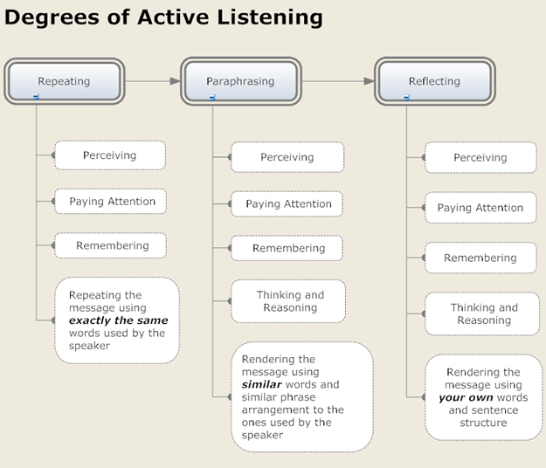
Listening Responses

Slide 30
Following Directions
(Listening to Instructions)

Slide 31
Write your name at the upper right corner of your paper
For the rest of these directions, start near the left top of your paper. Then print the result of each new direction below the previous result.

Slide 32
Print “IAMSMART”.

Slide 33
Insert two “O”s after the third, the sixth, and the eighth letters, in the IAMSMART statement.

Slide 34
Move the first letter so that it is between the third and fourth letters from the end.

Slide 35
Insert “N” before the third letter from the end and after the first letter.

Slide 36
Insert “D” before and after the first double “O”.

Slide 37
Insert “C” after the third letter and at the end.

Slide 38
Insert “G” before the first double “O” and after the third letter following the second double “O”.

Slide 39
Insert “L” before the second double “O”.

Slide 40
Remove the fourth letter.

Slide 41
Change the ninth letter to “K” and move it so that it falls between the eighth and ninth letters from the end.

Slide 42
Some letters appear more then once. Get rid of the third letter which does not appear more than once.

Slide 43
Remove the last letter.

Slide 44
Get rid of all the letters which are like the first letter (but leave the first letter).

Slide 45
Get rid of the third letter and all letters which are like it.

Slide 46
Write the first and last statements together.

Slide 47
Print “IAMSMART”.
IAMSMART

Slide 48
Insert two “O”s after the third, the sixth, and the eighth letters, in the IAMSMART statement.
IAMOOSMAOORTOO

Slide 49
Move the first letter so that it is between the third and fourth letters from the end.
AMOOSMAOORITOO

Slide 50
Insert “N” before the third letter from the end and after the first letter.
ANMOOSMAOORINTOO

Slide 51
Insert “D” before and after the first double “O”.
ANMDOODSMAOORINTOO

Slide 52
Insert “C” after the third letter and at the end.
ANMCDOODSMAOORINTOOC

Slide 53
Insert “G” before the first double “O” and after the third letter following the second double “O”.
ANMCDGOODSMAOORINGTOOC

Slide 54
Insert “L” before the second double “O”.
ANMCDGOODSMALOORINGTOOC

Slide 55
Remove the fourth letter.
ANMDGOODSMALOORINGTOOC

Slide 56
Change the ninth letter to “K” and move it so that it falls between the eighth and ninth letters from the end.
ANMDGOODMALOOKRINGTOOC

Slide 57
Some letters appear more then once. Get rid of the third letter which does not appear more than once.
ANMDGOODMALOOKINGTOOC

Slide 58
Remove the last letter.
ANMDGOODMALOOKINGTOO

Slide 59
Get rid of all the letters which are like the first letter (but leave the first letter).
ANMDGOODMLOOKINGTOO

Slide 60
Get rid of the third letter and all letters which are like it.
ANDGOODLOOKINGTOO

Slide 61
Write the first and last statements together.
IAMSMARTANDGOODLOOKINGTOO

Slide 62
Summary
Key to success:
Become a more effective listener. Practice the active listening technique and make it one of your active communication skills

Slide 63
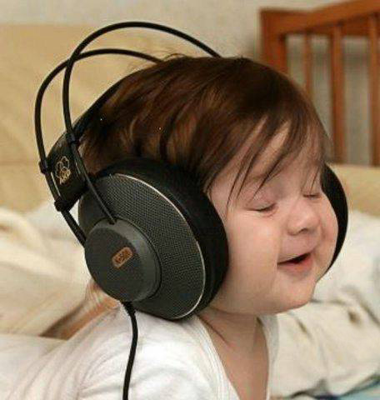
Thank you for Listening

Slide 64

Thank you for listening

