Slide 1
Recap
What is Business writing?
Types?
7 Cs of Communication
  COMPLETENESS
  CONCISENESS
  CONSIDERATION
  CLARITY
  CONCRETENESS
  COURTESY
  CORRECTNESS

Slide 2
Week 3
Similarities and Differences Between Verbal and Non Verbal Communication and
Approaches to Communication

Slide 3
Definition
Verbal Communication
Sending and receiving messages by using words, sounds, speaking and language
Nonverbal Communication
Sending and receiving messages in a variety of ways without the use of verbal codes(words)

Slide 4
Category
Verbal Communication
Speaking (Oral)
Written(via email)
Sign
Nonverbal Communication
Physical
(facial expression, touch, smell, body motion)
Aesthetic
  (dancing, painting)
Sign
  (signal flag, horns, siren, alphabets)
Symbolic (religious, status)

Slide 5
Function
Verbal Communication
Speaking to inform
Speaking to inspire and motivate
Telling or narrating story
Asking questions
Nonverbal Communication
Express emotions
Express interpersonal attitude
Accompany speech
Self presentation of one’s personality
Rituals/ Ceremonies

Slide 6
Other Differences
Verbal Communication | Nonverbal Communication
Verbal cues are digital | Analogical
Less universal | More universal
Less sensory directness | Offer greater sensory directness
Less spontaneous | More spontaneous

Slide 7
Similarities
Both involve receiver and sender
Both reveal emotions, exchange ideas & thoughts
Both have cues that are distinct
Both can have multiple meanings
Both can be used for deceptive/ manipulative purposes
Both exhibit the property of productivity

Slide 8
Connection
Repetition | NV messages strengths verbal messages e.g. pointing to the object of discussion
Conflicting | Verbal and Nonverbal don’t support each other e.g. telling a lie
Complementing | Verbal messages elaborate the idea and Nonverbal messages supplement/ reinforce each other
Substituting | Nonverbal can be used instead of verbal e.g. saying “NO”
Regulating | e.g. touching i.e. you want to talk
Acceding/ Moderating | Moderates our tone e.g. shaking hands

Slide 9
Verbal & Nonverbal Communication
Verbal Communication
  The encoding of messages into words, either written or spoken
Nonverbal
  The encoding of messages by means of facial expressions, body language, and styles of dress.

Slide 10
Approaches to Communication
A “Plain English” Approach to Communication
The “You” Approach

Slide 11
A “Plain English Approach”
A philosophy, movement, “campaign” started in 1970s in UK
  Unable to understand forms for benefits
  Insurance coverage
A very sensible approach to business writing

Slide 12
Overview of Plain English Rules
Choose simple, common words
Use a simple sentence structure
Avoid the passive voice

Slide 13
1. Choose simple, common words
Avoids words we don’t use in everyday speech:
  Pertaining to …
  Per your instruction
  Responsible party
“Bart police are here to assist you”
“Bart police are here to help you”

Slide 14
Avoid technical words
Examples
- policyholder
- wherein, heretofore
- above mentioned
- captioned
- in regards to

Slide 15
Choose the most common word that expresses your meaning
“Use rare words rarely”
(Edward Bailey, Writing & Speaking at Work)
Example: Dress, frock, gown, costume, outfit
Notes:
Dress is the most common word here.

Slide 16
2. Use simple sentence structure
Having entered into an agreement, the parties heretofore mentioned are desirous of furthering the mutually beneficial efforts of both firms to …
[the point comes here!]

Slide 17
Avoid “dangling participles”
Being one of the oldest firms in the business, I am confident we can meet your needs.
(In general, don’t put the subordinate clause first)
Notes:
The correct form here would be: I am confident we can meet your needs because we are one of the oldest firms in the business.

Slide 18
3. Avoid the passive voice
Students are responsible for grading their own work
The work will be graded by each student
Notes:
Examples: Timesheets are due on Monday is not passive voice (although the better form in Plain English would be: “Turn in your timesheets by Monday.” However, “Timesheets are to be turned in” is passive voice, because you could add “by me.” at the end of the sentence.

Slide 19
A Plain English Example
In case of fire, use the stairs.
Do not use the elevator.
Persons with disabilities shall proceed to the nearest stairwell and await assistance.
☹

Slide 20
Plain English Exercise
Re-write the following in
Plain English

Slide 21
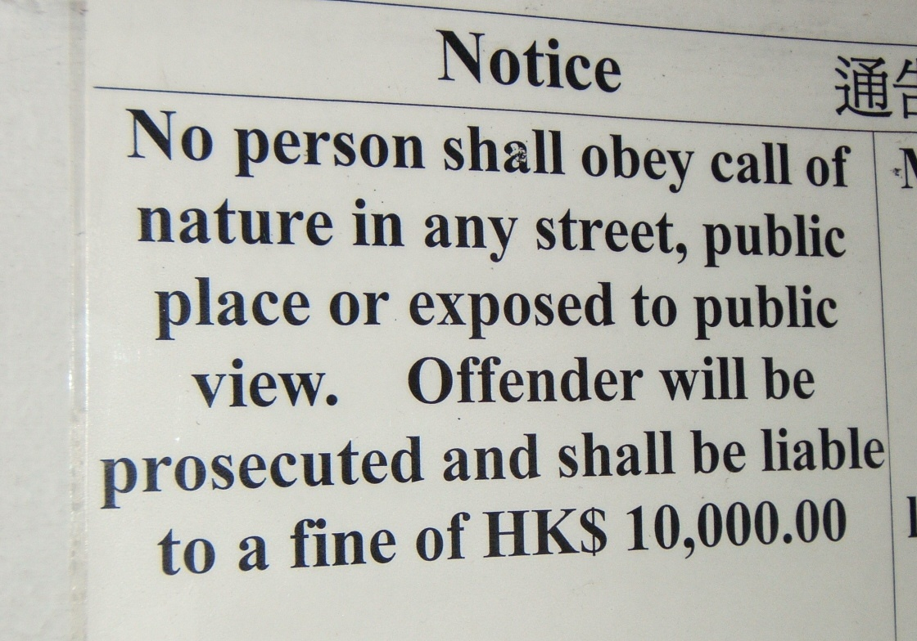

Slide 22
Advantages & Disadvantages of Plain English

Slide 23
Advantages of Plain English
Easily understood—no need for experts
Can be translated with accuracy
Is attractive in a minimalist way

Slide 24
Disadvantages of PE
Suitable for everyday business use,
but . . . lacks aesthetic merit
Sometimes hard (boring) to read in long passages
Takes some effort to write well

Slide 25
So should you
“Write how you talk?”
Not quite …everyday speech has a lower level of formality:
  Sentence fragments
  Contractions (such as “I’m” for “I am”)
  Colloquial words/ slang
  Repetitions

Slide 26
Good Business Communication depends on choosing the right level of formality and tone

Slide 27
Principle of Conciseness
Conveying the most information in the fewest words

Slide 28
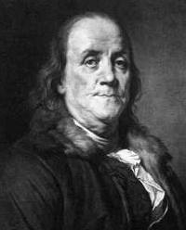
Benjamin Franklin
... this is such a long letter, but I did not have the time to write a short one. ...

Slide 29
How to write concisely
Begin with the end in mind—what’s the point here?
Have a good structure—use an outline
Limit the number of examples—choose the best single example to make your point
SAT-time! Make use of rich vocabulary and choose the exact word:

Slide 30
Choosing the right word
Don’t be vague:
“leverage” “emphasize” “focus”
Do use the right technical term
“cash flow, Income, profit” mean different things
“Marketing” is not the same as “promotional expense”
☒
Careful word choice = powerful writing

Slide 31
How to write concisely (Cont.)
Edit what you write
➔ taking a short break (or switching tasks) is better than staring at something for hours
Look for:
  Phrases that could be single words
  e.g. ?????
  Redundancy
  Repetition: “As mentioned above . . .”
  Wasted words: “In order to . . .” = “To . . .”

Slide 32
Understanding Level of Formality, Business Context and Tone
This is important for all business communication—written and spoken

Slide 33
Levels of Formality
Casual:
Hey, ! Guess what? I got the job!
Informal:
I’m really happy I heard back from the accounting firm.
Semi-formal:
I have been hired as an Accountant at the company that was my first choice.
(Overly) Formal:
My services have been retained as a Trainee Accountant, level 3B.

Slide 34
How do we detect Levels of Formality?
Word choice
  Low frequency (“monarchy”) signals formality
  Slang or familiar (“bump”) signals informality
Use of contractions “He ain’t with me!” signals informality
Complexity of sentence structure signals high formality
Formal language avoids colloquial words→

Slide 35
Colloquial language may be meaningful to one social group—but not others
Consider these expressions of surprise that have no literal (translatable meaning) but that mean “I’m shocked!” in different sub-cultures of the United States:
    What’s that about?
    Go figure!
    Beats me!

Slide 36
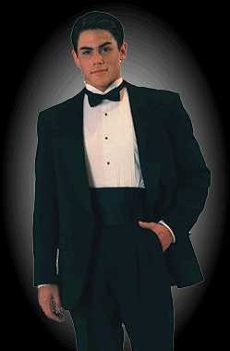
The business context (purpose) determines the appropriate level of formality

Slide 37
“Tone” is not the same as
“Level of Formality”

Slide 38
Choosing the right “tone”
Hostile Officious Cool Businesslike Pleasant Warm Friendly

Slide 39
Possible ways to communicate
In person meeting, individual
Group (team) meeting
Memo
Letter
Fax
E-mail
IM
Text message
Phone call
Web meeting

Slide 40
How to Choose the Medium
One-way or two-way communication
Emotional impact
“Permanent” record?
Level of formality

Slide 41
Using the "You" Approach

Slide 42
Which sentence works best?
I am extremely pleased to inform you that you have received a promotion.
The emphasis is on me, the speaker or writer of the sentence.

Slide 43
Example
It gives me great pleasure to make this announcement about an employee who I have known for many years. It has been my distinct pleasure to supervise and train Miss Sarah Smith who I am happy to announce has been awarded a promotion.
  Who really cares about my pleasure?
  Why is it important that I am the supervisor?
  Focus on the good news and on Sarah!

Slide 44
Congratulations on your promotion, Sarah!
  The subject of the sentence is "you”
  The message is clear, quick, and positive

Slide 45
Rewrite it:
Applications for credit cards must meet the following criteria:
  The application form must be signed and dated by the applicant.
  The application form must be filled in CAPS by the applicant.
  The application may be submitted in person at the credit department or online.

Slide 46
The best way to practice this skill to eliminate the use of:
  "I“
  "we“
  "our company" (or the company name or any personal pronoun reference) in all your business writing.

Slide 47
business letters can be formal without being impersonal
The words "you," "we" and "I" are more personal than referring to "this office," "this organization" or "our enterprise
  " Use "I" to refer to yourself
  "You" to the recipient (or recipient's company)
  "we" to refer to your own department or company.
  Do not use the company name (for example, "Motorola believes")

Slide 48
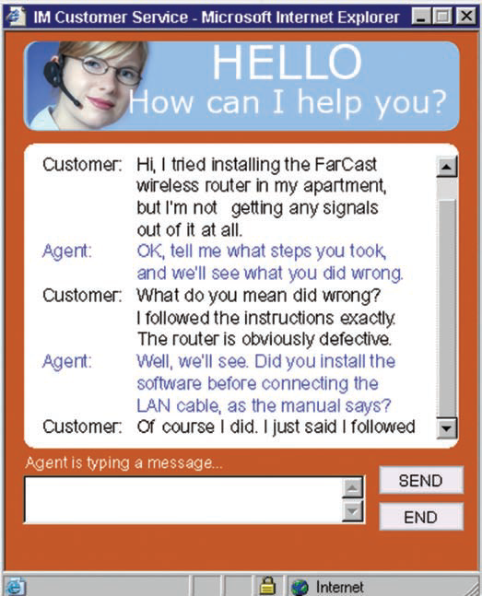

Slide 49
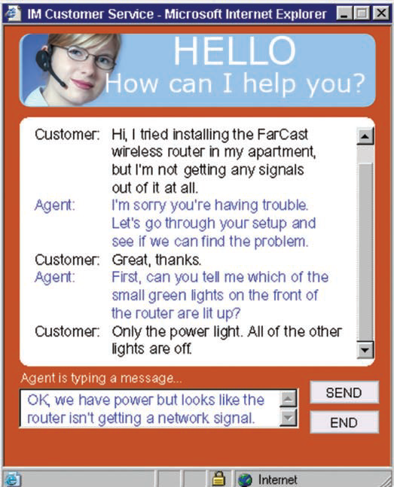

Slide 50
Summary
Similarities and Differences between Verbal and Nonverbal Communication
Verbal & Nonverbal Communication
Understand Plain English
    Always be working towards self-improvement
Practice Conciseness
    In writing, formal speaking and business conversation
There are many ways to communicate
    The choice depends on the business needs
Prefer Plain English
  Begin with a “Plain English” mind-set
  Always apply self-criticism and edit what you’ve written
Know that business purpose will usually determine the level of formality
Understand you make a choice about tone
The “You” Approach

