Slide 1
Week 2
Barriers in Communication

Slide 2
Components of Communication
Verbal Messages
the words we choose
Paraverbal Messages
how we say the words
Nonverbal Messages
our body language

Slide 3
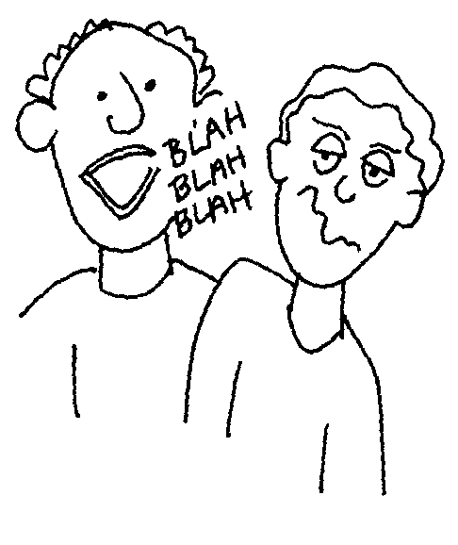
Verbal Messages
Effective Verbal Messages
1. Are brief, concise, and organized
2. Are free of jargon
3. Do not create resistance in the listener

Slide 4
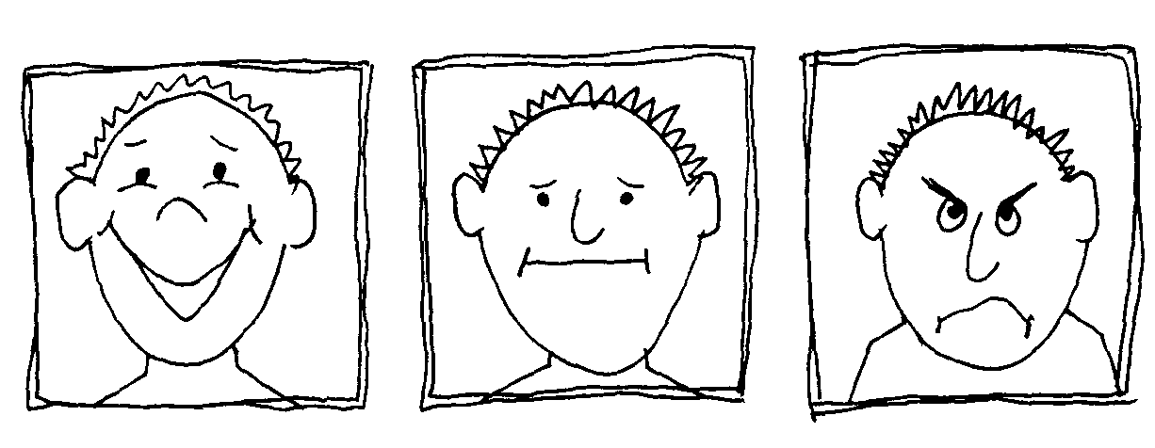
Categories in Non-Verbal Messages
Facial Expressions
A face can light up with:
  enthusiasm
  energy
  approval
  express confusion or boredom
  frown with displeasure
  eyes telegraphing joy
  sadness
  anger
  confusion

Slide 5
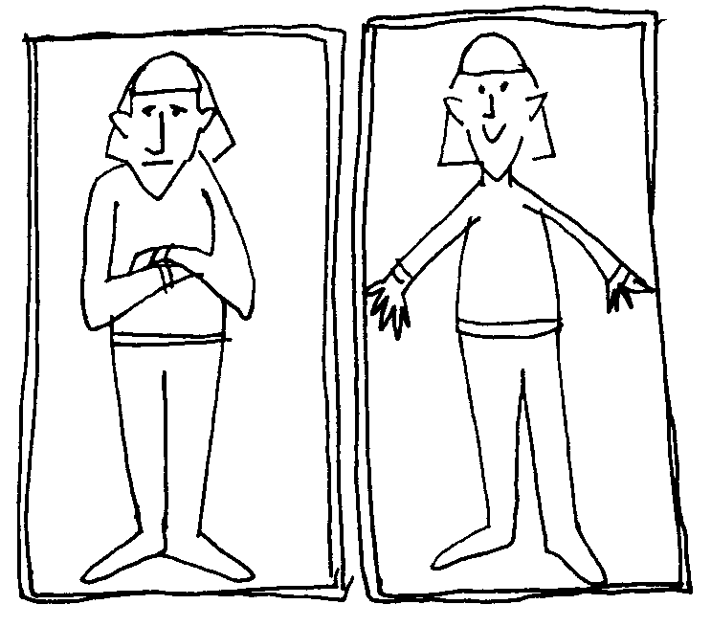
Postures and Gestures
Categories in Non-Verbal Messages
Warm openness
Cold rejection
Feeling of anticipation
Feeling of inflexibility etc

Slide 6
Non-Verbal Messages
1. Account for about 55% of what is perceived and understood by others.
2. Are conveyed through our facial expressions as well as our postures and gestures.

Slide 7
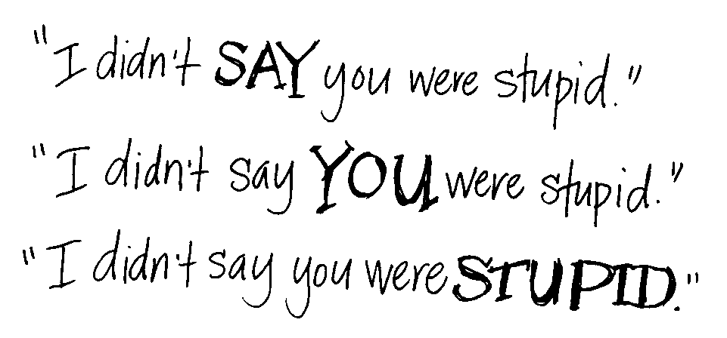
Paraverbal Messages
Messages that we transmit through the tone, pitch, and pacing of our voices.
It is how we say something, not what we say.

Slide 8
Verbal Messages
Paraphrasing | a brief, concise statement reflecting the content of the speakers message
Reflecting Feeling | a statement, in a way that conveys understanding, of the feeling that the listener has heard
Summarizing | a statement of the main ideas and feelings to show understanding
Questioning | asking open questions to gain information, encourage the speaker to tell her story, and gain clarification

Slide 9
What is a Barrier?
Hindrance
Blockage
Stoppage
Hurdle
Hampered
Obstacle
Cordon

Slide 10
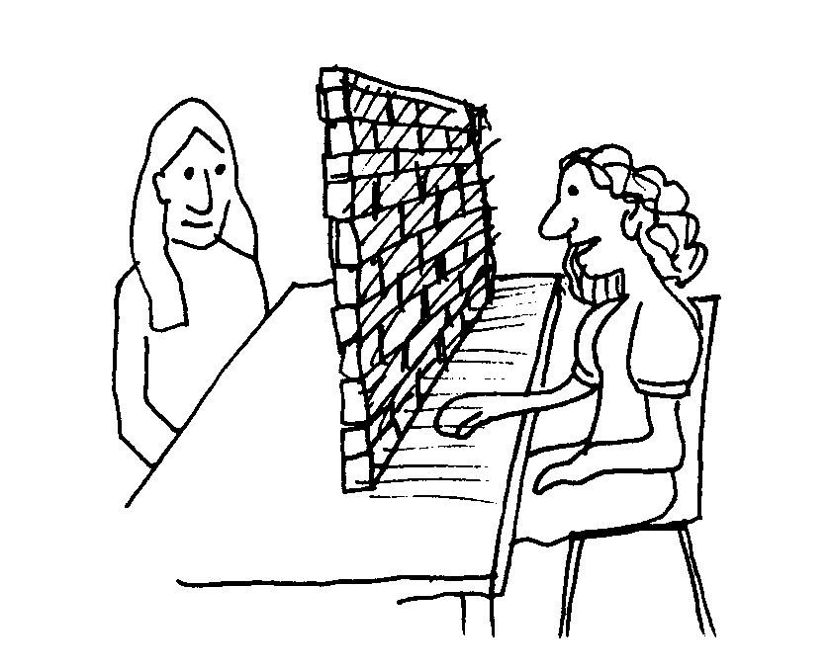
How would you define a Communication Barrier?
Message is misinterpreted
Receiver
Sender

Slide 11
Barriers to Business Communication
Language Barriers Physiological Barriers Psychological Barriers Cultural Barriers Bypassed Instructions Abstracting

Slide 12
Language Barriers
  Personal Experiences
  Knowledge Background
  Education
  Cultural background
Background
Words
  Connotations
  Denotations
  + & -

Slide 13
Language Barriers
Use of:
  Jargons
  Obsolete words
  Slangs
  Misleading Terminologies
Examples:
  ‘burn the paper’
  ‘get rid of the plant’
Bypassed
Instructions

Slide 14
Language Barriers
Abstracting
Short Summary
  + -
  Journalist
  Factual Non-Factual
  (Yellow Journalism)
Focus on few things and omitting others

Slide 15
Physiological Barriers
  Physical Environment
  Dull voice
  Too many others talking in the room at the same time
  Outside noises
  interruptions
  Visual distraction
  Mobile phones
  Interesting People around
  Proper light
  Music
  Talking loud
  Sounds etc
Context

Slide 16
Physiological Barriers
  Drowsy/dizzy
  Air-conditioning
  Hot/stuffy/cold room
  Day dreaming (something on mind)
  Hunger/ overeating
  Health Problems
  Anxiety
  Flue/ Cough
  Exhausted
  Starving etc
Physical
Conditions

Slide 17
Psychological Barriers
  Social Status
  Less educated
  Dumb/ Goof
  Can’t talk ENGLISH??
  Gender
  Emotions
  Feelings
  Prejudices etc
Mind

Slide 18
Cultural Barriers
  Speakers accents
  Vocabulary
  Cultural assumptions
  Cultural Biases
  Cultural connotations
Different
Cultures

Slide 19
Nonverbal Barriers
Flashing or rolling eyes
Quick or slow movements
Arms crossed, legs crossed
Gestures made with irritation
Poor personal care
Doodling
Staring at people or avoiding eye contact
Excessive twitching with materials

Slide 20
Definition
Verbal Communication
Sending and receiving messages by using words, sounds, speaking and language
Nonverbal Communication
Sending and receiving messages in a variety of ways without the use of verbal codes(words)

Slide 21
Summary
Verbal Communication
Non verbal Communication
Paraverbal communication
Barriers in Communication
Verbal & Nonverbal Communication

