Slide 1
Lecture 31
Creating Effective Visual Aids
Presentation Skills

Slide 2
Recap
Verbal Communication Skills
  Tips to improve your verbal communications skills
  7 C’s of Communication
  Effective verbal communication

Slide 3
What are Visual Aids?
Visual aids are an important part of many presentations.
The most commonly used media are the flipchart and computer-based presentation programs.

Slide 4
The Purpose of Using Visual Aids in your Presentations
The Purpose of Using Visual Aids should be:
  To support your ideas and improve audience comprehension of your presentation
  To add variety to your presentation by giving the audience a break from listening and letting to see something.
  To help illustrate complex ideas or concepts and help in reinforcing your ideas.

Slide 5
Presentations and Visual Aids
While you usually submit a written version of your work, you may also be expected to present it to your class orally.
This can be a great opportunity to learn presentation technologies such as:
Posters
PowerPoint or “prezi”.

Slide 6
Presentations and Visual Aids
You can make visual aids to support your:
  spoken delivery
    ranging from basic points to more complex multimedia creations incorporating:
    film clips
    Pictures
    graphics and
    Animations

Slide 7
Why use Visual Aids?
Preparation for your presentation should involve design of any visual aids which help your audience to understand what you are saying.
Images and diagrams can convey messages and information which, if spoken, would take longer to explain and be harder to digest.
However, don't assume that you can flash up a diagram and the audience will immediately understand what it means.

Slide 8
Why use Visual Aids?
Audience need time and clear explanations to make sense of your material.
Visual stimuli combined with your oral delivery also make the presentation more memorable.
They are also a good way of maintaining your audience's interest and attention.
Make sure they support and complement what you are saying, not directly repeat, contradict or distract from your speech.

Slide 9
What is a Visual Aid?
The main types of visual aids are:
  Whiteboard
  flip chart
  overhead projector (OHP)
  PowerPoint (or other presentation software)
  Video
  Props
  Handouts
  Posters
  yourselves demonstrating an action or in a role play

Slide 10
Which types of visual aid might you use in your next presentation?
For example:
Consider whether PowerPoint is the best way to show a detailed diagram or would a handout be better?
What might you use a flip chart for?

Slide 11
Example: Posters
These can be made on PowerPoint or Microsoft Word.
They’re not difficult to design, but:
  before you decide to make one
  check how you will get it printed
  as that can be expensive if you have to pay a printer.

Slide 12
What makes an Effective PowerPoint Presentation?
You will probably have your own ideas about this, so think about how you feel about PowerPoint as a member of the audience and list good and poor techniques.

Slide 13
Here are some highlights, common pitfalls and techniques for making the most of PowerPoint including aspects using as:
  PowerPoint as a script
  Designing accessible visual aids
  Effective diagrams and graphs
  Referencing
  We will watch the sample Presentation at the end!!!

Slide 14
Using your Visual Aids
Here are a few suggestions for making most effective use of your carefully designed visual aids:
1. Be careful not to stand in front and obscure the view of your audience.

Slide 15
Using your Visual Aids
2. Avoid reading from the large projector screen as this means you turn your back to the audience obscuring eye contact and reducing projection of your voice.
    If you need to read directly from the text look at the PC or laptop screen.

Slide 16
Using your Visual Aids
3. Try making brief notes on index cards, including any details like dates, statistics or names that you need to get right. No-one will expect you to speak without an aide memoir.

Slide 17
Using your Visual Aids
Be sure to interact with the information on your visual aids by pointing to specific points or part of diagrams etc.
This helps the audience to make links between your speech and detail on the visual aids.

Slide 18
Using your Visual Aids
Think about what you want the audience do with any handouts.
If they need them during the session hand them out when necessary.
If they are for future reference consider handing them out at the end to avoid them causing distraction. Advise the audience of what you plan to do.

Slide 19
Contingency Plans

Slide 20
Contingency Plans
Whenever you use technology in a presentation you run the risk of technical problems. You can reduce the risk of this impacting on your presentation by:
  Making sure you have your PowerPoint presentation saved in a few formats.
    memory stick
    CD
    e-mailed to an easily accessible e-mail account

Slide 21
Contingency Plans
Prepare OHP transparencies and/or handouts in case technical issues mean that you can't use the computer and/or projector.
If you want to show a website, you could use screen captures rather than risking going online.

Slide 22
Contingency Plans
Make sure all the hardware and software you need will be available, e.g:
  Speakers
  access to internet
  multimedia software
  spare bulb, if you're using an OHP!
Practice with any multimedia, ideally in the venue you will be presenting in.

Slide 23
Contingency Plans
Be aware that PowerPoint presentations created on an Apple Mac operating system may not be compatible with the PC/laptop that you are required to present on. You may need to check this compatibility.

Slide 24
10 Tips for Using Visual Aids

Slide 25
10 Tips for Using Visual Aids
Plan your presentation before creating visual aids.
  Know what you want the audience to do as a result of hearing your presentation.
  Then figure out what they need to know to do what you want them to do.
  Then create a simple outline that logically and clearly develops your main points.
  Finally, create visual aids to support your message.

Slide 26
10 Tips for Using Visual Aids
Use visual aids sparingly.
They are aids to your presentation – not its sum and substance.
Use them to highlight and support your key points.

Slide 27
10 Tips for Using Visual Aids
Make them visible to the entire audience.
  Projecting an image people can’t see is as senseless as speaking so softly people can’t hear.

Slide 28
10 Tips for Using Visual Aids
Talk to the audience, not to the aid.
  Look at the audience at least 80% of the time.
  Avoid turning your back to the audience.

Slide 29
10 Tips for Using Visual Aids
Avoid laser pointers.
  Your aid should be so clear that your audience can easily follow along.
  Use your hand, if necessary.
  (If you absolutely have to use a pointer, set it down after you are finished. Holding on to it will only encourage you to use it for every point on every slide.)

Slide 30
10 Tips for Using Visual Aids
Explain the content of the aid when you first show it.
  As soon as you show people an object, they will look at it – even if you’re talking about something else.
  Don’t make them divide their attention.

Slide 31
10 Tips for Using Visual Aids
When you finish with the aid, remove it, cover it, or turn it off.
  When using PowerPoint, tap the B key and the screen will go to black.
  Tap any other key and the screen light up again.

Slide 32
10 Tips for Using Visual Aids
Limit the amount of material on any one aid.
Use each slide to convey a single point.
Bullet points – no more than four or five per slide –
  explain,
  illustrate, or
  substantiate that one point.

Slide 33
10 Tips for Using Visual Aids
Avoid clip art from well-known sources.
It’s almost always boring and amateurish.
DO use:
  Images
  graphs, and
  charts,
whenever possible and appropriate.

Slide 34
10 Tips for Using Visual Aids
Be prepared to give your presentation without your visual aids.
Murphy’s Law –
"if anything can go wrong, it will"
-- applies in spades to anything involving technology and an audience.
  Have a backup plan in case something goes wrong.
  Take a hard copy of your slides.

Slide 35
Learn about Visual Aids with the example

Slide 36


Slide 37
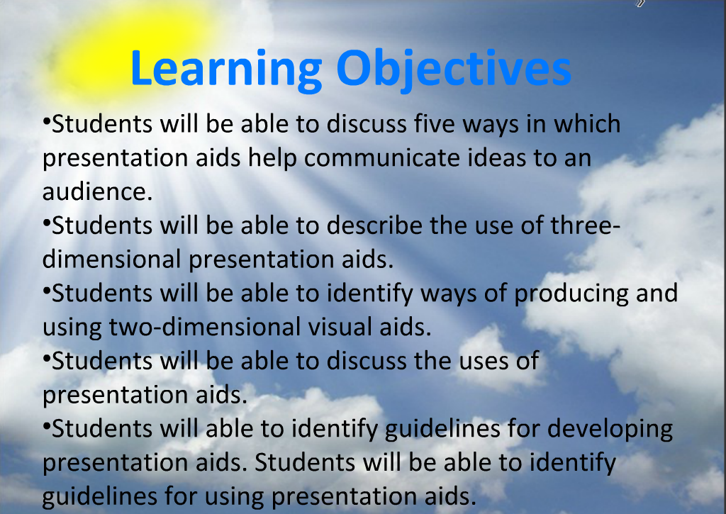

Slide 38


Slide 39


Slide 40


Slide 41
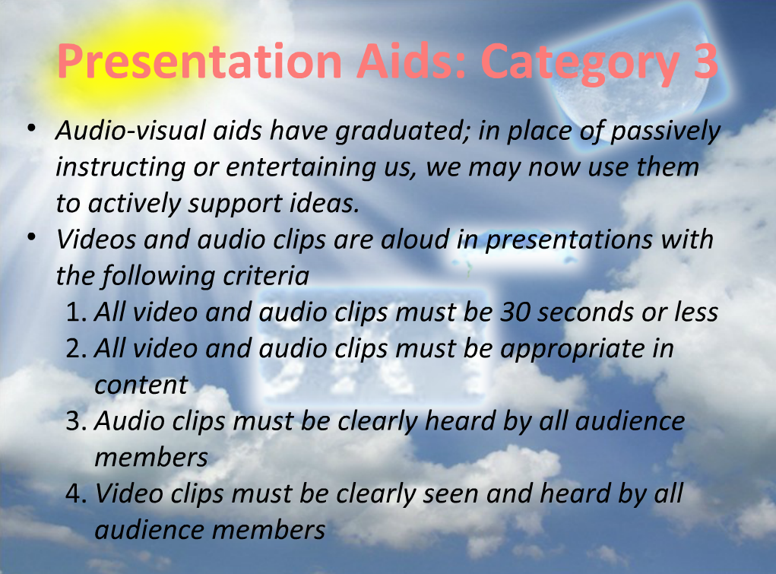

Slide 42


Slide 43
Summary
What are visual aids?
Why use visual aids?
Purpose of visual aids
10 Tips for Using Visual Aids
Contingency plans
Example: Designing and using Visual Aids

Slide 44
References
http://powerpoint.wiziq.com/topic/757-powerpoint-presentations-visual-aids
http://www.toastmasters.org/MainMenuCategories/FreeResources/NeedHelpGivingaSpeech/TipsTechniques/VisualAidsPowerPoint.aspx
http://www.brunel.ac.uk/learnhigher/giving-oral-presentations/designing-visual-aids.shtml

