Slide 1
Week 5
Reading Activities

Slide 2
What is reading comprehension?
Understanding a written text:
Extracting the required information from it as efficiently as possible

Slide 3
What do we read?
Reports
Reviews
Summaries
Pamphlets
Handbooks
Textbooks
Guidebooks
Recipes
Advertisements
Travel brochures
Catalogues
Puzzles
Problems
Game rules
Instructions
Directions
Notices
Rules & regulations
Posters
Signs
Forms
Graffiti
Menus
Price lists
Tickets
Comic strips
Cartoons & caricatures
Legends
Maps
Statistics
Diagrams
Flow charts
Pie charts
Time-tables
Telephone directories
Phrasebooks
Dictionaries
And…
Novels
Short stories
Tales
Essays
Diaries
Anecdotes
Biographies
Poems
Limericks
Nursery rhymes
Letters
Postcards
Telegrams
Notes
Newspapers
Magazines

Slide 4
There are 2 main reasons for reading
Reading for pleasure
Reading for information:
      To find out something
      To do something with the information you get

Slide 5
How do we read – the main ways of reading are:
Skimming: quickly running one’s eyes over the text
Scanning: quickly going through a text to find specific information
Extensive reading: reading long texts
        Reading for pleasure
Intensive reading: reading short texts to extract information
        Reading for detail

Slide 6
Skills involved when reading:
Recognizing
Understanding information
Interpreting
Transcoding information
Scanning
Skimming
Identifying the main point

Slide 7
Developing reading skills – how to?
Start with global understanding of the text and afterwards move towards detailed understanding:
      Builds students’ confidence
      Develops awareness of how texts are organized
      Encourages to find out what is in the text
Use authentic texts
Do not separate reading comprehension from other skills such as writing, listening and speaking.
Present reading is an active skill: guessing, predicting, checking, asking questions, - responding to what is read.
Give flexible and varied exercises.
Define the aim of the exercise given.
Make a clear distinction between teaching and testing

Slide 8
What can we do in the classroom?
Encourage silent reading to develop efficient reading strategies
  Consider the text as a whole
  Accompany pictures, diagrams,
  Make guesses: what the text is about, who it is for, who wrote it, where it appeared…
  Skim through the text to see if you were right
  Ask questions referring to the content of the text
  Reread the text – answer the questions asked

Slide 9
What can we do in the classroom?
2. The students should time themselves
Record their speed on a chart
3. Encourage comparisons between different interpretations and discussion
  Silent reading followed by an individual activity
  Comparisons in pairs, groups
  A general discussion involving the whole class

Slide 10
Reading comprehension exercise - types
1. Sensitizing – develop strategies to cope with unfamiliar words and complex or obscure sentences.
Inference – making use of syntactic, logical and cultural clues to discover unknown elements
Understanding relations within the sentence – train to look first for the ‘core’ of the sentence: subject + verb
Linking sentences and ideas – recognizing connectors and reference words

Slide 11
2. Improving reading speed
Give students passages to read and ask them to time themselves

Slide 12
3. From Skimming to Scanning
Predicting – predicting or guessing what is to come next
Previewing – specific reading technique using beyond the
text information to find where the required information is
likely to be
Anticipation – causing an expectation of the text
Skimming and scanning – from a general view of the whole
text to a limited reading of the text

Slide 13
How the aim is conveyed?
Function of the text – why was it written
Organization of the text – the pattern of the text was chosen to alter the message
Thematization -order of the elements in a sentence

Slide 14
Understanding meaning and content:
Use various types of questions
Devise exercises in which there is no simple, obvious answer
Make the students active in the reading process
Devise activities which are natural to the text: responding to a letter, reacting to an advertisement…

Slide 15
Assessing the text – the ability to evaluate the text:
Being aware of the writer’s intention:
  Tone
  Language used
  Discuss and judge the ideas presented
Discriminating from facts and opinions

Slide 16
Now You Try…
With a partner, read the next story and draw a picture to represent each story part. Use just the pictures to retell the story.

Slide 17
“The Contest”
Once upon a time, the wind and the sun were having an argument about who was the stronger of the two. “We must have a contest. That is the only way we will ever know who is the stronger one,” said the sun.
“I am ready for any contest. What should it be?" said the wind.
“Look at all those people in the city. Whichever of us can make all the people in the city take off their coats is the winner,” said the sun. “OK,” said the wind, “It is hardly a challenge, but I will do it. Who should go first?” “Because I am so sure that I will win, I will let you go first,” said the sun.
The sun hid behind a large fluffy cloud and the wind got to work. His idea was to blow an icy blast that would blow the coats right off the people in the city. The wind blew and blew and blew. The blast was the coldest, strongest blast that the people had ever felt. Instead of blowing the coats right off the people, a strange thing happened. The people wrapped their coats tightly around themselves. The harder the wind blew, the tighter the people wrapped their coats around themselves. At last, the exhausted wind gave up.
Now, it was time for the sun to get to work. The sun came out from behind the clouds and shone down on the city with all his strength. The people began to feel the warmth of the sun. They loosened their coats. The sun continued to shine with all his might. The people grew warmer and warmer. Soon they were so warm that they had to take their coats off. So the sun won the contest. He was indeed the stronger of the two!

Slide 18

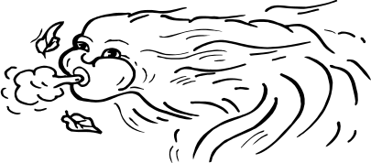


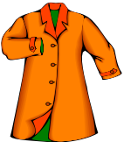



Slide 19
Reading from the picture?

Slide 20
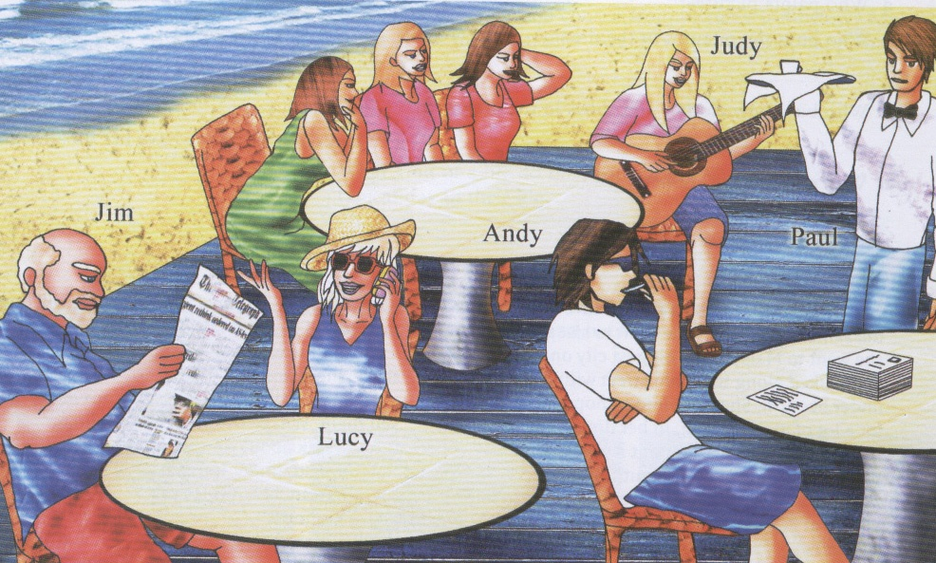

Slide 21
Questions?
Who was reading the newspaper?
Who was playing on the guitar?
What was the waiter carrying in his hand?
What was placed on right most table?
Who was talking on the phone?

Slide 22
Activity 2
Love Train

Slide 23
Activity 3
Remains of a Marriage

Slide 24
Reading Comprehension Quiz

Slide 25
Activity 4
Dreams

Slide 26
Summary
Reading is a constant process of guessing.
What one brings to the text is often more important than what one finds in it.
You must learn to use to understand unknown elements.

