Slide 1
Introduction to Communication Skills
Week 1

Slide 2
Outline
What is Communication?
How do we Communicate?
What is a Skill?
Language Skills
Types of Communication
Styles of Communication
The Communication Cycle
Communication in Workplace

Slide 3
What is Communication?
The dictionary defines communication as a process by which information is exchanged between individuals through a common system of symbols, signs or behaviors.
Communication is the activity of conveying information
Communication has been derived from the Latin word "communis", meaning to share
Communication requires:
      a sender
      a message, and
      an intended recipient

Slide 4
Communication
Verbal
the message that we deliver
Vocal
the voice that we convey
Visual
our body language

Slide 5
How do we Communicate?
?

Slide 6
What is a Skill?
Skill is defined as a learned power of doing something competently. It is a developed aptitude or ability.

Slide 7
Language Skills
Listening
Reading
Receptive Skills
Speaking
Writing
Productive Skills

Slide 8
Communication Frequency
Listening
32 %
Reading
19%
Speaking
26 %
Writing
23 %

Slide 9
Communication is of 2 Types:
Verbal Communication
      Words
      Voice Modulation
Non-verbal Communication
      Posture & Movement
      Gestures
      Facial Expressions

Slide 10
Styles of Communication
Agressive communication
Submissive communication
Assertive communication

Slide 11
How do we Communicate?
Written-Visual | Verbal-Non verbal
Assignment CV Application Report | Interview Presentation Meetings

Slide 12
A communication system normally goes through a cycle involving:
1 | The Sender | person who sends the message; the source
2 | The Receiver | The person who receives the message
3 | The message | Subject matter of communication. It may contain facts, ideas, feelings and thoughts
4 | The Channel | Verbal/ Nonverbal
5 | The Feed back | Receiver’s response or reaction or reply to the message, which is directly towards the sender

Slide 13
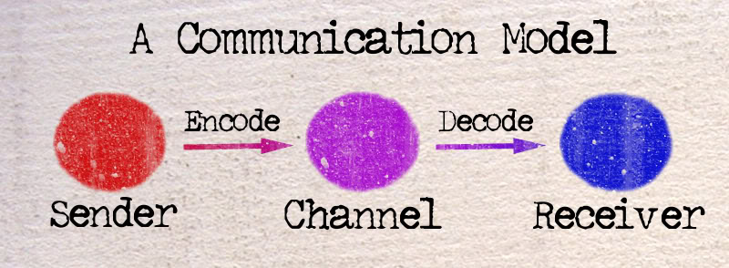
The Communication Cycle

Slide 14
1. Sender
2. Message
3. Channel
4. Receiver
5. Feedback
Encoding
Noise
Barrier
Decoding

Slide 15
1. A message sent | Gesture Facial expression Drawing Spoken/written
Entry in sensory world (all senses) | Sight Smell Hearing Taste Touch
Stimuli (Picks up message) | Stimuli varies from person to person: Person’s abilities Cultural background Drowsy/dizzy/day dreaming/ not alert Outside noises Facial expressions Double/ dual meaning
The Filtering Process (brain) | Through contents Experiences Knowledge Emotions Cultural background
5. Message Response through: | Words Gestures Physical actions
6. The Cycle Repeated

Slide 16
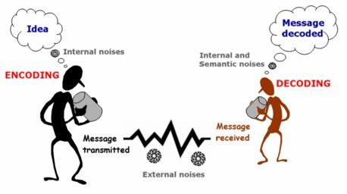

Slide 17
Communication in Workplace
Dictionary definition - A place, such as an office or factory, where people are employed.

Slide 18
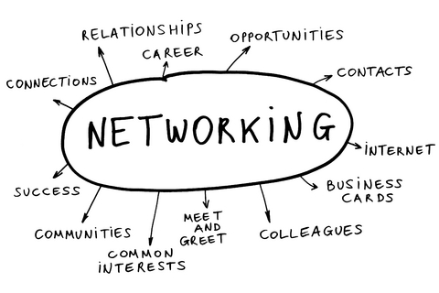
Why do we Communicate?

Slide 19
What is our workplace?
Administration office
Accounting office
Human Resources Office
Bookstore
Maintenance office
Engineering office
General Services
Clinic
Registrar
Security Guard office
Student Services
Discipline office
Campus Ministry office
Others

Slide 20
Communication
The exchange of thoughts, messages, or information, as by speech, signals, writing, or behavior.
The art and technique of using words effectively to impart information or ideas.
Acceptable communication differs from company to company, but many aspects are universal.

Slide 21
Tips to help us communicate effectively in the workplace
Listen - When you listen to others attentively it makes them feel good. It also makes for a deeper and more positive connection with others.
In turn, you form an understanding and they will listen to you when it’s your turn to speak.
Poor listening happens often and results
in misunderstandings and
miscommunications.

Slide 22
WHAT IS YOUR PURPOSE?
Have Intention - Ask yourself what your intention is before starting a project, going to a meeting, or speaking to someone.
You can also ask others what their intentions
are in similar situations. Knowing your intention will help you be more conscious of what you’re doing or saying.
which means you’ll be able to be more
effective and skillful.

Slide 23
SPEAK CLEARLY
Speak Clearly - Take a deep
breath and remain positive when
talking to people.
Try to cut out
the “ums,” “uh-hmms” and “ahhs;”
these make it difficult for people
to understand what you’re trying
to communicate.
Try to keep your
voice steady and don’t talk too
quickly or too quietly.
Be confident in what you’re saying
and others will feel your
confidence too.

Slide 24
BE GENUINE
Be Genuine - Being genuine can include
speaking honestly, expressing excitement
or sadness when you feel like it, and being
friendly.
There is nothing wrong with
saying, “no, I don’t really agree with that,”
or “you know, I think you’ve changed my
mind!” However, don’t be rude. “I was
just being honest” is not a good excuse
for being harsh.
Being genuine builds your
confidence.

Slide 25
Be Receptive
Be open to what
others are saying or offering.
Often, people restrict the flow of
ideas or communication because
they’re making too many
assumptions or are being too quick
to judge and criticize.

Slide 26
Communication
Flow

Slide 27
Downward communication, Upward communication, Lateral communication, and the Grapevine.

Slide 28
Downward Workplace Communication: Enabling
Let's focus first on downward communication in the workplace, and a couple of its important characteristics. Consider these common, downward forms of workplace communication:
A manager explains a task to an employee
A customer gives an order to a supplier
Shareholders instruct management

Slide 29
And, as information moves downward in the workplace, it grows increasingly detailed.
Make a Budget report
Make a Budget report for the month to include the following
Make sure the report includes the exact amount and the qty.

Slide 30
All organizations of more than one person must use workplace communication in one way or another.
One person must give another instructions before any activity can occur.

Slide 31
At each stage in the downward flow of communication, people in the organization receive information to help them do their jobs. And, at each stage the information become less abstract, more specific, and more detailed.

Slide 32
Upward Communication: Compliance
A second major flow of communication is upward, from employee to supervisor, supervisor to department head, department head to vice president, and so on.

Slide 33
Lateral communication: Coordination
Now, think of the information that flows back and forth between you and your peers, whether you're a front-line worker, a manager, or a member of the board of directors. This is lateral communication.

Slide 34
Characteristics
First, no superior/subordinate relationship exists here; it's strictly a case of two people with roughly equal amounts of power and prestige. That makes this form of communication voluntary and discretionary.
Yes, the boss may tell us to communicate with each other, but unless we both want to do it, we're not going to exchange much information of value.

Slide 35
The Grapevine: Filling the Gaps
It’s Tuesday morning, and John down the hall just emptied out his desk and left the building. Apparently for good.
Everyone wants an answer to the same question: "Why?" If there's no official answer, and sometimes even if there is one, the people around him begin speculating about possible reasons.
This is a communication channel that no one owns and no one controls. And while we might complain about gossips and busybodies, we all use it sooner or later.

Slide 36
It has a function
Despite its many faults, though, the grapevine does have a place, a function, in all organizations. It fills in gaps left behind by conventional and official communication.

Slide 37
Communication Flow
downward, or enabling, communication that moves instructions and other directive information down or through a hierarchy
upward, or compliance, communication that provides feedback to the people who originate downward communication
lateral, or coordinating, communication that moves between peers to maintain or improve operational efficiency
the grapevine, which fills in gaps in official communication and provides answers to unaddressed questions.

Slide 38
Why is effective communication essential in the workplace?
Communication: we are constantly bombarded by it. It may be in the form of spoken or written words, pictures, gestures, symbols and (for an interesting few) telepathic messages from a variety of intriguing sources. But in the workplace, effective communication is essential to our progress and well being.

Slide 39
What is your communicating style?
Good communication skills require a high level of self-awareness. Understanding your personal style of communicating will go a long way toward helping you to create good and lasting impressions on others

Slide 40
Three basic communication styles:
Aggressive
Passive
Assertive

Slide 41
Recap- Important Details
Be calm and collected at all times
Be loud enough to be easily heard
Use words with accurate diction & correct pronunciation
Speak slowly and make use of pauses to stress important ideas

Slide 42
References
citt.hccfl.edu/Manuals/PDev/comm_handout.ppt
www.nopsscea.org/.../Communication%20in%20the%20Workplace

