Slide 1
English Comprehension and Composition – Lecture 30
Objectives:
Word Skills:
  Dictionary skills
  Effective use of thesaurus
  Vocabulary building
  Synonyms Practice Exercises
  Antonyms

Slide 2
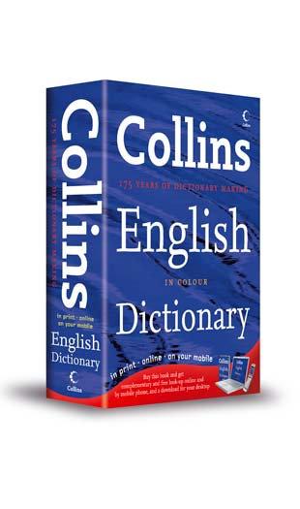
DICTIONARY
Get to know your

Slide 3

Dictionaries are books that list all the words in a language.

Slide 4
With a Dictionary, you can learn:
-How to spell a word
-What a word means
-How to say a word
-What part of speech a word is
-How many syllables are in a word
-Whether or not to capitalize a word
-How to abbreviate a word (ex= USA)
-Meanings of prefixes and suffixes for a word

Slide 5

How is a Dictionary Organized?

Slide 6
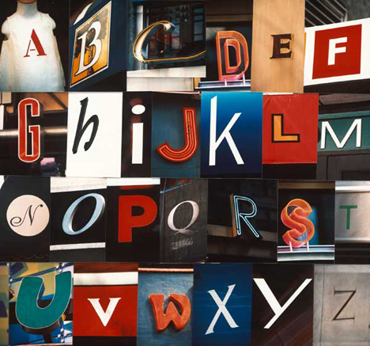
To make dictionaries easier to use, the words are organized in alphabetical order.

Slide 7
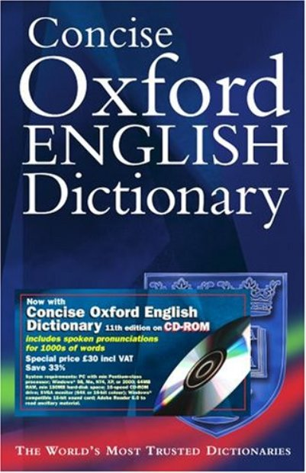
Since there are so many words in a dictionary, guide words are used to help you locate a word quickly.

Slide 8
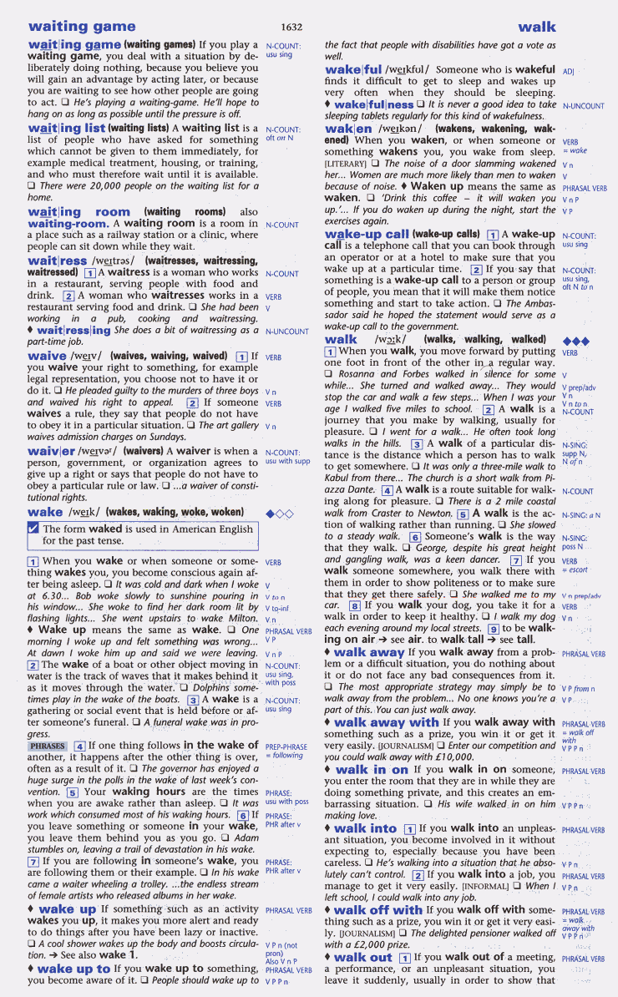
Guide words are found at the top of each page. They tell you the first and last word that is found on that page.

Slide 9

How do guide words help you find a word quickly?
Look at the guide words
Use what you know about alphabetizing to decide if your word falls between the two guide words

Slide 10
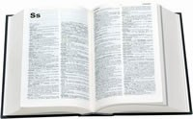
Let’s see what that means-
Let’s pretend we are looking up the word, science. First we would turn to the S section.

Slide 11

Then we would use the guide words and what we know about alphabetizing to decide the correct page in the S section.

Slide 12
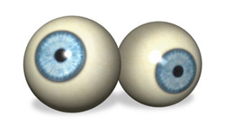
We would look at the guide words at the top of each page and decide which ones our word would come between in alphabetical order.

Slide 13

Let’s do that for the word science-
Which one of these pages would contain the word science?

Slide 14

science
The page with the guide words-
stamp - summer
Or the page with the guide words-
sandwich - seventy

Slide 15

Dictionary Definitions
What do they mean?

Slide 16
Have you ever looked up the definition for a word in the dictionary?
If so, then you might have been confused by some of the parts of that definition.

Slide 17
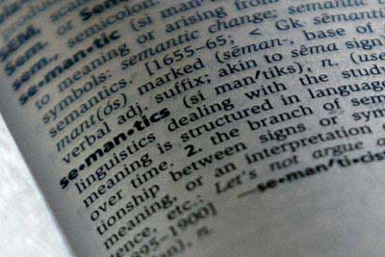
Today, we’re going to learn what each part of a definition means.

Slide 18

VOCABULARY
Headword- the word you are looking up. It is always in bold type.
Entry- the information on the word you are looking up.
Pronunciation- tells you how to say the word. Found in (parentheses).
Part of speech- tells you how the word is used in a sentence (n=noun, v=verb, adj=adjective, adv=adverb).

Slide 19
VOCABULARY
Definition- all possible meanings for the word. Many words have more than one meaning.
Examples- Shows you how the word is used in a sentence. Usually found in italics.
Etymology- this tells you the history of the word, and what language it came from.

Slide 20
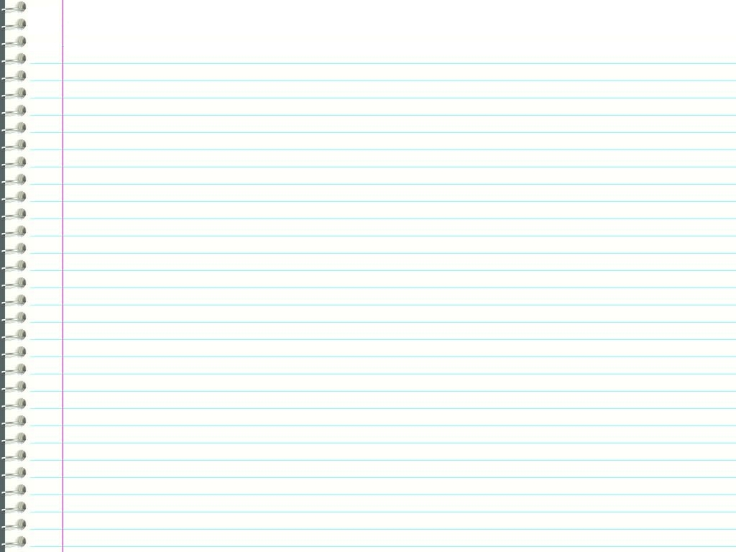
This is a definition for flag:
flag (flag)
noun A piece of cloth with a pattern or symbol of a country, an organization, etc.
verb To stop, or to signal. We flagged down the police officer.

Slide 21
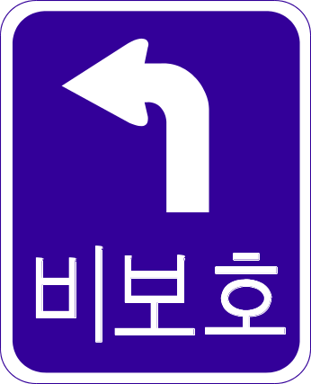
flag (flag)
noun A piece of cloth with a pattern or symbol of a country, an organization, etc.
verb To stop, or to signal. We flagged down the police officer.
The word being defined is followed by the pronunciation in parenthesis.

Slide 22

The first word tells the word’s part of speech
flag (flag)
noun A piece of cloth with a pattern or symbol of a country, an organization, etc.
verb To stop, or to signal. We flagged down the police officer.

Slide 23
The next section is the actual definition of the word.
noun A piece of cloth with a pattern or symbol of a country, an organization, etc.
verb To stop, or to signal. We flagged down the police officer.

Slide 24
noun A piece of cloth with a pattern or symbol of a country, an organization, etc.
verb To stop, or to signal. We flagged down the police officer.
Finally, you might see a sentence showing how the word is used. Especially if the use is not the most common for the word.

Slide 25
How do I decide which Definition to use?
Decide how the word is used.
Read all meanings of the word given to you.
Imagine a blank space in the sentence where the word appears.
Substitute the meaning you feel is correct into that sentece.
If the sentence still makes sense, then you have the correct definition.

Slide 26

Now you know how to use a dictionary!

Slide 27
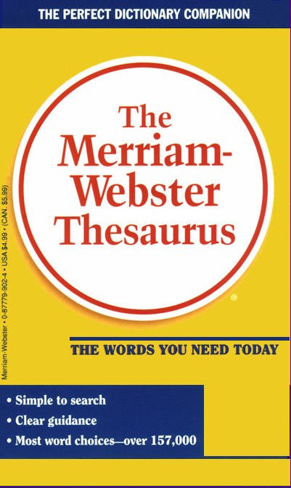
Using a
THESAURUS

Slide 28
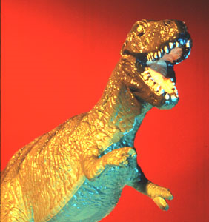
What is a Thesaurus?
A thesaurus is a book that can help you find words with the same or similar meanings.
(No, a thesaurus is NOT a kind of dinosaur)

Slide 29
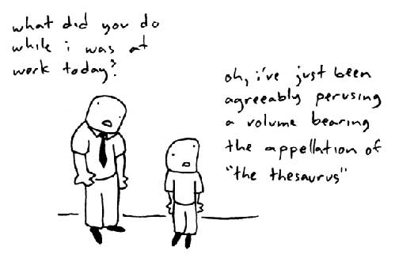
Why use a Thesaurus?
To avoid using the same word over and over
To find a word that has the same or similar meaning
To find the opposite of a word
To learn new words
To make your writing more interesting or exciting

Slide 30
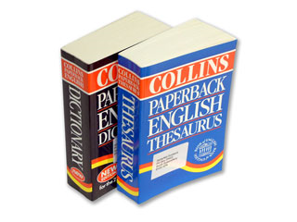
How do I use a Thesaurus?
A thesaurus is arranged very much like a dictionary.
Alphabetical order
Guide words
Entries
A thesaurus entry usually has:
Headword in BOLD
Part of speech
Synonyms (words with same or similar meaning)
Antonyms (words with opposite meanings)

Slide 31
How do I use a Thesaurus?
Vocabulary building through Synonyms, Antonyms
Learning synonym antonyms is a part of all vocabulary building processes because:
1. It increases the number of words we retain.
2. Synonyms and antonyms are items often tested on English language exams.
3. They are (generally) easier to learn and remember than other non-related words due to the relationship they have with each other.

Slide 32
How do I use a Thesaurus?
Once you have the word before you, you must decide which synonym to use.
Words have different connotations--that is, different implied meanings--and if you use a word you're not familiar with, you may be saying something that you didn't intend to say. A basic rule to remember is that if you don't know the word, don't use it!!

Slide 33
How do I use a Thesaurus?
Consider the words "slender" and "skinny." Both words are found under the heading thin in the thesaurus, but "slender" has positive connotations, while "skinny" does not. If you write
"The slender man walked down the street." and
"The skinny man walked down the street."
your mind sees two different images, even though the words are similar.
A thesaurus is a valuable tool, if used correctly.

Slide 34
Recap
Word Skills:
Dictionary skills
Effective use of thesaurus
Vocabulary building
Synonyms Practice Exercises
Antonyms

Slide 35
References
The material has been adapted from the following links:
http://www.learnenglishfeelgood.com/vocabulary/mobile-phone-vocabulary1.html#
http://www.superteacherworksheets.com/synonyms-antonyms/syn-ant-mixed_WDWWQ.pdf
http://www.studenthandouts.com/English/10-Printable-Verbal-Reasoning.html
http://bogglesworldesl.com/synonym_worksheets.htm

