Slide 1
English Comprehension and Composition – Lecture 26
Objectives:
Overview of Email Writing
Kinds of Emails
Parts of Emails
Email Features
Sample Emails

Slide 2
Email messages
Email, e-mail or electronic mail is the transmission of messages over electronic networks like the internet.

Slide 3
Things to remember while writing an e-mail
Write a meaningful subject line.
Keep the message focused.
Avoid attachments (if not necessary)
Identify yourself clearly.
Be kind — don’t flame.
Proofread.
Distinguish between formal and informal situations.
Respond Promptly.
Show Respect and Restraint.

Slide 4
Some Important Questions for writing Email
How much should I write in an email?
Email is meant for quick, simple communication. As a general guide that means roughly 4 or 5 paragraphs at most. Due to the limitations of formatting and layout, anything much longer than that is probably best sent as a separate attachment such as a Word file. Most people have a limited attention span with email - if they are receiving a lot of mail you want to get the main message explained in the shortest possible space.

Slide 5
Do spelling and grammar matter in email?
We think it does. Poor spelling and grammar show a lack of attention to detail and send the wrong message about yourself and how you do business. Most email programs today have built-in spell checkers so there is no excuse! You wouldn't send a letter that was poorly punctuated and uses no capital letters - why not make sure your email messages look professional too?

Slide 6
What do cc: and bcc: mean?
There is a certain etiquette with email, especially in the use of the carbon copy (cc:) and blind carbon copy (bcc:) fields. It is courteous to add addresses to the 'cc:' field if those people need to know about the subject but are not required to act on the contents.
The 'bcc:' field is useful where discretion is required. People in this field are concealed from other recipients in the 'To', 'cc:' and 'bcc:' fields. They can themselves see others in the 'To' and 'cc:' fields but not the 'bcc:' fields.
In this example, an email is sent directly to John by Bob. He copies Tom by including Tom's address in the cc: field. Harry and Sue are blind copied - they can see who the original recipients were but Tom and John won't see their names.

Slide 7
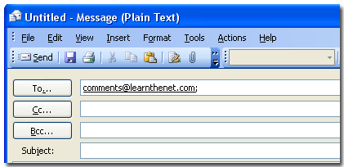
Basic Email Format
The receiver’s email address
Carbon copy
Blind carbon copy
Email subject

Slide 8
wednesdaysensei@hotmail.com
joeshmou@youknow.net
July 5 meeting time change

Slide 9
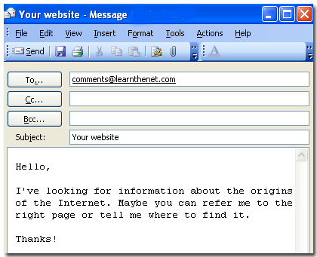
Type your email message in the text box, then click send and it will be sent to the receivers you have indicated in the to, Cc, and Bcc areas.

Slide 10
An example of a bad email:
Subject: Some points to discuss
Hey people, We were thinking of changing a few things around the office. These things have bothered most of us and the management thinks it is time we take notice of these aspects. I know that we are all real busy but we should speak about these points in our next meeting. Also, many have not yet submitted the reports and the deadline is coming up in the next couple of days. So, make sure we all concentrate. Thanks, Benny Markson.

Slide 11
An example of a good email:
Subject: Discussion related to management policy and reminder for deadline due.
Dear Staff,
It has come to the notice of the management, there are certain policies that are not
expectable by most of the employees. These policies are bothering most of the
employees and this is affecting their general performance. Although, most of us
have a busy schedule, we shall bring up the policy plans during our next weekly
meeting.
It has also been found, the project is nearing its deadline and many have not yet
completed their tasks at hand. Your problems and queries will be addressed in the
next meeting as stated above. Thus, it will be better if we start concentrating on our
project and give no opportunity to the client to complain. The management has full
trust on its employees and we hope you will not disappoint us.
Thanks,
Benny Markson
HR Manager
Jackson Consultants

Slide 12
Recap
Overview of Email Writing
Parts of Emails
Email Features
Sample Emails

Slide 13
References
The material has been adapted from the following links:
http://www.qgroupplc.com/?catid={C07567E5-9742-4A9F-8940-261D1E629EC5}#{4FB078D9-DD5A-4058-9FB1-B635C84261FB}
http://www.sampleemails.org/

