Slide 1
English Comprehension and Composition – Lecture 16
Objectives:
Pre writing Techniques with activities and examples

Slide 2
Pre-writing Techniques
Free-writing
Note keeping
Brain storming
Mind mapping
Journalistic questions (how +5 w’s)
Exercises for students

Slide 3
What is Pre-writing?
Pre-writing is the first stage of the writing process, aimed to “discover and explore our initial ideas about a subject.”
At the beginning of writing, it is usual to find yourself totally blank, without ideas about what to say. Pre-writing techniques, make it much easier to start a writing.

Slide 4
1. Free-writing
“Free Writing” is like pouring all of your thoughts onto paper.
Don’t take your pen off the page; keep writing for the entire time.
If you don’t know what to write, write “I don’t know what to write” until you do.
Don’t try to sort “good” and “bad” ideas.
Don’t worry about spelling and grammar.

Slide 5
Example of Free-Writing
A Memorable Moment
The day I got my driver's license. Cloudy. Raining. Crummy taste in my mouth. Nervous stomach. Sweaty hands. exam room. Crowded. People pushing. Smoking. Waiting in line for eternity. Dirty floor, carved up desk tops. Waiting and waiting. Still in line. Candy wrappers on floor. People next to me looked poor. Dirty T-shirts Everyone seems older than me. My written test graded. Passed. Thanks I said. He ignored me, just looked straight ahead. Next, he mumbled. Wait. Wait in line for vision test. People loud, rude, nervous in line. Getting angry at waiting. Been here three hours said a scruffy looking kid. Tough. Faceless eye examiner. Passed. Go to the next line. Thank you. No response. Thanks a lot. Still no response. Important moment for me.

Slide 6
Practice of Free Writing
Free write for 3-5 minutes on the following topic:
What is the most embarrassing experience you have ever had?

Slide 7
The most embarrassing experience I have ever had
At my cousin’s wedding- during the mehndi cerimony. Almost 200 hundered guests were present…the bride and groom were ready for the ceremony…all the girls were excited…I had to carry the biggest plate of mehndi… decorated with rose petals and candles…was wearing heels…went to the stage to say something to the bride…while coming down, the heel stuck in the carpet fold and I flew down with the plate of mehndi…fell with a thud and crash…all eyes on me…family rushed to my rescue, but people laughed too especeally kids…didn’t feel any pain but felt the heat of extreme embarrassment and shame. Later on laughed my heart out with my couzins and family…the incident makes me laugh even now…

Slide 8
2. Note keeping/ Keeping a Journal
Keeping a journal is an excellent way to practice your writing skills. Your journal is mostly for you. It’s a private place that you record your experiences and your inner life; it is the place where, as one writer says, “I discover what I really think by writing it down.”

Slide 9
How to keep a journal?
You can keep a journal in a notebook.
Every morning or night, or several times a week, write for at least fifteen minutes in this journal.
Don’t just record the day’s events. Instead write in detail about what most angered, moved or amused you that day.
Your journal is private, so don’t worry about grammar or correctness.

Slide 10
Examples of a Journal Entry
September 7, 2011
The day started with waking up late for the convocation; quite unlike me ☺
Finally arrived the Convention Center in time and got to meet all class mates after a log time.
It was a great feeling to receive my Medal, amidst roaring applause, in front of an audience of almost 1200 people.
But I missed my parents very much….

Slide 11
3. Brain Storming
Brainstorming is a strategy of listing all the terms related to the topic. No need to worry about whether those ideas are useful or not. You just jot down all the possibilities. The more, the better. Then look back things you have listed and circle those that make a sense to the topic. Often, brainstorming looks more like a list while free writing may look more like a paragraph. With either strategy, your goal is to get as many ideas down on paper as you can.

Slide 12
Example of Brainstorming
Topic: What would I do with one million dollars?
Travel to Europe, Asia, S. America
Pay off our house
Help friends financially
Go abroad for studies
Share and donate to charities
Buy a lot of books!
Invest/save and let the interest grow

Slide 13
Practice of Brain storming
Take 5 minutes to brainstorm ideas about the following question:
  What are some of the most memorable experiences of your life?

Slide 14
Most Memorable Experiences of my Life
Receiving my first ever award for securing first position in class
Going to Murree with friends in school
Travelling in rain with class mates on my way back from a confrence
Receiving my medal on convocation
Loosing a scholarship oppertunity
Loosing both my parents in one year
Getting a new job exactly when I needed it the most

Slide 15
4. Mind Mapping
Mind mapping, Clustering, Mapping, Idea mapping or Webbing is a "visual of outlining”. It is another way to organize your ideas.
Start with your topic in the center, and branch out from there with related ideas.
Use words and phrases, not complete sentences.

Slide 16
Example Map
Make good grades
Play better in sports at school
school
Eventually go to college
My future plans
Stop putting off assignments
Spend more time
family
work
Pay attention in class better
Be nicer to my little brother
Do what my parents tell me--first!

Slide 17
Practice of Mind Mapping
Draw a map to organize your ideas about the following topic:
How to learn English!

Slide 18
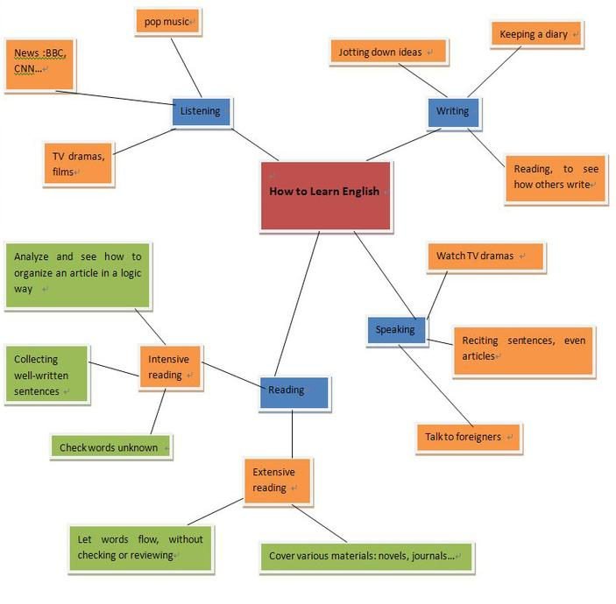

Slide 19
5. Journalistic Questions (How + 5 w’s)
Journalistic techniques refer to asking yourself six questions,
How? What? Where? When? Which? Who?
With these questions, you can fully explore ideas about the topic you are about to write and put everything down in detail. In this process, you should not spare hard efforts on every question but make it as flexible as possible. In other words, some Ws (such as what or who) should be attached with importance, while others (such as where or who) can be ignored. This largely depends on your topic.

Slide 20
Example of Journalistic Questions
What has happened to Bin Laden?
Where and When was he killed?
Who killed him?
How did the US Army track that man down?
On hearing the death of Bin Laden, how did Americans respond?
How did they celebrate?
What was the response of civilians in Afghanistan？
What's the significance of the death?
How can we prevent the potential terror activities?
What should we do to eliminate the terrorism in the long run?

Slide 21
Practice of Journalistic Questions
Imagine you have heard about a robbery. A bag of diamonds is stolen and the owner is murdered.
What journalistic questions would you ask to investigate?

Slide 22
A Robbery
At what time the robbery took place?
Where did it happen?
How many robbers?
Any eye witnesses?
What weapon was used?
What could be the reason?
Any suspects?
What were the diamonds worth?

Slide 23
Recap
Pre writing Techniques with Examples
Free-writing
Note keeping
Brain storming
Mind mapping
Journalistic questions (how +5 w’s)

Slide 24
References
The material has been adapted from the following links:
http://www.beaconlearningcenter.com/documents/1044_01.pdf
http://www.douglas.bc.ca/__shared/assets/WR253847.pdf
http://xiamenwriting.wikispaces.com/Pre-writing+Techniques

