Slide 1
HRM-755
PERFORMANCE MANAGEMENT
Session: SIX
OSMAN BIN SAIF

Slide 2
Summary of Previous Lecture
CHAPTER 3
Performance Management and Strategic planning
Purpose of strategic planning
Why strategic planning- need
Process of linking performance management to the strategic planning
Successful strategic plans
Environmental Analysis
External factors – Environmental Analysis

Slide 3
Agenda of Today’s Lecture
Environmental Analysis – Internal Factors
Gap Analysis
Gap Analysis – Competitive Situations
Mission
Vision

Slide 4
EA – Internal Factors
The following is a non exhaustive list of internal issues that should be considered in any environmental analysis:
Organizational structure:
  For example, is the current structure conducive to fast and effective communication?

Slide 5
EA – Internal Factors (Contd.)
Organizational culture:
  Organizational culture includes the unwritten norms and values exposed by the members of the organization.
  For example, is the current organizational culture likely to encourage or hinder innovation and entrepreneurial behaviors on the part of middle level managers?

Slide 6
EA – Internal Factors (Contd.)
Politics:
  For example, are the various units competiting for resources in such a way that any type of cross unit collaboration is virtually impossible? Or ,are units likely to be open and collaborative in cross unit projects?
Processes:
  For example, are the supply chains working properly? Can customers reach us when they need to and receive a satisfying response when they do?

Slide 7
EA – Internal Factors (Contd.)
Size:
  For example, is the organization too small or too large? Are we growing too fast? Will we be able to manage growth(or downsize) effectively?

Slide 8
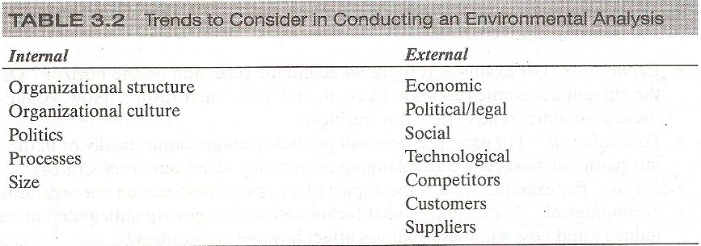
Questions to consider:
Where does your organization stand in regard to each of these important internal and external issues?
Regarding the external issues, what are some of the opportunities and threats?
Regarding the internal issues, what are some of the strengths and weaknesses?

Slide 9
Gap Analysis
After external and internal issues have been considered, information is collected regarding opportunities, threats, strengths and weaknesses.
This information is used to conduct gap analysis, which analyzes the external environment in relation to the internal environment.

Slide 10
Gap Analysis- Competitive Situations
The pairing of external opportunities and threats with internal strengths and weaknesses leads to the following situations; (ranked from most to least competitive).

Slide 11
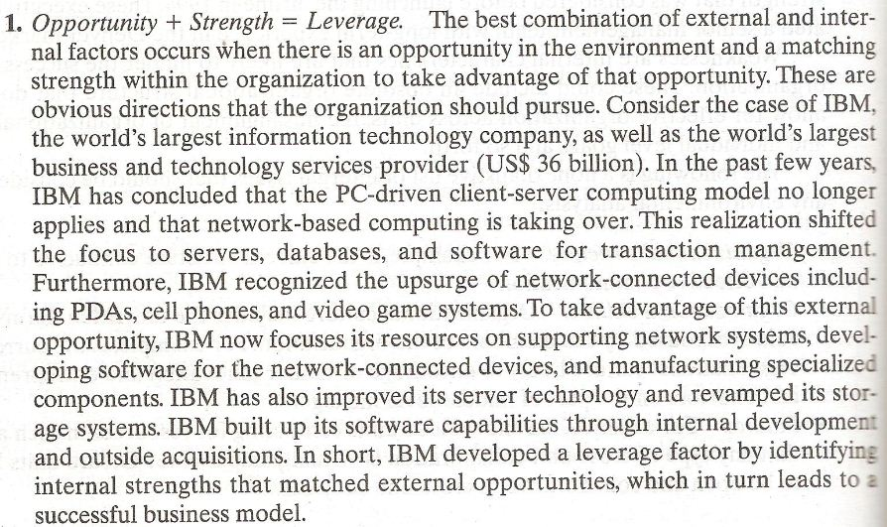

Slide 12
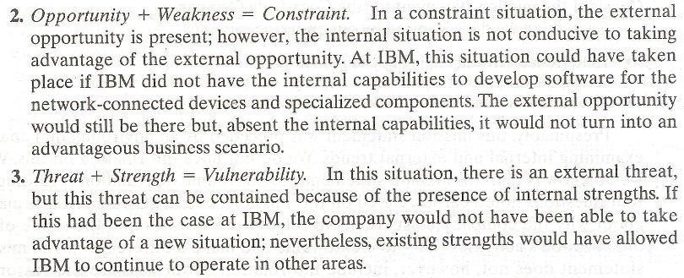

Slide 13
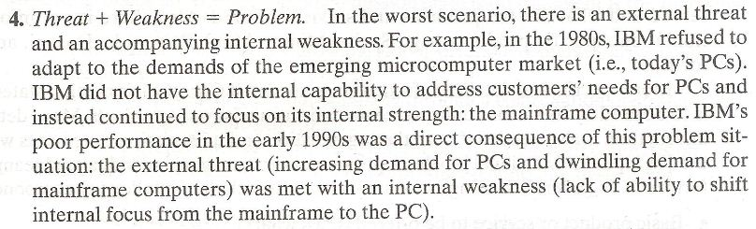

Slide 14
Gap Analysis- Competitive Situations (Contd.)
Now consider the organization you are currently working for or think of an example, or the organization for which you have worked most recently.
Try to identify one leverage and one problem based on an analysis of opportunities, threats, strengths and weaknesses.
  What was the situation like?
  What were the results?

Slide 15
Gap Analysis- Competitive Situations (Contd.)
In sum the process of creating a strategic plan begins with an environmental analysis, which considers internal as well as external trends.
  Internal trends can be classified as either strengths or weaknesses and
  External trends can be classified as either opportunities or threats.

Slide 16
Gap Analysis- Competitive Situations (Contd.)
A GAP Analysis consists of pairing strengths and weaknesses with opportunities and threats and
Determining whether the situation is;
  advantageous (i.e leverage),
  disadvantageous (i.e problem) or
  somewhere in between (i.e constraint and vulnerability).

Slide 17
Mission
After the environmental analysis has been completed and the gap analysis reveals an organizations leverage, constraints, vulnerabilities, and problems, the members of organization must determine who they are and what they do.

Slide 18
Mission (Contd.)
This information will then be incorporated into the organizations mission statement.
The mission statement summarizes the organizations most important reason for its scope.

Slide 19
Mission (Contd.)
Good mission statements provide answers to the following questions:
  Why does the organization exist?
  What is the scope of organizations activities?
  Who are the customers served?
  What are the products and services offered?

Slide 20
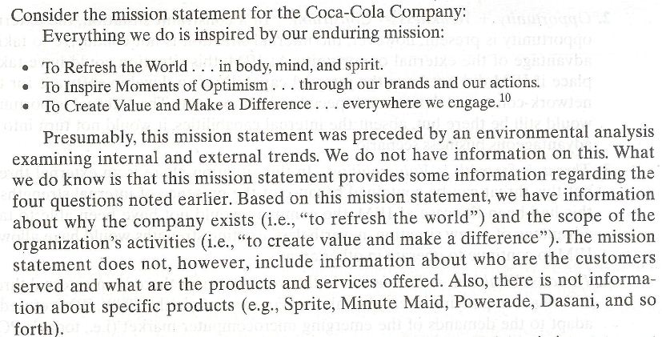

Slide 21
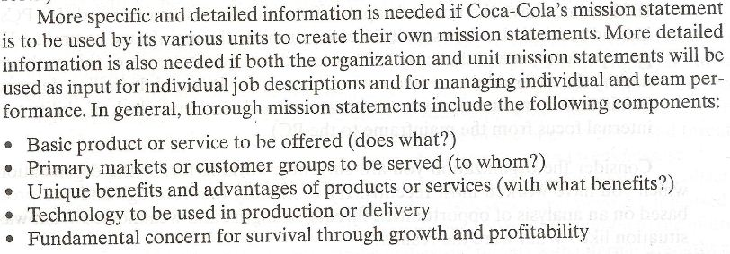

Slide 22
Mission (Contd.)
Mission statements also typically include information about the organization’s values and beliefs, including;
  Managerial philosophy of the organization
  Public image sought by the organization
  Self-concept of business adopted by employees and stockholders.

Slide 23
Mission (Contd.)
In sum, a mission statement defines;
  why the organization exists?
  The scope of its activities
  The customers served
  And the products and services offered

Slide 24
Mission (Contd.)
Mission statement can also include specific information;
  Technology used in production or delivery
  The unique benefits or advantages of the organization’s products and services.
Finally a mission statement can include a statement of values and beliefs.

Slide 25
Vision
An organizations vision is a statement of future aspiration. In other words, the vision statement includes a description of what the organization would like to become in the future(about 10 years in the future).

Slide 26
Vision (Contd.)
Vision statements are typically written after the mission statement is completed because the organizations needs to know who they are and what their purpose is before they can figure out who they will be in the future.

Slide 27
Vision (Contd.)
Note, however, that mission and vision statements are often combined and therefore, in many cases it is difficult to differentiate one from the other. In such cases, the vision statement usually includes two components: a core ideology, which is what is referred to as the vision per se.

Slide 28
Vision (Contd.)
The core ideology contains the core purpose and core values of an organization, and the envisioned future specifies long term objectives and picture of what the organization aspires to.

Slide 29
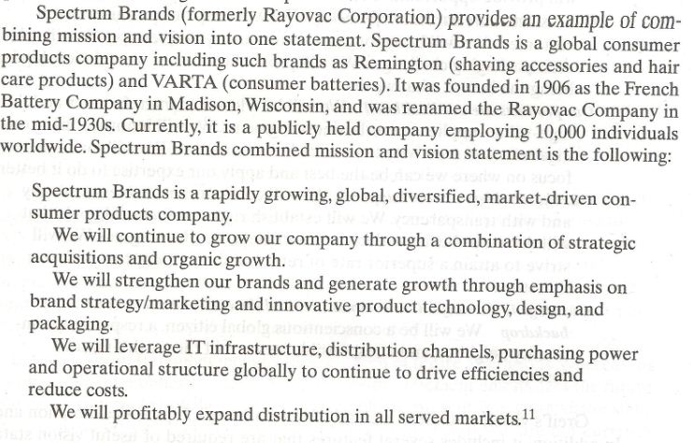

Slide 30
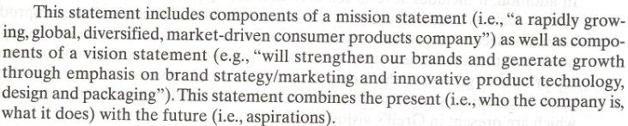

Slide 31
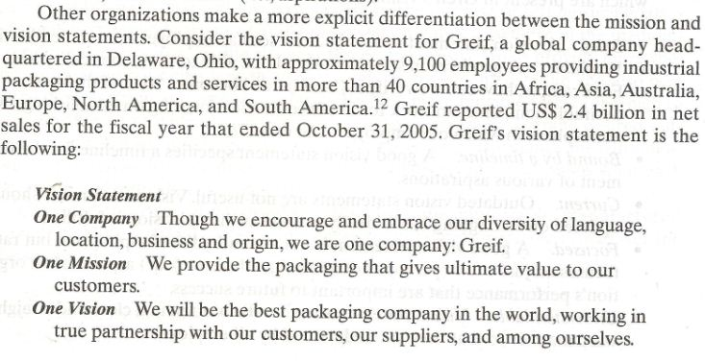

Slide 32
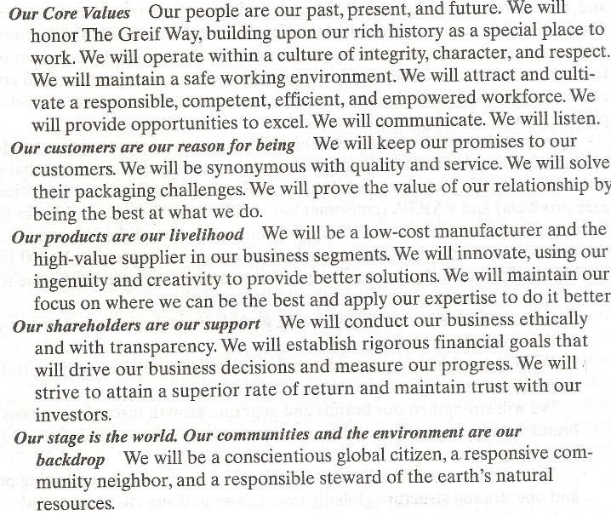

Slide 33
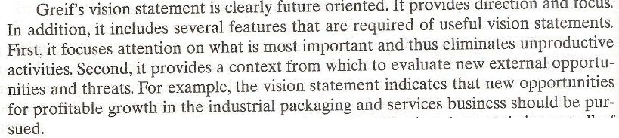

Slide 34
Summary of Today’s Lecture
Environmental Analysis – Internal Factors
Gap Analysis
Gap Analysis – Competitive Situations
Mission
Vision

Slide 35
Thanks

