Slide 1
HRM-755
PERFORMANCE MANAGEMENT
Session: Five
OSMAN BIN SAIF

Slide 2
Summary of Previous Lecture
Performance management Process
  Components of PMP
    Performance Execution
    Performance Assessment
    Performance review
    Performance renewal and Re-contracting

Slide 3
Agenda of Today’s Lecture
CHAPTER 3
Performance Management and Strategic planning
Purpose of strategic planning
Why strategic planning- need
Process of linking performance management to the strategic planning
Successful strategic plans
Environmental Analysis
External factors – Environmental Analysis

Slide 4
CHAPTER 3:
Performance Management and Strategic Planning
“Strategy is a style of thinking, a conscious and deliberate process, an intensive implementation system, the science of insuring future success”.----PETE JOHNSON

Slide 5
Definition and purpose of strategic planning
Strategic planning is a process that involves describing the organizations destination, assessing barriers that stand in the way of that destination, and selecting approaches for moving forward.

Slide 6
Strategic Planning (Contd.)
The main goal of strategic planning is to allocate resources in a way that provide organizations with a competitive advantage.
Overall, a strategic plan serves as a blueprint that defines how the organization will allocate its resources in pursuit of its goals.

Slide 7
Strategic Planning (Contd.)
Strategic planning serves the following purpose
First and foremost strategic planning allows organizations to define their identity. In other words, it provides organizations with a clearer scene of who they are and what their purpose is.

Slide 8
Strategic Planning (Contd.)
Second, strategic planning helps organizations prepare for the future because it clarifies the desired destination.
Knowing where the organization wants to go is a key first step in planning how to get there.

Slide 9
Strategic Planning (Contd.)
Third, strategic planning allows organizations to analyze their environment, and doing so enhance their ability to adapt to environmental changes and even anticipate future changes.

Slide 10
Strategic Planning (Contd.)
Fourth, strategic planning provides organization with focus and allows them to allocate resources to what matters the most.
In turn the improved allocation of resources is likely to stimulate growth and improve profitability.

Slide 11
Strategic Planning (Contd.)
Fifth, strategic planning can produce a culture of cooperation within the organization given that a common set of goals is created.
Such a culture of cooperation can gain organization a key competitive advantage.

Slide 12
Strategic Planning (Contd.)
Sixth, strategic planning can be a good corporate eye-opener because it generates new options and opportunities to be considered.
New opportunities to be considered may include expanding to new markets or offering new products.

Slide 13
Strategic Planning (Contd.)
Finally, strategic planning can be a powerful tool to guide employee’s daily activities because it identifies the behaviors and results that really matter.
A strategic plan provides critical information to be used in the performance management system.

Slide 14
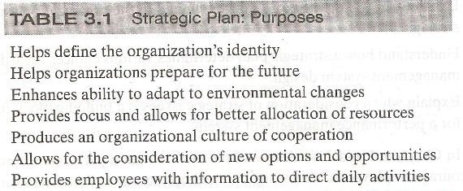

Slide 15
Process of linking performance management to the strategic planning
The mere presence of strategic plan does not guarantee that this information will be used effectively as part of performance management system.
In fact, countless organizations spend thousand of hours creating strategic plans that lead to no tangible actions.

Slide 16
Process of linking performance management to the strategic planning (Contd.)
Many organization spend to much time and effort crafting their mission and vision statements without undertaking any concrete follow-up actions.
The process then holds up a huge waste of time and a source of frustration and long-lasting cynicism (general distrust).

Slide 17
Process of linking performance management to the strategic planning (Contd.)
Thus, to ensure that strategic planning cascades down the organization and leads to concrete actions, a conscious effort must be made to link the strategic plans with individual performance.

Slide 18
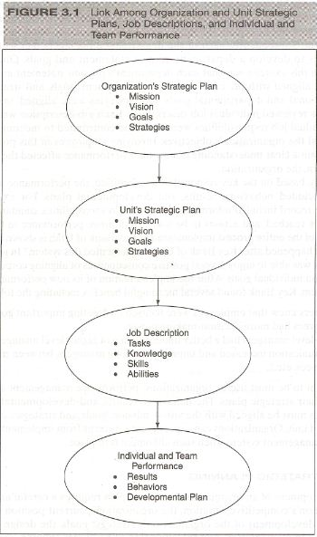

Slide 19
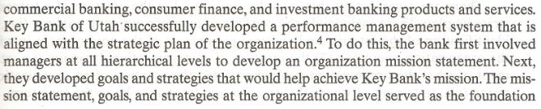
CASE - EXAMPLE

Slide 20
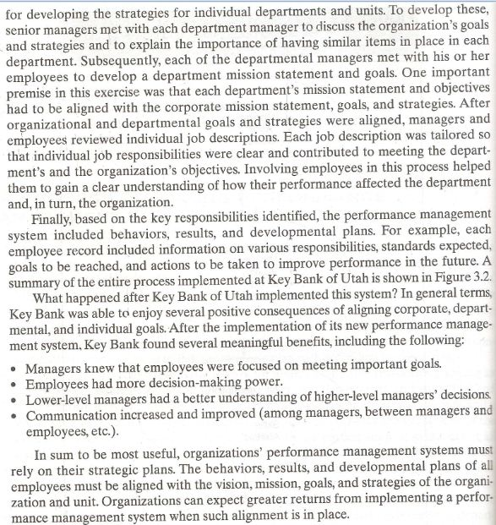

Slide 21
Strategic planning
The development of an organizations strategic plan requires a careful analysis of the organizations competitive situation, the organizations current position and destination, the development of the organizations strategic goals, the design of a plan of action and implementation, and the allocation of resources that will increase the likely hood of achieving the stated goals.

Slide 22
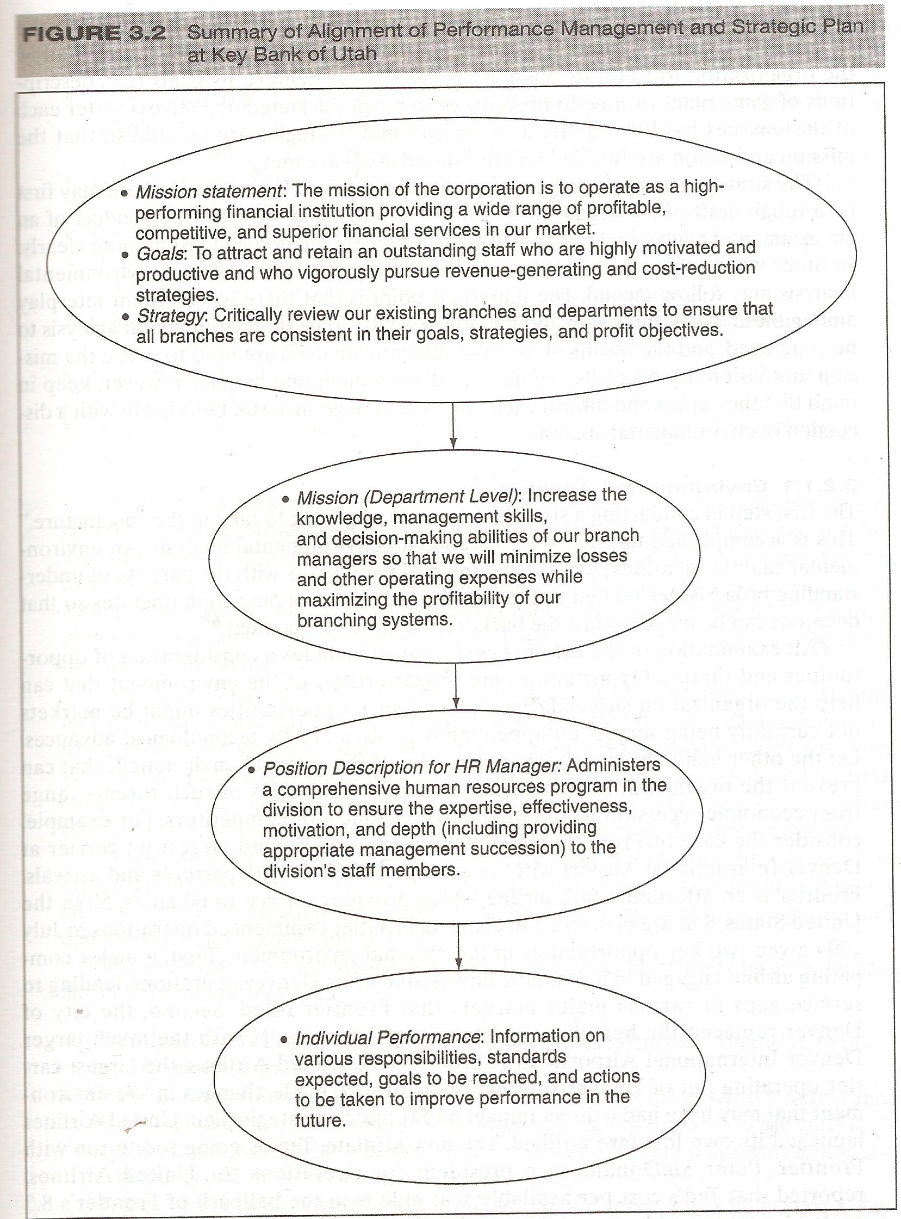

Slide 23
Successful Strategic plan
There are several steps that must be considered in creation of a successful strategic plan. These include;
The conduct of environmental analysis(i.e., the identification of external and internal parameters of environment in which the organization operates)

Slide 24
Successful Strategic plan (Contd.)
The creation of organizational mission(i.e., the statement of what the organization is all about)
The creation of organizational mission(i.e., statement of where the organization intends to be in the long term, say, about 10 years)
Setting goals(i.e., what the organization intends to do in short term,say, one to three years)

Slide 25
Successful Strategic plan (Contd.)
The creation of strategies that will allow the organization to fulfill its mission and vision to achieve its goals(i.e., description of game plans or how to reach the stated objectives)

Slide 26
Successful Strategic plan (Contd.)
After each of these issue has bee defined, organizational strategies are created so that the mission and vision are fulfilled and the stated goals are met.

Slide 27
Successful Strategic plan (Contd.)
The strategic planning process is not linear, however for example, there may first be a rough draft of the organization’s mission and vision and then conduct the environmental analysis may follow to help define the mission and vision more clearly.

Slide 28
Successful Strategic plan (Contd.)
In other words, the mission and vision may be drafted first and the environmental analysis second.
The important point is that there is a consistent interplay among these issues.

Slide 29
Environmental analysis
The first step in conducting a strategic plan is to step back to take in the “big picture”. This is accomplished through what is called an environmental analysis.

Slide 30
Environmental analysis (Contd.)
An environmental analysis identifies external and internal parameters with the purpose of understanding broad issues related to the industry where the organization operates so that the decision can be made against the backdrop of a broader context.

Slide 31
Environmental analysis (Contd.)
An examination of external environment includes a consideration of opportunities and threats.
Opportunities are characteristics of the environment that can help the organization succeed.(e.g markets not currently being served, untapped labor pools, new technology).

Slide 32
Environmental analysis (Contd.)
On the other hand threats are characteristics of external environment that can prevent the organization from being successful.
Examples;
  Economic recession
  Innovative products of competitors
    CASE EXAMPLE--FRONTIER

Slide 33
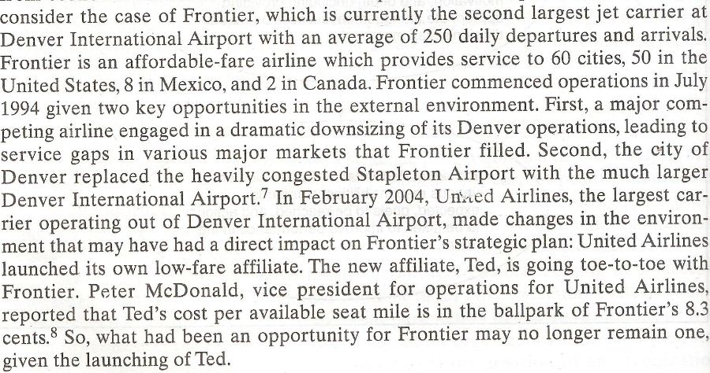

Slide 34
EA – External Factors
The following is a non exhaustive list of external factors that should be considered in any environmental analysis
Economics:
  For example is there an economic recession on the horizon? Or, is the current economic recession likely to end in the near future? How would these economic trends affect our business?

Slide 35
EA – External Factors (Contd.)
Political/legal:
  For example, how will political changes domestically or in the international markets we are planning on entering affect our entry strategy?
Social:
  For example, what is the impact of an aging workforce on our organization?

Slide 36
EA – External Factors (Contd.)
Technological:
  For example, what technological changes are anticipated in our industry and how will these changes affect how we do business?
Competitors:
  For example, how do the strategies and product of our competitors affect our own strategies and products? Can we anticipate our competitors next move?

Slide 37
EA – External Factors (Contd.)
Customers:
  For example, what do our customers want now, and what will they want in the next five years or so? Can we anticipate such needs?
Suppliers:
  For example, what is the relationship with our suppliers now and is it likely to change, and in what way, in the near future?

Slide 38
Summary of Today’s Lecture
CHAPTER 3
Performance Management and Strategic planning
Purpose of strategic planning
Why strategic planning- need
Process of linking performance management to the strategic planning
Successful strategic plans
Environmental Analysis
External factors – Environmental Analysis

Slide 39
Thanks

