Slide 1
HRM-755
PERFORMANCE MANAGEMENT
Session: Four
OSMAN BIN SAIF

Slide 2
Summary of Previous Lecture
Performance management Process
  Components of Performance Management process
    Pre-requisites
    Performance Planning
  Implementation of Performance Management process

Slide 3
Agenda of Today’s Lecture
Performance management Process
  Components of PMP
    Performance Execution
    Performance Assessment
    Performance review
    Performance renewal and Re-contracting

Slide 4
Performance Execution
Once the review cycle begins, the employee strives to produce the results and display the behaviors agreed upon earlier as well as to work on developmental needs.
The employee has primary responsibility and ownership of this process.
Employee participation does not begins at the performance execution stage, however as noted earlier the employee needs to have active input in the development of job description, performance standards, and the creation of rating form.

Slide 5
Performance Execution (Contd.)
At the performance execution stage, the following factors must be present;
Commitment to goal achievement:
  the employee must be committed to the goals that were set.
Ongoing performance feedback and coaching:
  the employee should not wait until the review cycle is over to solicit performance feedback.(proactive role)

Slide 6
Performance Execution (Contd.)
Communication with supervisor:
  supervisors are busy with multiple obligations.
  The burden is on the employee to communicate openly and regularly with the supervisor.
Collecting and sharing performance data:
  the employ should provide the supervisor with regular updates on progress toward goal achievement, in terms of both behavior and results.

Slide 7
Performance Execution (Contd.)
Preparing for performance reviews:
  the employee should not wait until the end of review cycle approaches to prepare for the review.
  On the contrary, the employee should engage in an ongoing and realistic self-appraisal, so immediate correction action can be taken if necessary.
  The usefulness of the self appraisal system can be enhanced by gathering informal performance information from peers and customers.

Slide 8
Performance Execution (Contd.)
Although the employee has primary responsibilities for performance execution, the supervisor also needs to do his or her share of the work.

Slide 9
Performance Execution (Contd.)
Supervisors have primary responsibility over the following issues;
Observation and documentation:
  supervisors must observe and document performance on daily basis.
  It is important to keep track of examples of both good and poor performance.

Slide 10
Performance Execution (Contd.)
Updates:
  as the organizations goals may change, it is important to update and revise initial objectives, standards, and key accountabilities and competency areas.
Feedback:
  feedback on progress towards goals and coaching to improve performance should be provided on a regular basis, and certainly before the review cycle is over.

Slide 11
Performance Execution (Contd.)
Resources:
  supervisor should provide employees with resources and opportunities to participate in developmental activities.
  Thus they should encourage and sponsor participation in training, classes and special assignments.
  Overall supervisors have a responsibility to ensure that the employee has the necessary supplies and funding to perform the job properly.

Slide 12
Performance Execution (Contd.)
Reinforcement:
  supervisor must let employees know that their outstanding performance is noticed by reinforcing effective behaviors and progress towards goals.
  Also supervisors should provide feedback regarding negative performance and how to remedy the observed problem.
  Observation and communication are not sufficient.
  Performance problems must be diagnosed early and appropriate steps must be taken as soon as the problem is discovered.

Slide 13
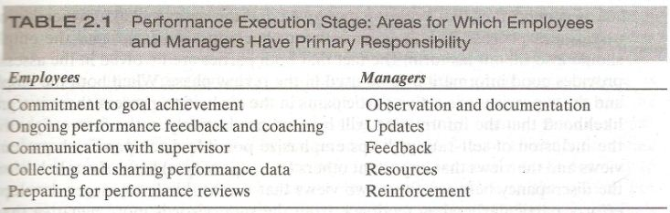

Slide 14
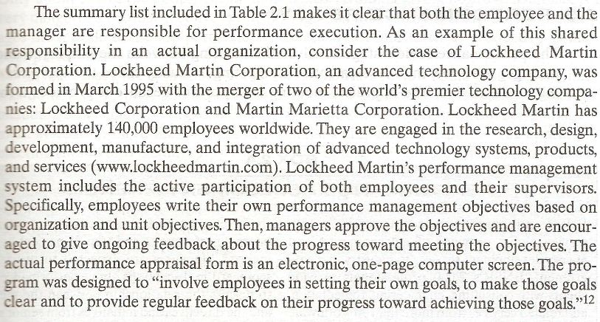

Slide 15
Performance Assessment
In the assessment phase, both the employee and manager are responsible for evaluating the extent to which behaviors have been displayed, and whether the desired results have been achieved.
Although many sources can be used to collect performance information (e.g peers, subordinates), in most cases the direct supervisor provides the information.

Slide 16
Performance Assessment (Contd.)
This also includes an evaluation of the extent to which the goals stated in the development plan have been achieved.

Slide 17
Performance Assessment (Contd.)
It is important that both the employee and the manager take ownership of the assesment process.
The manager fills out her appraisal form, and the employee should also fill out his form.

Slide 18
Performance Assessment (Contd.)
When both the employee and the supervisor are active participants in the evaluation process, there is a greatest likely hood that the information will be used productively in the future.

Slide 19
Performance Assessment (Contd.)
Specifically, the inclusion of self-ratings help emphasize possible discrepancies between self views and the views that important others(i.e., supervisor) have of our behavior.
It is discrepancy between these two views that is most likely to trigger development efforts, particularly when feedback from the supervisor is more negative than are employee self evaluations.

Slide 20
Performance Assessment (Contd.)
The inclusion of self appraisals is also beneficial regarding important additional factors.
Self appraisals can reduce and employee’s defensiveness during an appraisal meeting and increase employee’s satisfaction with the performance management system, as well as enhance perceptions of accuracy and fairness and therefore acceptance of the system.

Slide 21
Performance Assessment (Contd.)
In sum both the employee and the supervisor must evaluate employee performance.
Employee involvement in the process increases employee ownership and commitment to the system.
In addition it provides important information to be discussed during the performance review.

Slide 22
Performance review
The performance review stage involves meeting between the employee and the manager to review their assessments.
This meeting is usually called the appraisal meeting or discussions.

Slide 23
Performance review (Contd.)
The appraisal meeting is important because it provides a formal setting in which the employee receives feedback on his or her performance.
In spite of its importance in performance management ,the appraisal meeting is often regarded as the “Achilles” heel of the entire process.

Slide 24
Performance review (Contd.)
This is because many, managers are uncomfortable providing performance feedback, particularly when performance is deficient.
This high level of discomfort, which often translates into anxiety and the avoidance of the appraisal interview, can be mitigated through training those responsible for providing feedback.

Slide 25
Performance review (Contd.)
In most cases, the appraisal meeting is regarded as a review of the past, that is,
  what was done(i.e results)
  and how it was done(i.e behaviours).
The appraisal meeting also include a discussion of the employees developmental progress as well as plans for the future.

Slide 26
Performance review (Contd.)
The conversation should include a discussion of goals and developmental plans that the employee will be expected to achieve over the period before the next review session.
In addition a good appraisal meeting includes information on what new compensation, if any, the employee may be receiving as a result of his performance.

Slide 27
Performance review (Contd.)
In short;-
  The appraisal discussion focuses;
    on the past (what has been done and how),
    The present (what compensation is received or denied as a result)
    And the future (goals to be attained before the upcoming review session)

Slide 28
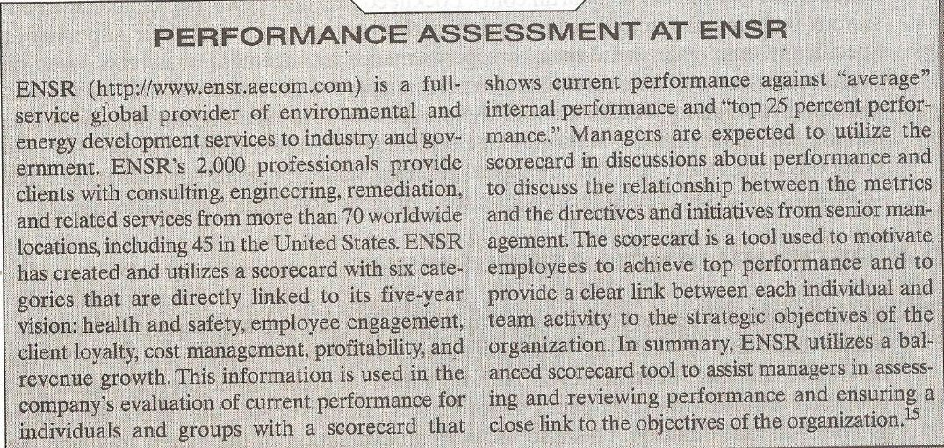

Slide 29
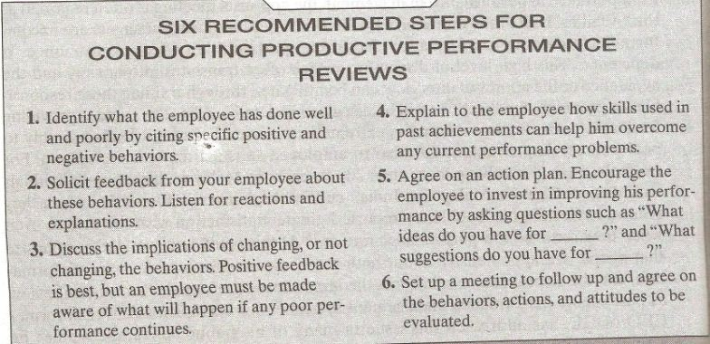

Slide 30
Performance renewal and
Re-contracting
The final stage in performance process is renewal and re-contracting.
Essentially it is identical to the performance planning component.

Slide 31
Performance renewal and
Re-contracting (Contd.)
The main difference is that the renewal and re-contracting stage uses the insights and the information gained from the other phases.
For Example;-
  Some of the goals may have been set unrealistically high given an unexpected economic downturn.
  This would lead to setting less ambitious goals for the upcoming review period.

Slide 32
Performance Management process
The performance management process includes a cycle which starts with prerequisites and ends with performance renewal and re-contracting.
This cycle is not over after the renewal and re-contracting stage.

Slide 33
Performance Management process (Contd.)
In fact, the process starts all over again.
  With the discussion of pre-requisites, including the organization’s mission and strategic goals and the job’s KSAs.
Because markets change, customer’s preferences and need’s change and the products change, there is a need to continuously monitor the pre-requisites so that performance planning and all the subsequent stages are consistent with the organizational strategic objectives.

Slide 34
Performance Management process (Contd.)
Recall the end, one of the main goals of any performance management skill is to promote the achievement of organization-wide goals.
Obviously, if managers and employees are not aware of these strategic goals, it is unlikely that the performance management system will be instrumental in accomplishing the strategic goals.

Slide 35
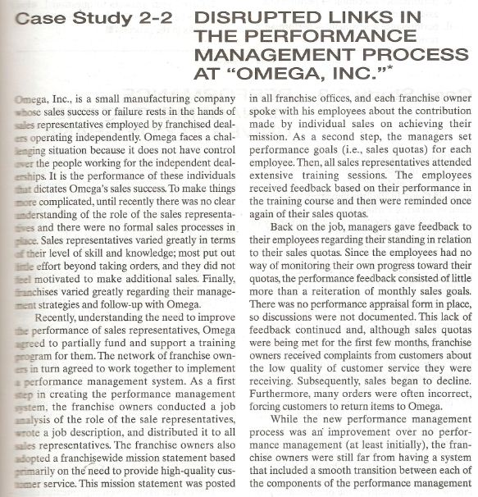

Slide 36
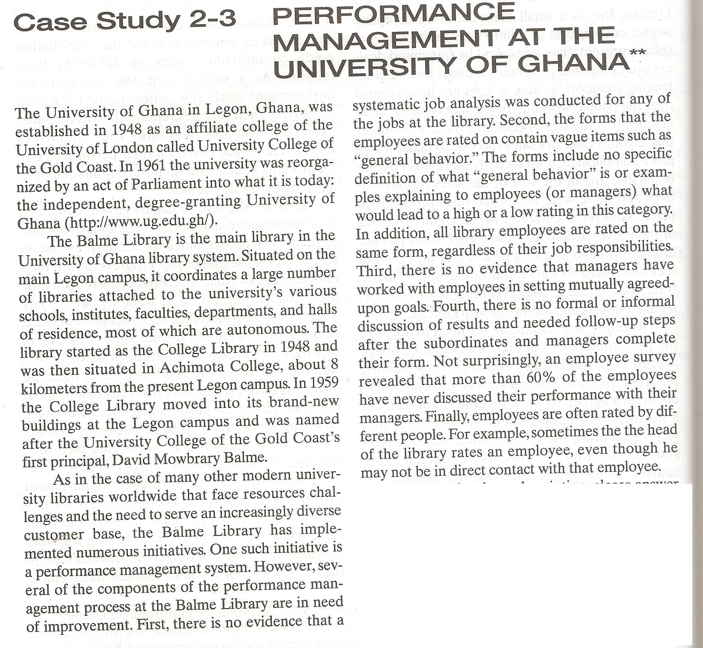

Slide 37
Summary of Today’s Lecture
Performance management Process
  Components of PMP
    Performance Execution
    Performance Assessment
    Performance review
    Performance renewal and Re-contracting

Slide 38
Thanks

