Slide 1
HRM-755
PERFORMANCE MANAGEMENT
LECTURE: THIRTY ONE
OSMAN BIN SAIF

Slide 2
Summary of Previous Lecture
Negative Feedback
Reasons for Negative Feedback Discomfort
Improving Defensive Response
SECTION 4: REWARD SYSTEMS, LEGAL ISSUES AND TEAM PERFORMANCE MANAGEMENT
CHAPTER 10: REWARD SYSTEMS AND LEGAL ISSUES
Traditional Pay Plans
Contingent Pay Plans
Reasons for Introduction of Contingent Pay Plans

Slide 3
Summary of Previous Lecture (Contd.)
Conditions necessary for a Successful CP Plan
Possible Problems Associated With Contingent Pay Plans
Types of CP Systems
Recommendations for Rewards
Pay Structures
Performance Management and Legislation
Legislations Examples, U.K , U.S

Slide 4
Agenda for Today’s Lecture
CHAPTER 11: MANAGING TEAM PERFORMANCE
Definition and Importance of Teams
Popularity of Teams
Team Performance
Conditions necessary for Team Performance
Types of Teams
Principles of Team Performance Management
Team Performance Management Process
Rewarding Team Performance

Slide 5
CHAPTER 11:
MANAGING TEAM PERFORMANCE
The greater the loyalty of the group towards the group, the greater is the motivation among the members to achieve the goals of the group, and greater the probability that the group will achieve its goals --- RENSIS LIKERT

Slide 6
Definition and Importance of Teams
A team is in place when two or more people interact dynamically and interdependently and share a common and valued goal, objective, or mission.
Examples of team range from a group of top managers working together face to face on an ongoing basis with the goal of achieving corporate goals to a group of programmers in Pakistan and United States writing programming codes that eventually will be put together as one software program.

Slide 7
Popularity of Teams
Why are the teams so popular?
First, business are facing increased pressure, including global competition, and they believe that the use of teams might be one way to improve products and services and to increase productivity.
Also, meeting the needs of global customers often requires teams with members from different parts of world.

Slide 8
Popularity of Teams (Contd.)
Second, many organizations have gone through down sizing and restructuring, which has lead to become flatter and has reduced the number of hierarchical levels.

Slide 9
Popularity of Teams (Contd.)
Third, products and services are becoming very complex requiring many people contributing their diverse talents to same project. In most cases, no one individual can surpass the combined talent of an entire group.

Slide 10
Popularity of Teams (Contd.)
Finally, rapidly changing business environments are also responsible for the popularity of teams because teams are able to respond more quickly and more effectively to changes than can individual working alone.

Slide 11
Team Performance
Team performance does not always fulfill its promise; therefore, it makes sense for performance management systems to go beyond focusing on individual performance.
Specifically, the system should target not only
  Individual performance but also
  An individuals contribution to the performance of his or her team
  Performance of team as a whole.

Slide 12
Conditions necessary for Team Performance
It is important to note that some conditions are necessary for team performance management to lead to improved team performance:
The process involved in the performance of the team are relatively unconstrained by other requirements of the task or the organization.
The team is designed well and the organizational context supports team performance.
Performance feedback focuses on team processes that are under the control of team members.

Slide 13
Types of Teams
The three main types of teams based on task complexity and membership configuration dimensions are
Work or service teams:
  These intact teams are engaged in routine tasks, including manufacturing or service tasks.
  An example is a group of people working at the assembly line is a car manufacturing plant such as Toyota or Honda.

Slide 14
Types of Teams (Contd.)
Project teams:
  These teams are assembled for a specific purpose and are expected to dis band as soon as their specific tasks have been completed.
  The tasks are outside the core production or service of the organization and are therefore not as routine as those of work or service teams.

Slide 15
Types of Teams (Contd.)
Network teams:
  These teams include members who are not constrained by time or space and members who are not limited by organizational boundaries.
  Usually, team members are geographically dispersed and stay in touch via telecommunications technology such as email, video conference and of course telephone.

Slide 16
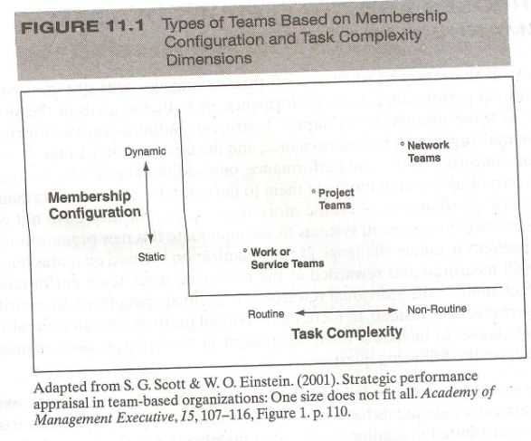

Slide 17
Principles of Team Performance Management
Basic principles of Team performance management:
Make sure your team is really a team:
  There are different types of teams.
  Before a team component is introduced in the performance management system, we need to make sure the organization has actual teams.

Slide 18
Principles of Team Performance Management (Contd.)
Make the investment to measure:
  Measuring team performance as is the case with measuring individual performance, takes time and effort.

Slide 19
Principles of Team Performance Management (Contd.)
Define measurement goals clearly:
  Defining how the data will be used is a decision that must be made before measures of team performance are designed.
Use a multi method approach to measurement:
  The measurement of team performance is complex.
  Thus, multiple methods and sources of data are often necessary.

Slide 20
Principles of Team Performance Management (Contd.)
Focus on process as well as outcomes:
  Behavioral process oriented measures as well as results are as useful for team performance management systems as for individuals.
Measuring long term changes:
  Although short term processes and results are easier to measure, it is important to also consider long term measures of performance.

Slide 21
Team Performance Management Process
Now let’s consider each of the component of the process when we design a system that includes team performance and let’s incorporate the six basic principles outlined in the previous slides into the various steps in the process.

Slide 22
Prerequisites
The first component of performance management process involves two prerequisites.
First, there is a need to have good knowledge of the organizations mission. This prerequisite is present regardless of whether there is an emphasis on team performance.

Slide 23
Prerequisites (Contd.)
Second, there is need to have a good knowledge of the job in question. In the case of individual jobs, a job analysis is conducted to determine the key components of a particular job: what task need to be done, how they are to be done and what knowledge , skills and abilities are needed to do them.

Slide 24
Prerequisites (Contd.)
There are KSAs that are especially conducive to team performance.
Examples include the following:
Communication:
  Giving and receiving constructive feed back, listening, and sharing information and ideas.
Decision making:
  Help the team make decision.

Slide 25
Prerequisites (Contd.)
Collaboration:
  Dealing with conflict effectively, committing to the team and its goals, valuing the diversity and experience of other team members, and sharing accountability.

Slide 26
Prerequisites (Contd.)
Team leadership:
  Taking on the role of team leader, including knowing how to extract the best out of the team
Self control:
  Keeping emotions under control and not displaying negative actions even when faced with opposition or even hostility from others.

Slide 27
Performance Planning
The second component of performance management process includes the consideration of results and behaviors.
In addition, performance planning involves the creation of developmental plan.
Each of these issues need to be considered at the team level, results expected of the team, behaviors expected of team members, and developmental objectives to be achieved by the team and its members.

Slide 28
Performance Planning (Contd.)
A discussion of results must include key team accountabilities, specific objectives for each key accountability and performance standards.
A discussion of behaviors need to include competencies.
Finally, the developmental plan includes a description of area that need improving and goals to be achieved in each area.

Slide 29
Performance Planning (Contd.)
The plan includes goals not only for the team as a whole, but also developmental objectives for individual performance that will benefit team performance.

Slide 30
Performance Execution
The third component of performance management process involves performance execution.
Autonomous teams are solely responsible for performance execution; how ever, when a team has a supervisor, then both the team and the supervisor share responsibility for performance execution.

Slide 31
Performance Execution (Contd.)
For example, team members need to be committed to goal achievement and should take a proactive role in seeking feedback from one another as well as from the supervisor.

Slide 32
Performance Execution (Contd.)
The supervisor also has some important responsibilities, including observing and documenting team performance and relative contribution of team members, updating the team on any change in the goals of the organization and providing resources and reinforcement so that team members will be motivated to succeed.

Slide 33
Performance Assessment
The fourth component of performance management process is performance assessment.
All team members must evaluate one another performance as well as the performance of the overall team.
Peer evaluation are a key component of the assessment stage because they lead to higher level of work load sharing, cooperation and performance.

Slide 34
Performance Assessment (Contd.)
Involvement of each team member in the evaluation process increases their ownership and commitment to the system.
Self appraisal also provide important information to be discussed during the performance review.
In the absence of self appraisal, it is often no clear to supervisors whether the team and its members have a real understanding of what is expected of them.

Slide 35
Performance Assessment (Contd.)
Three types of performance need to be assessed:
  Individual performance or task performance
  Individual performance or contextual performance
  Team performance as a whole.

Slide 36
Performance Dimensions
Team performance as a whole can be measured using the following four performance dimensions:
Effectiveness:
  This is the degree to which results satisfy team stakeholders including both internal and external customers.

Slide 37
Performance Dimensions (Contd.)
Efficiency:
  This is the degree to which internal team processes support the achievement of results, team growth and team member satisfaction.

Slide 38
Performance Dimensions (Contd.)
Learning and growth:
  This is the degree to which the team is able to learn new skills and improve performance over time.
  Specific measures can include innovation, documented learning, best practices and process involvement.

Slide 39
Performance Dimensions (Contd.)
Team members satisfaction:
  This is the degree to which team members are satisfied with their team membership. Specific measures can include team members perceptions regarding the extent to which team work contributes to their growth and personal well being.

Slide 40
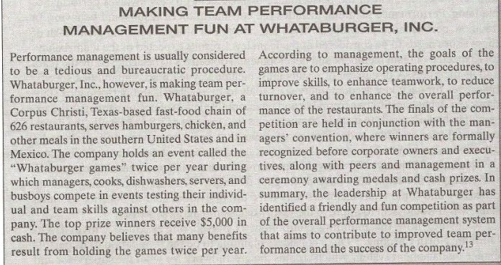

Slide 41
Performance Review
The fifth component of performance management process is the performance review, which takes place when the team members meet with the supervisor or manager to discuss how they have been working.
In organizations that are structured around autonomous teams, there may not be a supervisor or manager.
In that case, a team leader or representative would meet with a performance review board, which includes representatives from all teams.

Slide 42
Performance Review (Contd.)
At-least two meetings are needed. First, the supervisor meets with all members of team together.
The focus of this meeting is to discuss the overall team performance including results achieved by the team as a whole.
Information for this meeting comes from team members evaluating their collective performance, other teams evaluating the team in question, and the supervisors evaluation.

Slide 43
Performance Review (Contd.)
Second, the supervisor meets each team member individually.
The focus of this meeting is to discuss how the individual behaviors contributed to team performance.
Information for this meeting comes from individuals evaluating their own performance, peer ratings of the individuals performance, and the supervisors evaluation.

Slide 44
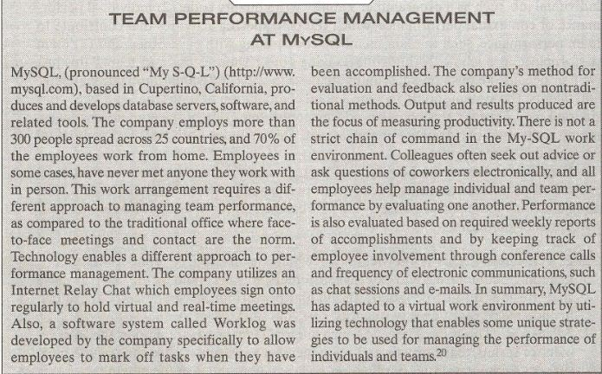

Slide 45
Performance Renewal and Re-contracting
The final component of performance management process involves renewal and re-contracting.
Essentially, this component is identical to the performance planning stage; however, performance renewal and re-contracting uses information gathered during the review period to make adjustments as needed.
For example, some new key accountabilities and competencies may be included.
Conversely, some goals may have to be adjusted either upward or downward.

Slide 46
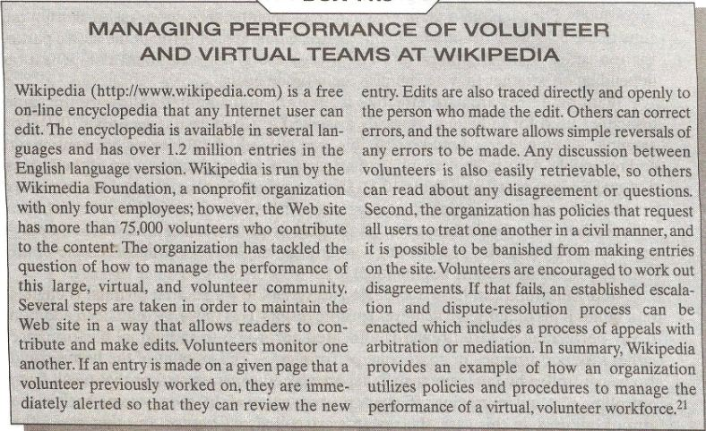

Slide 47
Rewarding Team Performance
Teams are a pervasive fact of organizational life.
Because of this, organizations that implement performance management systems that include team performance must redesign their reward systems to reward team performance.

Slide 48
Rewarding Team Performance (Contd.)
Organizations can reward team performance in a ways similar to those in which they reward individual performance.

Slide 49
Rewarding Team Performance (Contd.)
Team based rewards are effective if they are implemented following the same principles used for individual rewards discussed previously.
For example, all employees should be eligible, and reward should be visible, contingent and reversible.

Slide 50
Rewarding Team Performance (Contd.)
Also, in implementing team rewards , we need to be aware of the factors that make rewards fail.
For example, rewards given to team members based on the extent to which they cooperate with each other are likely to enhance accuracy but not necessarily speed.

Slide 51
Rewarding Team Performance (Contd.)
An organization can have variable pay system in which an individual is eligible for a bonus if his or her team achieves specific results.
This reward would be in addition to any performance based rewards allocated according to individual performance.

Slide 52
Rewarding Team Performance (Contd.)
The amount of bonus could also be controlled by team: teams that are able to generate savings that result from controlling costs and improving efficiency may see some of this money come back in the form of bonuses.

Slide 53
Rewarding Team Performance (Contd.)
In this case, the rewards are called self funded.
In other cases, the bonus can come from a company wide pool that varies each year, based on overall organizational performance.

Slide 54
Summary of Today’s Lecture
CHAPTER 11: MANAGING TEAM PERFORMANCE
Definition and Importance of Teams
Popularity of Teams
Team Performance
Conditions necessary for Team Performance
Types of Teams
Principles of Team Performance Management
Team Performance Management Process
Rewarding Team Performance

Slide 55
Thank You

