Slide 1
HRM-755
PERFORMANCE MANAGEMENT
Session: Three
OSMAN BIN SAIF

Slide 2
Summary of Previous Lecture
Disadvantages / Dangers of poorly implemented PM systems
Case study
Reward Systems
Types of Return
Aims and Role of PM system
Characteristics of Ideal PM system
Case Study- PM system

Slide 3
Agenda of Today’s Lecture
Performance management Process
  Components of Performance Management process
    Pre-requisites
    Performance Planning
  Implementation of Performance Management process

Slide 4
Performance management process
“In theory, the Performance Review process can be thought of a positive interaction between a coach and an employee, working together to achieve maximum performance . In reality, its more like finding a dead squirrel in your backyard and realizing the best solution is to fling it into your neighbors roof”.
  --SCOTT ADAMS

Slide 5
Performance management process (Contd.)
Performance management is an ongoing process.
PM does not take place just once a year, it is a continuous process including several components.
These components are closely related to each other, and poor implementation of any of the component has a negative impact on the performance management system as a whole.

Slide 6
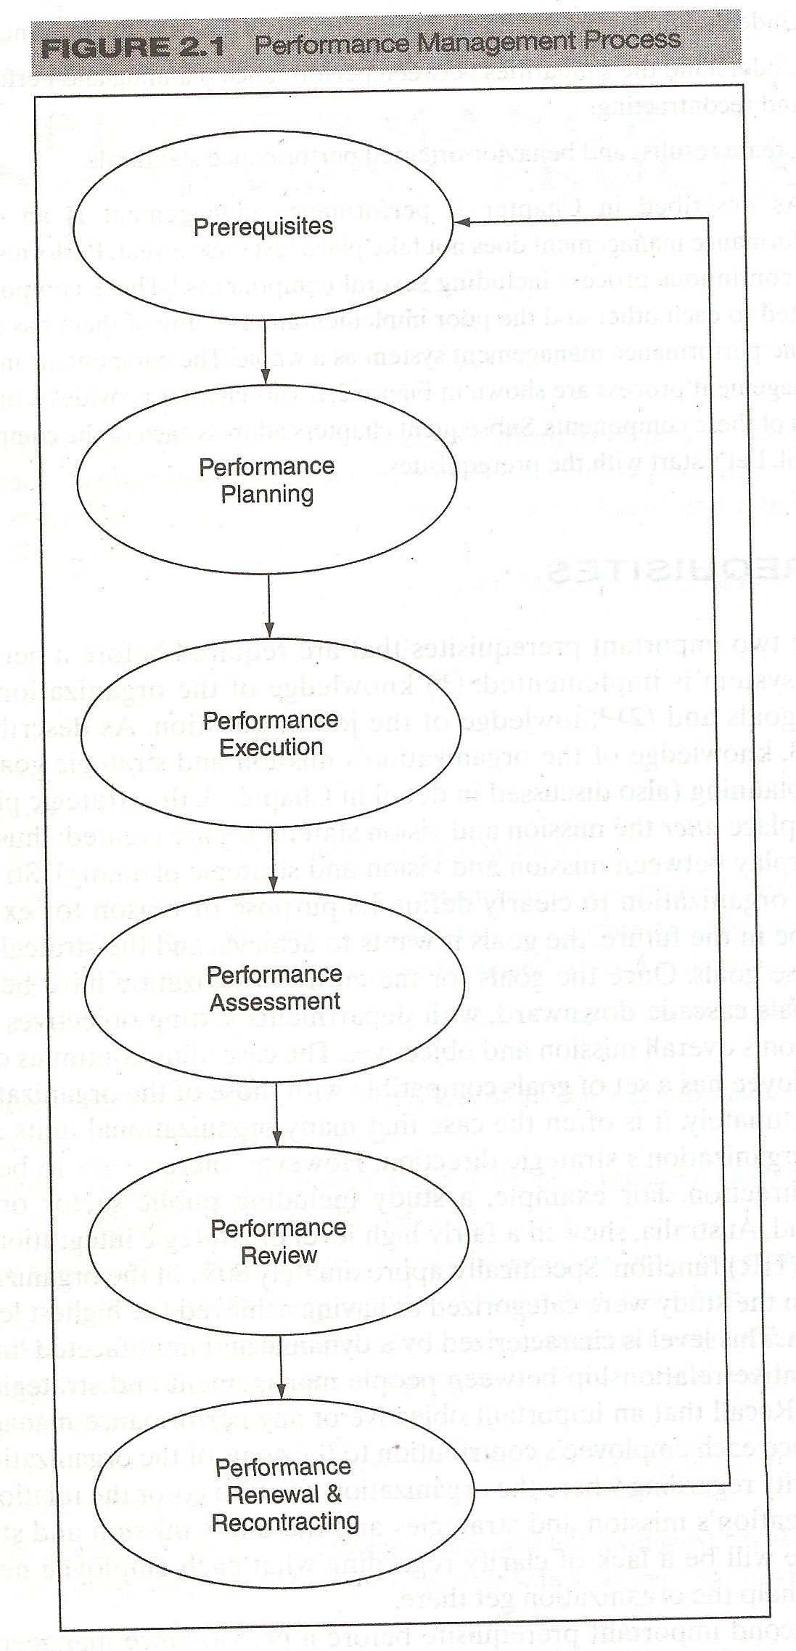
These are the components of a Performance Management Process.

Slide 7
Prerequisites
There are two main prerequisites that are required before a performance management system is implemented
Knowledge of organizations mission and strategic goals and
Knowledge of job in question

Slide 8
Prerequisites (Contd.)
PRE-REQUISITE 1
  Knowledge of organizations mission and strategic goals is a result of strategic planning
  Strategic planning allows an organization to clearly define it purpose or reason for existing, where it wants to be in future, the goals it wants to achieve and the strategies it will use to attain these goals.

Slide 9
Prerequisites (Contd.)
  Once the goals for the entire organization has been established, similar goals cascade downward, with departments setting objectives to support the organizations overall mission and objectives.
  The cascading continues downward until each employee has a set of goals compatible with those of the organization.

Slide 10
Prerequisites (Contd.)
PRE-REQUISITE 2
  The second important pre-requisite before a performance management system is implemented is to understand the job in question.
  This is done through job analysis.
  Job analysis is a process of determining the key components of a particular job, including activities, tasks, products, services and processes.

Slide 11
Prerequisites (Contd.)
  A job analysis is a fundamental pre-requisite of any performance management system.
  Without a job analysis, it is difficult to understand what constitutes the required duties for a particular job.
  If we don’t know what an employee is supposed to do on the job, we won’t know what needs to be evaluated and how to do so.
  As a result of the job analysis, we obtain information regarding the tasks carried out and the knowledge, skills and abilities (KSAs) required of a particular job.

Slide 12
Prerequisites (Contd.)
KSA refers to;
K- (knowledge)
  Information needed to perform the work
S- (skills)
  Required attributes that are usually acquired by having done the work in the past
A- (ability)
  The physical, emotional, intellectual and psychological aptitude to perform work.

Slide 13
Prerequisites (Contd.)
The tasks and KSAs needed for the various jobs are typically presented in the form of job description, which summarizes the job duties, needed KSAs and working conditions for a particular job.
CASE- Example– Trailer Truck Driver Job Description.

Slide 14
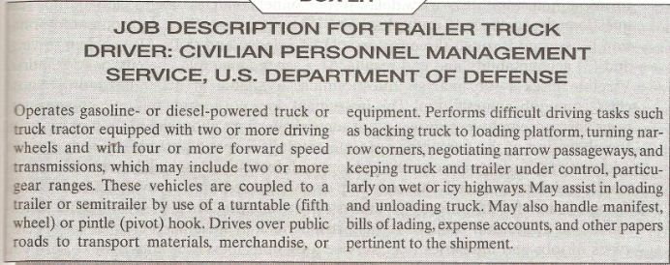

Slide 15
Prerequisites (Contd.)
This job description includes information about;
  What tasks are to be performed (e.g operation of a specific type of truck)
  Information about the needed
    knowledge (e.g manifests, bill of lading)
    Skills (e.g keeping truck and trailer under control, particularly in difficult whether conditions)
    Abilities (e.g physical and spatial abilities needed to turn narrow corners)

Slide 16
Prerequisites (Contd.)
Job Analysis:
  Job analysis can be conducted using observation, off-the-shelf questionnaires or interviews.
  Alternatively if the job is yet to be created, data can be gathered from individuals responsible for creating the job or those who will supervise the individuals in the new position.

Slide 17
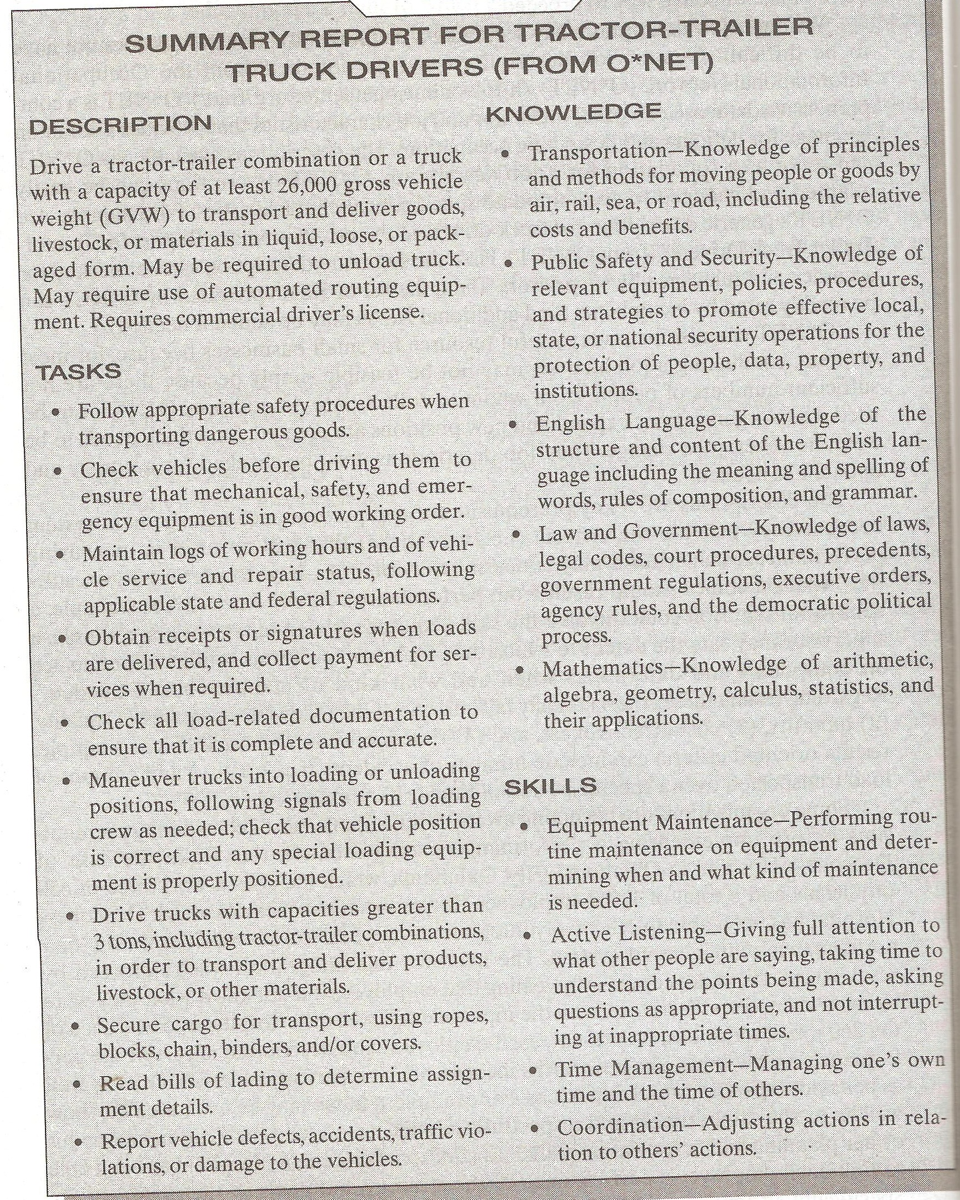

Slide 18
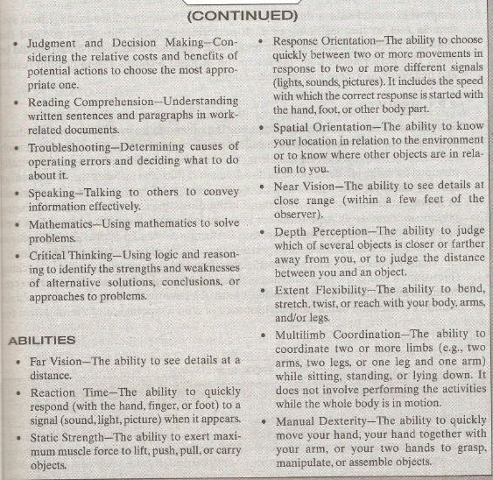

Slide 19
Performance planning
Employees should have thorough knowledge of the performance management system. In fact, at beginning of each performance cycle the supervisor and the employee meet to discuss, and agree upon, what needs to be done and how it should be done.

Slide 20
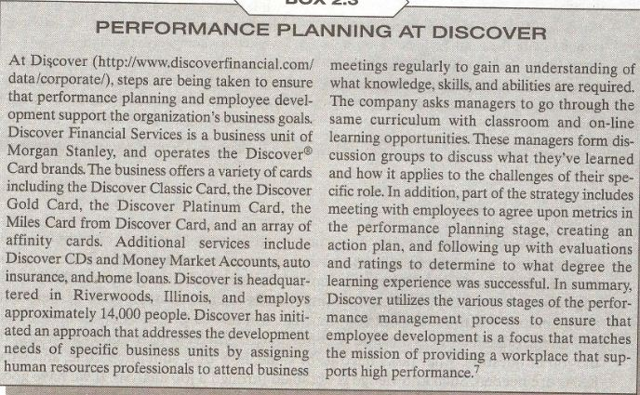

Slide 21
Performance planning (Contd.)
The performance planning includes;
  a consideration of both results
  and behaviors,
  as well as a developmental plan.

Slide 22
Results
Results refer to what need to be done or the outcomes an employee must produce.
A consideration of results needs to include the key accountabilities, or broad areas of a job for which the employee is responsible for producing results.

Slide 23
Results (Contd.)
This information is typically obtained from the job discussion.
A discussion of results also includes specific objectives that the employee will achieve as a part of each accountability.
Objectives are statements of important and measurable outcomes.

Slide 24
Results (Contd.)
Finally, discussing results also means discussing performance standards.
A performance standard is a yardstick used to evaluate how well employees have achieved each objective.
Performance standards provide information about acceptable and unacceptable performance.

Slide 25
Results (Contd.)
Example:-
  Consider the job of a university professors.
  Two key accountabilities are;
    Teaching
    Research
  An objective for teaching could be “to obtain a student evaluation of teaching performance on a point scale.

Slide 26
Results (Contd.)
  An objective for research could be ‘to publish two articles in scholarly referred journals per year”.
  Performance standard could be “to obtain a student evaluation of teaching performance of at-least 2 on a 4 point scale”
  And to publish at least one article in scholarly referred journals per year.
Thus objective is desired level of performance, where as the standard is usually a minimum acceptable level of performance.

Slide 27
Behaviors
Its is important to measure results, an exclusive emphasis on results can give a skewed or incomplete picture of employees performance.
Results from a survey indicated that, in addition to sales figure, salespeople would like to be appraised on such behavioral criteria as communications skills and product knowledge.

Slide 28
Behaviors (Contd.)
A consideration of behavior includes discussing competencies, which are measurable clusters of KSAs that are critical in determining how results will be achieved.
Examples of competencies are custom service, written or oral communication, creative thinking, and dependability.

Slide 29
Behaviors (Contd.)
Example:-
  Returning to the same example of professor, assume that teaching is done online and numerous technology related problems exist, so that the resulting teaching evaluations are deficient.
  This is an example of situation in which behaviors should be given more importance than results.
  In this situation the evaluation could include competencies such as online communication skills (e,g in the chat room).

Slide 30
Development plan
An important step before the review cycle begins is for the supervisor and employee to agree on a development plan.
At a minimum, this plan should include identifying areas that need improvement and setting goals to be achieved in each area.
Development plan usually include both results and behaviors.

Slide 31
Development plan (Contd.)
Performance plan includes the consideration of results and behaviors and the developmental plan.
A discussion of results need to include;
  key accountabilities ,(i.e broad area for which an employee is responsible)
  specific objectives for each key accountability,(i.e goals to be reached)
  and performance standards.(i.e what constitutes acceptable and unacceptable levels of performance)

Slide 32
Development plan (Contd.)
A discussion of behaviors needs to include competencies.(i.e clusters of Knowledge Skills Abilities)
Finally the developmental plan includes a description of areas that need improving and goals to be achieved in each area.

Slide 33
Implementation of PMS
Once the prerequisites are met and the planning phase has been completed, we are ready to begin the implementation of the performance management system.
This includes;
  Performance execution
  Performance assessment
  Performance review and recontracting

Slide 34
Summary of Today’s Lecture
Performance management Process
  Components of Performance Management process
    Pre-requisites
    Performance Planning
  Implementation of Performance Management process

Slide 35
Thanks

