Slide 1
HRM-755
PERFORMANCE MANAGEMENT
LECTURE: TWENTY SIX
OSMAN BIN SAIF

Slide 2
Summary of Previous Lecture
Development Activities
  Ways of achieving objectives of developmental plans
Direct Supervisors Role
360 Degree Feedback System

Slide 3
Agenda for Today’s Lecture
360 Degree Feedback System
Internet- based 360-degree systems
Check Point – 360-degree System Case Analysis

Slide 4
360 Degree Feedback System
The 360 degree feedback system has become a preferred tool for helping employees, particularly those in supervisory roles, improve performance by gathering information on their performance from different groups.
These systems are called 360 degree systems because information is gathered from individuals all around the employee.

Slide 5
360 Degree Feedback System (Contd.)
Specifically, information on what performance dimensions could be improved is gathered from supervisors, peers, customers, and subordinates.
This information is usually collected anonymously to minimize rating inflation.

Slide 6
360 Degree Feedback System (Contd.)
Employees also rate themselves on the various performance dimensions and compare self perceptions with the information provided by others.
A gap analysis is conducted to examine the areas for which there are large discrepancies between self perception and the perception of others.

Slide 7
360 Degree Feedback System (Contd.)
A 360 degree feedback system reports usually includes information on dimensions for which there is agreement that further development is needed.
This information is used to create a developmental plan as described earlier.

Slide 8
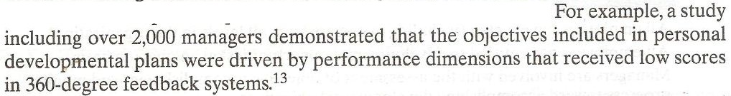

Slide 9
360 Degree Feedback System (Contd.)
The 360 degree feedback system is most helpful when it is used for developmental purposes only and not for administrative purposes.
This is because people are more likely to be honest if they know the information will be used to help the individual improve and not to punish or to reward him or her.

Slide 10
360 Degree Feedback System (Contd.)
The 360 degree feedback system is usually implemented for individuals who have supervisory roles, but these systems can be used for all positions within the organization.

Slide 11
360 Degree Feedback System (Contd.)
Many organizations take advantage of technology to minimize the amount of paperwork and time involved in collecting such data.
The internet is becoming a pervasive medium by which to administer 360 degree feedback systems.

Slide 12
360 Degree Feedback System (Contd.)
The service provider , usually an outside consulting firm, sends an email message with instructions and time frames for assessment to each employee to be rated.

Slide 13
360 Degree Feedback System (Contd.)
Then employees can assess a secure website and after entering their personal IDs and password, create individual lists of raters who will be asked to provide feedback about their performance.

Slide 14
360 Degree Feedback System (Contd.)
To make things easier, the employee can even select names from a drop-down menu that includes company managers and employees.
Allowing employees to select the raters who will provide information on their performance and is likely to increase acceptance of the results.

Slide 15
360 Degree Feedback System (Contd.)
The raters selected are asked to visit the web site and to provide performance feedback within a certain time period.
After the data have been collected electronically, it is fairly easy to compile the results and e-mail a report to the employee who has been evaluated.

Slide 16
360 Degree Feedback System (Contd.)
Some internet based systems also provide on line training for raters on how to complete the feedback forms in helpful and constructive ways.
Some systems even include features that allow for the detection of rating errors.

Slide 17
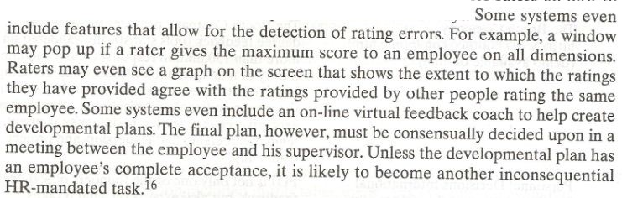

Slide 18
360 Degree Feedback System (Contd.)
Feedback Reports can include graphs showing the areas in which employee’s perception differs the most from the perceptions of other raters.
They can also show average scores, across sources of information, so that the areas that need improvement are readily identified.

Slide 19
360 Degree Feedback System (Contd.)
The resulting report can be e-mailed automatically to the employee and his supervisor so that both have an opportunity to review the results before meeting to create a development plan.

Slide 20
Internet- based 360-degree systems
A trend adopted by software companies that offer Internet- based 360-degree systems is to offer a bundle of systems including 360-degree feedback together with;
  learning management,
  Compensation
  And even recruiting
  And succession planning.

Slide 21
Internet- based 360-degree systems (Contd.)
These integrative applications, usually called “talent management” systems, allow organizations to manage data about employees in a systematic and coordinated way.

Slide 22
Internet- based 360-degree systems (Contd.)
Such integrative software applications allow organizations to create an inventory of their human capital and better understand their strengths and weaknesses at the organizational level.

Slide 23
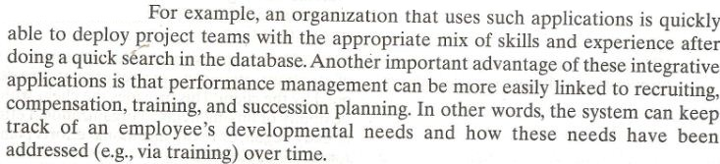

Slide 24
Internet- based 360-degree systems (Contd.)
The following cases provides informations on organizations which offer Internet- based 360-degree feedback systems and a brief description of their products.
It also includes information on whether a demonstration of it is available on-line.

Slide 25
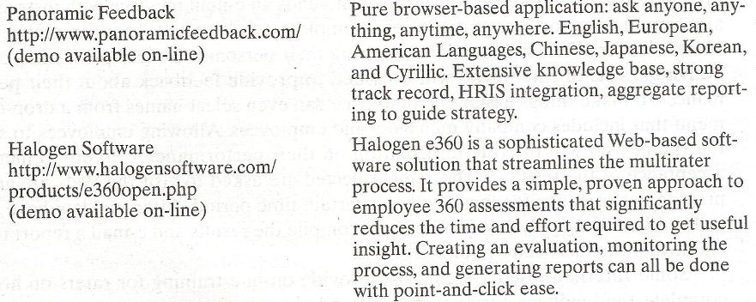

Slide 26
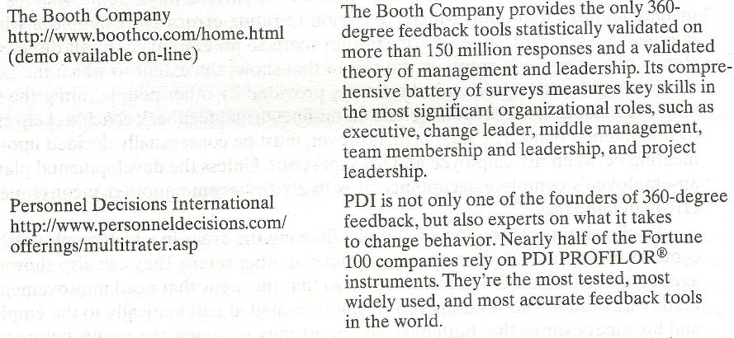

Slide 27
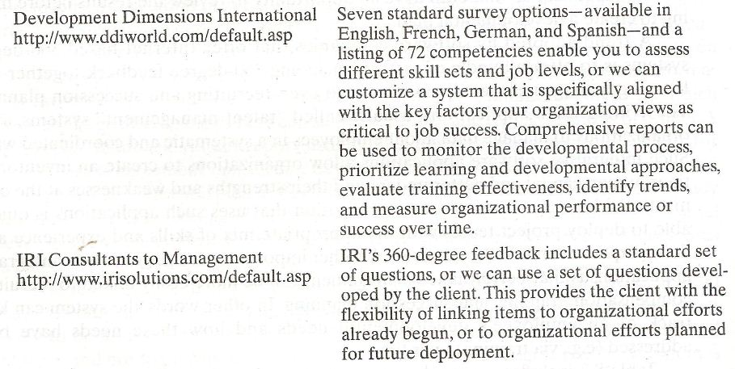

Slide 28
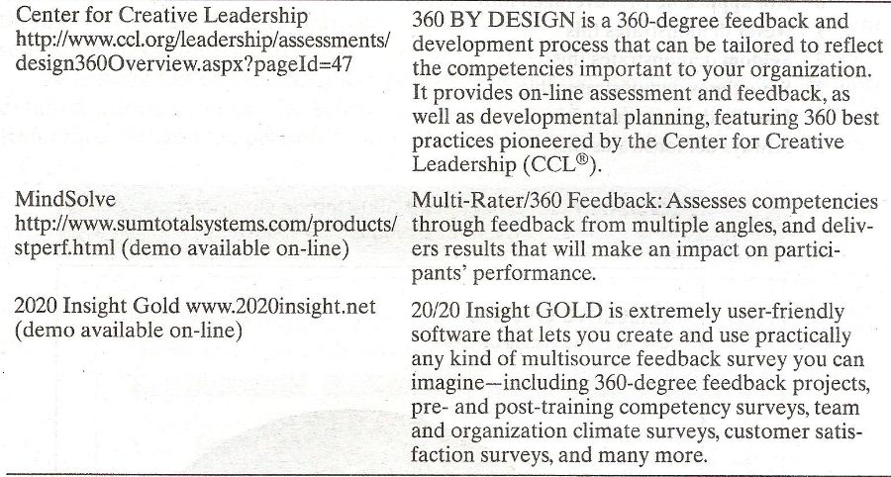

Slide 29
Check Point – 360-degree System Case Analysis

Slide 30
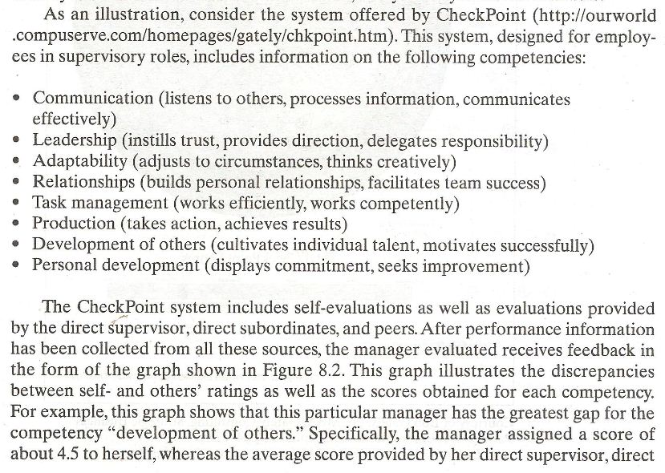

Slide 31
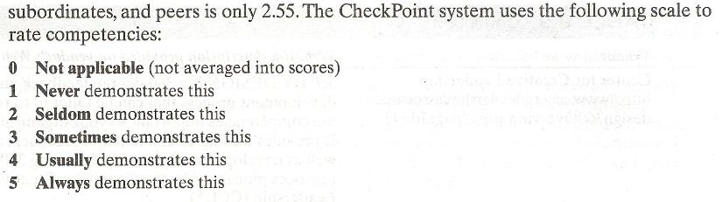

Slide 32
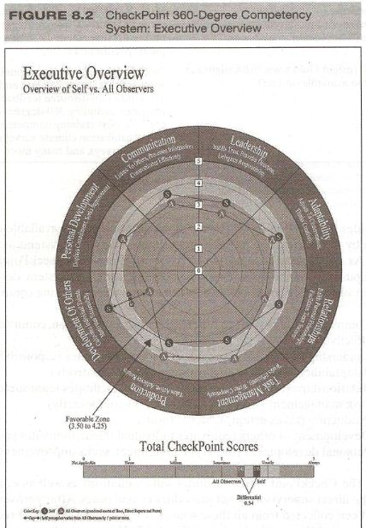

Slide 33
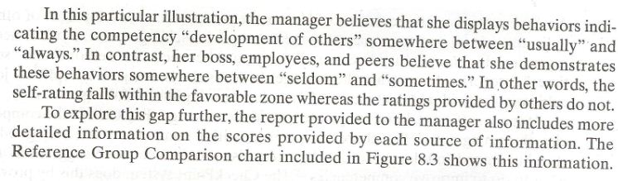

Slide 34
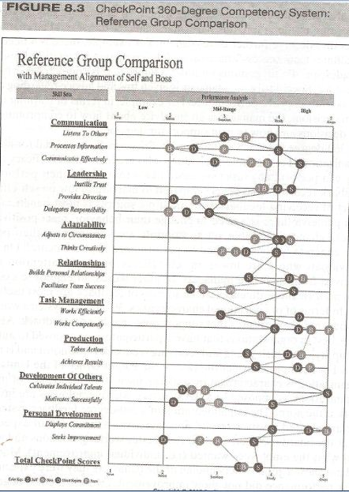

Slide 35
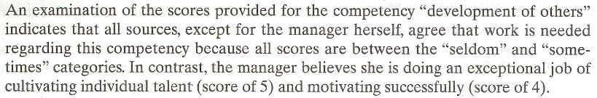

Slide 36
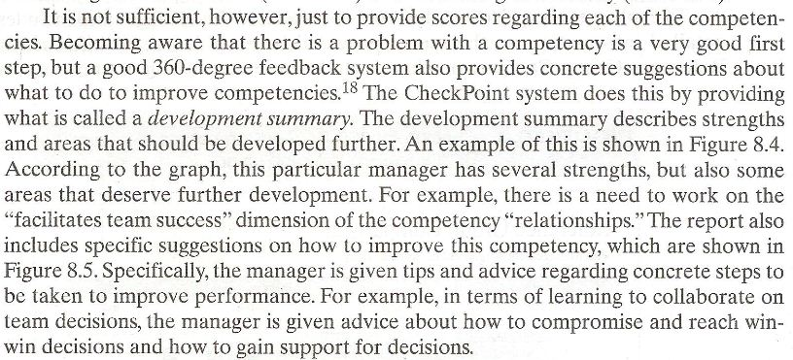

Slide 37
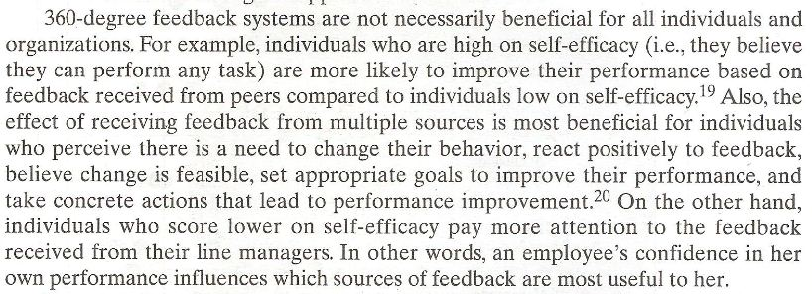

Slide 38
Summary of Today’s Lecture
360 Degree Feedback System
Internet- based 360-degree systems
Check Point – 360-degree System Case Analysis

Slide 39
Thank You

