Slide 1
HRM-755
PERFORMANCE MANAGEMENT
LECTURE: TWENTY FIVE
OSMAN BIN SAIF

Slide 2
Summary of Previous Lecture
SECTION 3; EMPLOYEE DEVELOPMENT
CHAPTER 8- PERFORMANCE MANAGEMENT AND EMPLOYEE DEVELOPMENT
  Personal Developmental Plan
  Objectives of Developmental Plan
  Content of Developmental Plan
  Development Activities

Slide 3
Agenda for Today’s Lecture
Development Activities
  Ways of achieving objectives of developmental plans
Direct Supervisors Role
360 Degree Feedback System

Slide 4
Developmental Activities
There are several ways through which employees can reach the objectives stated in their developmental plans. Including:
On the job training:
  Employees are paired with a coworker or supervisor who designs a formal on the job training course.
  The design of these mini training programs includes how many hours a day or week training will take place and specific learning objectives.

Slide 5
Developmental Activities (Contd.)
Courses:
  Some large organizations such as McDonalds, Motorola, Capgemini, Ernst and young, and others, offer in house courses given at their own corporate universities.
  Other organizations may provide tuition reimbursements.
  Given the proliferation of online courses, employees have a wide variety of options from which to choose.

Slide 6
Developmental Activities (Contd.)
Self guided reading:
  An employee can read books and study other resources on her own.
  Once again it is important that an objective be set regarding what will be read and within what time frame, as well as what measures will be used to assess whether learning has taken place.

Slide 7
Developmental Activities (Contd.)
Mentoring:
  Many organizations have mentoring programs.
  In general terms, mentoring is a developmental process that consist of a one on one relationship between a senior (mentor) and junior (protégé) employee.
  For such programs to be successful, it is best to allow the mentor and protégé to choose each other rather than arbitrarily assigning who will be mentoring whom.

Slide 8
Developmental Activities (Contd.)
  In general mentors serve as role models and teach protégé what it takes to succeed in the organization.
  In more specific terms, mentors can help protégé gain targeted skills.

Slide 9
Developmental Activities (Contd.)
Attending a conference:
  Another way to acquire required knowledge and skill is to sponsor an employees attendance at a conference or trade show.
  It is useful to require that the employee provide a written report, or even deliver a presentation, upon returning from the conference.
  In this way it is easier to assess what has been learned and in addition, the knowledge gained can be shared with other organizational members.

Slide 10
Developmental Activities (Contd.)
Getting a degree:
  Some organizations provide tuition reimbursement benefits for their employee to obtain additional degrees or certifications.
  For Example; the organization can sponsor an employee’s MBA program or an employee’s taking a course with the goal of earning a certification designation (e.g Certified Novell Administrator, Professional in Human Resources)

Slide 11
Developmental Activities (Contd.)
  In most cases, employees commit to continuing the relationship with their employer for a pre-specified amount of time after completing the degree.
  If the employee leaves the organization before this time frame, he may have to reimburse the organization for the cost of his education.

Slide 12
Developmental Activities (Contd.)
Job rotation:
  Another way to gain necessary skills is to be assigned to different job on a temporary basis.
  This is the model followed in medical profession in which residents have to rotate across specialty areas for several months.
  For example; residents may be required to rotate across the various emergency medicine services for a x number of months period.

Slide 13
Developmental Activities (Contd.)
Temporary assignments:
  A less systematic rotation system includes the opportunity to work on challenging temporary assignment.
  This allows employees to gain specific skills within a limited time frame.

Slide 14
Developmental Activities (Contd.)
Membership or leadership role in profession or trade organization:
  Some employer sponsor membership in professional or trade organizations,
  Such an organization distributes publications to its members and also holds informal and formal meetings in which employee have an opportunity to learn about best practices and other useful information for their jobs.

Slide 15
Developmental Activities (Contd.)
  For example; this could include The Society for Human Resource Management or The Chartered Institute of Personnel and Development for Human Resources Professionals.
  Also, presentation, communication, planning and other skills can be learned while serving in a leadership role in a volunteer organization outside of work.

Slide 16
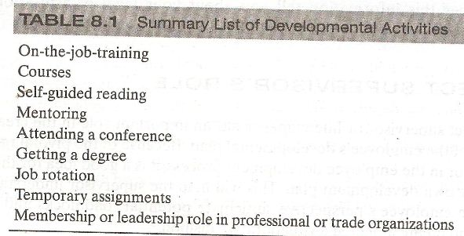

Slide 17
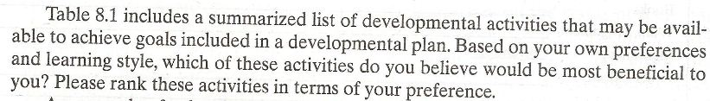

Slide 18
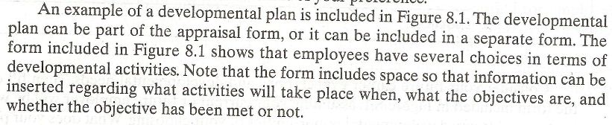

Slide 19
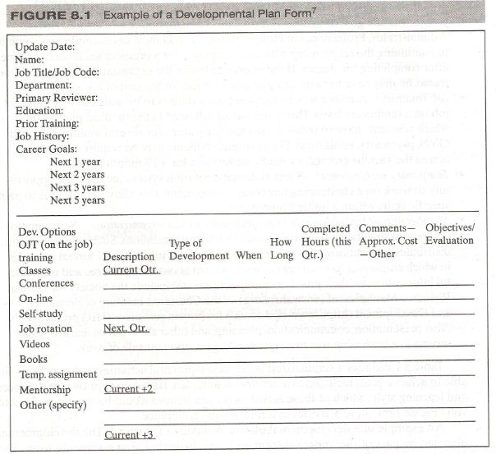

Slide 20
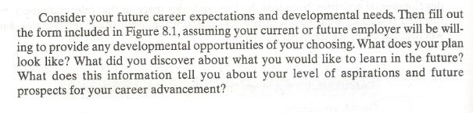

Slide 21
Direct Supervisors Role
The direct supervisor or the line manager has an important role in the creation and completion of the employees developmental plan.
Because of a pivotal role of the direct supervisor in the employee developmental process, it is a good idea for the supervisor to have her own developmental plan.

Slide 22
Direct Supervisors Role (Contd.)
This will help the supervisor understand the process from the employees prospective, anticipate potential roadblocks and defensive attitudes, and create a plan in a collaborative fashion.

Slide 23
Direct Supervisors Role (Contd.)
First, the supervisor needs to explain what would be required for the employee to achieve the desired performance.
This information needs to be provided together with information on the probability of success if the employee completes the suggested steps.

Slide 24
Direct Supervisors Role (Contd.)
Second, the supervisor has a primary role in referring the employee to appropriate developmental activities that can assist the employee in achieving the goals.
This include helping the employee select a mentor, appropriate reading resources, courses, and so forth.

Slide 25
Direct Supervisors Role (Contd.)
Third, the supervisor reviews and make suggestions about the developmental objectives.
Specifically, the supervisor helps assure the goals are achievable, specific and doable.

Slide 26
Direct Supervisors Role (Contd.)
Fourth, the supervisor has primary responsibility for checking in the employees progress towards achieving the developmental goals.
For example;
  The supervisor can remind the employee of due dates and revise goals if needed.

Slide 27
Direct Supervisors Role (Contd.)
Finally, the supervisor needs to provide reinforcements so that employee will be motivated to achieve the developmental goals.
Reinforcements can be extrinsic and include rewards such as bonuses and additional benefits, but reinforcements can also include the assignment of more challenging and interesting work that takes advantage of the new skills learned.

Slide 28
Direct Supervisors Role (Contd.)
Supervisors themselves need to be motivated to perform functions that will support the employees completion of their developmental objectives.
For this to happen, supervisors must be rewarded for doing a good job in helping their employees develop.

Slide 29
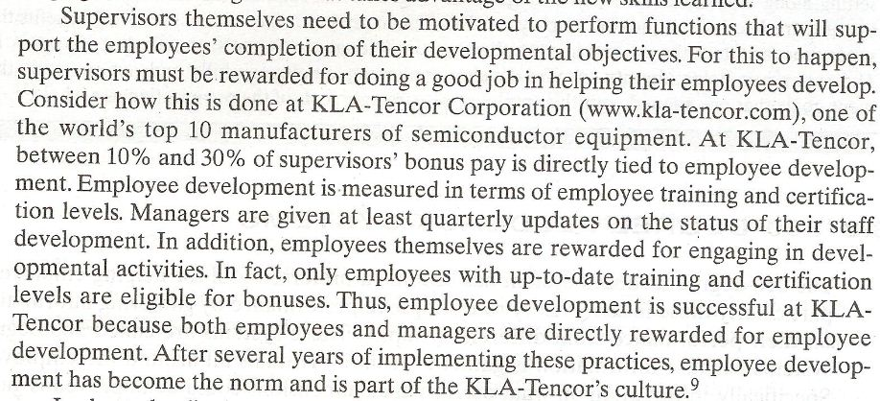

Slide 30
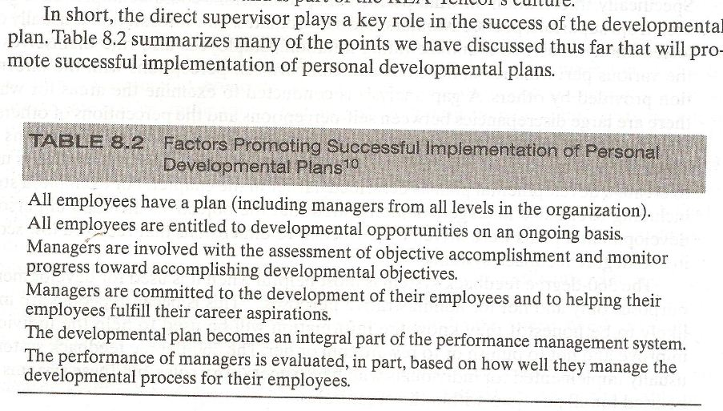

Slide 31
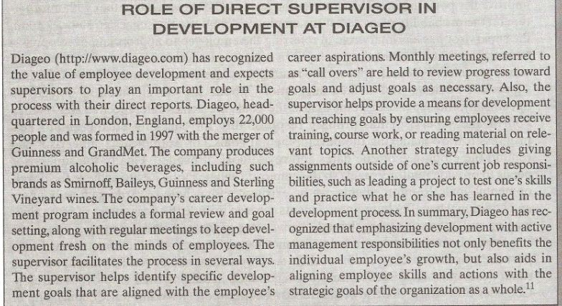

Slide 32
360 Degree Feedback System
The 360 degree feedback system has become a preferred tool for helping employees, particularly those in supervisory roles, improve performance by gathering information on their performance from different groups.
These systems are called 360 degree systems because information is gathered from individuals all around the employee.

Slide 33
360 Degree Feedback System (Contd.)
Specifically, information on what performance dimensions could be improved is gathered from supervisors, peers, customers, and subordinates.
This information is usually collected anonymously to minimize rating inflation.

Slide 34
360 Degree Feedback System (Contd.)
Employees also rate themselves on the various performance dimensions and compare self perceptions with the information provided by others.
A gap analysis is conducted to examine the areas for which there are large discrepancies between self perception and the perception of others.

Slide 35
360 Degree Feedback System (Contd.)
A 360 degree feedback system reports usually includes information on dimensions for which there is agreement that further development is needed.
This information is used to create a developmental plan as described earlier.

Slide 36
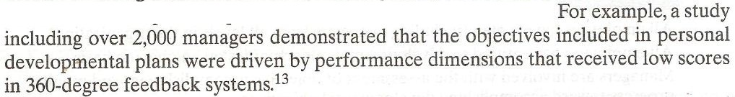

Slide 37
360 Degree Feedback System (Contd.)
The 360 degree feedback system is most helpful when it is used for developmental purposes only and not for administrative purposes.
This is because people are more likely to be honest if they know the information will be used to help the individual improve and not to punish or to reward him or her.

Slide 38
360 Degree Feedback System (Contd.)
The 360 degree feedback system is usually implemented for individuals who have supervisory roles, but these systems can be used for all positions within the organization.

Slide 39
360 Degree Feedback System (Contd.)
Many organizations take advantage of technology to minimize the amount of paperwork and time involved in collecting such data.
The internet is becoming a pervasive medium by which to administer 360 degree feedback systems.

Slide 40
360 Degree Feedback System (Contd.)
The service provider , usually an outside consulting firm, sends an email message with instructions and time frames for assessment to each employee to be rated.

Slide 41
360 Degree Feedback System (Contd.)
Then employees can assess a secure website and after entering their personal IDs and password, create individual lists of raters who will be asked to provide feedback about their performance.

Slide 42
360 Degree Feedback System (Contd.)
To make things easier, the employee can even select names from a drop-down menu that includes company managers and employees.
Allowing employees to select the raters who will provide information on their performance and is likely to increase acceptance of the results.

Slide 43
360 Degree Feedback System (Contd.)
The raters selected are asked to visit the web site and to provide performance feedback within a certain time period.
After the data have been collected electronically, it is fairly easy to compile the results and e-mail a report to the employee who has been evaluated.

Slide 44
Summary of Today’s Lecture
Development Activities
  Ways of achieving objectives of developmental plans
Direct Supervisors Role
360 Degree Feedback System

Slide 45
Thank You

