Slide 1
HRM-755
PERFORMANCE MANAGEMENT
LECTURE: TWENTY THREE
OSMAN BIN SAIF

Slide 2
Summary of Previous Lecture
Possible Errors in Ratings
Frame of Reference Training
Steps in designing a Frame of Reference Training
Behavior Observational Training
Self Leadership Training
Steps in designing a Self Leadership Training
Self Efficacy Training

Slide 3
Agenda for Today’s Lecture
Self Efficacy Training
Summary Raters Errors
Pilot Testing
Ongoing Monitoring and Evaluation

Slide 4
Self- Efficacy Training
A related type of training program is labelled self- efficacy training for raters (SET-R).
The goal of this type of training is to decrease a rater’s discomfort with the interpersonal demands of performance management and to enhance a manager’s belief that he has the necessary skills to manage employee’s performance.

Slide 5
Self- Efficacy Training (Contd.)
The self efficacy training for raters includes the following steps:
Raters watch a video tape of a vicarious success experience including a manager conducting a successful performance review meeting with a subordinates.

Slide 6
Self- Efficacy Training (Contd.)
Raters engage in a follow up discussion of the specific behaviors observed in the videotape that contributes to the meeting success.
This follow up discussion of dual goals of ;
  Focusing the raters attention on the techniques used by the videotaped manager to convey negative feedback
  Allowing for an opportunity to persuade raters that they too would be able to conduct such a successful meeting.

Slide 7
Self- Efficacy Training (Contd.)
Raters participate in a role play exercise that requires providing feedback to an employee. This role play exercise is repeated until raters demonstrate an appropriate level of mastery.

Slide 8
Raters Errors
In summary raters are likely to make both intentional and unintentional errors when providing performance information.

Slide 9
Raters Errors (Contd.)
Intentional errors are largely due to motivational issues.
In some cases raters are see more benefit in distorting ratings than in providing accurate information.

Slide 10
Raters Errors (Contd.)
Unintentional errors are largely due to cognitive biases that are the product of the complex tasks of observing, encoding, storing and retrieving performance information.

Slide 11
Raters Errors (Contd.)
Through the combined use of good communication plan and various training programs, ratings errors can be substantially minimized.

Slide 12
Raters Errors (Contd.)
Regarding the communication plan, it is important that it include convincing reasons that it is more advantageous to provide accurate than inaccurate performance information.

Slide 13
Raters Errors (Contd.)
Regarding training programs, these often focus on describing the errors that raters usually make (RET programs).

Slide 14
Raters Errors (Contd.)
In addition they should allow raters to generate a common frame of reference to be used in evaluating performance as well as offer raters tools to improve observation and memory skills and help mitigate the discomfort generated by the interpersonal demands of the performance management process.

Slide 15
Raters Errors (Contd.)
FOR training is particularly beneficial when performance measurement emphasizes behaviors.

Slide 16
Raters Errors (Contd.)
On the other hand BO training is particularly beneficial when performance measurement emphasizes results because raters learn not only how to observe behaviors but also how these behaviors are linked to results.

Slide 17
Pilot Testing
Before the performance management system is implemented formally, it is a good idea to test a version of the entire system so that adjustments and revisions can be made as needed.

Slide 18
Pilot Testing (Contd.)
In pilot testing of the system, evaluations are not recorded in the employees files, however, the system is implemented in its entirety from beginning to end, including all the steps that would be included if the system had actually been implemented.

Slide 19
Pilot Testing (Contd.)
In other words;
  Meetings take place between manager and employee.
  Performance data are gathered
  Developmental plans are designed
  And feedback is provided.

Slide 20
Pilot Testing (Contd.)
The most important aspect of the pilot test is that all the participants maintain records noting any difficulties they encountered, ranging from problems with the appraisal form and how performance is measured to the feedback is received.

Slide 21
Pilot Testing (Contd.)
The pilot test allows for the identification and early correction of any flaws before the system is implemented throughout the organization.

Slide 22
Pilot Testing (Contd.)
We should not assume that the performance management system will necessarily be executed or that it will produce the anticipated results.

Slide 23
Pilot Testing (Contd.)
The pilot testing allows us to gain information from the perspective of the system user on how well the system works, to learn about any difficulties and un foreseen obstacles, to collect recommendation on how to improve all aspects of the system.

Slide 24
Pilot Testing (Contd.)
An important decision is to be made is the selection of group of employees with whom the system will be tested.
In choosing this group, we need to understand that the managers who will be participating should be willing to invest the resources required to do the pilot test.

Slide 25
Pilot Testing (Contd.)
Pilot test provide crucial information to be used in improving the system before it is actually put in place.
Pilot testing the system can provide huge savings and identify potential problems before they become irreversible and the credibility of system is ruined permanently.

Slide 26
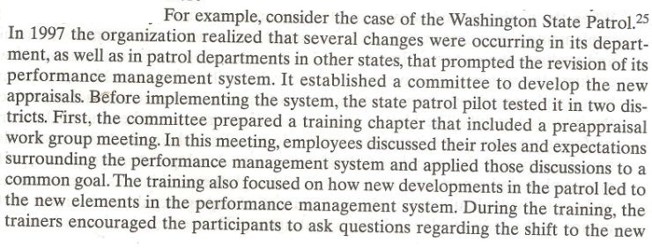

Slide 27
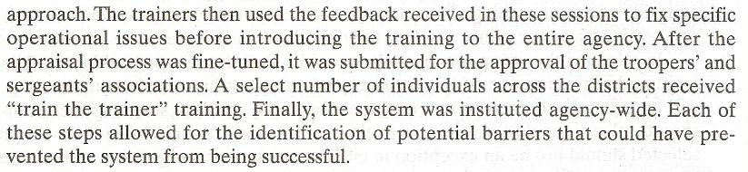

Slide 28
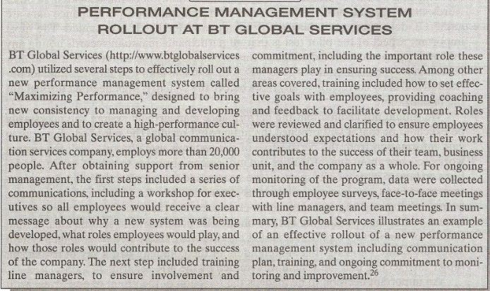

Slide 29
Ongoing Monitoring and Evaluation
When the testing is over and the performance management system has been implemented organization wide, it is important to use clear measurements to monitor and evaluate the system.

Slide 30
Ongoing Monitoring and Evaluation (Contd.)
In a nutshell, a decision is to be made about how to evaluate the systems effectiveness, how to evaluate the extent to which the system is being implemented as planned, and how to evaluate the extent to which it is producing the intended results.

Slide 31
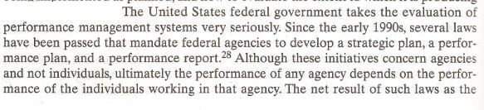

Slide 32
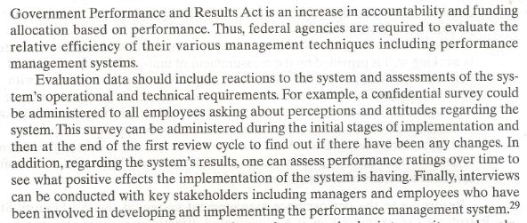

Slide 33
Ongoing Monitoring and Evaluation (Contd.)
Several additional measures can be used on a regular basis to monitor an evaluate the system:
Number of individuals evaluated:
  One of the most basic measure is to assess the number of employees who are actually participating in the system

Slide 34
Ongoing Monitoring and Evaluation (Contd.)
Distribution of performance ratings:
  An indicator of quality of the performance assessments is whether all or most scores are too high, too low, or clumped around the center of the distribution.

Slide 35
Ongoing Monitoring and Evaluation (Contd.)
Quality of information:
  Another indicator of quality of the performance assessment is the quality of information provided in the open ended section of the form.

Slide 36
Ongoing Monitoring and Evaluation (Contd.)
Quality of performance discussion meetings:
  Confidential survey can be distributed to all employee on a regular basis to gather information about how the survivor is managing the performance discussion meetings.

Slide 37
Ongoing Monitoring and Evaluation (Contd.)
System satisfaction:
  A confidence survey can also be distributed to assess the percentage of system users, both raters and ratees.

Slide 38
Ongoing Monitoring and Evaluation (Contd.)
Overall/cost benefit ratio:
  A fairly simple way to address the overall impact of the system is to ask a participants to rate the overall cost/benefit ratio for the performance management system .

Slide 39
Ongoing Monitoring and Evaluation (Contd.)
Unit level and organizational level performance:
  Such performance indicator might be customer satisfaction with specific units and indicators of the financial of various units or the organization as a whole.

Slide 40
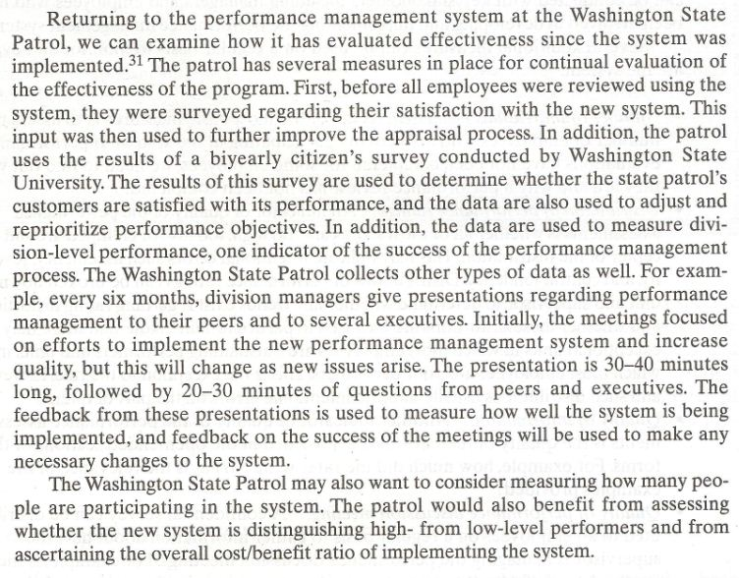

Slide 41
END OF CHAPTER CASE STUDY
  ACCOUNTING INC.

Slide 42
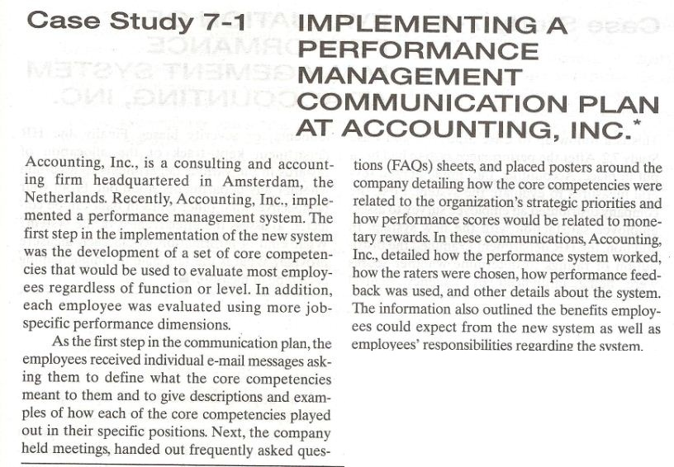

Slide 43
Summary of Today’s Lecture
Self Efficacy Training
Summary Raters Errors
Pilot Testing
Ongoing Monitoring and Evaluation

Slide 44
Thank You

