Slide 1
HRM-755
PERFORMANCE MANAGEMENT
LECTURE: TWENTY TWO
OSMAN BIN SAIF

Slide 2
Summary of Previous Lecture
Rater Error Training (RET).
Possible Errors in Ratings
  Similar to me Error
  Contrast Error
  Leniency Error
  Severity Error
  Central Tendency Error
  Halo Error

Slide 3
Summary of Previous Lecture (Contd.)
Possible Errors in Ratings
  Primary Error
  Recency Error
  Negative Error
  First Impression Error
  Spillover Error
  Stereotype Error
  Attribution Error

Slide 4
Agenda for Today’s Lecture
Possible Errors in Ratings
Frame of Reference Training
Steps in designing a Frame of Reference Training
Behavior Observational Training
Self Leadership Training
Steps in designing a Self Leadership Training
Self Efficacy Training

Slide 5
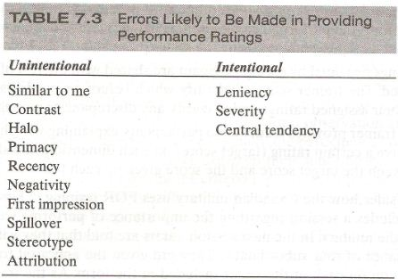
Possible Errors in Ratings

Slide 6
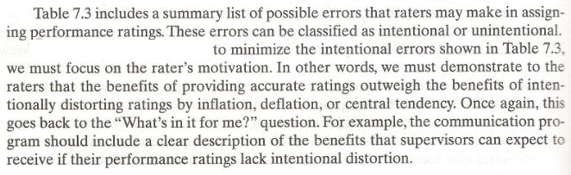

Slide 7
Rater Error Training
RET exposes raters to the different errors and their causes; however being aware of unintentional errors does not mean that supervisors will no longer make these errors.
Awareness is certainly a good first step but we need to go further if we want to minimize unintentional errors.
One fruitful possibility is the implementation of frame of reference training.

Slide 8
Frame of Reference Training
Frame of reference training helps improve rater accuracy by thoroughly familiarizing raters with the various performance dimensions to be assessed.

Slide 9
Frame of Reference Training (Contd.)
The overall goal is to give raters skill so that they can provide accurate ratings of each employee on each dimensions by a developing a common frame of reference.

Slide 10
Frame of Reference Training (Contd.)
A typical FOR training program includes a discussion of the job description for the individuals being rated and the duties involved.
Raters are then familiarized with the performance dimension to be rated by reviewing the definitions for each dimension and discussing examples of good, average and poor performance

Slide 11
Frame of Reference Training (Contd.)
Raters are then asked to use the appraisal forms to be used in the actual performance management system to rate fictitious employees usually shown in written or videotaped practice vignettes.

Slide 12
Frame of Reference Training (Contd.)
The trainees are also asked to write a justification for the ratings.
Finally the trainer informs the trainee of the correct ratings for each dimension and the reason for such ratings and discusses differences between the correct ratings and those provided by trainees.

Slide 13
Steps in Frame of Reference Training
Typically, FOR training programs include the following formal steps:
Raters are told that they will evaluate the performance of three employees on three separate performance dimensions.

Slide 14
Steps in Frame of Reference Training (Contd.)
Raters are given an appraisal form and instructed to read it as the trainer reads aloud the definition for each of the dimensions and the scale anchors.

Slide 15
Steps in Frame of Reference Training (Contd.)
The trainer discusses various employee behaviors that illustrate various performance levels for each rating scale included in the form.
The goal is to create a common performance theory (frame of reference) among raters so that the will agree on the appropriate performance dimension and effectiveness level for different behaviors.

Slide 16
Steps in Frame of Reference Training (Contd.)
Participation are shown a videotape of a practice vignette, including behaviors related to the performance dimensions being rated, and are asked to evaluate the employees performance using the scales provided.

Slide 17
Steps in Frame of Reference Training (Contd.)
Ratings provided by each participants are shared with the rest of the group and discussed.
The trainer seeks to identify which behaviors participants used to decide on their assigned ratings and to clarify any discrepancies among the ratings.

Slide 18
Steps in Frame of Reference Training (Contd.)
The trainer provides feedback to participants, explaining why the employee should receive a certain rating (target score) on each dimension, and shows discrepancies between the target score and the score given by each trainee.

Slide 19
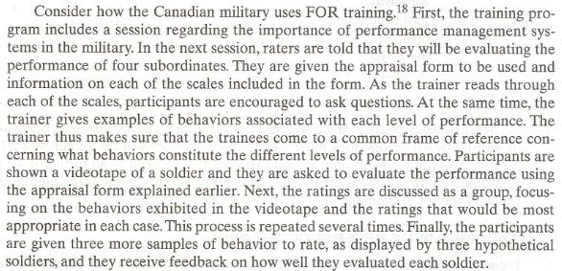

Slide 20
Frame of Reference Training (Contd.)
It is evident by now that FOR training can take quite a bit of time and effort to develop and administer it but it is well worth it.
Specifically as a consequence of implementing this type of training, raters not only are more likely to provide consistent and more accurate ratings but they are also more likely to help employees design effective developmental plans.

Slide 21
Frame of Reference Training (Contd.)
This is because sharing a common view of what constitutes good performance allows supervisors to provide employees with better guidelines to employ to reach such performance levels.

Slide 22
Behavior Observational Training
Behavior observational training is another type of program implemented to minimize unintentional rating errors.
BO training focuses on how raters observe, store, recall and use information about performance.
Fundamentally, this type of training improves raters skill at observing performance.

Slide 23
Behavior Observational Training (Contd.)
For example, one type of BO training showing raters how to use observational aids such as notes or diaries.
These observational aids help raters record a pre established numbers of behaviors on each performance dimensions.
Using these aids helps raters increase the sample of incidents observed and recorded during a specific time period.

Slide 24
Behavior Observational Training (Contd.)
In addition an aid such as diary is an effective way to standardize the observation of behavior and record of critical incidents throughout the review period.
In addition , it serves as a memory aid when filling out evaluation forms.

Slide 25
Behavior Observational Training (Contd.)
Memory aids are beneficial because rating based on memory alone, without notes or diaries, are likely to be distorted due to factors of social context (e.g friendship bias) and time (i.e duration of supervisor-subordinate relationship).

Slide 26
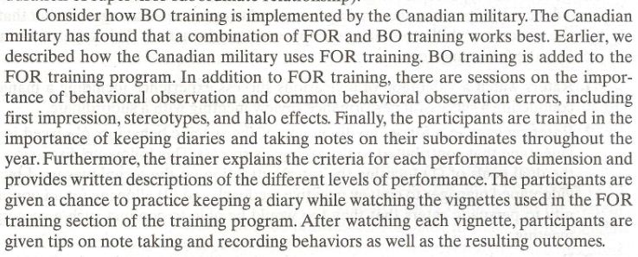

Slide 27
Self Leadership Training
The goal of self leadership is to improve a raters confidence in her ability to manage performance.
SL training include positive self talk, mental imagery, and positive beliefs and thought patterns.

Slide 28
Self Leadership Training (Contd.)
The assumption is that if there is increased self direction, self motivation, and confidence, there will be increased accuracy.
Overall , Self leadership emphasizes intrinsic (i.e internal) sources of behavioral standards and emphasizes doing things for their intrinsic value.

Slide 29
Self Leadership Training (Contd.)
SL training has become a popular tool in the context of performance management systems and as a type of training program beneficial for supervisors even when they are not necessarily involved in a performance management system.

Slide 30
Self Leadership Training (Contd.)
Several studies have shown that SL training can be effective in enhancing mental processes and increasing self efficacy (i.e belief that one can do something if one tries).

Slide 31
Steps in Designing a Self Leadership Training
Designing a SL program involves the following steps:
Observe and record existing beliefs and assumptions, self talk, and mental imagery patterns.
  For Example; what are the beliefs about the performance management systems?, how do managers visualize their role in the performance management system? ,

Slide 32
Steps in Designing a Self Leadership Training
Analyze the functionality and constructiveness of the belief, self talk, and imagery patterns uncovered in step 1.
  For example;
    Are the beliefs about the system detrimental to the system’s expected success?

Slide 33
Steps in Designing a Self Leadership Training
Identify or develop more functional or constructive beliefs and assumptions, self verbalizations and mental images to substitutes for dysfunctional ones.
  For example;
    Develop images of employees being satisfied as opposed to defensive and confrontational after receiving performance feedback from their supervisors.

Slide 34
Steps in Designing a Self Leadership Training
Substitute the more functional thinking for the dysfunctional thoughts experienced in actual situations.
  For example;
    More constructive assumptions, ways of talking to oneself, and mental images of the likely outcome of a performance discussion with an employee can be worked out and written down on paper.

Slide 35
Steps in Designing a Self Leadership Training
Continue monitoring and maintaining beliefs, self verbalization, and mental images over time.

Slide 36
Self- Efficacy Training
A related type of training program is labelled self- efficacy training for raters (SET-R).
The goal of this type of training is to decrease a rater’s discomfort with the interpersonal demands of performance management and to enhance a manager’s belief that he has the necessary skills to manage employee’s performance.

Slide 37
Self- Efficacy Training (Contd.)
The self efficacy training for raters includes the following steps:
Raters watch a video tape of a vicarious success experience including a manager conducting a successful performance review meeting with a subordinates.

Slide 38
Self- Efficacy Training (Contd.)
Raters engage in a follow up discussion of the specific behaviors observed in the videotape that contributes to the meeting success.
This follow up discussion of dual goals of ;
  Focusing the raters attention on the techniques used by the videotaped manager to convey negative feedback
  Allowing for an opportunity to persuade raters that they too would be able to conduct such a successful meeting.

Slide 39
Self- Efficacy Training (Contd.)
Raters participate in a role play exercise that requires providing feedback to an employee. This role play exercise is repeated until raters demonstrate an appropriate level of mastery.

Slide 40
Summary of Today’s Lecture
Possible Errors in Ratings
Frame of Reference Training
Steps in designing a Frame of Reference Training
Behavior Observational Training
Self Leadership Training
Steps in designing a Self Leadership Training
Self Efficacy Training

Slide 41
Thank You

