Slide 1
HRM-755
PERFORMANCE MANAGEMENT
LECTURE: TWENTY
OSMAN BIN SAIF

Slide 2
Summary of Previous Lecture
Appeals Process
Types of Issues
  Judgmental
  Administrative
Training programs for the acquisition of required skills
Content Areas for rater training program
Rater Error Training (RET)

Slide 3
Agenda of Today’s Lecture
SECOND SESSIONAL EXAM WILL BE AFTER THIS LECTURE—
SO AGENDA FOR TODAYS LECTURE IS “REVISION” ONLY.
COURSE FOR SECOND SESSIONAL EXAM IS FROM ELEVENTH LECTURE TO TWENTIETH LECTURE.

Slide 4
CHAPTER 5
  MEASURING RESULTS AND BEHAVIOR

Slide 5
Measuring Results
If results approach is adopted, the following key question should be:
What are the different areas in which this individual is expected to focus efforts(key accountability)?
Within each area, what are the expected objectives?
How do we know how well the results have been achieved(performance standards)?

Slide 6
Measuring Results (Contd.)
The key accountability are broad areas of job for which the employee is responsible for producing results.
A discussion of results also include specific objectives that the employee will achieve as a part of each accountability.

Slide 7
Measuring Results (Contd.)
Objectives are statements of important and measurable outcomes.
Discussing results also means discussing performance standards.

Slide 8
Measuring Results (Contd.)
A performance standard is the yardstick used to evaluate how ell employees have achieved each objective.
Performance standard provide information on acceptable and unacceptable performance in relation to quality, quantity, cost and time.

Slide 9
Determining Accountabilities
The first step in determining accountability is to collect information about the job.
The primary source is of course the job description that has resulted from the job analysis and a consideration of unit and organization level strategic priorities.
The job description provides information on the tasks performed.

Slide 10
Determining Accountabilities (Contd.)
Tasks included in the job description can be grouped into clusters of tasks based on their degree of relatedness.
Each of these clusters or accountabilities is a broad area of the job for which the employee is responsible for producing results.

Slide 11
Determining Objectives
After the accountability have been identified, the next step in measuring results is to determine specific objectives.

Slide 12
Determining Objectives (Contd.)
Objectives are statement of an important and measurable outcomes that, when accomplished, will help ensure success for the accountability.
Objectives are clearly important because they help employees guide their efforts.

Slide 13
Determining Objectives (Contd.)
The purpose of establishing objectives is to identify a limited number of highly important results that, when achieved, will have a dramatic impact on the overall success of the organization.
After objectives are set, employees should receive feedback on their progress towards attaining the objective.

Slide 14
Determining Objectives (Contd.)
Rewards should be allocated to those employees who have reached their objectives.

Slide 15
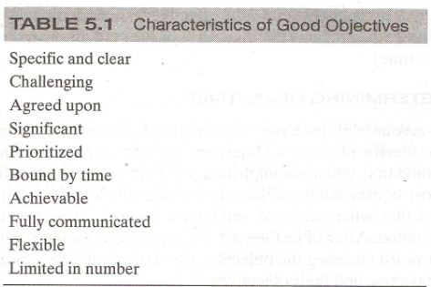

Slide 16
Determining Performance Standards (Contd.)
After accountabilities and objectives have been determine, the next step is to define performance standards.
These are yardsticks designed to help people understand to what extent the objectives have been achieved.

Slide 17
Determining Performance Standards (Contd.)
The standards provide raters with information about what to look for to determine the level of performance that has been achieved.
Standards can refer to various aspects of a specific objective, including quality, quantity and times.

Slide 18
Determining Performance Standards (Contd.)
Each of these aspects can be considered criteria to be used in judging the extent to which an objective has been achieved.
  Quality:
    how well the objective has been achieved

Slide 19
Determining Performance Standards (Contd.)
Quantity:
  how much has been produced, how many, how often and at what cost
Time:
  due dates, adherence to schedule, cycle times, deadlines.

Slide 20
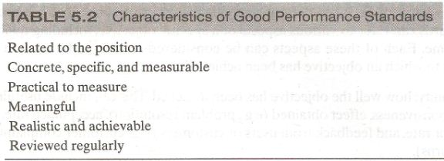

Slide 21
Measuring behaviors
A behavior approach to measuring performance includes the assessment of competencies.
Competencies are measureable clusters of knowledge, skills and abilities that are critical in determining how results will be achieved.
Example of competencies are customer services, written or oral communication, creative thinking, and dependability.

Slide 22
Measuring behaviors (Contd.)
We can consider two types of competencies:
Differentiating competencies:
  which are those that allow us to distinguish between average and superior performers.
Threshold competencies:
  which are those that everyone needs to display to the job to a minimally adequate standard.

Slide 23
Indicator
To understand the extent to which an employee possess a competency, we measure indicators.
An indicator is a behavior that if displayed suggests that the competency is present.

Slide 24
Components of Competency
In describing a competency, the following components must be present;
  Definition of competency
  Description of specific behavioral indicators that can be observed when someone demonstrates a competency effectively
  Description of specific behaviors that are likely to occur when someone does not demonstrates a competency effectively.
  List of suggestions for developing the competency in questions.

Slide 25
Competency Systems
Two types of systems are used to evaluate competencies
Comparative system: this system base the measurement on comparing employees with one others.
Absolute system: this system base the measurement on comparing employees with a pre-specified performance standard.

Slide 26
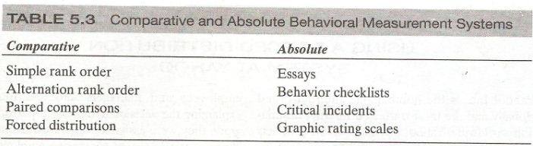

Slide 27
Appraisal form
At the core of any performance management system is the assessment of performance.
Information on performance is collected by using forms, which can be filled out on paper or electronically.

Slide 28
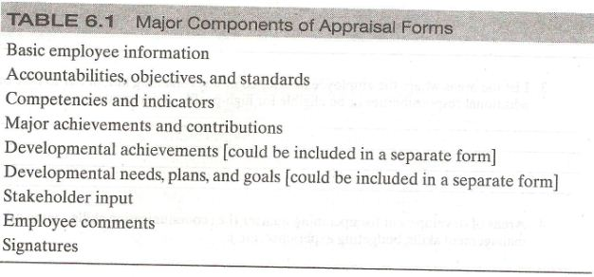
Major components of Appraisal Forms

Slide 29
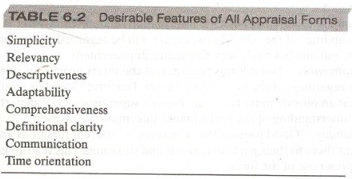
Desirable Features of All Appraisal Forms

Slide 30
Determining overall rating (Contd.)
Two main strategies are used to obtain an overall performance score for each employee.
Judgmental procedure
Mechanical procedure

Slide 31
Appraisal period and number of meeting (Contd.)
Organization with a performance management system typically conducts an annual review, however others choose to conduct semi annual or even quarterly formal reviews.
Conducting only an annual review might not provide sufficient opportunity for the supervisor and subordinates to discuss performance issues in a formal setting.

Slide 32
Formal Meetings
Performance management system can include six formal meetings between the subordinate and the supervisor.
  System inauguration
  Self appraisal
  Classical performance review
  Merit/salary review
  Developmental plans
  Objectives setting

Slide 33
Who should provide performance information?
So far we have assumed that the supervisor is the primary source for performance information.
This is the case in most organizations because the supervisor observes employees directly and has good knowledge about performance standards.

Slide 34
Who should provide performance information? (Contd.)
However, there are also alternative sources of performance information.

Slide 35
Who should provide performance information? (Contd.)
Performance management can be provided by
Supervisors
Peers
Subordinates
Self
Customers

Slide 36
Rater Motivation Model (Contd.)
The model shows that rating behaviors are influenced by;
  The motivation to provide accurate ratings
  The motivation to distort ratings.

Slide 37
Training Programs Coverage
Training programs may cover the following topics
Reasons for implementing the performance management system
  This includes an over view of the entire system, its purpose and benefits for all employees.

Slide 38
Training Programs Coverage (Contd.)
How to identify and rank job opportunities
  This includes information about how to conduct a job analysis and understand the most important accountabilities and competencies.

Slide 39
Training Programs Coverage (Contd.)
How to observe, record, and measure performance.
  This may include observational skills such as how to observe the behaviors that really matter and not be distracted by behaviors not related to the performance dimension to be measured.
  It also includes skills needed to fill out the appraisal form.

Slide 40
Training Programs Coverage (Contd.)
Information on appraisal form and system mechanics.
  This includes a detailed description of the content of the appraisal form and what each section is intended to measure.
  It also includes information about the number of recommended meetings and the expectations regarding each participant.

Slide 41
Training Programs Coverage (Contd.)
How to minimize rating errors.
  This includes steps that can be taken to minimize unintentional errors caused by the cognitive demands associated with the observation and evaluation performance.

Slide 42
Training Programs Coverage (Contd.)
How to conduct appraisal interview.
  This includes listening skills and communication skills and how to help the employee create a developmental plan.

Slide 43
Training Programs Coverage (Contd.)
How to train, counsel and coach.
  This includes skills that the supervisor needs to help employees improve their performance on an ongoing basis.

Slide 44
Communication plan
Having more and better knowledge of performance management system leads to greater employee acceptance and satisfaction.
Organizations often design a communication plan to ensure that information regarding the performance management system is widely disseminated in the organization.

Slide 45
Good Communication Plan
A good communication plan answers the following questions:
What is performance management?
  Answering this question involves providing general information about performance management, how performance management systems are implemented in other organizations, and the general goal of performance management systems.

Slide 46
Good Communication Plan (Contd.)
How does performance management fit into our strategy?
  To answer this question, we should provide information on the relationship between performance management and strategic planning. Information is provided on how the performance management system will help accomplish strategic goals.

Slide 47
Good Communication Plan (Contd.)
What’s in it for me?
  A good communication plan describes the benefit of implementing performance management for all those involved.

Slide 48
Good Communication Plan (Contd.)
How does it work?
  Answering this question entails giving a detailed description of performance management process and time line: for example, when meetings will take place, what the purpose of each meeting are, and when decisions about rewards will be made
.

Slide 49
Good Communication Plan (Contd.)
What are my responsibilities?
  The communication plan should include information on the role and responsibilities of each person involved at each stage of process.
  For example, it includes a description of the employees and supervisors main responsibilities in the performance management process.

Slide 50
Good Communication Plan (Contd.)
How is performance management related to other initiatives?
  The communication plan should information on the relationship between performance management and systems, such as training, promotion, and succession planning.

Slide 51
Communication Bias (Contd.)
Specifically there are three types of biases that affect the effectiveness of a communication plan, regardless of how well it has been implemented.
These are;
  Selective Exposure
  Selective Perception
  Selective Retention

Slide 52
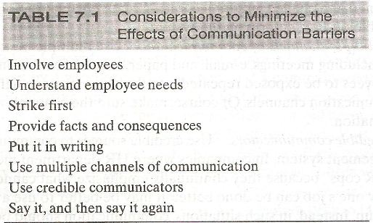

Slide 53
Appeals Process
In addition to implementing a communication process, support for the performance management system can be gained by implementing an appeals process.

Slide 54
Appeals process (Contd.)
When the appeal process is in place, employees have the ability to question two types of issues:
  Judgmental and
  Administrative.

Slide 55
Content Areas
Content areas that can be included in rater training programs
  Reasons for implementing the performance management system
  Information on appraisal form and system mechanics
  How to identify and rank job activities
  How to observe, record, and measure performance
  How to minimize rating errors
  How to conduct an appraisal interview
  How to train, counsel, and coach

Slide 56
Rater error training (Contd.)
RET typically includes definition of the most typical errors and a description of possible causes for those errors.
Such programs also allow trainees to view examples of common errors and to review suggestions on how to avoid making errors.

Slide 57
Summary of Today’s Lecture
SECOND SESSIONAL EXAM WILL BE AFTER THIS LECTURE—
SO AGENDA FOR TODAYS LECTURE IS “REVISION” ONLY.
COURSE FOR SECOND SESSIONAL EXAM IS FROM ELEVENTH LECTURE TO TWENTIETH LECTURE.

Slide 58
Thank You

