Slide 1
HRM-755
PERFORMANCE MANAGEMENT
LECTURE: EIGHTEEN
OSMAN BIN SAIF

Slide 2
Summary of Previous Lecture
Training Programs Coverage
End of Chapter Case study Practice
CHAPTER 7
IMPLEMENTING A PERFORMANCE MANAGEMENT SYSTEM
Preparation process for Implementation
Communication Plan
Good Communication Plan

Slide 3
Agenda of Today’s Lecture
Communication Plan
Good Communication Plan
Communication Bias
Types of Bias
  Selective Exposure
  Selective Perception
  Selective Retention
Ways to minimize negative impact of Biases
Appeals Process

Slide 4
Communication plan
Having more and better knowledge of performance management system leads to greater employee acceptance and satisfaction.
Organizations often design a communication plan to ensure that information regarding the performance management system is widely disseminated in the organization.

Slide 5
Good Communication Plan
A good communication plan answers the following questions:
What is performance management?
  Answering this question involves providing general information about performance management, how performance management systems are implemented in other organizations, and the general goal of performance management systems.

Slide 6
Good Communication Plan (Contd.)
How does performance management fit into our strategy?
  To answer this question, we should provide information on the relationship between performance management and strategic planning. Information is provided on how the performance management system will help accomplish strategic goals.

Slide 7
Good Communication Plan (Contd.)
What’s in it for me?
  A good communication plan describes the benefit of implementing performance management for all those involved.

Slide 8
Good Communication Plan (Contd.)
How does it work?
  Answering this question entails giving a detailed description of performance management process and time line: for example, when meetings will take place, what the purpose of each meeting are, and when decisions about rewards will be made
.

Slide 9
Good Communication Plan (Contd.)
What are my responsibilities?
  The communication plan should include information on the role and responsibilities of each person involved at each stage of process.
  For example, it includes a description of the employees and supervisors main responsibilities in the performance management process.

Slide 10
Good Communication Plan (Contd.)
How is performance management related to other initiatives?
  The communication plan should information on the relationship between performance management and systems, such as training, promotion, and succession planning.

Slide 11
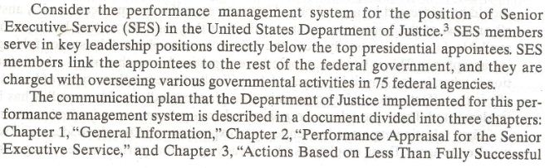

Slide 12
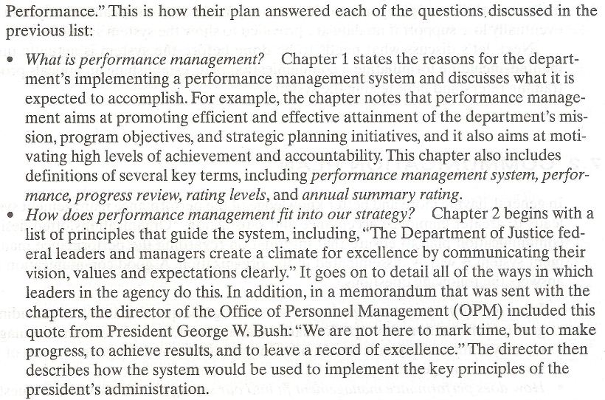

Slide 13
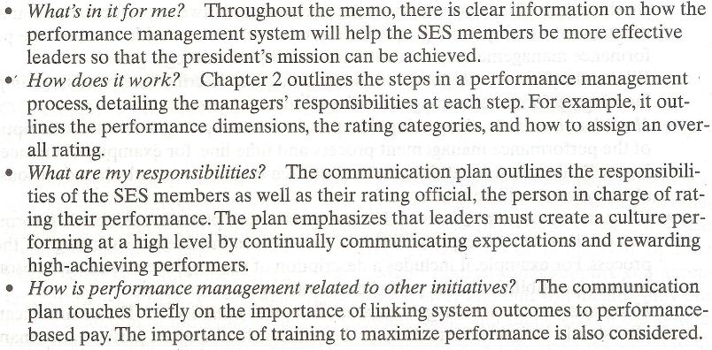

Slide 14
Good Communication Plan (Contd.)
In summary the communication plan implemented by the Department of Justice is extremely detailed and provides answers to most , if not all of the key questions that should be addressed by a good communication plan.

Slide 15
Communication Bias
However, even if a communication plan answers all or most of the important questions, the fact that the information has been made available does not necessarily mean the communication plan will be successful in gaining acceptance.

Slide 16
Communication Bias (Contd.)
This is because people have cognitive biases that affect what information is taken in and how it is processed.

Slide 17
Communication Bias (Contd.)
Specifically there are three types of biases that affect the effectiveness of a communication plan, regardless of how well it has been implemented.
These are;
  Selective Exposure
  Selective Perception
  Selective Retention

Slide 18
Selective Exposure
It is a tendency to expose our minds only to ideas with which we already agree.
Those employees who already agree that performance management is a good idea may become involved in the communication plan activities including reading about the system and attending meetings describing how the system works.

Slide 19
Selective Exposure (Contd.)
On the other hand, those who do not see much value in performance management may choose not to read information about it and put not to attend meetings related to performance management.

Slide 20
Selective Perception
Second, selective perception is a tendency to perceive a piece of information as meaning what we would like it to mean even though the information as intended by the communicator, may mean the exact opposite.

Slide 21
Selective Perception (Contd.)
Someone who believes performance management is about only rewards and punishment may incorrectly interpret that receiving a pay increase or bonus.

Slide 22
Selective Retention
Third selective retention is a tendency to remember only those pieces of information with which we already agree.
If an employee perceives his employer as vindictive, that employee is not likely to remember information about how the appeals process works or about other fair and equitable aspects of the system.

Slide 23
Selective Retention (Contd.)
Selective Exposure, Selective Perception, Selective Retention biases are pervasive and could easily render the communication plan ineffective.

Slide 24
Ways to minimize negative impact of Biases
There are several ways to minimize the negative impact of these biases and therefore, help gain support for the system.
Involve employees:
  Involve employee in the design of the system. People support what they create.
  The higher the level of participation is in designing the system, the greater the support for the system will be.

Slide 25
Ways to minimize negative impact of Biases (Contd.)
Understand employee needs:
  Understand the needs of employees and identify ways in which these needs can be met through performance management.

Slide 26
Ways to minimize negative impact of Biases (Contd.)
Strike first:
  Create a positive attitude toward the new performance system, before any negative attitude and rumors are created.
  Make communication realistic and do not set up expectation you cannot deliver.

Slide 27
Ways to minimize negative impact of Biases (Contd.)
Provide facts and consequences:
  Because of employees biases, facts do not necessarily speak for themselves.
  Clearly explain facts about the system and also explain what they mean or what the consequences are.

Slide 28
Ways to minimize negative impact of Biases (Contd.)
Put it in writing:
  Written communication are usually more powerful and credible than spoken communication because they can be carefully examined and challenged for accuracy.

Slide 29
Ways to minimize negative impact of Biases (Contd.)
Use multiple channels of communication:
  Use multiple methods of communication, including meetings, e-mails, and paper communication.

Slide 30
Ways to minimize negative impact of Biases (Contd.)
Use credible communications:
  Use credible source to communicate the performance management system.
  In companies where HR department members are perceived as “HR cops” because they continually emphasize what cannot be done as opposed to how ones job can be done better, it may be better to use a different department or group.

Slide 31
Ways to minimize negative impact of Biases (Contd.)
  In such situations, communication should be delivered by people who are trusted and admired within the organization.

Slide 32
Ways to minimize negative impact of Biases (Contd.)
Say it, and then say it again:
  Repeat the information frequently. Since people can absorb only a small amount of information at a time, the information should be repeated frequently.

Slide 33
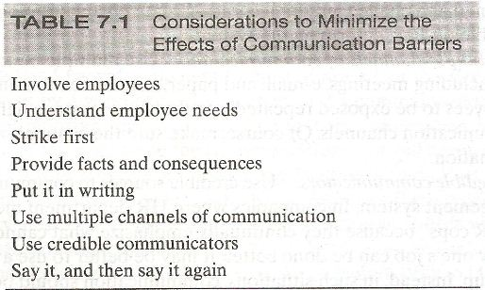

Slide 34
Appeals Process
In addition to implementing a communication process, support for the performance management system can be gained by implementing an appeals process.

Slide 35
Summary of Today’s Lecture
Communication Plan
Good Communication Plan
Communication Bias
Types of Bias
  Selective Exposure
  Selective Perception
  Selective Retention
Ways to minimize negative impact of Biases
Appeals Process

Slide 36
Thank You

