Slide 1
HRM-755
PERFORMANCE MANAGEMENT
LECTURE: SEVENTEEN
OSMAN BIN SAIF

Slide 2
Summary of Previous Lecture
Rater Motivation Model
Motivation for Inflated Ratings
Motivation for deflated Ratings
Preventing Conscious Distortion of Ratings
Preventing Rater Distortion through Rater Training Programs

Slide 3
Agenda of Today’s Lecture
Training Programs Coverage
End of Chapter Case study Practice
CHAPTER 7
IMPLEMENTING A PERFORMANCE MANAGEMENT SYSTEM
Preparation process for Implementation
Communication Plan
Good Communication Plan

Slide 4
Training Programs Coverage
Training programs may cover the following topics
Reasons for implementing the performance management system
  This includes an over view of the entire system, its purpose and benefits for all employees.

Slide 5
Training Programs Coverage (Contd.)
How to identify and rank job opportunities
  This includes information about how to conduct a job analysis and understand the most important accountabilities and competencies.

Slide 6
Training Programs Coverage (Contd.)
How to observe, record, and measure performance.
  This may include observational skills such as how to observe the behaviors that really matter and not be distracted by behaviors not related to the performance dimension to be measured.
  It also includes skills needed to fill out the appraisal form.

Slide 7
Training Programs Coverage (Contd.)
Information on appraisal form and system mechanics.
  This includes a detailed description of the content of the appraisal form and what each section is intended to measure.
  It also includes information about the number of recommended meetings and the expectations regarding each participant.

Slide 8
Training Programs Coverage (Contd.)
How to minimize rating errors.
  This includes steps that can be taken to minimize unintentional errors caused by the cognitive demands associated with the observation and evaluation performance.

Slide 9
Training Programs Coverage (Contd.)
How to conduct appraisal interview.
  This includes listening skills and communication skills and how to help the employee create a developmental plan.

Slide 10
Training Programs Coverage (Contd.)
How to train, counsel and coach.
  This includes skills that the supervisor needs to help employees improve their performance on an ongoing basis.

Slide 11
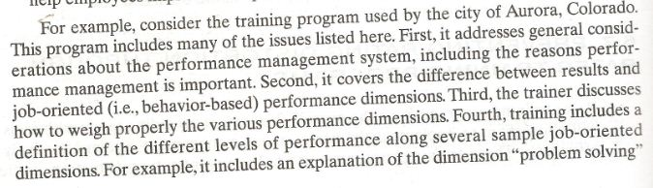

Slide 12
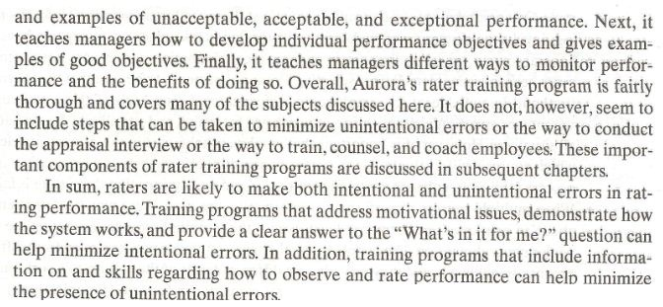

Slide 13
END OF CHAPTER CASE STUDY PRACTICE

Slide 14
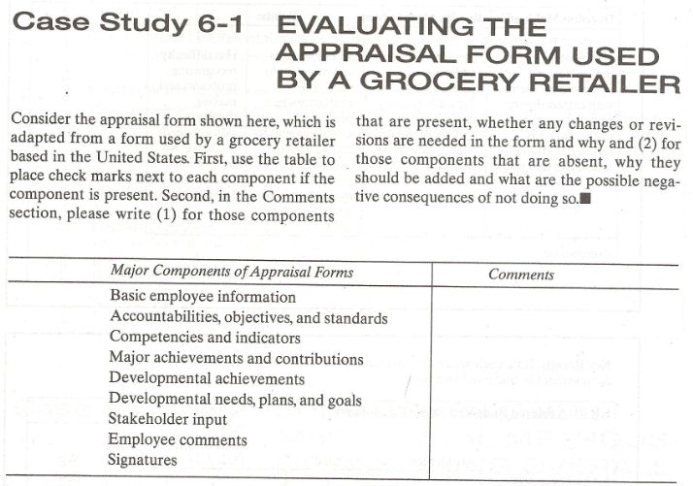

Slide 15
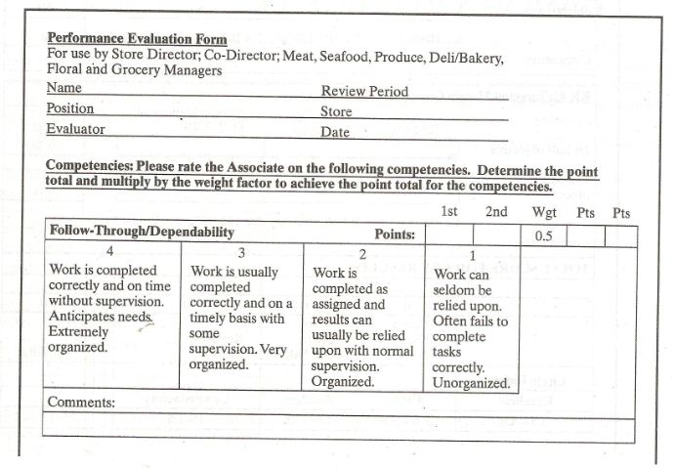

Slide 16
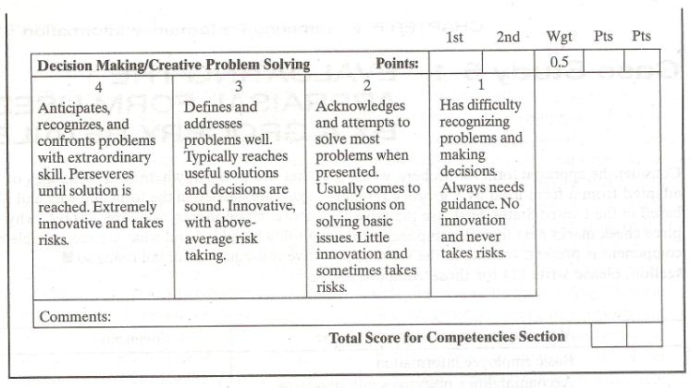

Slide 17
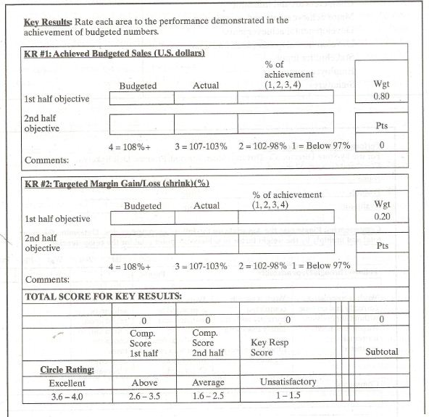

Slide 18
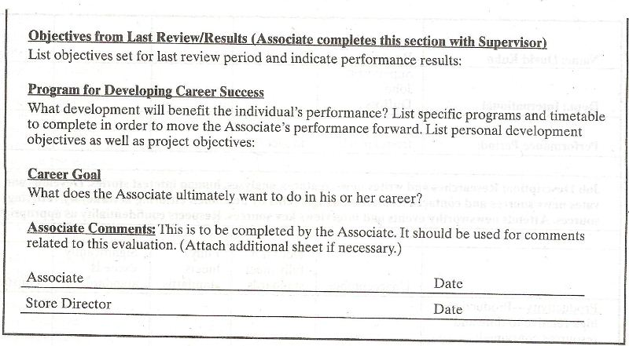

Slide 19
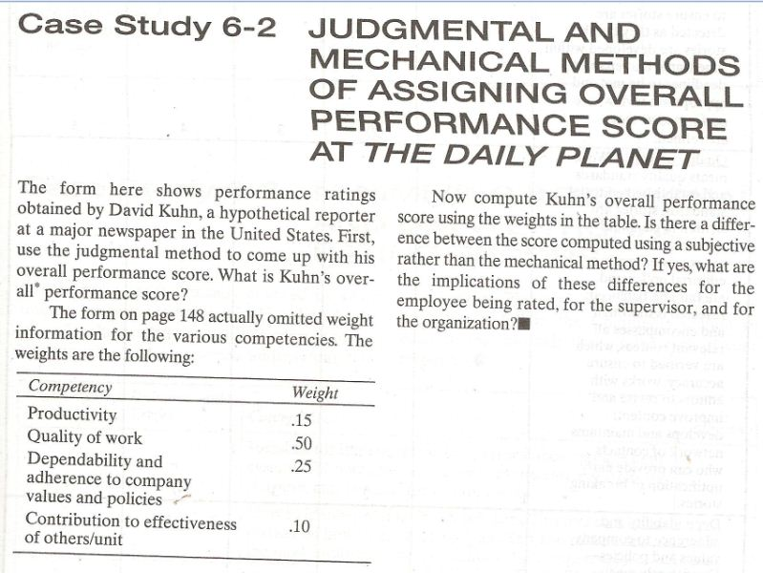

Slide 20
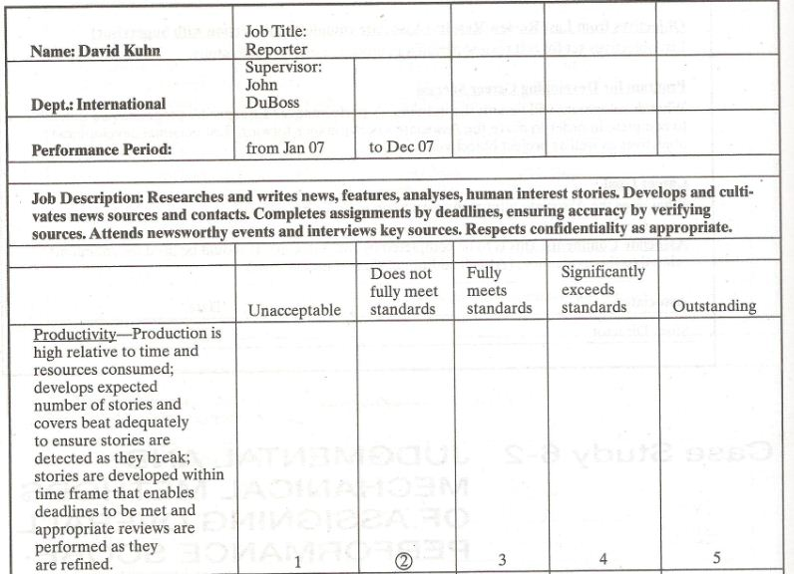

Slide 21
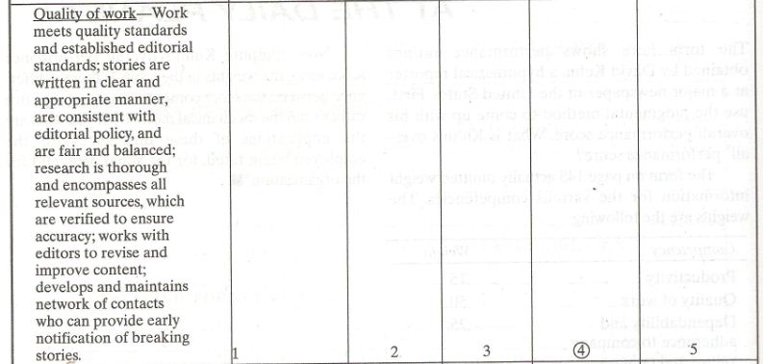

Slide 22
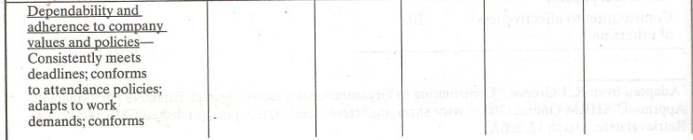
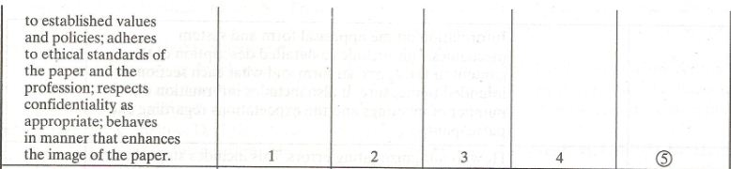

Slide 23
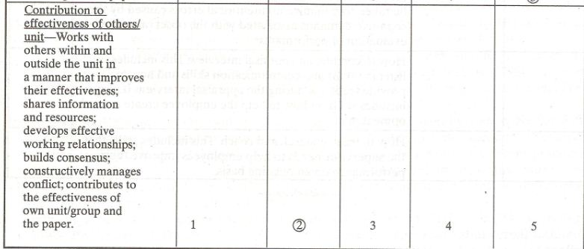

Slide 24
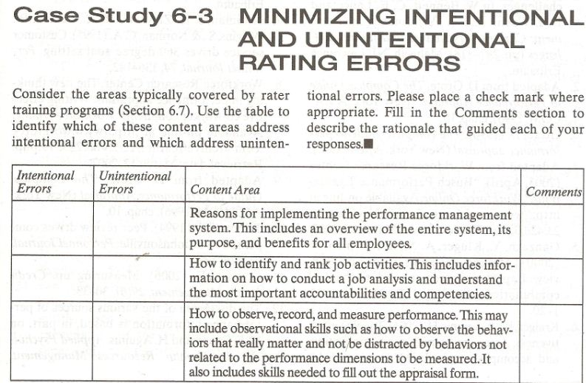

Slide 25
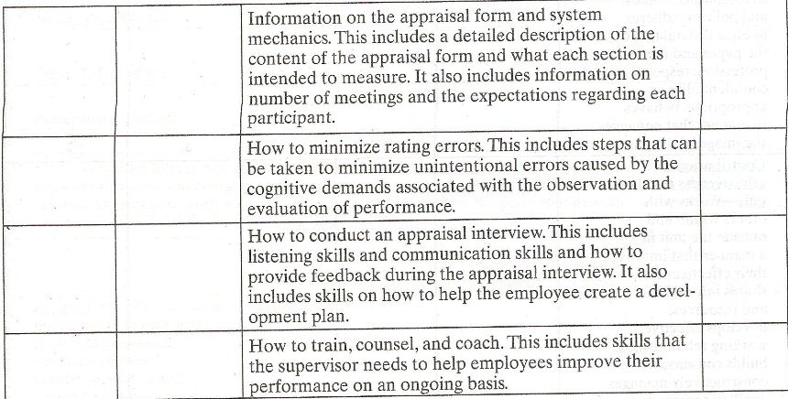

Slide 26
CHAPTER 7
IMPLEMENTING A PERFORMANCE MANAGEMENT SYSTEM
“Training is everything” – MARK TWAIN

Slide 27
Preparation: Communication, Appeals Process, Training Programs and Pilot Testing.
The implementation of a performance management system requires the involvement of many players.
The successful implementation of the system requires a clear understanding of how the system works and a clear understanding of its benefits from the different perspectives of all involved.

Slide 28
Preparation Process (Contd.)
Successful implementation requires wide organizational support and acceptance.
Initially it may be that each organizational layer and unit will include only one or just a handful of individuals who are knowledgeable and supportive of the system.

Slide 29
Preparation Process (Contd.)
These “champions” are likely to serve as advocates and resources for the system.
Eventually, however the system cannot be implemented successfully if only a handful of organizational members are on board.

Slide 30
Preparation Process (Contd.)
Before the system is launched, a successful communication plan must be implemented that will gain system acceptance.
Part of the communication plan includes a description of the appeals process.

Slide 31
Preparation Process (Contd.)
Then as part of the preparation phase before the system is actually launched, raters are trained to observe and evaluate performance as well as to give feedback.

Slide 32
Preparation Process (Contd.)
The system should then be tested and the results of a pilot test used to fix any glitches.
Only after these pre-system implementation steps are taken can the system be launched with confidence.

Slide 33
Preparation Process (Contd.)
Finally after the system has been tested and launched, there is a need to monitor and evaluate the system on an ongoing basis to determine whether it is working properly and what adjustments may be needed to make it work.

Slide 34
Preparation Process (Contd.)
The ongoing monitoring of the system is crucial because the system may eventually lose support if no data are provided to show the system’s benefits.

Slide 35
Communication plan
Having more and better knowledge of performance management system leads to greater employee acceptance and satisfaction.
Organizations often design a communication plan to ensure that information regarding the performance management system is widely disseminated in the organization.

Slide 36
Good Communication Plan
A good communication plan answers the following questions:
What is performance management?
  Answering this question involves providing general information about performance management, how performance management systems are implemented in other organizations, and the general goal of performance management systems.

Slide 37
Good Communication Plan (Contd.)
How does performance management fit into our strategy?
  To answer this question, we should provide information on the relationship between performance management and strategic planning. Information is provided on how the performance management system will help accomplish strategic goals.

Slide 38
Good Communication Plan (Contd.)
What’s in it for me?
  A good communication plan describes the benefit of implementing performance management for all those involved.

Slide 39
Good Communication Plan (Contd.)
How does it work?
  Answering this question entails giving a detailed description of performance management process and time line: for example, when meetings will take place, what the purpose of each meeting are, and when decisions about rewards will be made
.

Slide 40
Good Communication Plan (Contd.)
What are my responsibilities?
  The communication plan should include information on the role and responsibilities of each person involved at each stage of process.
  For example, it includes a description of the employees and supervisors main responsibilities in the performance management process.

Slide 41
Good Communication Plan (Contd.)
How is performance management related to other initiatives?
  The communication plan should information on the relationship between performance management and systems, such as training, promotion, and succession planning.

Slide 42
Summary of Today’s Lecture
Training Programs Coverage
End of Chapter Case study Practice
CHAPTER 7
IMPLEMENTING A PERFORMANCE MANAGEMENT SYSTEM
Preparation process for Implementation
Communication Plan
Good Communication Plan

Slide 43
Thank You

