Slide 1
HRM-755
PERFORMANCE MANAGEMENT
LECTURE: SIXTEEN
OSMAN BIN SAIF

Slide 2
Summary of Previous Lecture
Who should provide performance information?
  Supervisors
  Peers
  Subordinates
  Self
  Customers
Disagreement across sources: is this a problem?

Slide 3
Agenda of Today’s Lecture
Rater Motivation Model
Motivation for Inflated Ratings
Motivation for deflated Ratings
Preventing Conscious Distortion of Ratings
Preventing Rater Distortion through Rater Training Programs

Slide 4
Rater Motivation Model
Regardless of who rates performance, the rater is likely to be affected by biases that distort the resulting ratings.

Slide 5
Rater Motivation Model (Contd.)
Performance ratings may be intentionally or unintentionally distorted or inaccurate.
When this happens, incorrect decisions may be made, employees are likely to feel they are treated unfairly, and the organization is more prone to litigation.

Slide 6
Rater Motivation Model (Contd.)
In other words when performance ratings are distorted, the performance management system not only fails to result in desired outcomes but also may lead to very negative consequences for the organization.

Slide 7
Rater Motivation Model (Contd.)
To prevent these negative outcomes, we need to understand why raters are likely to provide distorted ratings.
A useful model to help us understand the rater’s motivation to provide accurate performance information is as following.

Slide 8
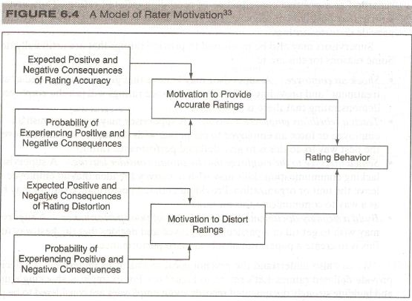

Slide 9
Rater Motivation Model (Contd.)
The model shows that rating behaviors are influenced by;
  The motivation to provide accurate ratings
  The motivation to distort ratings.

Slide 10
Rater Motivation Model (Contd.)
The motivation to provide accurate ratings is determined by whether the rater expects positive and negative consequences of accurate ratings and by whether the probability of receiving these rewards and punishments will be high if accurate ratings are provided.

Slide 11
Rater Motivation Model (Contd.)
Similarly the motivation to distort ratings is determined by whether the rater expects any positive and negative consequences if ratings are indeed distorted.

Slide 12
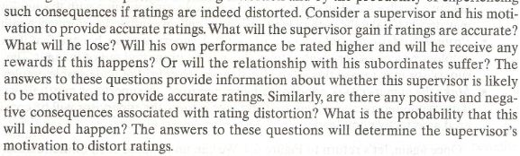

Slide 13
Rater Motivation Model (Contd.)
There are motivational barriers that prevent raters from providing accurate performance information.
Raters may be motivated to distort performance information and provide inflated or deflated ratings.

Slide 14
Motivation for Inflated Ratings
A supervisor may be motivated to provide inflated ratings to:
Maximize the merit raise/rewards.
  A supervisor may want to produce the highest possible reward for his employees and he knows this will happen if he provides the highest possible performance ratings.

Slide 15
Motivation for Inflated Ratings (Contd.)
Encourage employees
  A supervisor may believe that employee motivation will be increased if they receive high performance ratings.

Slide 16
Motivation for Inflated Ratings (Contd.)
Avoid creating a written record
  A supervisor may not want to leave a paper trail regarding an employee’s poor performance because such documentation may eventually lead to negative consequences for the employee in question.
  This situation is possible if the supervisor and employee have developed a friendship.

Slide 17
Motivation for Inflated Ratings (Contd.)
Avoid confrontation with employees
  A supervisor may feel uncomfortable providing negative feedback and in order to avoid a possible confrontation with the employee.
  Supervisor may decide to take the path of least resistance and give inflated performance ratings.

Slide 18
Motivation for Inflated Ratings (Contd.)
Promote undesired employees out of unit
  A supervisor may believe that if an employee receives very high ratings she may be promoted out of the unit.
  The supervisor may regard this as an effective way of getting rid of undesirable employees.

Slide 19
Motivation for Inflated Ratings (Contd.)
Make the manager look good to his/her supervisor.
  A supervisor may believe that if everyone receives very high performance ratings, the supervisor will be considered an effective unit leader.

Slide 20
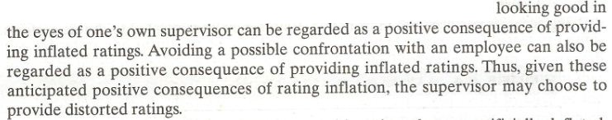

Slide 21
Motivation for Deflated Ratings
Supervisor may also be motivate to provide ratings that are artificially deflated.
Some reasons for this are:
Shock an employee
  A supervisor may believe that giving an employee a “shock treatment” and providing deflated performance ratings will jolt the employee, demonstrating that there is a problem.

Slide 22
Motivation for Deflated Ratings (Contd.)
Teach a rebellious employee a lesson
  A supervisor may wish to punish an employee or force an employee to cooperate with supervisor and believe that the best way to do this is to give deflated performance ratings.

Slide 23
Motivation for Deflated Ratings (Contd.)
Send a message to the employee that he should consider leaving
  A supervisor lacking communication skills may wish to convey the idea that an employee should leave the unit or organization.
  Providing deflated performance ratings may be seen as a way to communicate this message.

Slide 24
Motivation for Deflated Ratings (Contd.)
Build a strongly documented, written record of poor performance.
  A supervisor may wish to get rid of a particular employee and decides that the best way to do this is to create a paper trail of substandard performance.

Slide 25
Motivation for Deflated Ratings (Contd.)
Now we also understand that there are psychological mechanisms underlying the decision to provide deflated ratings.

Slide 26
Motivation for Deflated Ratings (Contd.)
For example;
  If shocking employees and building strong documented records about employees are considered to be positive consequences of rating deflation, it is likely that the supervisor will choose to provide distorted ratings.

Slide 27
Raters Motivation
We now assume that the process of evaluating performance can be filled with emotional over stones and hidden agendas that are driven by the goals and motivation of the person providing the ratings.

Slide 28
Raters Motivation (Contd.)
If raters are not motivated to provide accurate ratings, they are likely to use the performance management system to achieve political and other goals, such as rewarding allies and punishing enemies or competitors, instead of using it as a tool to improve employee and ultimately organizational performance.

Slide 29
Preventing Conscious Distortion of Ratings
What can be done to prevent conscious distortion of ratings?
  We need to provide incentives so that raters will be convinced that they have more to gain by providing accurate ratings than they do by providing in-accurate ratings.

Slide 30
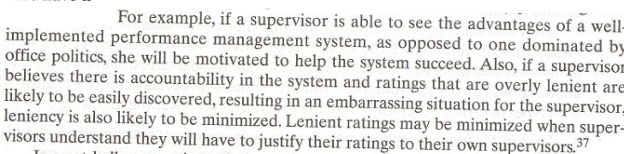

Slide 31
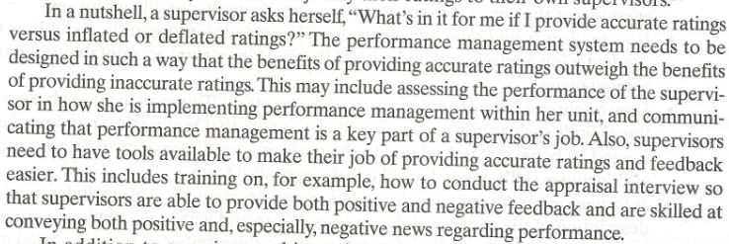

Slide 32
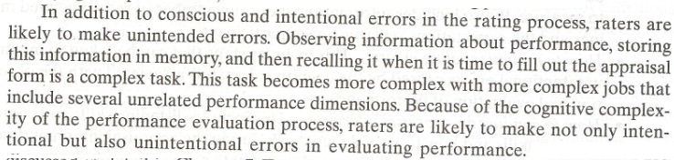

Slide 33


Slide 34
Preventing Rater Distortion through Rater Training Programs
Rater training programs have overall objective of providing raters with tools that will allow them to implement the performance management system effectively and efficiently.
These training programs also help prevent rating distortion.

Slide 35
Preventing Rater Distortion through Rater Training Programs (Contd.)
The following table summarizes the reasons discussed earlier for why raters are likely to inflate or deflate ratings.
How can training programs help mitigate the reasons causing intentional and un intentional ratings distortion?

Slide 36
Preventing Rater Distortion through Rater Training Programs (Contd.)
Recall that in addition to intentional errors , raters are likely to make un intentional errors in rating performance.

Slide 37
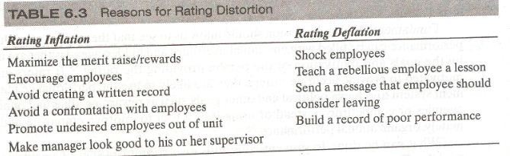

Slide 38
Summary of Today’s Lecture
Rater Motivation Model
Motivation for Inflated Ratings
Motivation for deflated Ratings
Preventing Conscious Distortion of Ratings
Preventing Rater Distortion through Rater Training Programs

Slide 39
Thank You

