Slide 1
HRM-755
PERFORMANCE MANAGEMENT
LECTURE: TWELVE
OSMAN BIN SAIF

Slide 2
Summary of Previous Lecture
CHAPTER 5
  Measuring Results and Behaviors
    Measuring Results
    Determining Accountabilities
    Determining Objectives
    Characteristics of Objectives
    Determining Performance Standards
    Characteristics of Good Performance Standards

Slide 3
Agenda of Today’s Lecture
Measuring Behavior
Indicator
Components of Competency
Comparative Systems
Advantages of Comparative Systems
Disadvantages of Comparative Systems
Absolute System

Slide 4
Measuring behaviors
A behavior approach to measuring performance includes the assessment of competencies.
Competencies are measureable clusters of knowledge, skills and abilities that are critical in determining how results will be achieved.
Example of competencies are customer services, written or oral communication, creative thinking, and dependability.

Slide 5
Measuring behaviors (Contd.)
We can consider two types of competencies:
Differentiating competencies:
  which are those that allow us to distinguish between average and superior performers.
Threshold competencies:
  which are those that everyone needs to display to the job to a minimally adequate standard.

Slide 6
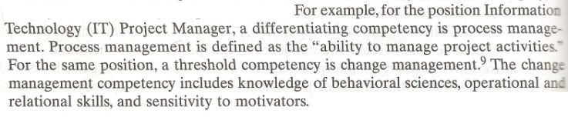

Slide 7
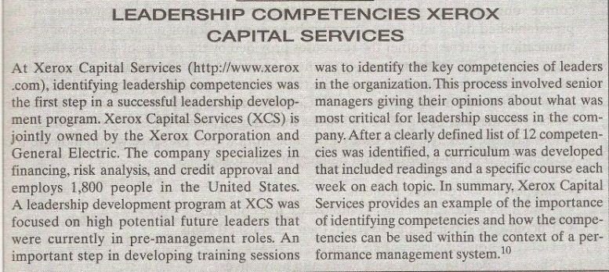

Slide 8
Indicator
To understand the extent to which an employee possess a competency, we measure indicators.
An indicator is a behavior that if displayed suggests that the competency is present.

Slide 9
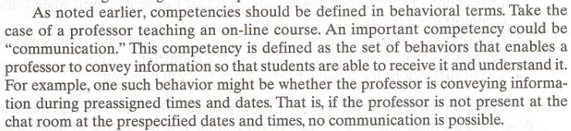

Slide 10
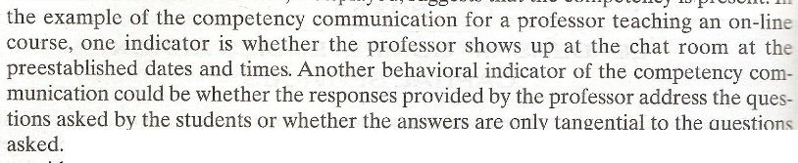

Slide 11
Indicator (Contd.)
Five indicators whose presence would indicate the existence of consideration competency are the following;
  Support subordinates project
  Ask about the well being of employees lives outside of work
  Encourage subordinates to reach their established goals
  Get to know employees personally
  Show respect for employees work and home lives.

Slide 12
Components of Competency
In describing a competency, the following components must be present;
  Definition of competency
  Description of specific behavioral indicators that can be observed when someone demonstrates a competency effectively
  Description of specific behaviors that are likely to occur when someone does not demonstrates a competency effectively.
  List of suggestions for developing the competency in questions.

Slide 13
Competency Systems
Two types of systems are used to evaluate competencies
Comparative system: this system base the measurement on comparing employees with one others.
Absolute system: this system base the measurement on comparing employees with a pre-specified performance standard.

Slide 14
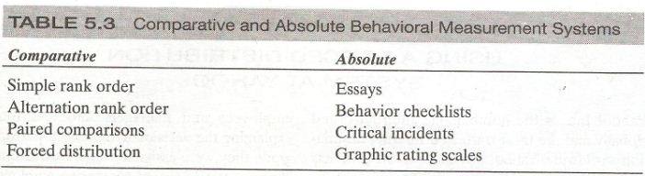

Slide 15
Comparative system
Comparative system of measuring behavior imply that employees are compared to one another.
Simple rank order system:
  in this system, employees are simply ranked from the best performer to the worst performer.

Slide 16
Comparative system (Contd.)
Alteration rank order procedure:
  in this system, the supervisor initially list all the employee.
  Then the supervisor selects the best performer and the worst performer.
  Then the second best and second worst
  And so forth , alternating from top to bottom of the list until all employees have been ranked.

Slide 17
Comparative system (Contd.)
Paired comparison:
  in this explicit comparisons are made between all pairs of employees to be evaluated.
  In other words, supervisors systematically compare the performance of each employee with all other employees.

Slide 18
Comparative system (Contd.)
Forced distribution:
  in this system, employees are apportioned according to an approximately normal distribution.
  For example,
    20% of the employees must be classified as Exceeding expectations
    70% must be classified as meeting expectations
    And 10% must be classified as not meeting expectations.

Slide 19
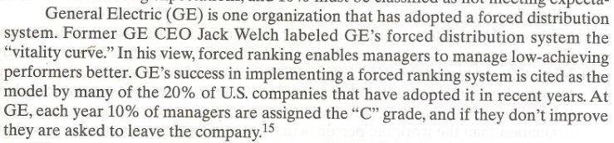

Slide 20
Advantage of Comparative systems
Advantages of uses of comparative system are
These type of measurements are easy to explain
Decision resulting from these type of systems are fairly straightforward.
They tend to control certain biases and errors made by those rating performance better than do those in absolute system.(e.g leniency, giving high scores to most employees)

Slide 21
Advantage of Comparative systems (Contd.)
Central tendency (i.e not giving any above expectations or below expectations ratings)

Slide 22
Disadvantages of Comparative System
Disadvantages associated with use of comparative system are
Employee usually are compared in terms of a single overall category.
Because the resulting data are based on ranking and not on actual scores, there is no information about the relative distance between employees.

Slide 23
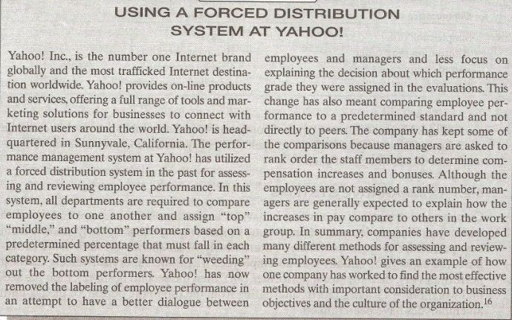

Slide 24
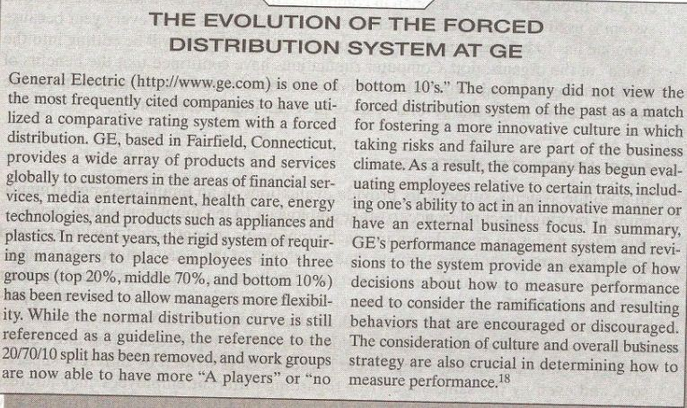

Slide 25
Absolute system
In absolute system, the supervisor provide evaluation of an employees performance without making direct reference to others employees.
In the simplest absolute system, supervisors write an essay describing each employees strengths and weaknesses and make suggestions for improvement.

Slide 26
Absolute system (Contd.)
One advantage of essay is that the supervisors have the potential to provide detailed feedback to employees regarding their performance.
On the other hand, essays are almost totally unstructured, so some supervisors may choose to be more detailed than others+.

Slide 27
Absolute system (Contd.)
A second type of absolute system involves a behavioral checklist, which consist of a form listing behavioral statements that are indicators of various competencies to be measured.

Slide 28
Absolute system (Contd.)
The supervisors task is to indicate statements that describe the employee being rated.
When this type of measurement system is in place, supervisors are not so much evaluators as they are reporters of employee behavior.
Example:

Slide 29
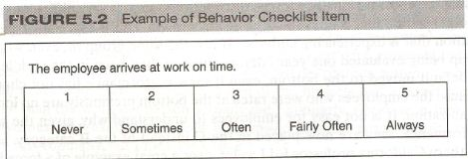

Slide 30
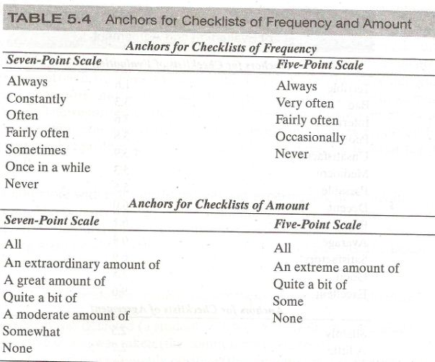

Slide 31


Slide 32
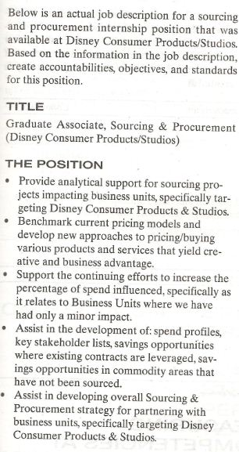

Slide 33


Slide 34


Slide 35
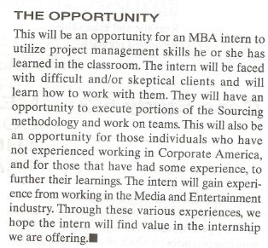

Slide 36
Summary of Today’s Lecture
Measuring Behavior
Indicator
Components of Competency
Comparative Systems
Advantages of Comparative Systems
Disadvantages of Comparative Systems
Absolute System

Slide 37
Thank You

