Slide 1
HRM-755
PERFORMANCE MANAGEMENT
Session: TEN
OSMAN BIN SAIF

Slide 2
Summary of Previous Lecture
Determinants of Performance
Implications for addressing performance problems
Factors influencing determinants of performance
Performance Dimensions
Reasons for inclusion of Task and Contextual Performance in PMS

Slide 3
Agenda of Today’s Lecture
Approaches to measure performance
  Trait approach
  Behavior approach
  Result approach
End of Chapter CASE EXAMPLE

Slide 4
Approaches to measure performance
The employees do not function in vacuum, they work in organizational context, engaging in certain behaviors that produce certain results.
The same employee may behave differently if placed in a different situation.

Slide 5
Approaches to measure performance (Contd.)
The common approaches that are used to measure performance are:
  Trait approach
  Behavior approach
  Result approach

Slide 6
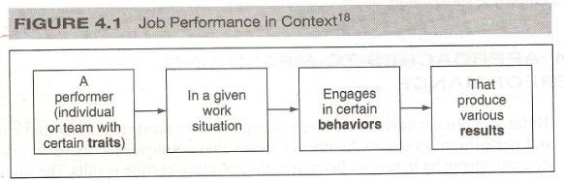

Slide 7
Trait approach
Trait approach emphasizes the individual performer and ignores the specific situation, behavior, and results.
If one adopts the trait approach, raters evaluate relatively stable traits.
These can include abilities such as cognitive abilities or personality.

Slide 8
Trait approach (Contd.)
These can include abilities;
  such as cognitive abilities (which are not easily trainable) or
  personality (which is not likely to change over time).

Slide 9
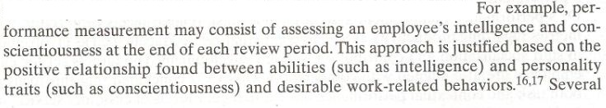

Slide 10
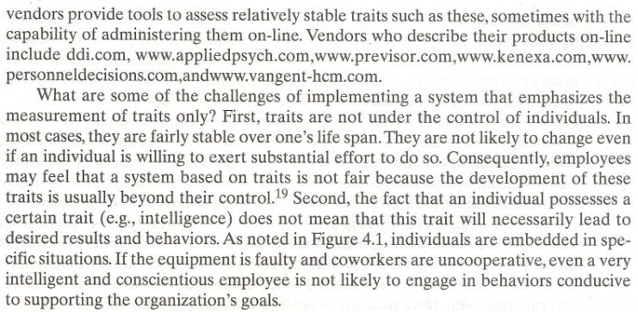

Slide 11
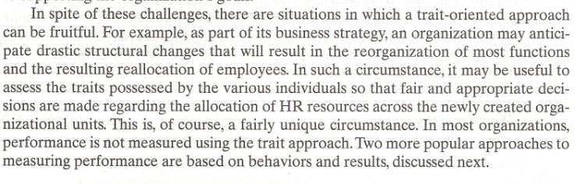

Slide 12
Behavior approach
The behavior approach emphasizes;
  what employees do on the job and does not consider employees traits or the outcomes resulting from their behaviors.
  This is basically a process oriented approach that emphasizes how an employee does the job.

Slide 13
Behavior approach (Contd.)
  Behavior approach is most appropriate under the following circumstance:
  The link between behaviors and results is not obvious:
    sometimes the relationship between behaviors and the desired outcomes is not clear.
    In some cases the desired results are not achieved in spite of fact that the right behaviors are in place.

Slide 14
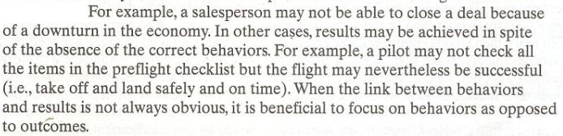

Slide 15
Behavior approach (Contd.)
  Outcomes occur in distant future:
    when the desired results will not be seen for months, or even years, the measurement of behavior is beneficial.

Slide 16


Slide 17


Slide 18
Behavior approach (Contd.)
  Poor results are due to causes beyond the performers control:
    when the results of an employees performance are beyond the employees control ,then it makes sense to emphasize the measurement of behaviors.

Slide 19
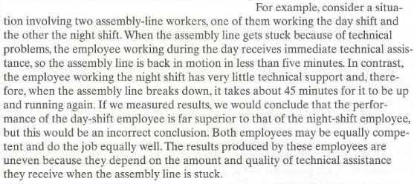

Slide 20
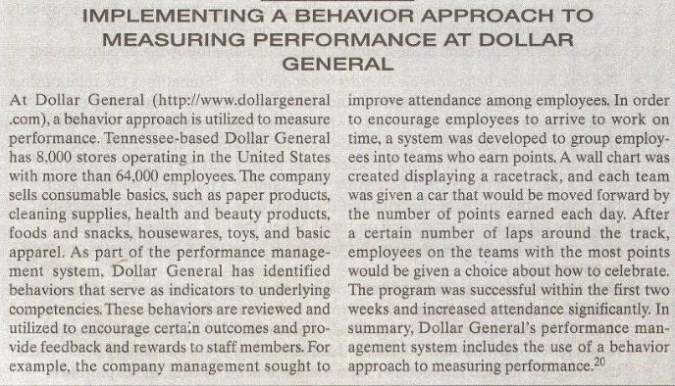

Slide 21
Results approach
The result approach emphasizes the outcomes and results produced by the employees.
It does not consider the traits that employees may possess or how employees do the job.
This is basically a bottom line approach that is not concerned about the employees behaviors and processes but instead focuses on what is produced.

Slide 22
Results approach (Contd.)
The result approach is most appropriate under the following circumstances:
Workers are skilled in the needed behaviors:
  an emphasis on result is appropriate when workers have the necessary knowledge and the skills to do work.

Slide 23
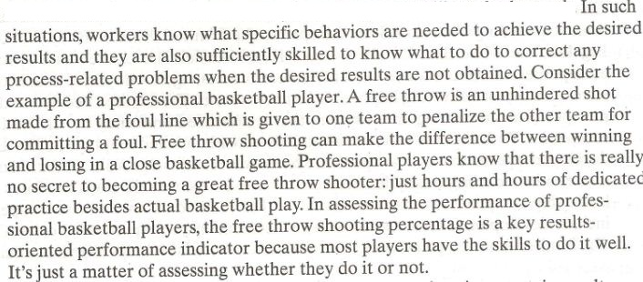

Slide 24
Results approach (Contd.)
Behavior and results are obviously related :
  in some situations, certain results can be obtained only if a worker engages in certain specific behaviors. This is a case of jobs involving repetitive tasks such as assembly line work or newspaper delivery

Slide 25
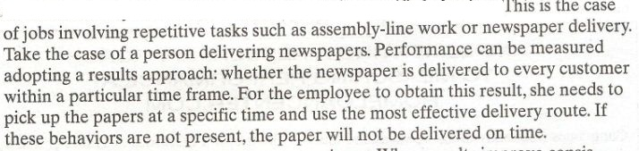

Slide 26
Results approach (Contd.)
Results show consistent improvement over time:
  when the results improve consistently over time, it is an indication that workers are aware of behaviors needed to complete the job successfully.
  In these situations, it is appropriate to adopt a results approach to assessing performance.

Slide 27
Results approach (Contd.)
There are many ways to do the job right :
  when there are different ways in which one can do the tasks required for a job, a result approach is appropriate.
  An emphasis on result can be beneficial because it could encourage employees to achieve the desired outcomes in creative and innovative ways.

Slide 28
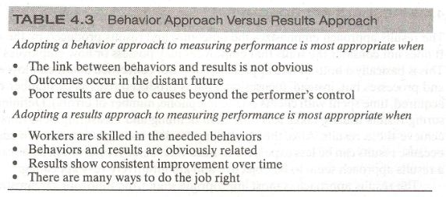

Slide 29
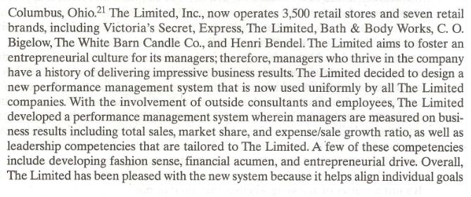

Slide 30
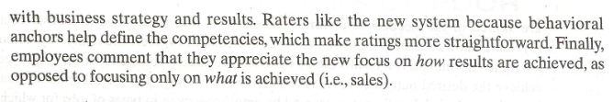

Slide 31
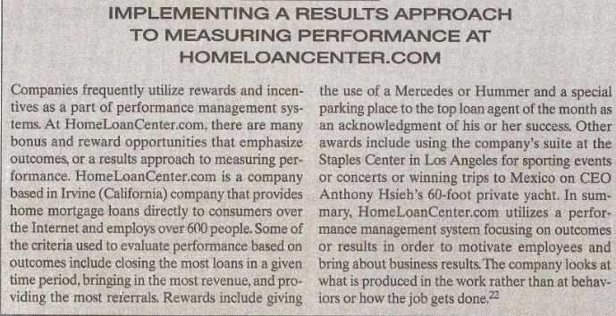

Slide 32
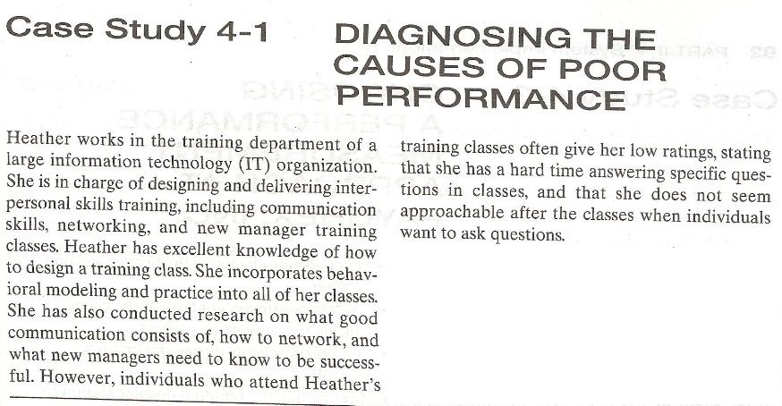

Slide 33
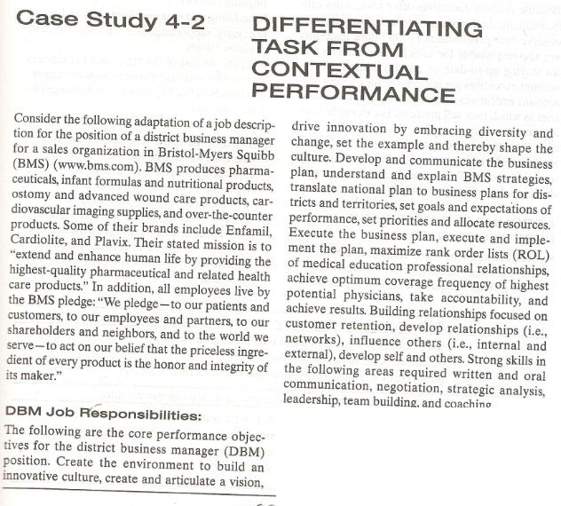

Slide 34
Summary of Today’s Lecture
Approaches to measure performance
  Trait approach
  Behavior approach
  Result approach
End of Chapter CASE EXAMPLE

Slide 35
Thank You

