Slide 1
HRM-755
PERFORMANCE MANAGEMENT
Session: One
OSMAN BIN SAIF

Slide 2
Self Introduction
Finance Graduate;
  MSC. Accounting and Finance (University of Exeter, UK)
  MBA- Bi-Majors Finance / HRM (SZABIST, Islamabad)
  Certified Financial Consultant (IFC , Canada)
  Certifications in Project Management, Monitoring and Evaluation and Research Policy Development and Meta Futures.
Consultant with SDPI
Senior Researcher with TP WING, MOC
Visiting Faculty various universities and institutes.

Slide 3
Course Objective
This course will examines the importance of an effective performance management system in helping organizations define and achieve short and long term goals.
It explains and reinforces the concept that performance management is not a one-time supervisory event, but an ongoing process of planning, facilitating, assessing, and improving individual and organizational performance.

Slide 4
Course Objective (Contd.)
In addition, the course emphasizes the importance of measuring the effectiveness of human resource activities that are designed to enhance individual and organizational performance.

Slide 5
Key Learning Outcomes
After the successful completion of this course, students will be able to :
1. Design an organization’s performance management process that is compliant with law and supports organizational mission and strategy.

Slide 6
Key Learning Outcomes (Contd.)
2. Compare and contrast various organizational performance management programs and best practices and define attributes of effective performance management systems.

Slide 7
Key Learning Outcomes (Contd.)
3. Employ job-related performance standards and performance indicators that reflect the employee’s range of responsibilities.
4. Assess how increased employee involvement can contribute to effective performance and coach employees to identify career paths and resources available to support individual development.

Slide 8
Key Learning Outcomes (Contd.)
5. Identify and communicate appropriate actions with employees (e.g. training and development, wage increase, promotion, bonus etc.) based on their performance strengths and weaknesses.

Slide 9
Course Contents/ Structure
SECTION 1: STRATEGIC AND GENERAL CONSIDERATIONS
  CHAPTER 1: Performance Management and Reward System in Context.
  CHAPTER 2: Performance Management Process
  CHAPTER 3: Performance Management and Strategic Planning

Slide 10
Course Contents/ Structure
SECTION 2: SYSTEM IMPLEMENTATION
  CHAPTER 4: Defining Performance and Choosing a Measurement Approach
  CHAPTER 5: Measuring Results and Behavior
  CHAPTER 6: Gathering Performance Information
  CHAPTER 7: Implementing a Performance Management System

Slide 11
Course Contents/ Structure
SECTION 3: EMPLOYEE DEVELOPMENT
  CHAPTER 8: Performance Management and Employee Development
  CHAPTER 9: Performance Management Skills

Slide 12
Course Contents/ Structure
SECTION 4: REWARD SYSTEM, LEGAL ISSUES, AND TEAM PERFORMANCE MANAGEMENT
  CHAPTER 10: Reward Systems and Legal Issues
  CHAPTER 11: Managing Team Performance

Slide 13
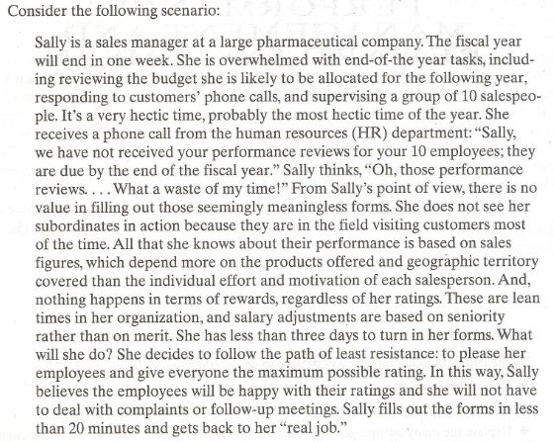
Performance Management

Slide 14
Performance Management (Contd.)
There is something very wrong with this picture, which unfortunately happens all too frequently in many organizations.
Although Sally’s HR department calls this process “performance management”, it is not.
Then what is “Performance Management”?

Slide 15
Performance Management (Contd.)
Definition:
  “Performance management is a continuous process of identifying, measuring, and developing the performance of individuals and teams and aligning performance with the strategic goals of the organization”.

Slide 16
Performance Management (Contd.)
  lets consider each of the definition’s two main components.
    Continuous process:
      Performance management is ongoing. It involves a never ending process of setting goals and objectives, observing performance ,and giving and receiving ongoing coaching and feedback.

Slide 17
Performance Management (Contd.)
  Alignment with strategic goals:
    Performance management requires that managers ensure that employee’s activities and output are congruent with the organization’s goals
    and consequently, help the organization gain a competitive advantage.

Slide 18
Performance Management (Contd.)
Performance management therefore create a direct link between employee performance and organizational goals and makes the employees contribution to the organization explicit.

Slide 19
Performance Management (Contd.)
Note that many organizations have what is labelled a “performance management” system.
However we must distinguish between performance management and performance appraisal.

Slide 20
Performance Management (Contd.)
A system that involves employees evaluation once a year without ongoing effort to provide feedback management system. Instead, this is only a performance appraisal system.
Performance appraisal is the systematic description of employees strength and weakness.

Slide 21
Performance Management (Contd.)
Thus, performance appraisal is an important component of performance management, but it is just a part of bigger whole because performance management is much more than just performance measurement.

Slide 22
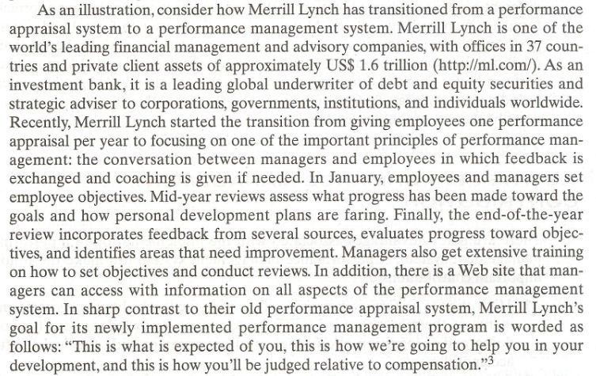
Performance Management- Case Study 2

Slide 23
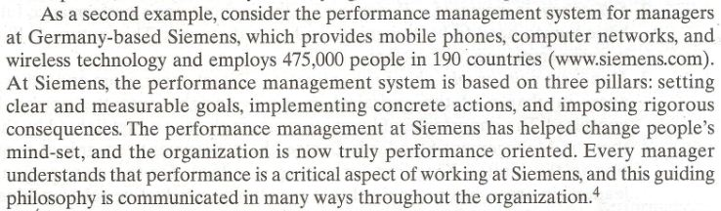
Performance Management- Case Study 3

Slide 24
Performance Management (Contd.)
Performance management system that do not make explicit the employees contribution to the organizational goals are not true performance management system.
Making an explicit link between an employees performance objectives and the organizational goals also serves the purpose of establishing a shared understanding about what is to be achieved and how it is to be achieved.

Slide 25
Performance Management (Contd.)
This is painfully clear in Sally case described earlier: from her point of view, the performance review forms did not provide any useful information regarding the contribution of each of her subordinates to the organization.
Sally's case is unfortunately more common than we would like.

Slide 26
Performance Management (Contd.)
A survey conducted by consulting firm Watson Wyatt showed that only 3 in 10 employees believe their company's performance review system actually helped them improve their performance

Slide 27
The Performance Management Contribution/ Advantages
There are many advantage associated with the implementation of a performance management system.
A performance management system can make the following important contributions

Slide 28
The Performance Management Contribution/ Advantages (Contd.)
Motivation to perform is increased:
  Receiving feedback about ones performance increases the motivation for future performance.
  Knowledge about how one is doing and recognition about ones past success provide the fuel for future accomplishments.

Slide 29
The Performance Management Contribution/ Advantages (Contd.)
Self-esteem is increased:
  Receiving feedback about ones performance fulfills a basic human need to be recognized and valued at work.
  This, in turn, is likely to increase employee’s self-esteem.

Slide 30
The Performance Management Contribution/ Advantages (Contd.)
Managers gains insight about subordinates:
  Direct supervisors and other managers in charge of appraisal gain new insights into the person being appraised.

Slide 31
The Performance Management Contribution/ Advantages (Contd.)
The definition of job and criteria are clarified:
  The job of person being appraised may be clarified and defined more clearly.
  In other words, employee’s gain a better understanding of the behaviors and results required of their specific position.

Slide 32
The Performance Management Contribution/ Advantages (Contd.)
Self insight and development are enhanced:
  The participants in this system are likely to develop a better understanding of themselves and of the kind of development activities that are of value to them as they progress through the organization.
  Participants in this system also gain a better understanding of their particular strengths and weaknesses that can help them better define future career paths.

Slide 33
The Performance Management Contribution/ Advantages (Contd.)
Administrative actions are more fair and appropriate :
  Performance management system provides valid information about performance that can be used for administrative actions such as merit increases, promotions, and transfers, as well as terminations.
  In general, a performance management system helps ensure that rewards are distributed on fair and credible basis.
  In turn, such decision based on sound performance management system lead to improved interpersonal relationship and enhanced supervisor-subordinate trust.

Slide 34
The Performance Management Contribution/ Advantages (Contd.)
Organizational goals are made clear:
  The goal of unit and organization are made clear, and the employee understands the link between what she does and organization success.
  This is the contribution to the communication of what the unit and organization are all about and how organization goals cascade down to the unit and the individual employee.

Slide 35
The Performance Management Contribution/ Advantages (Contd.)
Employee becomes more competent:
  An obvious contribution is that employee performance is improved.
  In addition, there is a solid foundation for helping employees become more successful by establishing developmental plans.

Slide 36
The Performance Management Contribution/ Advantages (Contd.)
There is a better protection from lawsuits:
  Data collected through performance management system can help document compliance with regulations(e.g., equal treatment of all employees regardless of sex or ethnic back ground).

Slide 37
The Performance Management Contribution/ Advantages (Contd.)
Supervisors view of performance are communicated more clearly:
  Performance management system allows managers to communicate to their subordinates their judgment regarding performance.

Slide 38
The Performance Management Contribution/ Advantages (Contd.)
Organization change is facilitated:
  Performance management system can be a useful tool to drive organizational change.
  For example, assume an organization decides to change its culture to give top priority to product quality to produce quality and consumer service.
  Once this new organization direction is established, performance management is used to align the organizational culture with the goals and objectives of the organization to make possible changes.

Slide 39
The Performance Management Contribution/ Advantages (Contd.)
Motivation, commitment , and intentions to stay in the organization are enhanced:
  When employees are satisfied with their organizations performance management system, they are more likely to be motivated to perform well, to be committed to their organization, and not try to leave the organization.

Slide 40
Summary of Today’s Lecture
Self Introduction
Course Objective
Key Learning Outcomes
Contents of the Course Structure
Understanding Performance management
Case study
PM Systems
Case Study 2
Case Study 3
Contribution / Advantages of PM System

Slide 41
Thanks

