Slide 1
HRM-755
PERFORMANCE MANAGEMENT
Session: SEVEN
OSMAN BIN SAIF

Slide 2
Summary of Previous Lecture
Environmental Analysis – Internal Factors
Gap Analysis
Gap Analysis – Competitive Situations
Mission
Vision

Slide 3
Agenda of Today’s Lecture
Characteristics of Good Vision statements
Goals
Strategies
Strategies – HR Function
Developing strategic plans at unit level
Job descriptions

Slide 4
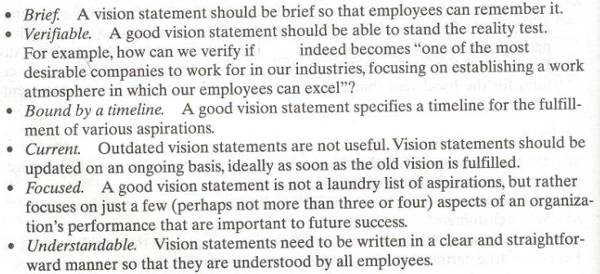
Characteristics of a Good Vision Statement

Slide 5
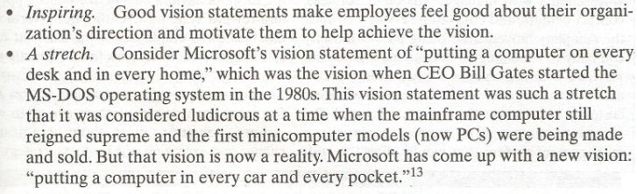
Characteristics of a Good Vision Statement (Contd.)

Slide 6
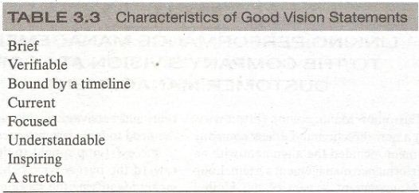
Characteristics of a Good Vision Statement (Contd.)

Slide 7
Goals
After an organization has analyzed its external opportunities and threats as well as internal strengths and weaknesses and has defined its mission and vision, it can realistically establish goals that will further its mission.

Slide 8
Goals (Contd.)
The purpose of setting such goal is to formalize statements about what the organization hopes to achieve in the medium to long term achievement.

Slide 9
Goals (Contd.)
Goals provide more specific information regarding how the mission will be implemented.
Goals can also be a source of motivation and provide employees with a more tangible target for which to strive.

Slide 10
Goals (Contd.)
Goals also provide a good basis for making decisions by keeping desired outcomes in mind.
Finally, goals provide the basis for performance measurement because they allow for a comparison of what need to be achieved verses what each unit ,group, and individual is achieving.

Slide 11
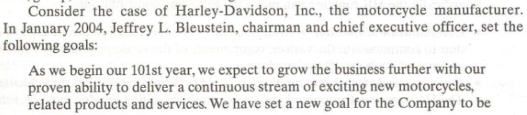
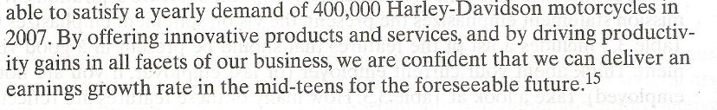
CASE EXAMPLE: Goals (Contd.)

Slide 12
CASE EXAMPLE: Goals (Contd.)
These goals provide a clear direction for Harley Davidson.
In-fact, they provide useful information to guide unit level goals as well as individual and team performance.
The entire organization has a clear sense of focus because all members know that there is a goal to deliver 400,000 motorcycles in 2007.

Slide 13
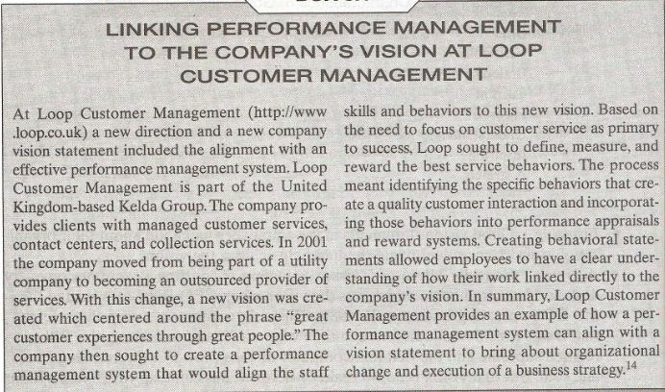

Slide 14
Strategies
At this point, we know that organization is all about (mission), what it needs to be in future(vision), and some intermediate steps to follow to get there(goals).
What remains is a discussion of how to fulfill the mission and vision and how to achieve the stated goals.

Slide 15
Strategies (Contd.)
This is achieved by creating strategies, which are description of game plans, or how to procedures to reach the stated objectives.
The strategies could address issues of growth, survival, turn around, stability, innovation and leadership, among others.

Slide 16
Strategies- HR Function
Human resources function play a critical role in creating and implementing the strategies that will allow the organization to realize its mission and vision.

Slide 17
Strategies- HR Function (Contd.)
HR function can make the following contributions:
Communicate knowledge of strategic plans:
  The HR function can be a good conduit to communicate the various components of strategic plan(e.g., mission, vision, and goals) to all the employees.

Slide 18
Strategies- HR Function (Contd.)
Outline knowledge, skills, and abilities needed for strategic implementation:
  The HR function through job analyses and the resulting job descriptions, serves as a repository of knowledge regarding what KSAs are needed for successful implementation of the strategic plans.

Slide 19
Strategies- HR Function (Contd.)
Propose reward system:
  The HR function can provide useful information on what type of reward system should be implemented to motivate employees to support the strategic plan.

Slide 20
Developing strategic plans at unit level
The organization’s strategic plan has a direct impact on the unit’s strategic plan.
This illustrates that a mission statement is aligned with the overall organization’s mission statement.

Slide 21
Developing strategic plans at unit level (Contd.)
Similarly, the vision statement, goals and strategies of various units need to be congruent with the overall organizational vision, goals, and strategies.

Slide 22
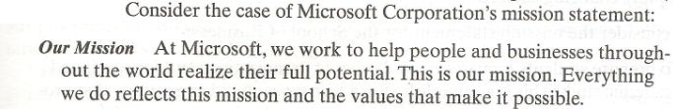

Slide 23
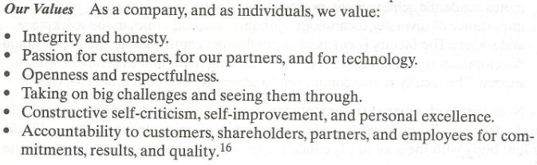

Slide 24
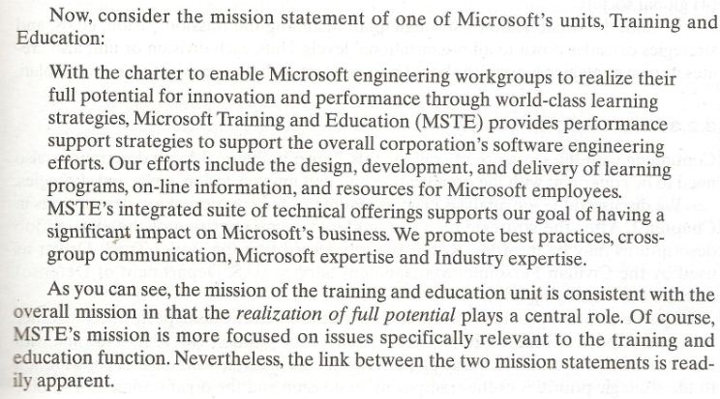

Slide 25
Developing strategic plans at unit level (Contd.)
As you can see, the mission of the training and education unit is consistent with the overall mission in that the realization of full potential plays a central role.
MSTE’s mission is more focused on issues specifically relevant to the training and education function.

Slide 26
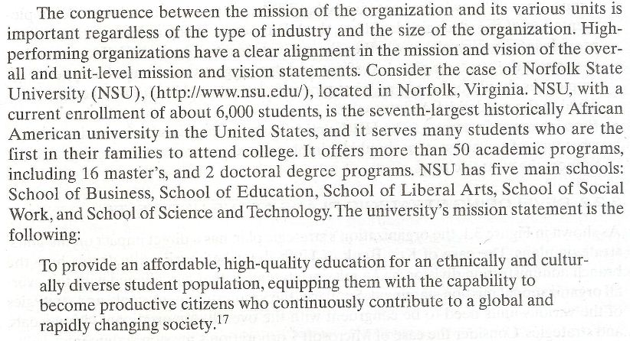

Slide 27
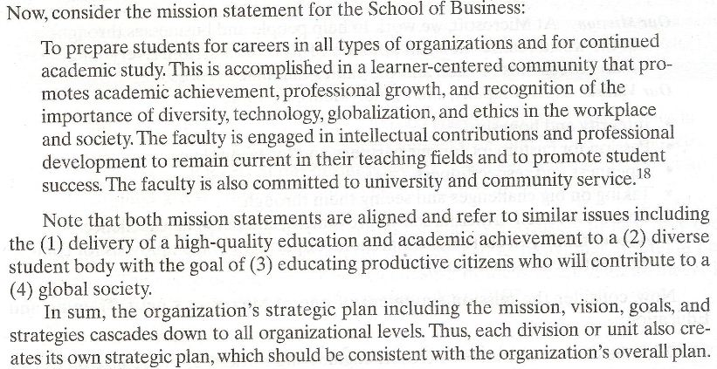

Slide 28
Job descriptions
Job description also need to be congruent with the organization and unit mission, vision and goals and strategies.
The job analysis process leads to the creation of job description.

Slide 29
Job descriptions (Contd.)
After the strategic plan is completed, some rewriting of the existing job descriptions may be in order.
Example : Trailer Truck CASE

Slide 30
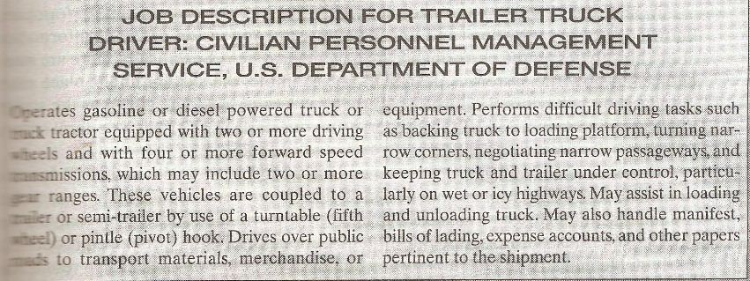

Slide 31
Job descriptions (Contd.)
Job description provide information about the various tasks performed together with a description of some of KSAs required for the position.

Slide 32
Job descriptions (Contd.)
But what is the link with the organization and unit strategic plans?
How do the specific tasks make a contribution to the strategic priorities of the transportation division and the organization as a whole?

Slide 33
Job descriptions (Contd.)
The description includes only cursory and indirect information regarding these issues.
For example, one can assume that;
  The proficient handling of bills of landing,
  expense accounts, and
  other papers pertinent to the shipment
Contributes towards a smooth shipping operation and therefore, make a contribution to the transportation division.
However, this link is not sufficiently clear.

Slide 34
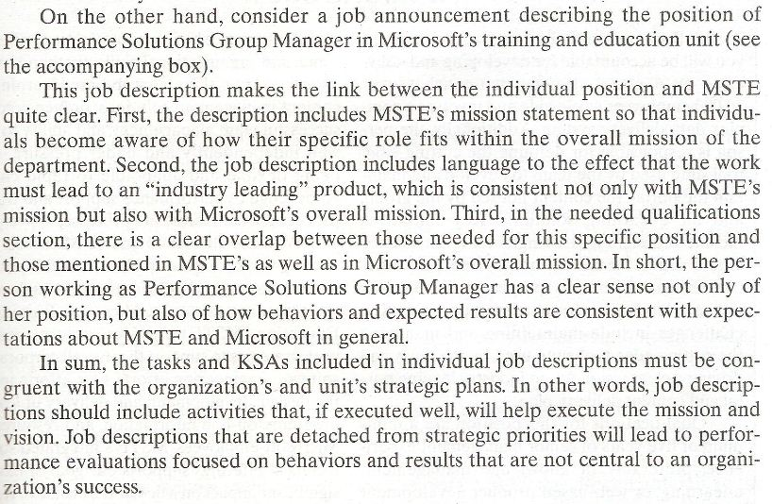

Slide 35
Summary of Today’s Lecture
Characteristics of Good Vision statements
Goals
Strategies
Strategies – HR Function
Developing strategic plans at unit level
Job descriptions

Slide 36
Thank You

