Slide 1
HRM-755
PERFORMANCE MANAGEMENT
LECTURE: THIRTY TWO
OSMAN BIN SAIF

Slide 2
Agenda for Today’s Lecture
REVISION ---- LECTURE 21 TO LECTURE 31
(COURSE FOR FINAL EXAMINATION)

Slide 3
Rater error training
Many performance management system are plagued with rater errors.
The goal of rater error training is to make raters aware of what rating errors they are likely to make and help them develop strategies to minimize those errors.

Slide 4
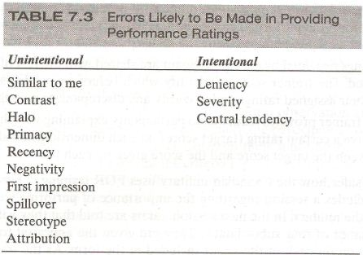
Possible Errors in Ratings

Slide 5
Frame of Reference Training
Frame of reference training helps improve rater accuracy by thoroughly familiarizing raters with the various performance dimensions to be assessed.

Slide 6
Frame of Reference Training (Contd.)
The overall goal is to give raters skill so that they can provide accurate ratings of each employee on each dimensions by a developing a common frame of reference.

Slide 7
Frame of Reference Training (Contd.)
A typical FOR training program includes a discussion of the job description for the individuals being rated and the duties involved.
Raters are then familiarized with the performance dimension to be rated by reviewing the definitions for each dimension and discussing examples of good, average and poor performance

Slide 8
Frame of Reference Training (Contd.)
Raters are then asked to use the appraisal forms to be used in the actual performance management system to rate fictitious employees usually shown in written or videotaped practice vignettes.

Slide 9
Frame of Reference Training (Contd.)
The trainees are also asked to write a justification for the ratings.
Finally the trainer informs the trainee of the correct ratings for each dimension and the reason for such ratings and discusses differences between the correct ratings and those provided by trainees.

Slide 10
Behavior Observational Training
Behavior observational training is another type of program implemented to minimize unintentional rating errors.
BO training focuses on how raters observe, store, recall and use information about performance.
Fundamentally, this type of training improves raters skill at observing performance.

Slide 11
Behavior Observational Training (Contd.)
For example, one type of BO training showing raters how to use observational aids such as notes or diaries.
These observational aids help raters record a pre established numbers of behaviors on each performance dimensions.
Using these aids helps raters increase the sample of incidents observed and recorded during a specific time period.

Slide 12
Behavior Observational Training (Contd.)
In addition an aid such as diary is an effective way to standardize the observation of behavior and record of critical incidents throughout the review period.
In addition , it serves as a memory aid when filling out evaluation forms.

Slide 13
Behavior Observational Training (Contd.)
Memory aids are beneficial because rating based on memory alone, without notes or diaries, are likely to be distorted due to factors of social context (e.g friendship bias) and time (i.e duration of supervisor-subordinate relationship).

Slide 14
Self Leadership Training
The goal of self leadership is to improve a raters confidence in her ability to manage performance.
SL training include positive self talk, mental imagery, and positive beliefs and thought patterns.

Slide 15
Self Leadership Training (Contd.)
The assumption is that if there is increased self direction, self motivation, and confidence, there will be increased accuracy.
Overall , Self leadership emphasizes intrinsic (i.e internal) sources of behavioral standards and emphasizes doing things for their intrinsic value.

Slide 16
Self Leadership Training (Contd.)
SL training has become a popular tool in the context of performance management systems and as a type of training program beneficial for supervisors even when they are not necessarily involved in a performance management system.

Slide 17
Self- Efficacy Training
A related type of training program is labelled self- efficacy training for raters (SET-R).
The goal of this type of training is to decrease a rater’s discomfort with the interpersonal demands of performance management and to enhance a manager’s belief that he has the necessary skills to manage employee’s performance.

Slide 18
Pilot Testing
Before the performance management system is implemented formally, it is a good idea to test a version of the entire system so that adjustments and revisions can be made as needed.

Slide 19
Pilot Testing (Contd.)
In pilot testing of the system, evaluations are not recorded in the employees files, however, the system is implemented in its entirety from beginning to end, including all the steps that would be included if the system had actually been implemented.

Slide 20
Ongoing Monitoring and Evaluation
When the testing is over and the performance management system has been implemented organization wide, it is important to use clear measurements to monitor and evaluate the system.

Slide 21
Ongoing Monitoring and Evaluation (Contd.)
In a nutshell, a decision is to be made about how to evaluate the systems effectiveness, how to evaluate the extent to which the system is being implemented as planned, and how to evaluate the extent to which it is producing the intended results.

Slide 22
Personal Developmental Plan
Personal developmental plan specifies courses of action to be taken to improve performance. Achieving the goals stated in the developmental plan allows employees to keep abreast of changes in their field or profession.

Slide 23
Personal Developmental Plan (Contd.)
Such plans highlight an employees strengths and areas in need of development, and they provide an action plan to improve in areas of weakness and further develop areas of strength.

Slide 24
Content of Developmental Plan
What does a developmental plan looks like?
Plans should include a description of specific steps to be taken and specific objectives to reach.

Slide 25
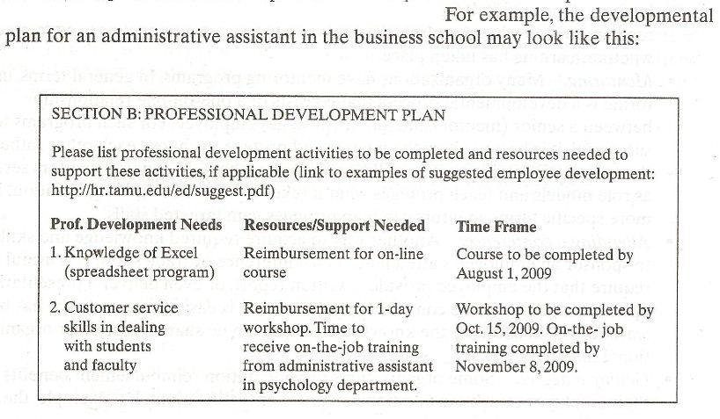

Slide 26
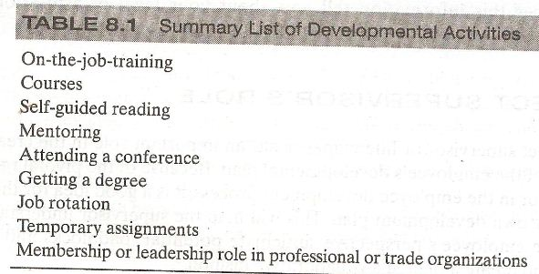
DEVELOPMENTAL ACTIVITIES

Slide 27
Direct Supervisors Role
The direct supervisor or the line manager has an important role in the creation and completion of the employees developmental plan.
Because of a pivotal role of the direct supervisor in the employee developmental process, it is a good idea for the supervisor to have her own developmental plan.

Slide 28
Direct Supervisors Role (Contd.)
This will help the supervisor understand the process from the employees prospective, anticipate potential roadblocks and defensive attitudes, and create a plan in a collaborative fashion.

Slide 29
360 Degree Feedback System
The 360 degree feedback system has become a preferred tool for helping employees, particularly those in supervisory roles, improve performance by gathering information on their performance from different groups.
These systems are called 360 degree systems because information is gathered from individuals all around the employee.

Slide 30
360 Degree Feedback System (Contd.)
Specifically, information on what performance dimensions could be improved is gathered from supervisors, peers, customers, and subordinates.
This information is usually collected anonymously to minimize rating inflation.

Slide 31
360 Degree Feedback System (Contd.)
Employees also rate themselves on the various performance dimensions and compare self perceptions with the information provided by others.
A gap analysis is conducted to examine the areas for which there are large discrepancies between self perception and the perception of others.

Slide 32
360 Degree Feedback System (Contd.)
A 360 degree feedback system reports usually includes information on dimensions for which there is agreement that further development is needed.
This information is used to create a developmental plan as described earlier.

Slide 33
Performance management skills
Performance management systems are NOT likely to help employees develop and improve their performance if managers do not have the necessary skills to help employees accomplish their goals.

Slide 34
Performance management skills (Contd.)
Such skills include;
  being able to serve as coaches,
  to observe, and
  document performance accurately,
  To give both positive and negative feedback,
  And to conduct useful and constructive performance review discussions.

Slide 35
Coaching
Coaching is a collaborative, ongoing process in which the manger interacts with his or her employees and takes an active role and interest in their performance.
In general, coaching involves directing, motivating, and rewarding employee behavior.

Slide 36
Coaching (Contd.)
Coaching is a day to day function that involves observing performance, complimenting good work, and helping to correct and improve any performance that does not meet expectations and standards.

Slide 37
Coaching (Contd.)
Coaching is also concerned with long term performance and involves ensuring that the developmental plan is being achieved.
Being a coach thus is similar to serving as a consultant and for coaching to be successful, a coach must establish a helping relationship.

Slide 38
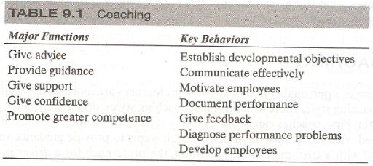


Slide 39
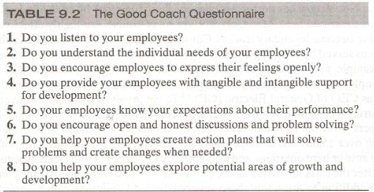
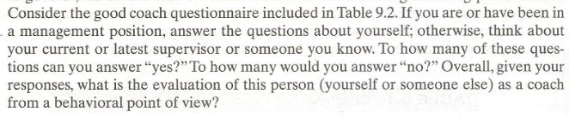

Slide 40
Coaching styles
A manager personality and behavioral preference are more likely to influence his or her coaching styles.
There are four main coaching styles:
  Driver
  Persuader
  Amiable
  Analyzer

Slide 41
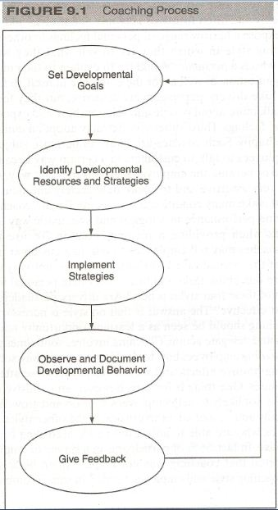

Slide 42
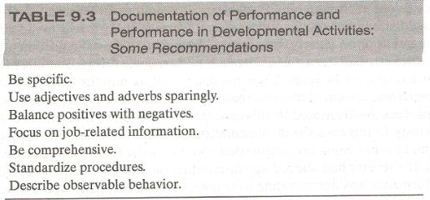

Slide 43
Giving Feedback
Giving feedback to an employee regarding her progress towards achieving her goals is a key component of the coaching process.
Feedback is information about past behavior that is given with goal of improving future performance.

Slide 44
Giving Feedback (Contd.)
Feedback includes information about both positive and negative aspects of job performance and lets employee know how well they are doing with respect to meeting the established standards.

Slide 45
Purposes of Feedback
Feedback is not a magic bullet for performance improvement, however it serves several important purposes.
Helps build confidence:
  Praising good performance builds employee confidence regarding future performance.

Slide 46
Purposes of Feedback (Contd.)
Develops competence:
  Communicating clearly about what has been done right and how to do the work correctly is valuable information that helps employees become more competent and improve their performance.
Enhances involvement:
  Receiving feedback and discussing performance issues allow employees to understand their roles in the unit and organization as a whole.

Slide 47
Negative feedback
Negative feedback includes information that performance has fallen short of accepted standards.
The goal of providing negative feedback is to help employees improve their performance in the future;
  it is not to punish,
    embarrass, or
    chastise them.

Slide 48
Traditional Pay Plans
A traditional approach in implementing reward system is to reward employees for the positions they fill as indicated by their jobs and not necessarily by how they do their work.
In other words, employees are rewarded for filling a specific slot in the organizational hierarchy.

Slide 49
Contingent Pay Plans
Contingent pay(CP) also called pay for performance, means that individuals are rewarded based on how well they perform on job.
Thus, employees receive increase in pay based wholly or partially on job performance.

Slide 50
CP systems for different organizational cultures:
Traditional organizations
  Piece rate
  Sales commissions
  Group incentives
Involvement organizations
  Profit sharing
  Skill-based pay

Slide 51
Pay structures (Contd.)
Several job evaluation methods are available but the most popular are;
  Ranking,
  Classification, and
  Point.

Slide 52
Basic Principle of Legislation
Legislation and court cases in many other countries around the world indicate that discriminatory effects of a performance management system can be minimized by applying the basic principle:
  Treat everyone in exactly the same way.
    Unfortunately this does not happen very often.
    As a consequence, there has been an increase in number of employment discrimination cases filed and many of these cases have involved issues around the design and implementation of the performance management system.

Slide 53
Team Performance
Team performance does not always fulfill its promise; therefore, it makes sense for performance management systems to go beyond focusing on individual performance.
Specifically, the system should target not only
  Individual performance but also
  An individuals contribution to the performance of his or her team
  Performance of team as a whole.

Slide 54
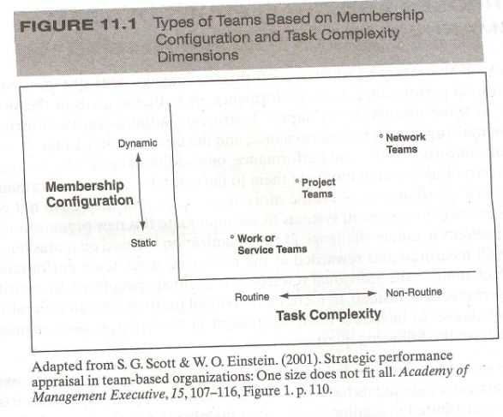

Slide 55
Rewarding Team Performance (Contd.)
Organizations can reward team performance in a ways similar to those in which they reward individual performance.

Slide 56
Thank You

