Slide 1
HRM-755
PERFORMANCE MANAGEMENT
LECTURE: TWENTY NINE
OSMAN BIN SAIF

Slide 2
Summary of Previous Lecture
CASE STUDY– DEVELOPMENTAL PLAN FORM
CHAPTER 9 FROM SECTION 3;
  PERFORMANCE MANAGEMENT SKILLS
Performance management Skills
Coaching
Guiding Principles for Successful Coaching
Functions of Coaching
Coach Engagement
Good Coach
Coaching Styles

Slide 3
Agenda for Today’s Lecture
Coaching Process
Observation and Documentation of Developmental Behavior and Outcomes
Constraints in Observing and Evaluating Performance
Reasons for Documentation of Progress
Recommendations for Documentation of Progress

Slide 4
Agenda for Today’s Lecture (Contd.)
Giving Feedback
Purposes of Feedback
Enhancing Feedback
Praise

Slide 5
Coaching Process
The coaching process is accomplished in following manner:
The first step involves setting developmental goals.
The developing goals are a key component of the developmental plan.
These goals must be reasonable, attainable, and derived from a careful analysis of the areas in which an employee needs to improve.

Slide 6
Coaching Process (Contd.)
The second step in coaching process is to identify resources and strategies that will help the employee achieve the developmental goals.
These can include on the job training, attending courses, self guided reading, mentoring, attending a conference, getting a degree, job rotation, a temporary assignment, and membership or a leadership role in a professional or trade organization.

Slide 7
Coaching Process (Contd.)
The third step involves implementing the strategies that will allow the employees to achieve the developmental goals.

Slide 8
Coaching Process (Contd.)
The fourth step is to collect and evaluate data to assess the extent to which each of developmental goals has been achieved.

Slide 9
Coaching Process (Contd.)
The final step is the coach provides feedback to the employee, and based on the extent to which each of the goals has been achieved, the developmental goals are revised and the entire process begins again.

Slide 10
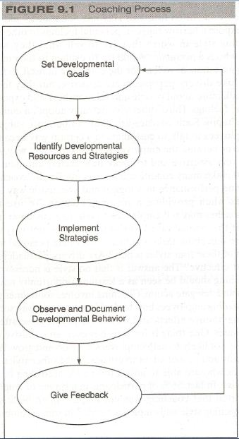

Slide 11
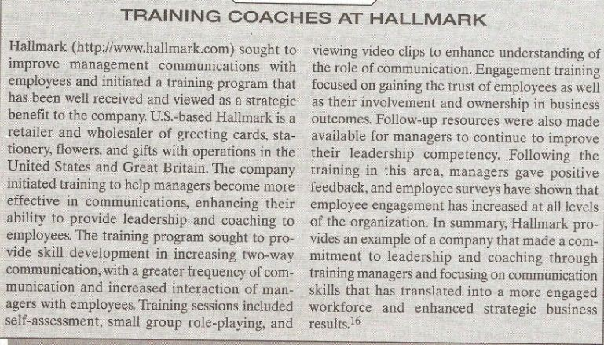

Slide 12
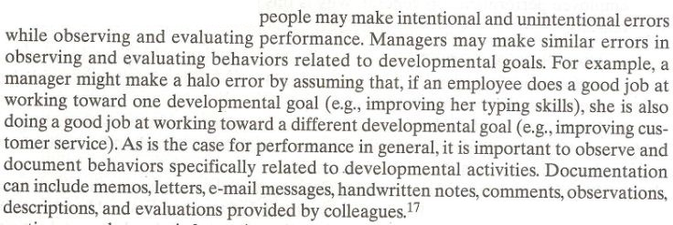
Observation and Documentation of Developmental Behavior and Outcomes
Observing an employees progress in achieving developmental goals is not as easy as it may seem.

Slide 13
Constraints in Observing and Evaluating Performance
Consider the following constraints that managers might experience in attempting to observe an employees performance regarding developmental activities.
Time constraints:
  Managers might be too busy to gather and document information about an employees progress towards his developmental goals.

Slide 14
Constraints in Observing and Evaluating Performance (Contd.)
Situational constraints:
  Managers are often unable to observe employees as they engage in developmental activities and therefore may not have firsthand knowledge about their performance.

Slide 15
Constraints in Observing and Evaluating Performance (Contd.)
Activity constraints:
  When the developmental activity is highly unstructured, such as an employees reading a book, the manager may have to wait until the activity is completed to assess whether the activity has been beneficial.

Slide 16
Reasons for Documentation of Progress
The importance of documenting an employees progress toward the achievement of developmental goals cannot be over emphasized.
It is critical to document employee performance in general.

Slide 17
Reasons for Documentation of Progress (Contd.)
Why is this so important? Consider the following reasons:
Minimize cognitive load:
  Observing and evaluating developmental activities and performance in general, is a complex cognitive task.

Slide 18
Reasons for Documentation of Progress (Contd.)
Create trust:
  When documentation exists to support evaluations, there is no mystery regarding the outcomes.
Plan for the future:
  Documenting developmental activities and their outcomes enables discussion about specific facts instead of assumptions and hearsay.

Slide 19
Reasons for Documentation of Progress (Contd.)
Provide legal protection:
  Specific laws prohibit discrimination against members of various classes in how developmental activities are allocated.

Slide 20
Recommendations for Documentation of Progress
What can manager do to document performance regarding developmental activities and performance in general, in a useful and constructive way?
Consider the following recommendations.
Be specific:
  Document specific events and outcomes.
  Avoid making general statements (He is Lazy).

Slide 21
Recommendations for Documentation of Progress (Contd.)
Use adjectives and adverbs sparingly:
  The use of evaluative adjectives and adverbs may lead to ambiguous interpretations.
  (e.g good, poor, speedily, sometimes)
Balance positive with negatives:
  Document instance of both good and poor performance.
  Do not focus on only positives or only negatives.

Slide 22
Recommendations for Documentation of Progress (Contd.)
Focus on job related information:
  Focus on information that is job related and specifically related to the developmental activities and goals at hand.
Be comprehensive:
  Include information on performance regarding all developmental goals and activities and cover the entire review period as opposed to a shorter time period.

Slide 23
Recommendations for Documentation of Progress (Contd.)
Standardize procedure:
  Use the same method and format to document information for all employees.
Describe observable behavior:
  Phrase your notes in behavioral terms and avoid statements that would imply subjective judgment or prejudice.

Slide 24
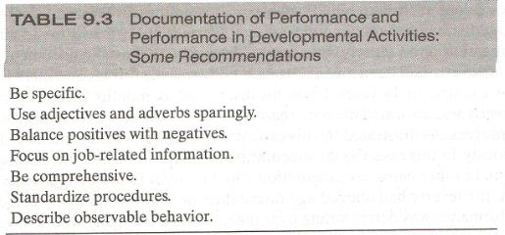

Slide 25
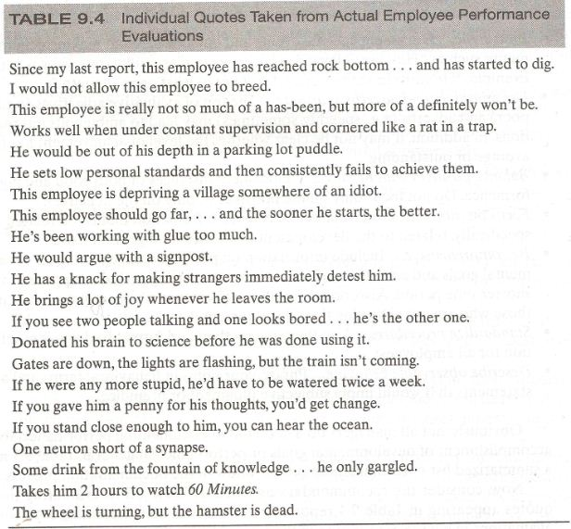

Slide 26
Giving Feedback
Giving feedback to an employee regarding her progress towards achieving her goals is a key component of the coaching process.
Feedback is information about past behavior that is given with goal of improving future performance.

Slide 27
Giving Feedback (Contd.)
Feedback includes information about both positive and negative aspects of job performance and lets employee know how well they are doing with respect to meeting the established standards.

Slide 28
Purposes of Feedback
Feedback is not a magic bullet for performance improvement, however it serves several important purposes.
Helps build confidence:
  Praising good performance builds employee confidence regarding future performance.

Slide 29
Purposes of Feedback (Contd.)
Develops competence:
  Communicating clearly about what has been done right and how to do the work correctly is valuable information that helps employees become more competent and improve their performance.
Enhances involvement:
  Receiving feedback and discussing performance issues allow employees to understand their roles in the unit and organization as a whole.

Slide 30
Enhancing Feedback
Consider the following suggestions to enhance feedback:
Timelines:
  Feedback should be delivered as close to the performance event as possible.

Slide 31
Enhancing Feedback (Contd.)
Frequency:
  Feedback should be provided on an ongoing basis daily if possible.
Specificity:
  Feedback should include specific work behaviors, results, and the situation in which these behaviors and results were observed.

Slide 32
Enhancing Feedback (Contd.)
Verifiability:
  Feedback should include information that is verifiable and accurate.
Consistency:
  Feedback should be consistent.
Privacy:
  Feedback should be given in a place and at a time that prevent any potential embarrassment.

Slide 33
Enhancing Feedback (Contd.)
Consequences:
  Feedback should include contextual information that allows the employee to understand the importance and the consequences of the behaviors and results in question.
Description first, evaluation second:
  Feedback should first focuses on describing behaviors and results rather than on evaluating and judging behaviors and results.

Slide 34
Enhancing Feedback (Contd.)
Performance continuum:
  Feedback should describe performance as a continuum, going from less to more in the case of good performance and from more to less in the case of poor performance.

Slide 35
Enhancing Feedback (Contd.)
Pattern identification:
  Feedback is most useful if it is about a pattern of poor performance rather than isolated events or mistakes.
Confidence in the employee:
  Good feedback includes a statement that the manager has confidence that the employee will be able to improve her performance.

Slide 36
Enhancing Feedback (Contd.)
Advice and idea generation:
  Feedback can include advice given by the supervisor about how to improve performance.

Slide 37
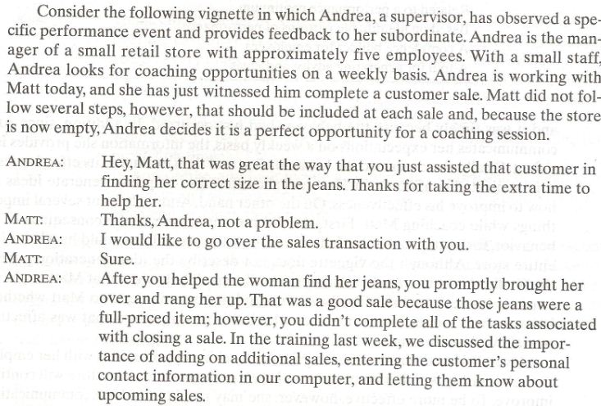

Slide 38
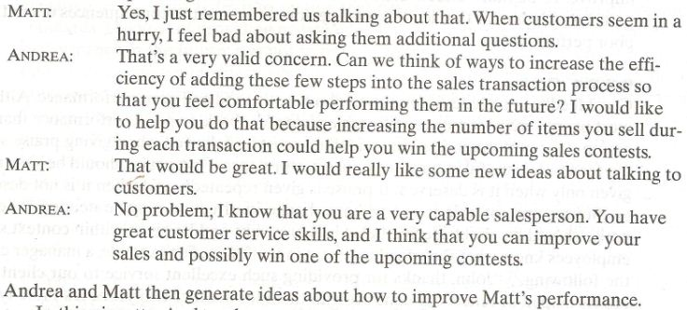

Slide 39
Praise
Good feedback includes information about both good and poor performance.
Although most people are a lot more comfortable giving feedback and performance that they are on poor performance, some guidelines must be followed when giving praise so that the feedback is useful in terms of future performance.

Slide 40
Praise (Contd.)
Praise should be sincere and given only when it is deserved.
If praise in given repeatedly and when it is not deserved, employee are not able to see when a change in direction may be needed.

Slide 41
Praise (Contd.)
Praise should be about specific behaviors or results and be given within context so that employees know what they need to repeat in the future.

Slide 42
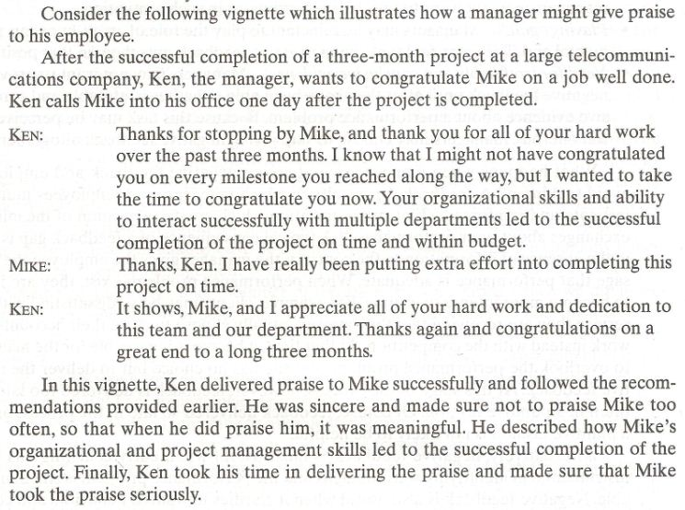

Slide 43
Summary of Today’s Lecture
Coaching Process
Observation and Documentation of Developmental Behavior and Outcomes
Constraints in Observing and Evaluating Performance
Reasons for Documentation of Progress
Recommendations for Documentation of Progress

Slide 44
Summary of Today’s Lecture (Contd.)
Giving Feedback
Purposes of Feedback
Enhancing Feedback
Praise

Slide 45
Thank You

