Slide 1
HRM-755
PERFORMANCE MANAGEMENT
LECTURE: TWENTY EIGHT
OSMAN BIN SAIF

Slide 2
Summary of Previous Lecture
Check Point – 360-degree System Case Analysis---- Continued
360-degree System Beneficial or NOT Beneficial?
Advantages of 360 degree feedback system
Risks for implementing 360 degree feedback system
Characteristic of a Good System
CASE--- 360-degree feedback at AAH pharmaceuticals

Slide 3
Agenda for Today’s Lecture
CASE STUDY– DEVELOPMENTAL PLAN FORM
CHAPTER 9 FROM SECTION 3;
  PERFORMANCE MANAGEMENT SKILLS
Performance management Skills
Coaching
Guiding Principles for Successful Coaching
Functions of Coaching
Coach Engagement
Good Coach
Coaching Styles

Slide 4
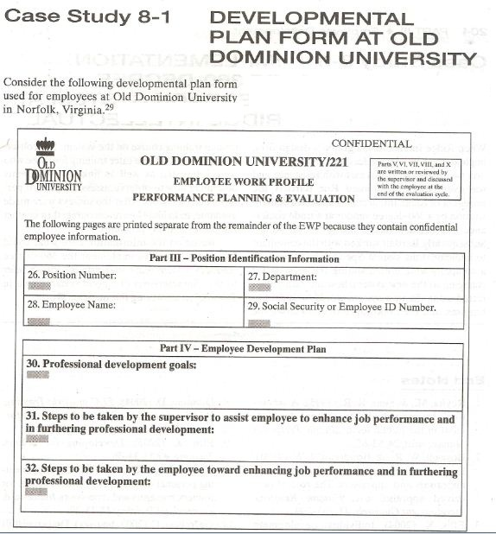

Slide 5
CHAPTER 9
PERFORMANCE MANAGEMENT SKILLS
“A leader becomes complete only after giving something back” --- LAURENCE S. LYONS

Slide 6
Performance management skills
Performance management systems are NOT likely to help employees develop and improve their performance if managers do not have the necessary skills to help employees accomplish their goals.

Slide 7
Performance management skills (Contd.)
Such skills include;
  being able to serve as coaches,
  to observe, and
  document performance accurately,
  To give both positive and negative feedback,
  And to conduct useful and constructive performance review discussions.

Slide 8
Coaching
Coaching is a collaborative, ongoing process in which the manger interacts with his or her employees and takes an active role and interest in their performance.
In general, coaching involves directing, motivating, and rewarding employee behavior.

Slide 9
Coaching (Contd.)
Coaching is a day to day function that involves observing performance, complimenting good work, and helping to correct and improve any performance that does not meet expectations and standards.

Slide 10
Coaching (Contd.)
Coaching is also concerned with long term performance and involves ensuring that the developmental plan is being achieved.
Being a coach thus is similar to serving as a consultant and for coaching to be successful, a coach must establish a helping relationship.

Slide 11
Guiding Principles for Successful Coaching
Although many theories on coaching exist, there are four guiding principles that provide a good framework for understanding successful coaching.
A good coaching relationship is essential:
  For coaching to work, it is imperative that the relationship between the coach and the employee be trusting and collaborative.
  The coach needs to try to walk in employees shoes and view the job and organization from his or her perspective.

Slide 12
Guiding Principles for Successful Coaching (Contd.)
  The coach also need to search for positive aspects of the employee because this is likely to lead to a better understanding and acceptance of the employee.
  The coach needs to understand that coaching is not something done to the employees but done with the employees.

Slide 13
Guiding Principles for Successful Coaching (Contd.)
The employee is the source and director of change:
  The coach must understand that the employee is the source of change and self growth.
  After all, the purpose of coaching is to change employee behavior and set a direction for what the employee will do differently in the future.

Slide 14
Guiding Principles for Successful Coaching (Contd.)
  This change will not happen if the employee is not in the driving seat.
  Accordingly the coach needs to facilitate the employee’s setting the agenda, goals and direction.

Slide 15
Guiding Principles for Successful Coaching (Contd.)
The employee is whole and unique:
  The coach must understand that each employee is a unique individual with several job related and job unrelated identities and a unique personal history. (e.g computer network specialist, father, skier)
  The coach must try to create a whole, complete and rich picture of the employee.

Slide 16
Guiding Principles for Successful Coaching (Contd.)
  It will be beneficial if the coach has knowledge of and can help the employee connect his life and work experiences in meaningful ways.

Slide 17
Guiding Principles for Successful Coaching (Contd.)
The coach is the facilitator of the employees growth:
  The coach main role is one of facilitation.
  A coach must direct the process and help with the content (e.g of a developmental plan) but not take control of these issues.

Slide 18
Guiding Principles for Successful Coaching (Contd.)
  The coach needs to maintain an attitude of exploration, help expand the employee’s awareness of strengths, resources and challenges and facilitate goal setting.

Slide 19
Functions of Coaching
In more specific terms, coaching involves the following functions:
Giving advice to help employee improve their performance.
Providing employees with guidance so that employees can develop their skills and knowledge appropriately.
Providing employees support and being there only when the manager is needed.

Slide 20
Functions of Coaching (Contd.)
Giving employees confidence that will enable them to enhance their performance continuously and to increase their sense of responsibility for managing their own performance.

Slide 21
Functions of Coaching (Contd.)
Helping employees gain greater competence by guiding them towards acquiring more knowledge and sharpening the skills that can prepare them for more complex tasks and higher level positions.
Coaching involves a consideration of both short term and long term objectives, including how the employee can benefit from acquiring new skills and knowledge that could be useful in future positions and in novel tasks.

Slide 22
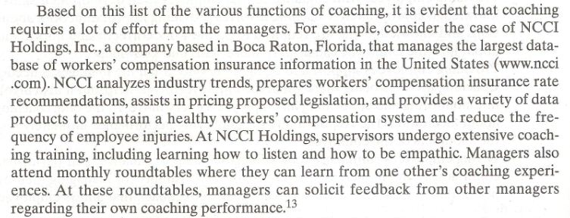

Slide 23
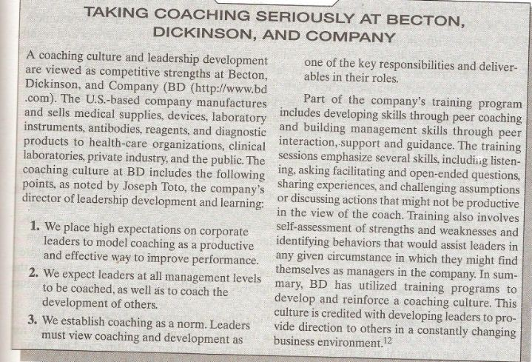

Slide 24
Coach Engagement
Coaching help turns feedback into results. For this to happen, coaches need to engage in the following:
Establish development objectives:
  The manger works jointly with the employees in creating the developmental plan and its objectives.

Slide 25
Coach Engagement (Contd.)
Communicate effectively:
  The manager maintains regular and clear communication with employees about their performance, including both behaviors and results.

Slide 26
Coach Engagement (Contd.)
Motivate employees:
  Managers must reward positive performance.
  When positive performance is rewarded, employees are motivated to repeat the same level of positive performance in the future.

Slide 27
Coach Engagement (Contd.)
Document performance:
  Managers observe employee behavior and results. Evidence must be gathered regarding instance of good and poor performance.

Slide 28
Coach Engagement (Contd.)
Give feedback:
  Managers measure employee performance and progress towards goal. They praise good performance an point out instance of substandard performance.

Slide 29
Coach Engagement (Contd.)
Diagnose performance problems:
  Managers must listen to employees and gather information to determine whether performance deficiencies are the result of a lack of knowledge and skills, abilities or motivation or whether they stem from situational factors beyond the control of the employee.

Slide 30
Coach Engagement (Contd.)
Develop employees:
  Managers provide financial support and resources for employee development by helping employees plan for future and by giving challenging assignments that force employees to learn new things.

Slide 31
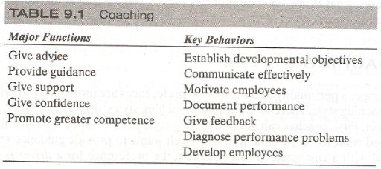


Slide 32
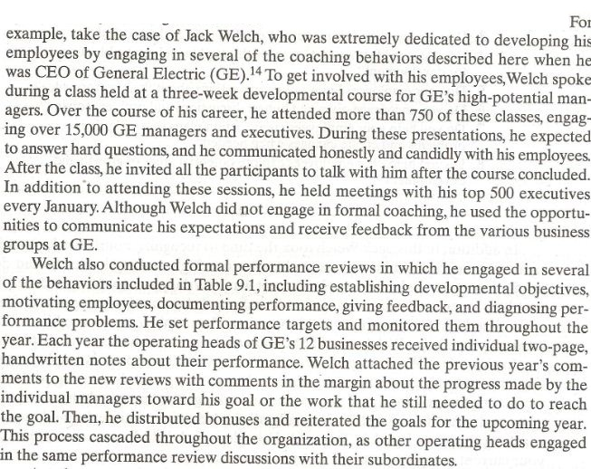

Slide 33
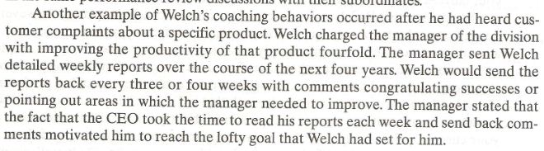

Slide 34
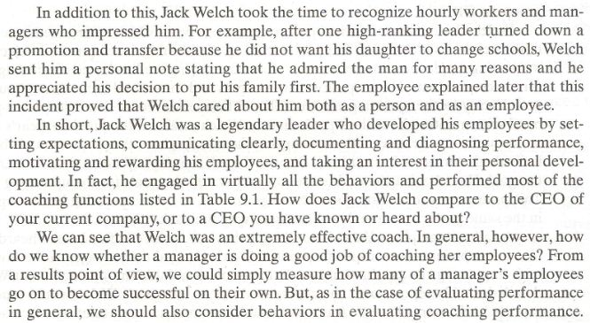

Slide 35
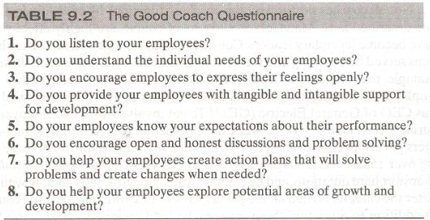
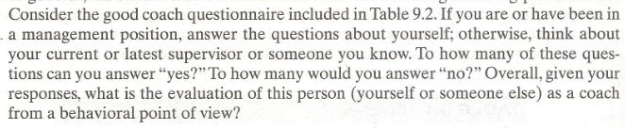

Slide 36
Coaching styles
A manager personality and behavioral preference are more likely to influence his or her coaching styles.
There are four main coaching styles:
  Driver
  Persuader
  Amiable
  Analyzer

Slide 37
Coaching styles (Contd.)
First, coaches can adopt a driving style in which they tell the employee being coached what to do.
Assume that the coach wants to provide guidance regarding how to deal with a customer.
In this situation, the preference for a driver is to say to the employee “you must talk to customer in this way”.

Slide 38
Coaching styles (Contd.)
Such coaches are assertive, speak quickly and often firmly, usually talk about facts and tasks, are not very expressive and expose a narrow range of personal feelings to others.

Slide 39
Coaching styles (Contd.)
Second, coaches can use a persuading style in which they try to sell what they want the employee to do.
Someone who is a persuader would try to explain to the employee why it is beneficial for the organization, as well as for the employee himself, to talk to a customer in a specific way.

Slide 40
Coaching styles (Contd.)
Third, other coaches may adopt an amiable style and want every one to be happy.
Such coaches are likely to be more subjective than objective and direct employees to talk to customers in a certain way because it feels like the right thing to do or because the employee feels it is a right way to do it.

Slide 41
Coaching styles (Contd.)
Finally, coaches may have a preference for analyzing performance in a logical and systemic way an then follow rules and procedures when providing a recommendation.
To use the same example, such analyzer coaches may tell employees to talk to a customer in a specific way “because this is what the manual says.”

Slide 42
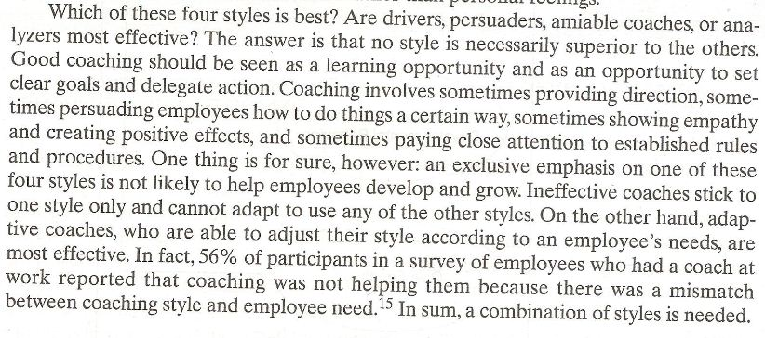

Slide 43
Summary of Today’s Lecture
CASE STUDY– DEVELOPMENTAL PLAN FORM
CHAPTER 9 FROM SECTION 3;
  PERFORMANCE MANAGEMENT SKILLS
Performance management Skills
Coaching
Guiding Principles for Successful Coaching
Functions of Coaching
Coach Engagement
Good Coach
Coaching Styles

Slide 44
Thank You

