Slide 1
HRM-755
PERFORMANCE MANAGEMENT
LECTURE: TWENTY SEVEN
OSMAN BIN SAIF

Slide 2
Summary of Previous Lecture
360 Degree Feedback System
Internet- based 360-degree systems
Check Point – 360-degree System Case Analysis

Slide 3
Agenda for Today’s Lecture
Check Point – 360-degree System Case Analysis---- Continued
360-degree System Beneficial or NOT Beneficial?
Advantages of 360 degree feedback system
Risks for implementing 360 degree feedback system
Characteristic of a Good System
CASE--- 360-degree feedback at AAH pharmaceuticals

Slide 4
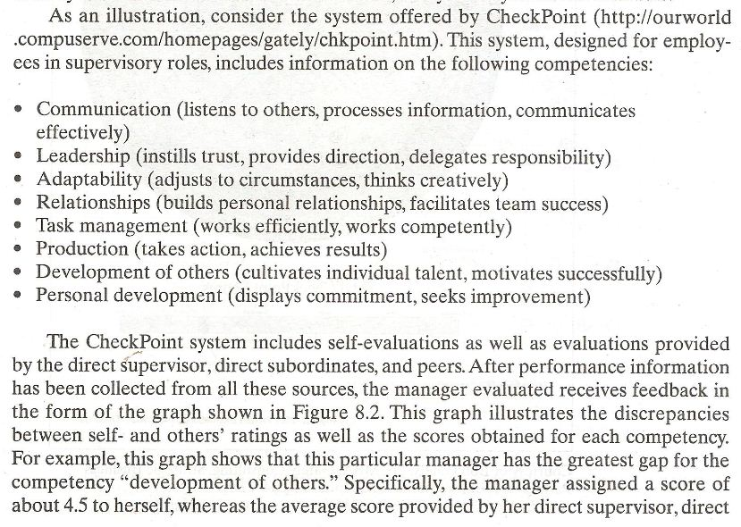

Slide 5
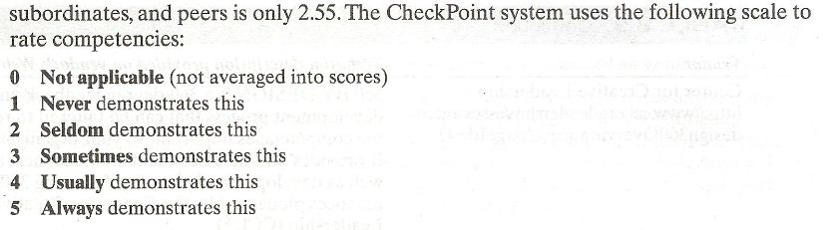

Slide 6
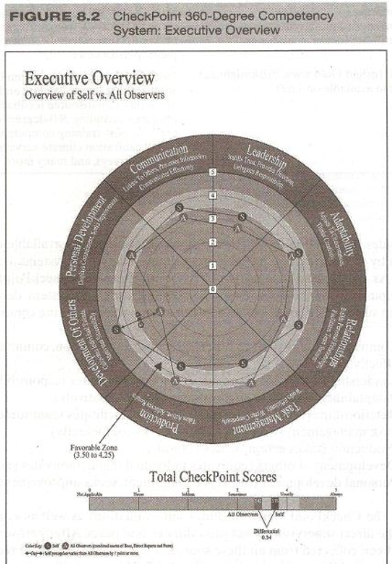

Slide 7
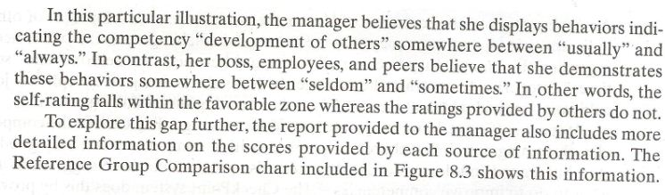

Slide 8
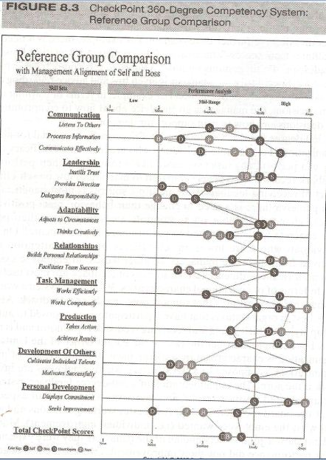

Slide 9
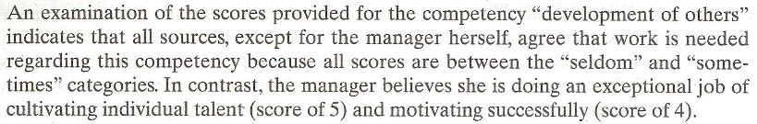

Slide 10
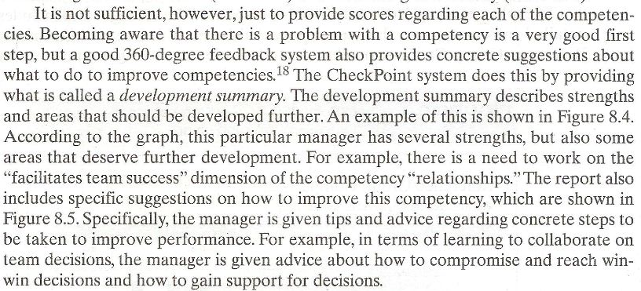

Slide 11
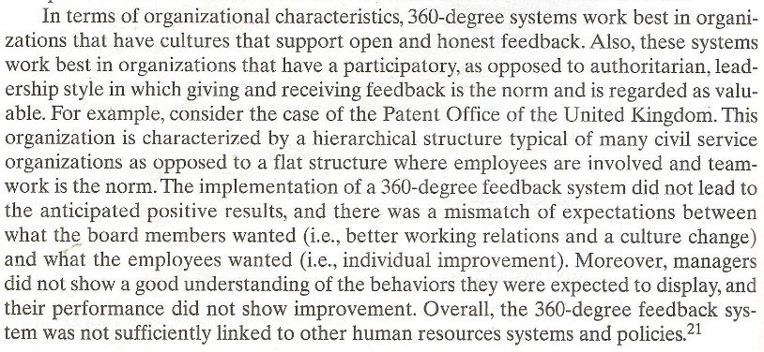

Slide 12
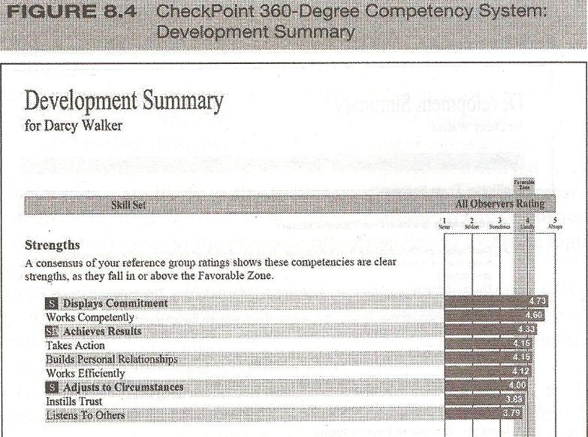

Slide 13
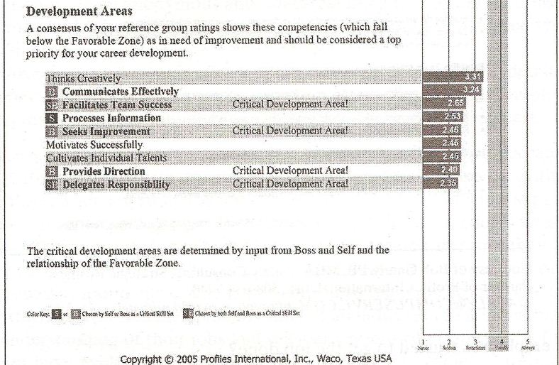

Slide 14
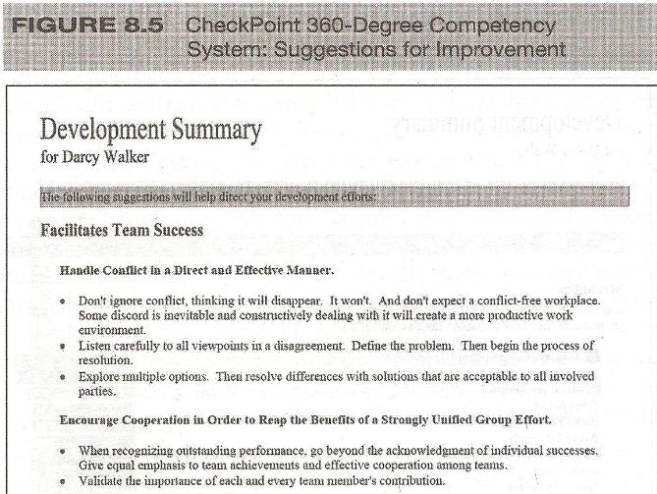

Slide 15
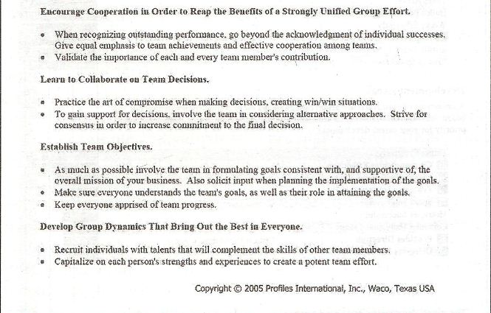

Slide 16
360-degree System Beneficial or NOT Beneficial?
The following questions give good insight as to whether implementing a 360-degree system would be beneficial in a specific organization.
Are decisions that are made about rewards and promotions fairly free of favoritism?

Slide 17
360-degree System Beneficial or NOT Beneficial? (Contd.)
Are decisions made that take into account the input of people affected by such decisions?
Do people from across departments usually cooperate with each other and help each other?

Slide 18
360-degree System Beneficial or NOT Beneficial? (Contd.)
Is there little or no fear of speaking up?
Do people believe that their peers and subordinates can provide valuable information about their performance?
Are employees trusted to get the job done?

Slide 19
360-degree System Beneficial or NOT Beneficial? (Contd.)
Do people want to improve their performance?

Slide 20
360-degree System Beneficial or NOT Beneficial? (Contd.)
In sum, the successful implementation of a 360-degree feedback system is heavily dependent on the culture of the organization and the work context.
If the answer to most of these questions is ‘yes’, the implementation of a 360-degree feedback system is likely to be successful and leads to performance implementation.

Slide 21
Advantages of 360 degree feedback system
Organizations and individual can gain several advantages as a consequence of implementing a 360 degree feedback system. These include the following
Decreased possibility of biases:
  Because these systems include information from more than one sources, there is decreased possibility of biases in the identification of employees weaknesses.

Slide 22
Advantages of 360 degree feedback system (Contd.)
Increased awareness of expectations:
  Employees become very aware of others expectations about their performance.
  This include not only the supervisors expectations but also the expectations of other managers, coworkers, subordinates and customers.

Slide 23
Advantages of 360 degree feedback system (Contd.)
Increased commitment to improve:
  Because of the positive and acceptance attitude of the employee for the feedback, as the feedback is provided by the people nominated by the employee.

Slide 24
Advantages of 360 degree feedback system (Contd.)
Improve self-perceptions of performance:
  Employees distorted views of their own performance are likely to change as a result of the feedback received from other sources.

Slide 25
Advantages of 360 degree feedback system (Contd.)
Improved performance:
  Although receiving information about ones performance is not sufficient to improve, it is certainly a very important step.

Slide 26
Advantages of 360 degree feedback system (Contd.)
Deduce discussable:
  360 degree feedback systems provide an excellent opportunities to coworkers, supervisors, and subordinates to give information about performance in an anonymous and nonthreatening way.

Slide 27
Advantages of 360 degree feedback system (Contd.)
Employees enable to take control of their careers:
  By receiving detailed and constructive feedback on weakness and strengths in various areas, employees can gain a realistic assessment of where they should go with their careers.

Slide 28
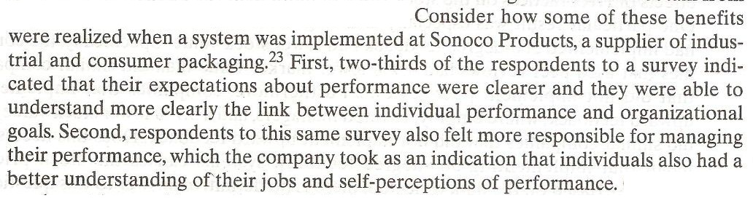

Slide 29
Risks for implementing 360 degree feedback system
The risk for implementing 360 degree feedback system is as
Negative feedback can hurt an employees feelings, particularly if those giving the feedback do not offer their comments in a constructive way.

Slide 30
Risks for implementing 360 degree feedback system (Contd.)
The system is likely to lead to positive results only if individuals feel comfortable with the system and believe they will be rated honestly and treated fairly.

Slide 31
Risks for implementing 360 degree feedback system (Contd.)
When very few raters are providing the information, say, two or three, it may be easy for the employee being rated to identify who the rater are.
Raters may become overloaded with forms to fill out because they need to provide information on so many individuals.

Slide 32
Risks for implementing 360 degree feedback system (Contd.)
Implementing a 360 degree feedback system should not be a one time only event. The system should be in place and data collected over time on an ongoing basis.

Slide 33
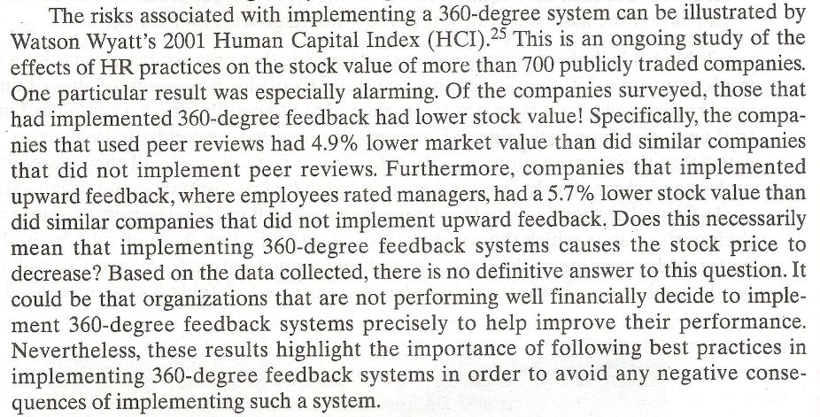

Slide 34
Characteristic of a Good System
When the system have the following characteristics, they are most likely to be successful:
Anonymity:
  In good systems, feedback is anonymous and confident.

Slide 35
Characteristic of a Good System (Contd.)
Observation of employee performance:
  Only those with good knowledge and first hand experience with the person being rated should participate the process.
Feedback interpretation:
  Good systems allow the person being rated to discuss the feedback received with a person interested in the employees development.

Slide 36
Characteristic of a Good System (Contd.)
Follow up:
  The information gathered has little value if there is no follow up action. Once feedback is received, it is essential that a developmental plan is created right away.
Used for developmental purposes only:
  When 360 degree feedback systems are used for administrative purposes such as promotions and compensation, raters are likely to distort the information provided.

Slide 37
Characteristic of a Good System (Contd.)
Avoidance of survey fatigue:
  Survey fatigue can be avoided if individuals are not asked to rate too many employees at the same time.

Slide 38
Characteristic of a Good System (Contd.)
Emphasis on behaviors:
  Although systems can include feedback on both behavior and results, it is better to emphasize behaviors.
Raters go beyond ratings:
  In addition to providing scores on various dimensions, raters should provide written descriptive feedback that gives detailed and constructive comments on how to improve performance.

Slide 39
Characteristic of a Good System (Contd.)
Raters are trained:
  As in the case of providing evaluations for administrative purposes, raters should be trained. Mainly, this includes skills to discriminate good from poor performance and how to provide feedback in a constructive manner.

Slide 40
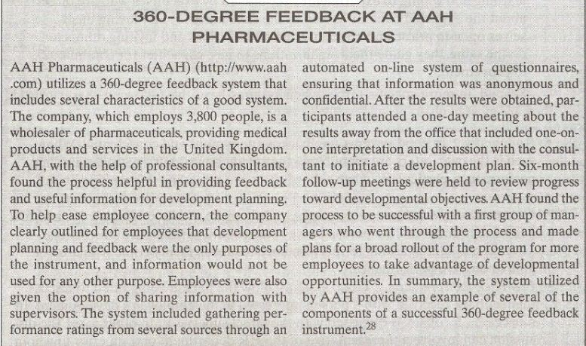

Slide 41
Summary of Today’s Lecture
Check Point – 360-degree System Case Analysis---- Continued
360-degree System Beneficial or NOT Beneficial?
Advantages of 360 degree feedback system
Risks for implementing 360 degree feedback system
Characteristic of a Good System
CASE--- 360-degree feedback at AAH pharmaceuticals

Slide 42
Thank You

