Slide 1
HRM-755
PERFORMANCE MANAGEMENT
LECTURE: TWENTY FOUR
OSMAN BIN SAIF

Slide 2
Summary of Previous Lecture
Self Efficacy Training
Summary Raters Errors
Pilot Testing
Ongoing Monitoring and Evaluation

Slide 3
Agenda for Today’s Lecture
SECTION 3; EMPLOYEE DEVELOPMENT
CHAPTER 8- PERFORMANCE MANAGEMENT AND EMPLOYEE DEVELOPMENT
  Personal Developmental Plan
  Objectives of Developmental Plan
  Content of Developmental Plan
  Development Activities

Slide 4
CHAPTER 8
PERFORMANCE MANAGEMENT AND EMPLOYEE DEVELOPMENT
“One of the test of Leadership is the ability to recognize a problem before it becomes an emergency”– ARNOLD H. GLASOW

Slide 5
Personal Developmental Plan
Personal developmental plan specifies courses of action to be taken to improve performance. Achieving the goals stated in the developmental plan allows employees to keep abreast of changes in their field or profession.

Slide 6
Personal Developmental Plan (Contd.)
Such plans highlight an employees strengths and areas in need of development, and they provide an action plan to improve in areas of weakness and further develop areas of strength.

Slide 7
Personal Developmental Plan (Contd.)
The personal developmental plan allow employees to answer the following questions:
  How can I continually learn and grow in the next year?
  How can I do better in the future?
  How can I avoid performance problems faced in the past?

Slide 8
Personal Developmental Plan (Contd.)
Developmental plans can be created for every job, ranging from entry level to the executive suite.
No matter how high up the position within the organization and how simple or complex the nature of job in question, there is always room for improvement.

Slide 9
Personal Developmental Plan (Contd.)
Information to be used in developmental plans comes from the appraisal form.
Specifically, a developmental plan can be designed based on each of the performance dimensions evaluated.

Slide 10


Slide 11


Slide 12
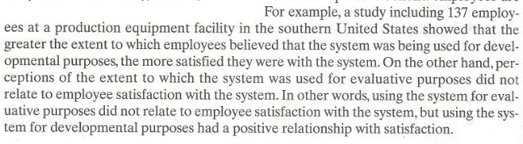

Slide 13
Developmental Plan Objectives
The overall objective of developmental plan is to encourage continuous learning performance improvement, and personal growth.

Slide 14
Developmental Plan Objectives (Contd.)
In addition developmental plans have other, more specific objectives:
  Improve performance in current job:
    A good developmental plan helps employees meet performance standards.
    Thus, a developmental plan includes suggested courses of action to address each of performance dimensions that are deficient.

Slide 15
Developmental Plan Objectives (Contd.)
  Sustain performance in current job:
    A good developmental plan provides tool so that employees can continue to meet and exceed expectations regarding the current job.

Slide 16
Developmental Plan Objectives (Contd.)
  Prepare employees for advancement:
    A good developmental plan includes advice and courses of action that should be taken so that employees will be able to take advantage of future opportunities and career advancement.

Slide 17
Developmental Plan Objectives (Contd.)
  Enrich the employees work experience:
    Even if career opportunities within the organization are not readily available, a good plan provides employees with growth opportunities and opportunities to learn new skills.

Slide 18
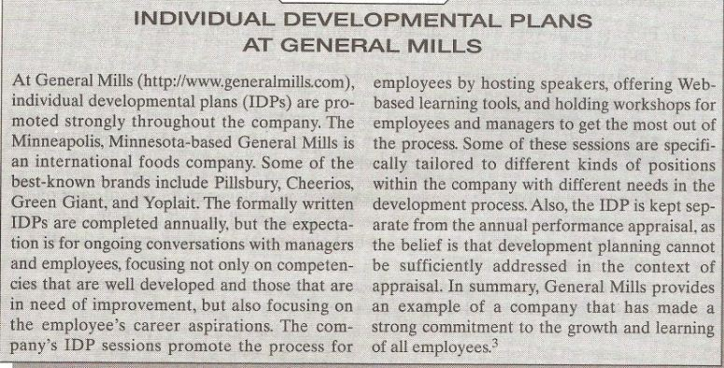

Slide 19
Developmental Plan Objectives (Contd.)
Consider the employee developmental plan used by Texas A and M university in college station, Texas.
Since the developmental plan is a formal component of the university’s performance management system, the developmental plan is included within the appraisal form.

Slide 20
Developmental Plan Objectives (Contd.)
The appraisal form used by Texas A and M first lists the six objectives of the performance management system:
  Provide employees with feedback to improve or maintain job performance.
  Outline areas for employee development.

Slide 21
Developmental Plan Objectives (Contd.)
  Set standards for the next review period.
  Recognize job related accomplishments.

Slide 22
Developmental Plan Objectives (Contd.)
  Enhance communication and working relationships.
  Identify job performance deficiencies and report to the next level of supervisory responsibility.

Slide 23
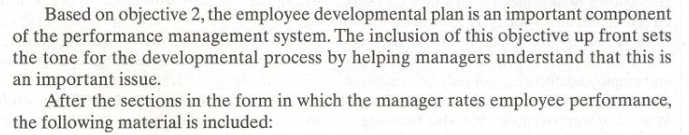

Slide 24
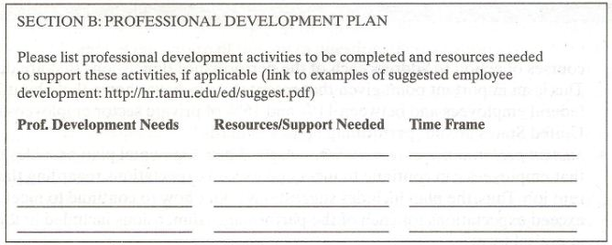

Slide 25
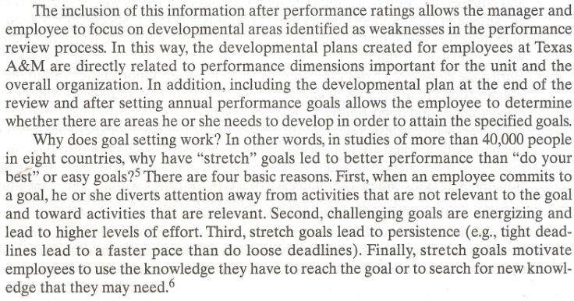

Slide 26
Content of Developmental Plan
What does a developmental plan looks like?
Plans should include a description of specific steps to be taken and specific objectives to reach.

Slide 27
Content of Developmental Plan (Contd.)
In other words, what is the new skill or knowledge that will be acquired and how will this occur?
This include information on the resources and strategies that will be used to achieve the objectives.

Slide 28
Content of Developmental Plan (Contd.)
This includes information on the resources and strategies that will be used to achieve the objectives.

Slide 29
Content of Developmental Plan (Contd.)
The plans objectives should include not only the end product, such as new skill to be learned, but also the completion date and how the supervisor will know whether the new skill has indeed been acquired.

Slide 30
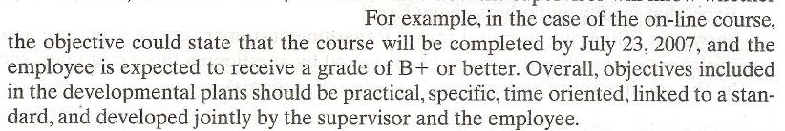

Slide 31
Content of Developmental Plan (Contd.)
An additional important feature of development plan is that they should keep the needs of both the organization and the employee in mind.
The choice of what specific skills or performance areas will be improved is dictated by the needs of the organization, especially when the organization is investing in the plan.

Slide 32
Content of Developmental Plan (Contd.)
In addition the plan created is dictated by the needs of the individual.
The supervisor and the employee need to agree on what development or new skills will help enrich the employees work experience, as well as help accomplish organizational goals now or in the near future.

Slide 33
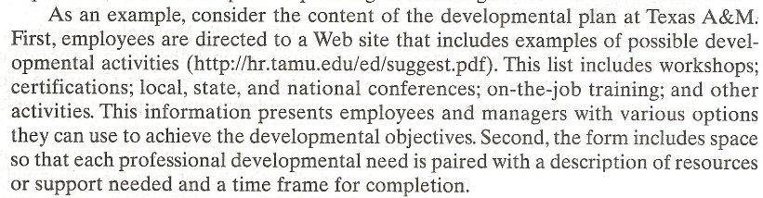

Slide 34
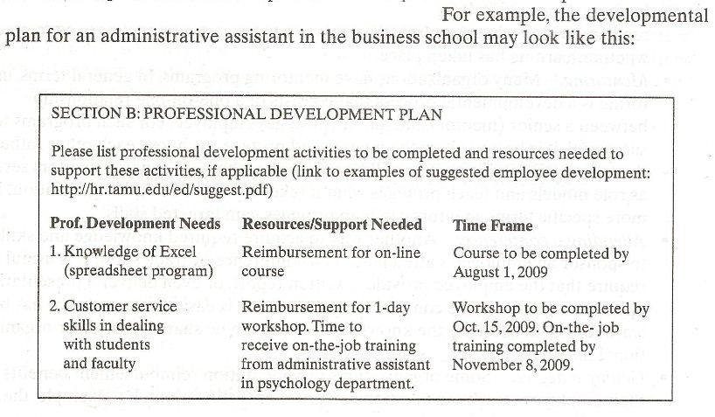

Slide 35
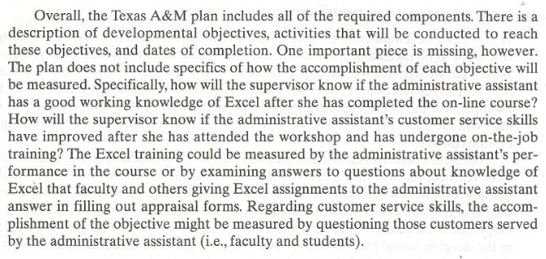

Slide 36
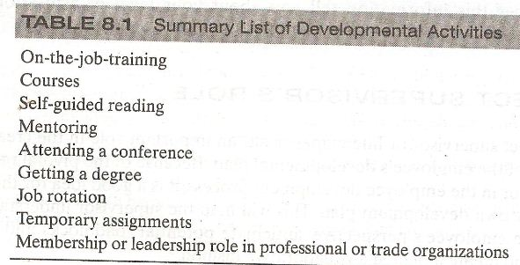
DEVELOPMENTAL ACTIVITIES

Slide 37
Summary of Today’s Lecture
SECTION 3; EMPLOYEE DEVELOPMENT
CHAPTER 8- PERFORMANCE MANAGEMENT AND EMPLOYEE DEVELOPMENT
  Personal Developmental Plan
  Objectives of Developmental Plan
  Content of Developmental Plan
  Development Activities

Slide 38
Thank You

