Slide 1
HRM-755
PERFORMANCE MANAGEMENT
LECTURE: FOURTEEN
OSMAN BIN SAIF

Slide 2
Summary of Previous Lecture
CHAPTER 6;
  GATHERING PERFORMANCE INFORMATION
    Components of Performance Management Process
    Gathering Performance Information
    Appraisal Form
    Components of Appraisal Form
    Examples of Appraisal Forms
    Characteristics of Appraisal Forms
    Desirable Features of Appraisal Forms

Slide 3
Agenda of Today’s Lecture
Determining overall rating
  Judgmental Procedure
  Mechanical Procedure
CASE Example: PA Form used by Grocery Retailer
Appraisal period and number of meeting
Possibilities of Appraisal Meetings

Slide 4
Agenda of Today’s Lecture (Contd.)
Formal Meetings
  System inauguration
  Self appraisal
  Classical performance review
  Merit/salary review
  Developmental plans
  Objectives setting

Slide 5
Determining overall rating
After the form has been completed, there is usually a need to compute an overall performance score.
This is particularly necessary for making administrative decisions such as the allocation of rewards.

Slide 6
Determining overall rating (Contd.)
Computing overall performance scores is also useful in determining whether employees and groups of employees are improving their performance over time.

Slide 7
Determining overall rating (Contd.)
Two main strategies are used to obtain an overall performance score for each employee.
Judgmental procedure
Mechanical procedure

Slide 8
Judgmental Procedure
Judgmental procedure:
  The judgmental procedure consist of considering every aspect of performance and then arriving at a defensible summary.
  Judgmental procedure basically relies on the ability of the rater to arrive at a fair and accurate overall score.

Slide 9
Mechanical Procedure
Mechanical procedure:
  The mechanical procedure consist of first considering the scores assigned to each section of the appraisal form and then adding them up to obtain an overall score.
  When adding scores from each section, weights are typically used based on the relative importance of each performance dimension measured.

Slide 10
Example 3: PA Form used by Grocery Retailer (Contd.)
Consider the following performance evaluation form, which is used to evaluate the performance of sales associate at a super market chain.
The form includes hypothetical ratings obtained by a sales associate on just two competencies and two key results.

Slide 11
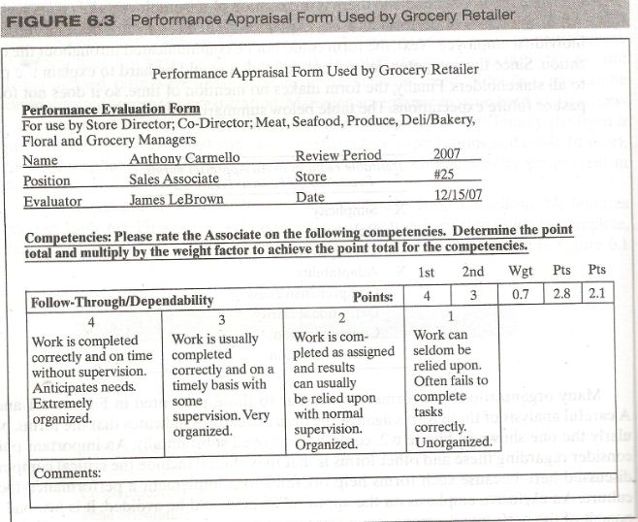
Example 3 PA Form used by Grocery Retailer

Slide 12
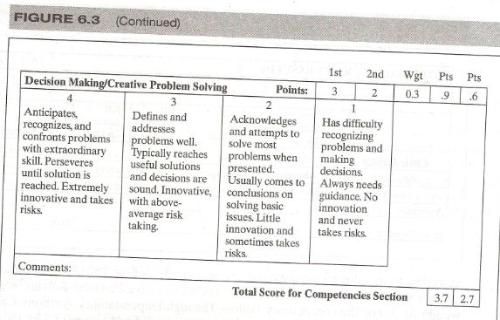

Slide 13
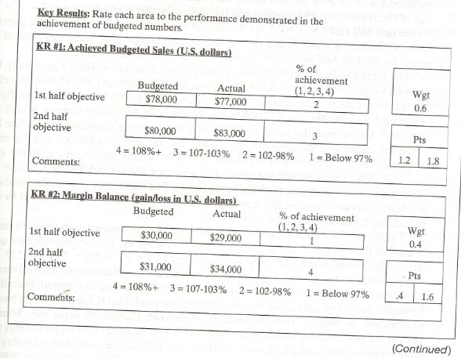

Slide 14
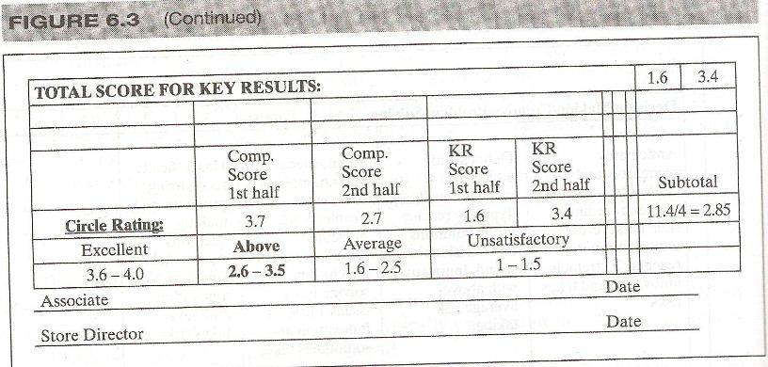

Slide 15
Determining overall rating (Contd.)
Which strategy is best, judgmental or appraisal?
In most cases, mechanical method is superior to the judgmental method.

Slide 16
Determining overall rating (Contd.)
A supervisor is more likely to introduce her own biases in computing the overall performance score when no clear rules exist regarding the relative importance of various performance dimensions and there is no direction on how to combine the various performance dimensions in circulating the overall score.

Slide 17
Appraisal period and number of meeting
How long should the appraisal period be?
What period of time should be included in the appraisal form?
What is the best time to complete the review?

Slide 18
Appraisal period and number of meeting (Contd.)
Organization with a performance management system typically conducts an annual review, however others choose to conduct semi annual or even quarterly formal reviews.
Conducting only an annual review might not provide sufficient opportunity for the supervisor and subordinates to discuss performance issues in a formal setting.

Slide 19
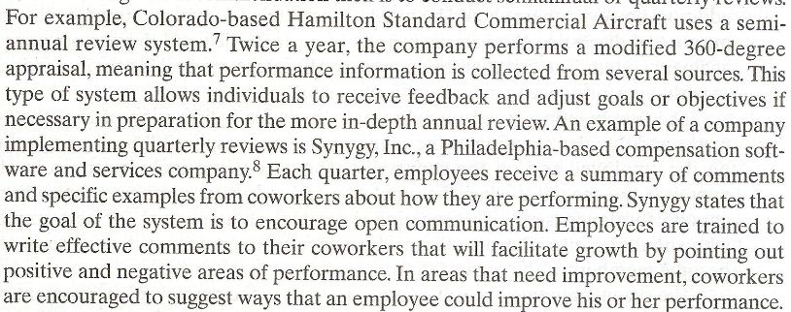

Slide 20
Possibilities of Appraisal Meetings
When is the best time to complete the reviews?
Most organization adopt one of two possibilities:
  First, the appraisal form could be completed on or around the annual anniversary date.
  In the case of semiannual reviews, the review should be six months before the annual anniversary date and the second review would be on or around the anniversary date.

Slide 21
Possibilities of Appraisal Meetings (Contd.)
Advantage of First Choice;
  The biggest advantage of this choice is that supervisors does not have to fill out everyone’s forms at one time.
Disadvantage of First Choice;
  The disadvantage of this choice is that, because results are not tied to a common cycle for all the employees, resulting rewards cannot be tied to the fiscal year.

Slide 22
Possibilities of Appraisal Meetings (Contd.)
  The second choice is to complete the appraisal forms toward the end of the fiscal year.
  In the case of system including semiannual reviews, one review would be completed halfway through the fiscal year and the other one towards the end of fiscal year.

Slide 23
Possibilities of Appraisal Meetings (Contd.)
Advantage of the second choice;
  It facilitates cross employee comparisons as well as the distribution of rewards.
  An additional advantage of following the fiscal year cycle is that individual goal setting can more easily be tied to corporate goal setting because most companies align their goal cycle with their fiscal cycle.

Slide 24
Possibilities of Appraisal Meetings (Contd.)
Disadvantage of second choice;
  Managers and supervisors are burdened by evaluating all employee at once during a short period of time.

Slide 25
Formal Meetings
Performance management system can include six formal meetings between the subordinate and the supervisor.
  System inauguration
  Self appraisal
  Classical performance review
  Merit/salary review
  Developmental plans
  Objectives setting

Slide 26
Formal Meetings (Contd.)
Informal performance discussions take place throughout the year.
In addition there should however be regularly scheduled formal meetings for the specific purpose of discussing the various aspects of performance and the performance management system.

Slide 27
Formal Meetings (Contd.)
The fact that supervisor allocates time to this activity sends a message that performance management is important.

Slide 28
System Inauguration Meeting
It includes a discussion of how the system work and the identification of the requirements and responsibilities resting primarily on the employee and on the supervisor.
This discussion includes the role of self-appraisal and the dates when the employee and supervisor will meet formally to discuss performance issues.

Slide 29
System Inauguration Meeting (Contd.)
This meeting is particularly important for new employees who should be introduced to the performance management system as soon as they become members of the organization.

Slide 30
Self- Appraisal Meeting
It involves the employee’s assessment of his or her self.
This meeting is informational in nature and at this point, the supervisor does not pass judgment on how the employee regard his/ her own performance.

Slide 31
Self- Appraisal Meeting (Contd.)
This meeting provides and opportunity for the employee to describe how she sees her own performance during the review period.

Slide 32
Classical Performance Review Meeting
During this meeting employee performance is discussed, includes both the perspective of the supervisor and the employee.
Most performance management systems include this type of meeting only.
No other formal meetings to discuss performance are usually scheduled.

Slide 33
Classical Performance Review Meeting (Contd.)
This meeting is mainly past oriented and typically does not focus on what performance should look like in the future.

Slide 34
Merit/ Salary Review Meeting
This meeting discusses what if any, compensation changes will result as a consequence of the period’s performance.
It is useful to separate the discussion of rewards from the discussion of performance so that employees can focus on performance first and then on rewards.

Slide 35
Developmental Plan Meeting
It discusses the employee’s developmental needs and what steps will be taken so that performance will be improved during the following period.
This meeting also includes information about what types of resources will be provided to the employees to facilitate the development of any required new skills.

Slide 36
Objective Setting Meeting
It includes setting goals, both behavioral and result oriented. Regarding the following review period.
At this point the employees have received very clear feedback about her performance during the past review period, knows what rewards will be allocated, understands developmental needs and goals, and knows about resources available to help in the process of acquiring any required skills.

Slide 37
Objective Setting Meeting (Contd.)
Although these six meetings are possible, not all six take place separately.
It is best to separate the various types of information discussed so that employee and supervisor will focus on each of the components seperately.

Slide 38
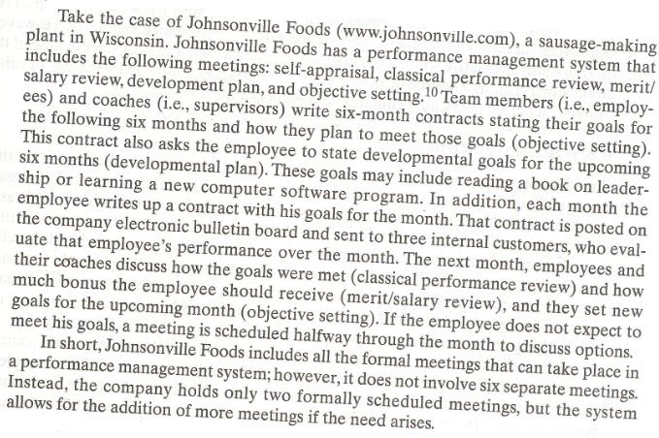

Slide 39
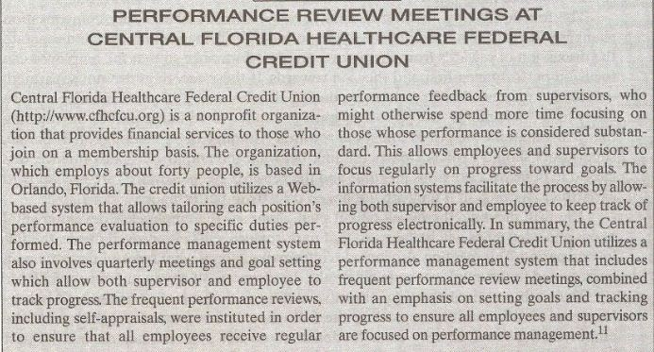

Slide 40
Summary of Today’s Lecture
Determining overall rating
  Judgmental Procedure
  Mechanical Procedure
CASE Example: PA Form used by Grocery Retailer
Appraisal period and number of meeting
Possibilities of Appraisal Meetings

Slide 41
Summary of Today’s Lecture (Contd.)
Formal Meetings
  System inauguration
  Self appraisal
  Classical performance review
  Merit/salary review
  Developmental plans
  Objectives setting

Slide 42
Thank You

