Slide 1
HRM-755
PERFORMANCE MANAGEMENT
LECTURE: THIRTEEN
OSMAN BIN SAIF

Slide 2
Summary of Previous Lecture
Measuring Behavior
Indicator
Components of Competency
Comparative Systems
Advantages of Comparative Systems
Disadvantages of Comparative Systems
Absolute System

Slide 3
Agenda of Today’s Lecture
CHAPTER 6;
  GATHERING PERFORMANCE INFORMATION
    Components of Performance Management Process
    Gathering Performance Information
    Appraisal Form
    Components of Appraisal Form
    Examples of Appraisal Forms
    Characteristics of Appraisal Forms
    Desirable Features of Appraisal Forms

Slide 4
CHAPTER 6
GATHERING PERFORMANCE INFORMATION

Slide 5
Gathering Performance Information
Performance management process includes several stages:
  Prerequisite
  Performance planning
  Performance execution
  Performance assessment
  Performance review
  Performance renewal and Recontracting

Slide 6
Gathering Performance Information (Contd.)
An important component of the performance assessment stage is the use of appraisal forms.
These forms are instruments used to document and evaluate performance.

Slide 7
Gathering Performance Information (Contd.)
Earlier we had discussed various techniques and approaches to measure performance, this chapter will provide a more exhaustive description of the use of appraisal forms and their content.

Slide 8
Appraisal form
At the core of any performance management system is the assessment of performance.
Information on performance is collected by using forms, which can be filled out on paper or electronically.

Slide 9
Appraisal form (Contd.)
One advantage of filling the form electronically is that the information is stored and it can easily be shared.
For Example;
  Between the manager and the HR department.

Slide 10
Appraisal form (Contd.)
Also having the data available in electronic form can help in subsequent analyses.
For example;
  In making comparisons of the relative average performance levels of various units with in the organization.

Slide 11
Appraisal form (Contd.)
Finally, using electronic forms is beneficial because, as changes take place in the organization or job in question, forms need to be revised and updated, and electronic forms are usually easier to modify than paper forms.

Slide 12
Components of Appraisal Forms
Regardless of whether they are electronic or paper, appraisal forms usually include a combination of the following components.
  Basic employee information:
    this section of the form include basic employee information such as job title, division, department, and other work group information, employee number, and pay grade or salary classification.

Slide 13
Components of Appraisal Forms (Contd.)
  Accountabilities, objectives, and standards:
    if the organization adopts a result approach, this section of form would include the name and description of each accountability, objectives agreed upon by manager and employee, and the extent to which the objectives have been achieved.

Slide 14
Components of Appraisal Forms (Contd.)
  Competencies and indicators:
    If the organization adopts a behavior approach, this section of the form includes a definition of the various competencies to be assessed, together with their behavioral indicators.

Slide 15
Components of Appraisal Forms (Contd.)
  Major achievements and contributions:
    Some form include a section in which a rater is asked to list the two or three major accomplishments of the individual being rated during the review period.

Slide 16
Components of Appraisal Forms (Contd.)
  Developmental achievements:
    This section of form includes information about the extent to which the developmental goals set for the review period have been achieved.
  Developmental needs, plans and goals:
    This section of form is future oriented and includes information about specific goals and timetables in terms of employee development.

Slide 17
Components of Appraisal Forms (Contd.)
  Stakeholder input:
    Some forms include section to be filled out by other stakeholders, such as customers with whom the employee interacts.
  Employee comments:
    This section include reactions and comments provided by employee being rated.

Slide 18
Components of Appraisal Forms (Contd.)
  Signatures:
    The final section of most forms includes a section in which the employee being rated, the rater, and the raters supervisor provide their signatures to show they have seen and discussed the content of the form.

Slide 19
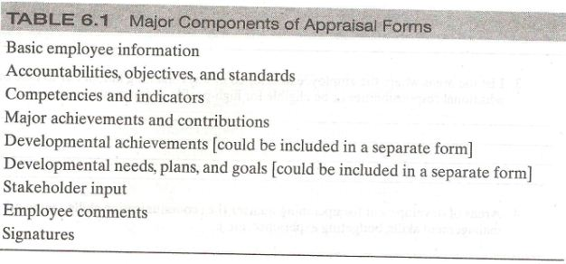
Major components of Appraisal Forms

Slide 20
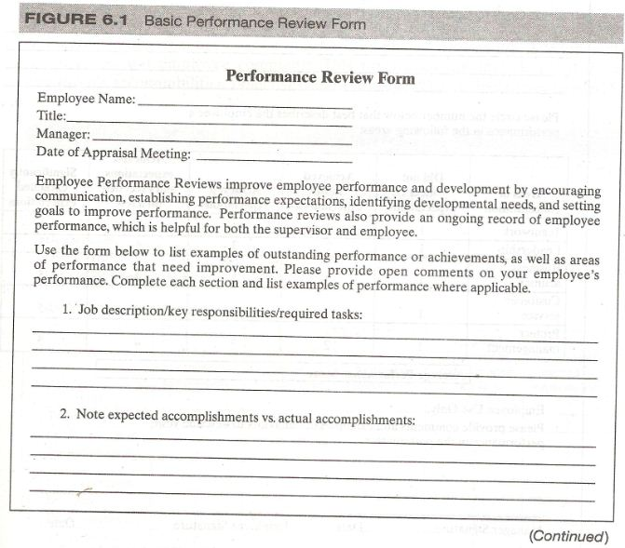
Example of Appraisal Form

Slide 21
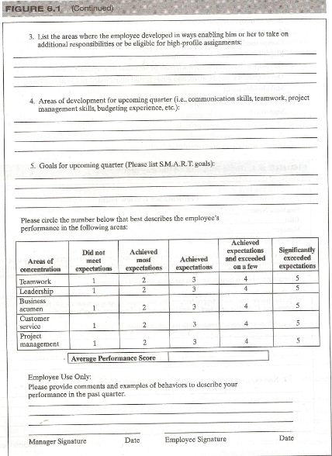

Slide 22
Examples of Appraisal Form
Example 1; Appraisal Form evaluation
  Following is a generic form
  First the form asks for employee’s basic information.
  Second, while the form asks the manager to list the expected versus actual accountabilities.
  Third the form includes five competencies but does not include definition of competencies.

Slide 23
Examples of Appraisal Form (Contd.)
  It also does not list the indicators
  The form does not include space to list major achievements, developmental needs, and employee comments.
  The form does not solicit information from all relevant stakeholders.
  The following table summarizes which of the components are present;

Slide 24
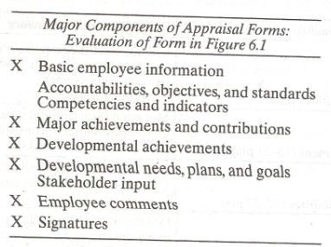

Slide 25
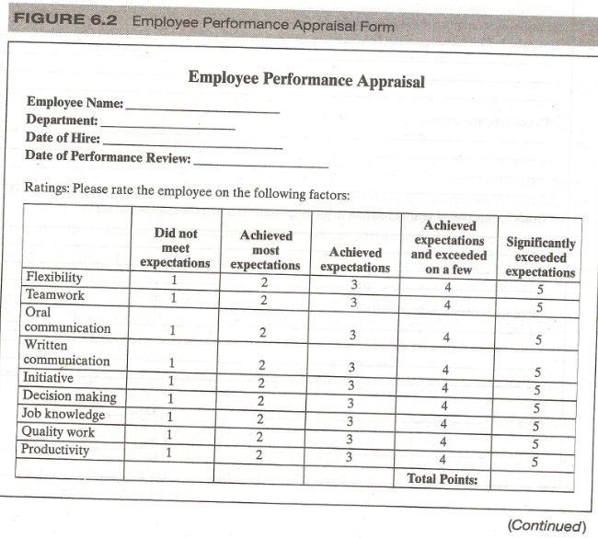
Example 2 Appraisal Form

Slide 26
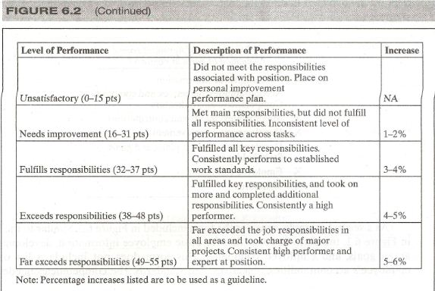

Slide 27
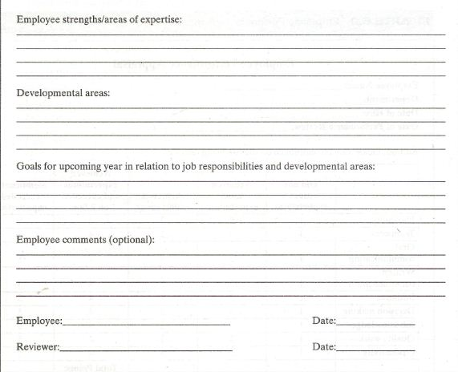

Slide 28
Example 2 Appraisal Forms
Second example is similar to the first example.
This form has a section for basic employee information, developmental areas, goals and employee comments.
This form does not include a list of the employee’s accountabilities, objectives and standards.

Slide 29
Example 2 Appraisal Forms (Contd.)
The competencies needed for the position are listed but not the behavioral indicators to look for to evaluate the presence of the competency.
Furthermore, unlike the previous example, the employee’s developmental and major achievements are not acknowledged.
And finally again stakeholders are not asked for their input.
The following components are present ;

Slide 30
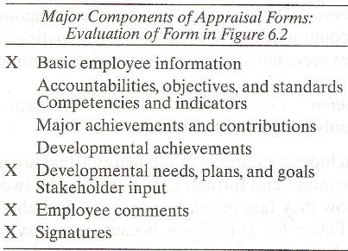

Slide 31
Characteristics of appraisal form
We should be aware that there is no such thing as appraisal form.
In some cases, a form may emphasize competencies and ignore results.
This would be the case if the system adopted a behavior as opposed to results approach to measuring performance.

Slide 32
Characteristics of appraisal form (Contd.)
In others, the form may emphasize developmental issues and minimize or even completely ignore, both behaviors and results.
One size does not fit all, and different components are appropriate based on the purpose of the appraisal.

Slide 33
Characteristics of appraisal form (Contd.)
In spite of large variability in terms of format and components, there are certain desirable features that make appraisal forms particularly effective:
Simplicity:
  Forms must be easy to understand, easy to administer, quick to complete, clear and concise.

Slide 34
Characteristics of appraisal form (Contd.)
Relevancy:
  Good forms include information related directly to the tasks and responsibility of the job, otherwise they will be regarded as an administrative burden and not a tool for performance improvement.

Slide 35
Characteristics of appraisal form (Contd.)
Descriptiveness:
  Good forms require that the raters provide evidence of performance regardless of the performance level.
Adaptability:
  Good forms allow managers in different functions and departments to adapt them to their particular needs and situations.

Slide 36
Characteristics of appraisal form (Contd.)
Comprehensiveness:
  Good forms include all the major areas of performance for a particular position for the entire review period.
Definitional clarity:
  Desirable competencies and results are clearly defined for all the raters so that everyone evaluates the same attributes.

Slide 37
Characteristics of appraisal form (Contd.)
Communication:
  The meaning of each of the components of the form must be a successfully communicated to all people particularly in the evaluation process.
Time orientation:
  Good forms help clarify expectations about performance. They address not only the past but also the future.

Slide 38
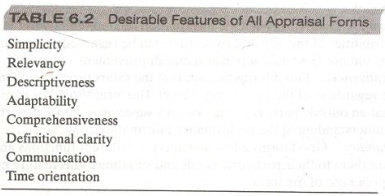
Desirable Features of All Appraisal Forms

Slide 39
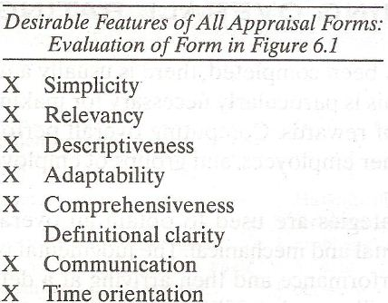
Example 1

Slide 40
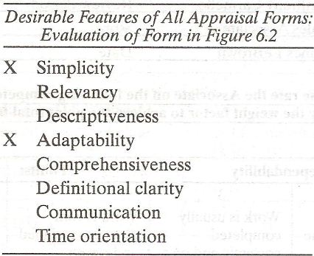
Example 2

Slide 41
Summary of Today’s Lecture
CHAPTER 6;
  GATHERING PERFORMANCE INFORMATION
    Components of Performance Management Process
    Gathering Performance Information
    Appraisal Form
    Components of Appraisal Form
    Examples of Appraisal Forms
    Characteristics of Appraisal Forms
    Desirable Features of Appraisal Forms

Slide 42
Thank You

