Slide 1
HRM-755
PERFORMANCE MANAGEMENT
Session: ELEVEN
OSMAN BIN SAIF

Slide 2
Summary of Previous Lecture
Approaches to measure performance
  Trait approach
  Behavior approach
  Result approach
End of Chapter CASE EXAMPLE

Slide 3
Agenda of Today’s Lecture
CHAPTER 5
  Measuring Results and Behaviors
    Measuring Results
    Determining Accountabilities
    Determining Objectives
    Characteristics of Objectives
    Determining Performance Standards
    Characteristics of Good Performance Standards

Slide 4
CHAPTER 5
MEASURING RESULTS AND BEHAVIORS
“The reason most people never reach their goal is that they don’t define them, or ever seriously consider them as believable or achievable. Winners can tell you where they are going, what they plan to do along the way, and who will be sharing the adventure with them” – DENIS WAITLEY

Slide 5
Measuring Results
If results approach is adopted, the following key question should be:
What are the different areas in which this individual is expected to focus efforts(key accountability)?
Within each area, what are the expected objectives?
How do we know how well the results have been achieved(performance standards)?

Slide 6
Measuring Results (Contd.)
The key accountability are broad areas of job for which the employee is responsible for producing results.
A discussion of results also include specific objectives that the employee will achieve as a part of each accountability.

Slide 7
Measuring Results (Contd.)
Objectives are statements of important and measurable outcomes.
Discussing results also means discussing performance standards.

Slide 8
Measuring Results (Contd.)
A performance standard is the yardstick used to evaluate how all employees have achieved each objective.
Performance standard provide information on acceptable and unacceptable performance in relation to quality, quantity, cost and time.

Slide 9
Measuring Results (Contd.)
Organizations that implement management by objective (MBO) philosophy are likely to implement performance management systems, including objectives and standards.
For example: Police dept CASE Study

Slide 10
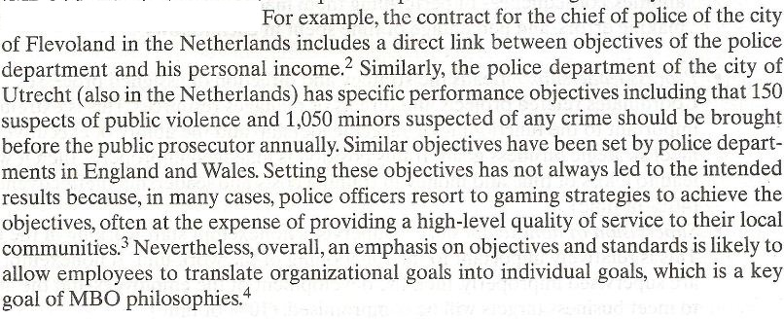

Slide 11
Determining Accountabilities
The first step in determining accountability is to collect information about the job.
The primary source is of course the job description that has resulted from the job analysis and a consideration of unit and organization level strategic priorities.
The job description provides information on the tasks performed.

Slide 12
Determining Accountabilities (Contd.)
Tasks included in the job description can be grouped into clusters of tasks based on their degree of relatedness.
Each of these clusters or accountabilities is a broad area of the job for which the employee is responsible for producing results.

Slide 13
Determining Accountabilities (Contd.)
After the accountabilities have been identified, we need to determine their relative degree of importance.

Slide 14
Determining Accountabilities (Contd.)
To understand the issue, we need to ask the following questions:
What percentage of employees time is spent performing each accountability?

Slide 15
Determining Accountabilities (Contd.)
If the accountability were performed inadequately, would there be a significant impact on the work units mission?
If there a significant consequence of error? Could inadequate performance of the accountability contributes to the injury or death of the employee or others, serious property damage, or loss of time and money?

Slide 16
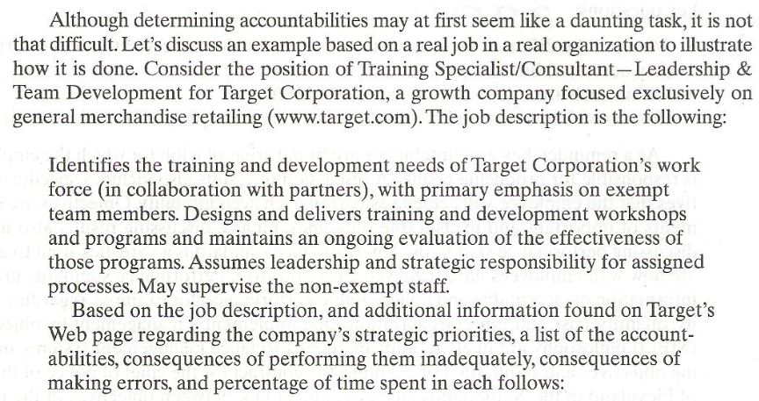

Slide 17
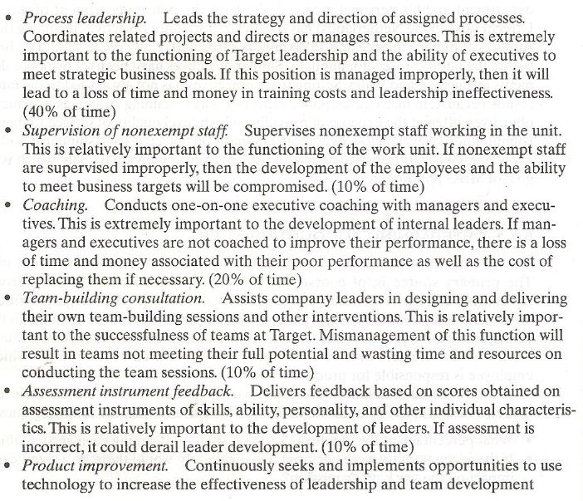

Slide 18


Slide 19
Determining Objectives
After the accountability have been identified, the next step in measuring results is to determine specific objectives.

Slide 20
Determining Objectives (Contd.)
Objectives are statement of an important and measurable outcomes that, when accomplished, will help ensure success for the accountability.
Objectives are clearly important because they help employees guide their efforts.

Slide 21
Determining Objectives (Contd.)
The purpose of establishing objectives is to identify a limited number of highly important results that, when achieved, will have a dramatic impact on the overall success of the organization.
After objectives are set, employees should receive feedback on their progress towards attaining the objective.

Slide 22
Determining Objectives (Contd.)
Rewards should be allocated to those employees who have reached their objectives.

Slide 23
Characteristics of Objectives
To serve as a useful function, objectives must have the following characteristics.
Specific and clear:
  objectives must be easy to understand, they must be verifiable and measurable.

Slide 24
Characteristics of Objectives (Contd.)
Challenging:
  objectives need to be challenging. They must be a stretch, but employees should feel that the objective is reachable.
Agreed upon:
  to be most effective, objectives need to result from an agreement between the manager and the employee.

Slide 25
Characteristics of Objectives (Contd.)
Significant:
  objectives must be important to the organization. Employees must believe that if the objective are achieved, it will make a critical impact on the overall success of the organization.
Prioritized:
  not all objectives are created equal: therefore, objectives should be prioritized and tackled one by one.

Slide 26
Characteristics of Objectives (Contd.)
Bound by time:
  good objectives have deadlines and mileposts.
Achievable:
  good objectives are doable; that is, employees should have sufficient skills and training to achieve them.

Slide 27
Characteristics of Objectives (Contd.)
Fully communicated:
  in addition to manager and employee in question, the other organizational members who may be affected by objectives need to be aware of them.

Slide 28
Characteristics of Objectives (Contd.)
Flexible:
  good objectives are not immutable. They can and likely will change based on changes in the work or business environments.

Slide 29
Characteristics of Objectives (Contd.)
Limited in number:
  too many objectives may become impossible to achieve, but too few may not make a sufficient contribution to the organization. Objectives must be limited in number.

Slide 30
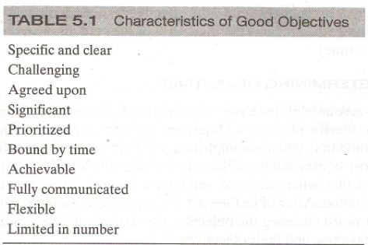

Slide 31
Determining Performance Standards
After accountability and objectives have been determined, the next step is to define performance standards. These are yard sticks designed to help people understand to what extent the objectives have been achieved. The standards provide raters with information about what to look for to determine the level of performance that has been achieved.

Slide 32
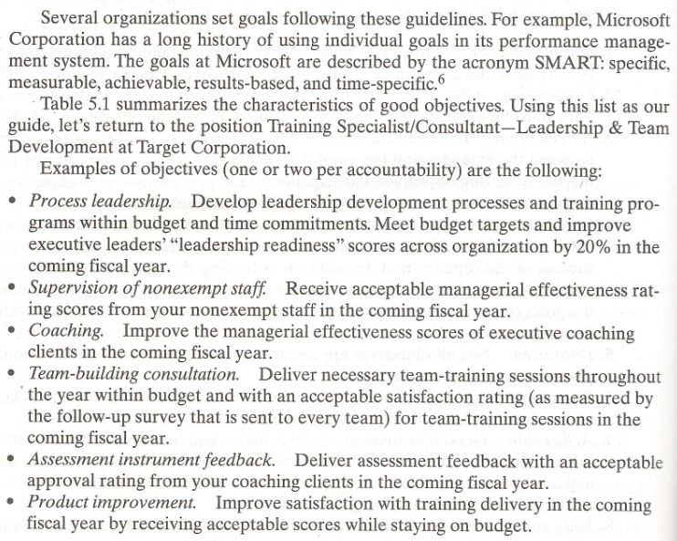

Slide 33
Determining Performance Standards (Contd.)
After accountabilities and objectives have been determine, the next step is to define performance standards.
These are yardsticks designed to help people understand to what extent the objectives have been achieved.

Slide 34
Determining Performance Standards (Contd.)
The standards provide raters with information about what to look for to determine the level of performance that has been achieved.
Standards can refer to various aspects of a specific objective, including quality, quantity and times.

Slide 35
Determining Performance Standards (Contd.)
Each of these aspects can be considered criteria to be used in judging the extent to which an objective has been achieved.
  Quality:
    how well the objective has been achieved

Slide 36
Determining Performance Standards (Contd.)
Quantity:
  how much has been produced, how many, how often and at what cost
Time:
  due dates, adherence to schedule, cycle times, deadlines.

Slide 37
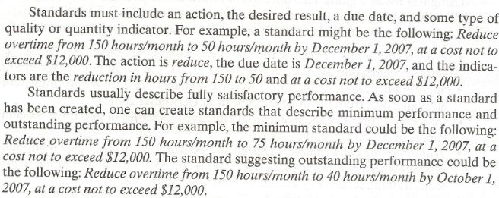

Slide 38
Characteristics of Performance Standards
In writing standards, consider the following characteristics that often determine whether one is useful standard:
Related to the position:
  good standards are based on jobs key elements and tasks, not on individual traits or person to person comparison.

Slide 39
Characteristics of Performance Standards
Concrete, specific, and measurable:
  good standards are observable and verifiable.
Practice to measure:
  good standards provide necessary information about performance in the most efficient way possible.

Slide 40
Characteristics of Performance Standards
Meaningful:
  good standards are about what is important and relevant to the purpose of the job, to the achievement of organizations mission and objectives and to the user or recipient of the product or service.

Slide 41
Characteristics of Performance Standards
Realistic and achievable:
  standards are possible to accomplish, but they require a stretch.
Reviewed regularly:
  information should be available on a regular basis to determine whether the employee has reached the standard and if not remedial actions should be taken.

Slide 42
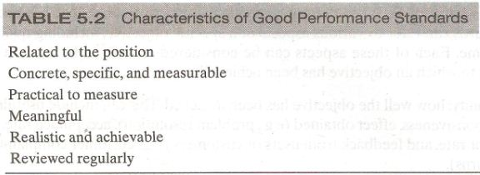

Slide 43
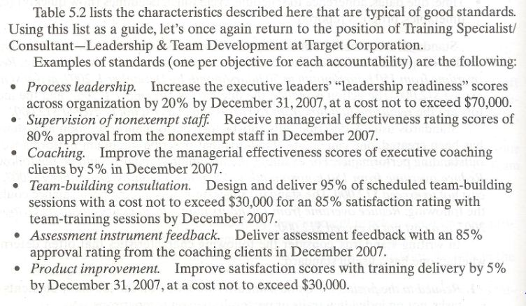

Slide 44
Summary of Today’s Lecture
CHAPTER 5
  Measuring Results and Behaviors
    Measuring Results
    Determining Accountabilities
    Determining Objectives
    Characteristics of Objectives
    Determining Performance Standards
    Characteristics of Good Performance Standards

Slide 45
Thank You

