Slide 1
Financial Derivatives Market of South Africa

Slide 2
  History
The Johannesburg's Stock Exchange (JSE) is established in Johannesburg to facilitate the explosion of trade sparked by the discovery of gold in the Witwatersrand. The discovery of gold in 1886 resulted in the formation of mining and financial companies with investors who needed a central facility to access primary capital. Initially trading took place in a miner' tent and moved to the stables at the corner of what in now Saur and Commissioner Streets. Benjamin Minors Wollan proposed to a meeting of the Exchange and Chambers Company board and members that 'the Johannesburg Stock Exchange should be established. On 8th November 1887 Woollan founded the JSE by providing a facility to conduct trading. The establishment of the JSE at this time made it the oldest stock exchange facility in the subcontinent.

Slide 3
Growth in the mining industry was reflected in the economic boom of the 1890s that the JSE experienced. Between 1887 and 1934 an estimated 200 million pounds was invested in the gold industry with more than half from foreign investments. In 1933 a rival exchange known as the Union Exchange was formed in Johannesburg. It continued to trade until 1958 when it was closed by the Treasury Companies and the companies listed under it were transferred to the JSE.

Slide 4
In 1947 the Stock Exchanges Control Act was passed to regulate the operation of stock exchange by stating capital requirements for members and the conduct for brokers. In 1963 the JSE joined the World Federation of Exchanges an international association of the world's leading regulated markets. The physical location of the JSE changed several times throughout its existence as it grew. On 7 June 1996 the open outcry trading floor (where traders shout across the floor or gesture to sell or buy shares) was closed and replaced by an order driven, centralised, automated trading system known as the Johannesburg Equities Trading (JET) system.

Slide 5
  Performance
Stocks in South Africa had a negative performance during the last month. South Africa Stock Market (FTSE/JSE), declined 1306 points or 3.26 percent during the last 30 days. Historically, from 1995 until 2013, South Africa Stock Market (FTSE/JSE) averaged 15732 Index points reaching an all time high of 40984 Index points in March of 2013 and a record low of 4308 Index points in September of 1998. The FTSE/JSE All Share Index is a major stock market index which tracks the performance of all companies listed on the Johannesburg Stock Exchange in South Africa. It is a free-float, market capitalization weighted index. The FTSE/JSE All Share Index has a base value of 10815.08 as of June 21, 2002. This page includes a chart with historical data for South Africa Stock Market (JALSH).

Slide 6
Benefits of Derivatives
Despite the fact that some derivative products are complex, derivatives in general are very useful financial instruments and are often misunderstood by investors and the broad public. In order to show where the dangers and benefits of derivative instruments are for investors and to provide an overview about the current state of the South African derivatives market, a MCom study was undertaken by Stefan Schwegler at the Nelson Mandela Metropolitan University. He conducted an in-depth literature review and interviewed twenty one experts at a number of local financial institutions. Respondents were asked to provide some insight on the use and popularity of derivatives in South Africa as well as their involvement in the global financial crisis.

Slide 7
Stefan’s research indicates that derivative instruments play a major role in today’s global financial environment. This is evident from the fact that 94 percent of the world’s largest companies use derivatives on a continuous basis to manage their risk. The significance of derivatives markets is also shown by the fact that the total global market value of derivatives markets is approximately $600 trillion and that derivatives grow at a rate of between 20 to 30 percent a year (FinFund 2010; Bank for international settlements 2010). Thus, the global derivatives market is ten times larger than the whole world’s economic output and is the largest financial market ahead of equities, bonds and money markets.

Slide 8
Although the South African derivatives market makes up only a small percentage of that, the local market posts some impressive figures. Standardised derivatives trading in South Africa only commenced in 1987 and the first derivatives exchange opened in 1990. Until 2001, several derivative instruments, such as Single Equity Options, Single Stock Futures and options on futures were introduced to attract more investors. The introduction of Single Stock Futures was a significant milestone and made South Africa one of the most popular trading places in the world. In 2008, the Johannesburg Stock Exchange was the worldwide leader in Single Stock Futures contracts traded.

Slide 9
Establishment of Derivative Market
The South African Futures Exchange grew out of an informal market in April 1987. At that time a local merchant bank, Rand Merchant Bank, started an informal financial market. Subsequently, option contracts were introduced in October 1992, agricultural commodity futures in 1995 and a fully automated trading system in May 1996.
The Equity Derivative Division of the Johannesburg Stock Exchange (JSE) has been in operation since 1990, coordinating trading activities in warrants, single stock futures (SSF), and equity indices and interest rate futures and options. Warrants are long-dated put or call options issued by a third party on individual or baskets of securities of listed companies. Single stock futures are futures contracts where the underlying security is an equity exchange listed on the JSE.

Slide 10
A single stock futures contract is a legally binding commitment made through a futures exchange to buy or sell a single equity in the future. SSF are standardized with regard to size, expiration, and tick movement. The price of a single stock futures contract is negotiated through the South African Futures Exchange order matching platform called the automated trading system (ATS). The exchange also lists options on single stock futures which are American style options exercisable into single stock futures. Initially, derivatives on only 4 JSE-listed companies were listed on the South African Futures Exchange, but this number has gradually increased to 52. Market participants are retail investors, professional traders, asset managers, and short-term equity traders.

Slide 11
The deregulation of the agricultural market in 1995 led to the establishment of an agricultural commodity futures market. At that time, the government made a commitment to stay out of the price determination process in the agricultural market. In demonstration of this commitment, the South African Futures Exchange (SAFEX) Agricultural Markets Division was established in January 1995,
with a start-up capital of 4.2 million rand. The first commodity listed on the exchange was a physical settled beef contract, shortly followed by a potato contract. Later, however, both contracts were delisted because of inactivity.

Slide 12
Notwithstanding the delisting, the flagship contracts that facilitated the success of the agriculture futures market were the white and yellow maize contracts, listed in May 1996, which resulted in a high growth in volumes traded on the market. Wheat was introduced in November 1997, and a sunflower seeds contract in early 1999.
the Agricultural Futures Market has expanded since its inception. It started with five active brokers, and has now increased to 52 brokers with about 12,000 clients consisting of hedgers, participants like producers, millers, traders, banks, cooperatives and agricultural companies, and speculators. The Futures Market trades from Monday to Friday using an ATS, with an average daily trading volume of 200,000 tons of maize. Since 1996, more than 1.8 million contracts have traded, with concentration of trade in white maize contracts.

Slide 13
Currency Futures on Yield-X, the JSE’s interest rate exchange, represent a significant advance for the South African financial market. On 18 June, 2007, the JSE commenced the trading of rand currency futures on Yield-X, one of the JSE’s electronic trading platforms, as a part of the exchange control reforms announced in the 2007 budget. Yield-X has the ability to provide pre-trade approval as opposed to post-trade checking. This system capability was imperative in order to restrict the currency derivative trading to those qualified participants only
The underlying instrument is the US$/rand, GBP/rand and EUR/rand future contracts. For the US$/rand future contract, the model uses US$/rand forward points quoted by local banks, and a US$/rand spot price to calculate the fair value. For the other two contracts, EUR/rand and GBP/rand, the calculation makes use of the EUR/US$ and GBP/rand currency pairs. These currency pairs are crossed with the US$/rand pair in order to deliver the EUR/rand and GBP/rand fair values. The reason for using the dollar pairs is because of the low liquidity in the EUR/rand and GBP/rand currency pair market. Trading has commenced on the rand/US$ contract only as a retail product.

Slide 14
Institutional investors have an investment ceiling in currency futures. The qualifying clients that are permitted to trade and hold positions in currency futures comprise: pension funds and long-term insurance companies subject to their 15 percent foreign allocation allowance; asset managers and registered collective investment schemes subject to their 25 percent foreign allocation limits; individuals and foreigners with no limits applicable. All corporates, banks, and trusts can trade in currency futures provided they have a valid JSE or Bond Exchange of South Africa (BESA) control approval number in place or approval from the South African Reserve Bank. The minimum contract for qualifying individuals is US$1,000 with no limitations.

Slide 15
Interest rate derivatives were approved for listing on the BESA in December 2004. Consequently, the BESA introduced four interest rate instruments, including bond futures, FRAs, vanilla swaps, and standard bond options. BESA-listed derivative instruments are traded using both an electronic system and over the counter.

Slide 16
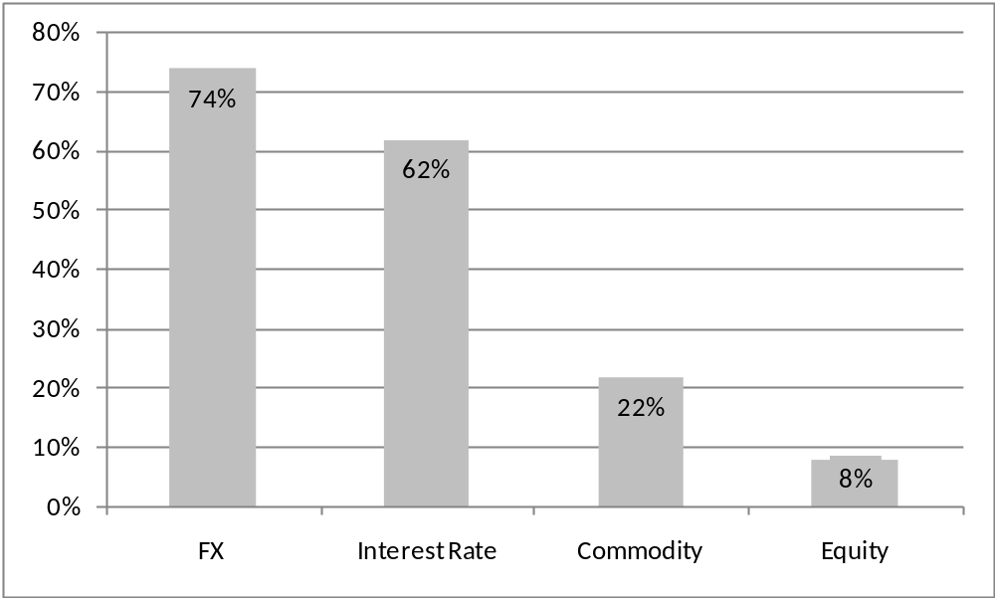
Derivative User in the Country
Review of prior South African study: types of risks hedged by S A Companies

Slide 17
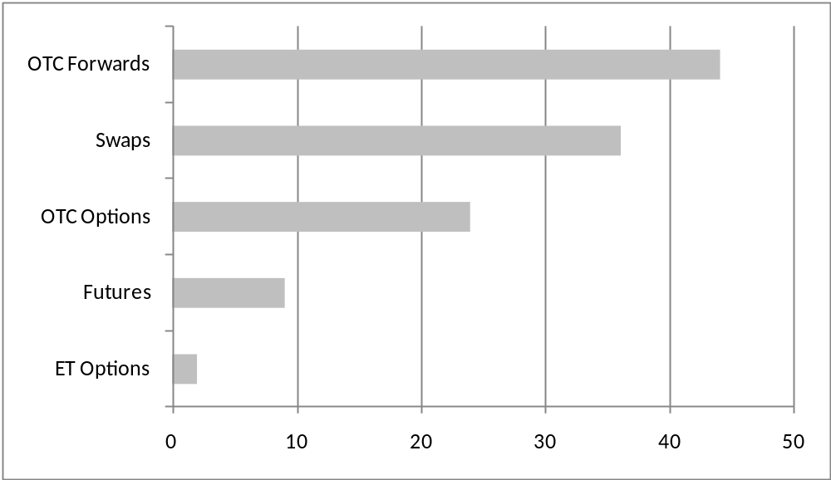
Review of prior South African study: types of derivatives used by SA companies

Slide 18
Focus on currency risk (FX) and Interest rate risk is similar to results of international studies
Focus on OTC forwards and swaps and to a lesser extent – the use of OTC options
Insignificant use made of ET Futures and Options

Slide 19
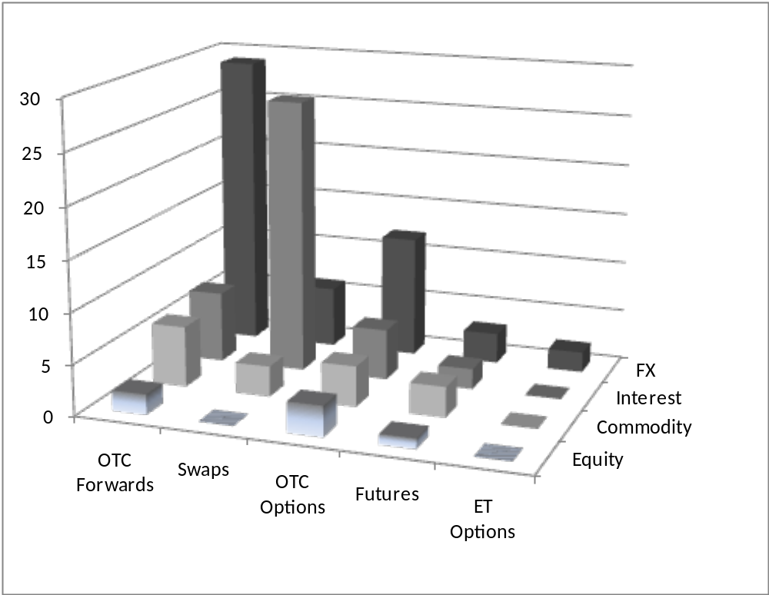
Which derivatives are used for each type of exposure?

Slide 20
Focus on OTC forwards to hedge currency risks and interest rate swaps to hedge interest rate risk. This is similar for other studies
Very large companies – yet 41% of companies employ only one type of derivative. Companies mainly employed forwards (3/4), and then interest rate swaps. Close to 1/3 of companies used options. Futures used by only 10% of companies.
Foreign currency is a major risk for most companies;
Percentage of companies using each type of derivative

Slide 21
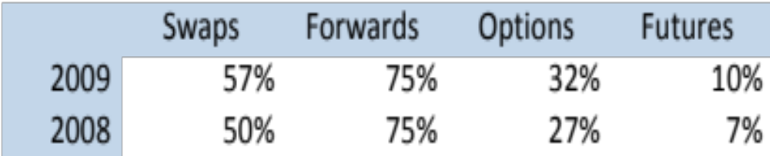
85% of all financial companies use interest rate swaps
75% of basic materials firms reported the use of forwards
58% of all financial firms used options
67% of food producers used futures

Slide 22
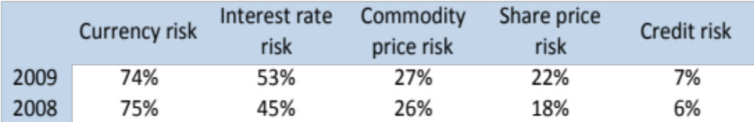
Which risks are all companies exposed to?
74% of companies are exposed to currency risk, followed by interest rate risk
Link to use of OTC forwards to hedge foreign currency risk
Only 7% of companies reported that they entered into derivatives to hedge exposure to credit risk

Slide 23
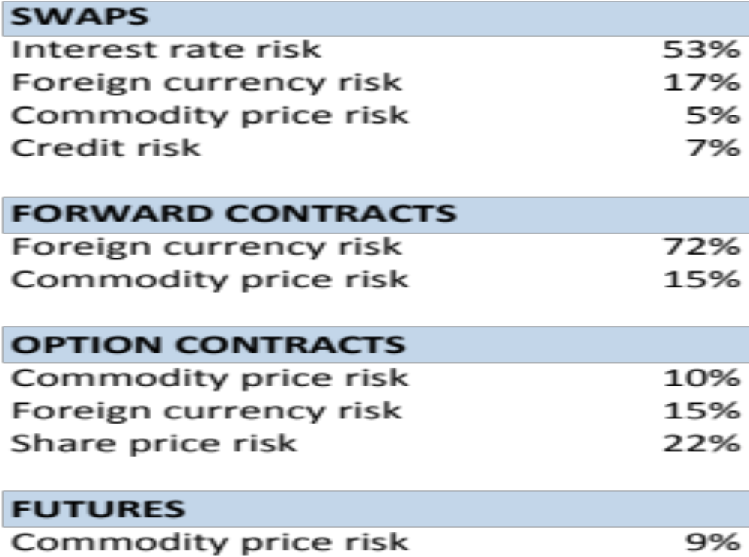
Reported risk exposures and types of derivatives used

Slide 24
Derivative use by small caps
Sample of companies with a market capitalisation below R1 billion and companies listed on the AltX – 104 companies analysed in this study
Total market capitalisation of companies under review = R18.9bn
Service sector = 69%, Manufacturing = 19% & Primary sector = 12%
Only 17% of small companies reported the use of derivatives
Comparable studies in the USA – 12-13% of small companies
NZ – 36%, Netherlands – 42% and Sweden – 34%
South Africa – higher weighting of firms in the Services sector

Slide 25
Derivative use by small caps
Of the companies that use derivatives, 89% use derivatives to manage foreign currency exposure, 11% use options to manage equity exposure and 5% use swaps to manage interest rate exposure
Only 1 company hedged interest rate risk – using interest rate swaps
Study found that 16 companies used forwards and 1 company used options to hedge foreign currency risk
It was found that only 1 company hedged interest rate risk using swaps
Almost all exposure hedged relates to the use of forwards to hedge foreign exchange exposure
Only 6% of companies use more than one derivative

Slide 26
Factors Contributing to the Growth of Derivatives
Capital Market
South Africa’s economic and capital market growth has contributed to the rapid growth of the derivatives market. GDP per capita grew averagely by 2.6 percent between 2001 and 2008 (Table 4). The underlying value of equities and bonds in the capital market appreciated by 20.6 percent and 14.1 percent per annum respectively, while the underlying value of futures contracts experienced an average increase of 41.2 percent.
Weather
Weather risk markets are amongst the newest and most dynamic markets for financial risk transfers and include participants from a broad range of economic sectors such as energy, insurance, banking, agriculture, leisure and entertainment. Although the weather risk market is till very much based in the United States (US), new participants from Europe, Asia and Latin America are entering this market.

Slide 27
Instruments and Types of Contracts being Used in the Derivative Market
In South Africa, derivative products include forwards and futures, forward rate agreements, interest-rate swaps, basis swaps, options, equity derivatives, and commodity futures with exchange-based and over-the-counter trade. South Africa’s agricultural commodities futures markets sees active trade in maize, wheat, sunflower seeds and soya beans, thereby providing risk-management tools for regional producers as well as pricing benchmarks.

Slide 28
OTC trading of currency and interest rate derivatives has been growing rapidly. Although currency derivatives are highly liquid and their notional amount of outstanding OTC contracts accounted for a larger share of trading in the market in 2007, the interest rate derivatives are growing much faster (Table 1). Overall, South Africa’s OTC market accounted for about 9.9 percent of OTC derivatives in emerging markets in 2007

Slide 29
South Africa: Trading Volume of over-the-counter Derivatives
2001–2007)
(Daily Averages; Notional Amount in millions of U.S. dollars)
Volume | 2001 | 2004 | 2007 | Growth Rate
Currency derivatives 1/ | 7,858 | 8,032 | 10,568 | 2.21
Interest rates 2/ | 578 | 2,961 | 4,474 | 412.28
Total | 8,436 | 10,375 | 15,042 | 22.98
Total emerging market | 160,375 | 240,389 | 151,787 | 49.89
Share of emerging market 3/ | 5.26 | 4.32 | 9.91

Slide 30
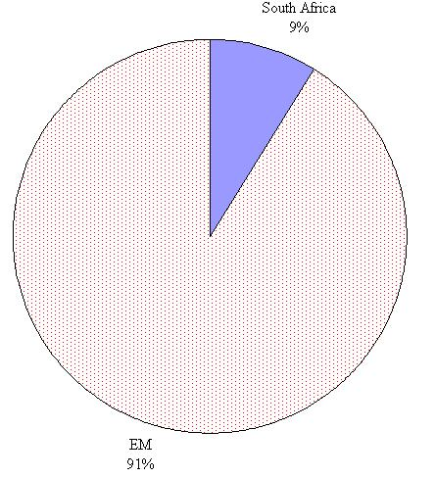
South Africa: Share of Emerging Market over-the-counter Derivatives

Slide 31
CONCLUSION
The FMB is the product of a solid review and engagement process, and will significantly strengthen the prudential and market conduct regulation in South Africa as it pertains to financial markets. Stable, investor friendly and fair markets feeds though to a more efficient and effective allocation of limited resources supporting business growth, economic growth and employment.
Compared to the existing SSA, it remains flexible but strengthens certain provisions. It addition, the scope of regulation is broadened to cover the shadow financial system and improve the monitoring and communication of systemic risk between the SRO, the FSB and the Minister of Finance; namely that the right steps can be taken at the right time, minimising long lasting market disruptions.

Slide 32
CONCLUSION
While further strengthening of the exchange control regulations needs to be considered, it is also important to expand the set of institutional investors. The tighter regulations could stipulate limits for institutional and corporate qualified participants in the currency futures market. The aim of these regulations on asset allocations by insurance and pension funds is to prevent excessive risk taking. However, such regulations also constrain the demand side in the futures market and may limit the potential benefits for the local securities market. As the global financial turmoil 2 persists, there are concerns that the financial sector of many SSA countries will become increasingly vulnerable to swings in market sentiment and risk aversion in global financial markets.

Slide 33
CONCLUSION
The current financial crisis and the lax regulation of derivatives that is exacerbating the financial turmoil in developed countries have also pointed towards the need for more regulation in order for the derivatives market to yield its ultimate benefit. There is a need to maintain investment restrictions on institutional investors, especially foreign investors such as insurance and pension funds. At the same time, the set of local institutional investors needs to be expanded to deepen the market

Slide 34
Certain investment restrictions have affected the involvement of unit trusts in fixed income derivatives (interest rate futures). However, other institutional investors such as pension funds and banks are very active in the interest rate futures market. Local banks concentrate on the one-to-five-year maturity segment and pension funds on the five-year and above segment. There is a need to review investment restrictions on unit trusts with a view to further deepen the market once the industry is properly regulated and supervisory capacity is enhanced.

