Slide 1
Capital Budgeting and Financial Planning
Course Instructor: M.Jibran Sheikh

Slide 2
Uncertain Profit
A firm is introducing a product into a new market.
Imagine that as marketing manager you are trying to estimate the profit that will result from the product introduction. As you know, profit depends on:
• Sales in units
• Price per unit
• Unit cost – marginal cost per unit
• Fixed costs – overhead, etc. Known to be $30,000.
Profit = Sales *(Price-Unit Cost) – Fixed Costs

Slide 3
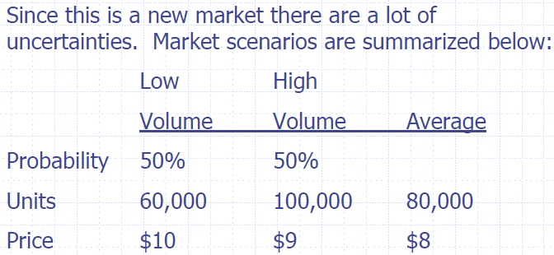
Market Uncertainties

Slide 4
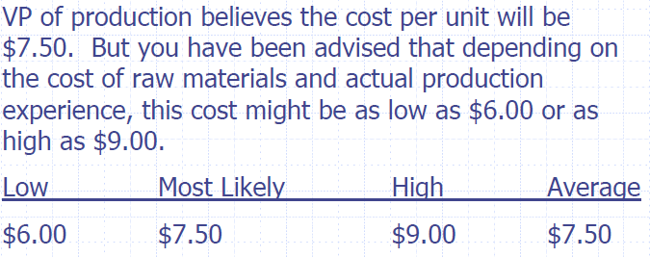
Unit Cost Uncertainties

Slide 5
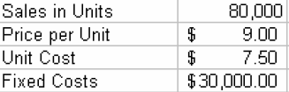
With out Simulation
What is the profit going to be for the new product?
Lets say the details are as follow

Slide 6
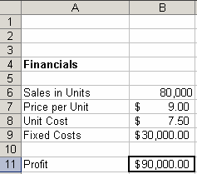
With out Simulation
=B6*(B7-B8)-B9
Profit is $90,000 great isn’t it! But what about uncertainties?????????

Slide 7
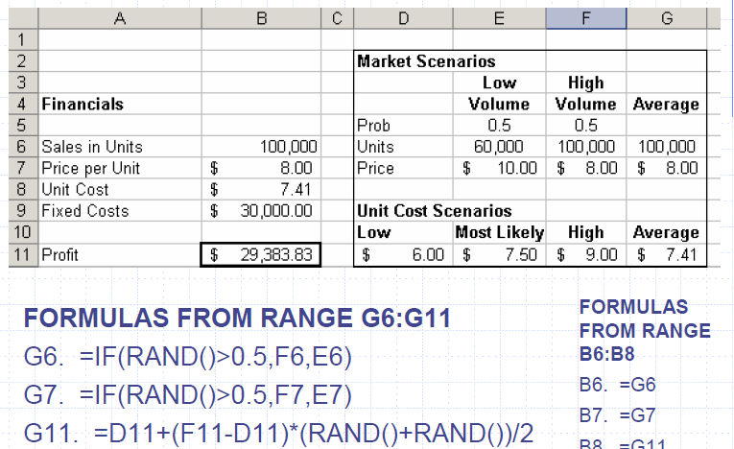
Incorporating Uncertainty in Model

Slide 8
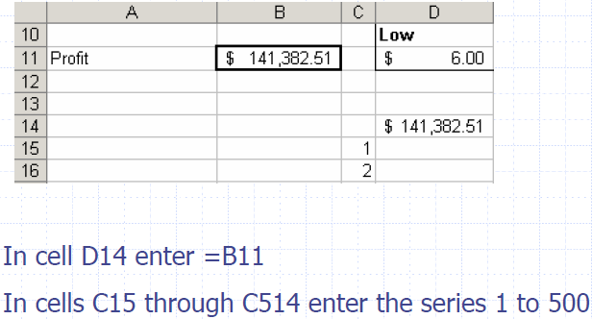

Slide 9
Run simulation using a Data Table
1. Select range of cells.
2. Select Data on the main menu.
3. Click Table.
4. In the table dialog box enter any blank
cell for the Column input cell.
5. Click OK.

Slide 10
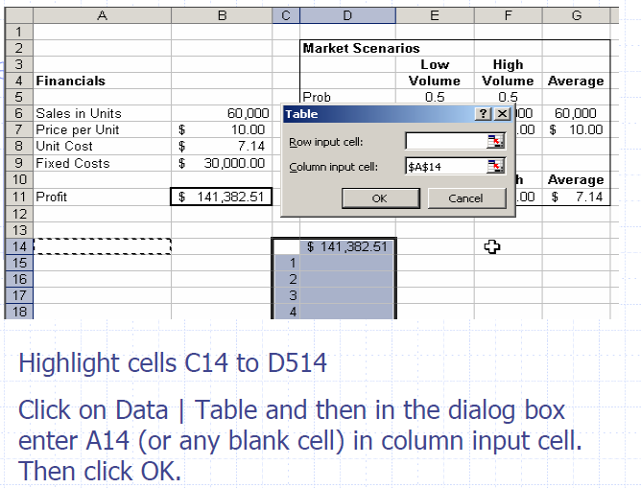

Slide 11
