Slide 1
Capital Budgeting and Financial Planning
Course Instructor: M.Jibran Sheikh

Slide 2
Key Board Shortcuts
Here are a few tips to improve the appearance of your spreadsheets and speed up your work. To do any of the following to a cell or range of cells, first select the cell or cells and then:
(a) Press Ctrl + B to make the cell contents bold.
(b) Press Ctrl + I to make the cell contents italic.
(c) Press Ctrl + C to copy the contents of the cells.
(d) Move the cursor and press Ctrl + V to paste the cell you just copied into the new active cell or cells.

Slide 3
Spreadsheet construction
Spreadsheet models that will be used mainly as a calculation tool for various scenarios should ideally be constructed in three sections, as follows.
1 An inputs section containing the variables (eg the amount of a loan and the interest rate).
2 A calculations section containing formulae (eg the loan term and interest rate).

Slide 4
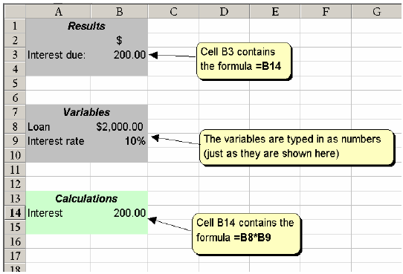

Slide 5
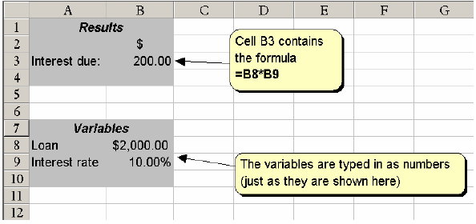

Slide 6
Formulae with conditions
If statements are used in conditional formulae.
Suppose company employing salesmen awards a bonus to those salesmen who exceed their target by more than $1,000. The spreadsheet could work out who is entitled to the bonus using an ‘IF’ statement.
IF statements follow the following structure (or syntax).
=IF(logical_test,value_if_true,value_if_false)

Slide 7
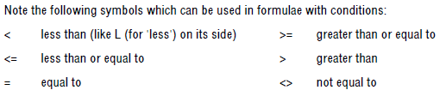
Formulae with conditions (cont..)
The logical test is any value or expression that can be evaluated to Yes or No. For example, D4>1,000 is a logical expression; if the value in cell D4 is over 1,000, the expression evaluates to Yes. Otherwise, the expression evaluates to No.
Value_if_true is the value that is returned if the answer to the logical test is Yes.
For example, if the answer to D4>1,000 is Yes, and the value_if_true is the text string "BONUS", then the cell containing the IF function will display the text "BONUS".

Slide 8
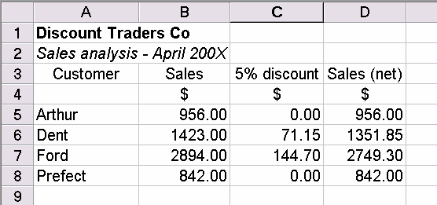
Examples of formulae with conditions
A company offers a discount of 5% to customers who order more than $1,000 worth of goods. A spreadsheet showing what customers will pay might look like this.
The formula in cell C5 is: =IF(B5>1,000,(0.05*B5),0).
This means, if the value in B5 is greater than $1,000 multiply it by 0.05, otherwise the discount will be zero. Cell D5 will calculate the amount net of discount, using the formula: =B5-C5. The same conditional formula with the cell references changed will be found in cells C6, C7 and C8. Strictly, the variables $1,000 and 5% should be entered in a different part of the spreadsheet.

Slide 9
Further Example
Here is another example. Suppose the pass mark for an examination is 50%. You have a spreadsheet containing candidate’s scores in column B. If a score is held in cell B10, an appropriate formula for cell
C10 would be: =IF(B10<50,"FAILED","PASSED").

Slide 10
Advantages and disadvantages of spreadsheet software
Advantages of spreadsheets
Excel is easy to learn and to use
Spreadsheets make the calculation and manipulation of data easier and quicker
They enable the analysis, reporting and sharing of financial information
They enable ‘what-if’ analysis to be performed very quickly

Slide 11
Disadvantages of spreadsheets
A spreadsheet is only as good as its original design, garbage in = garbage out!
Formulae are hidden from sight so the underlying logic of a set of calculations may not be obvious
A spreadsheet presentation may make reports appear infallible
Research shows that a high proportion of large models contain critical errors
A database may be more suitable to use with large volumes of data

Slide 12
Budgeting
Spreadsheet packages for budgeting have a number of advantages.
(a) Spreadsheet packages have a facility to perform 'what if' calculations at great speed. For example, the consequences throughout the organisation of sales growth per month of nil, 1/2%, 1%, 11/2% and so on can be calculated very quickly.
(b) Preparing budgets may be complex; budgets may need to go through several drafts. If one or two figures are changed, the computer will automatically make all the computational changes to the other figures.
(c) A spreadsheet model will ensure that the preparation of the individual budgets is co-ordinated.
Data and information from the production budget, for example, will be automatically fed through to the material usage budget (as material usage will depend on production levels).
These advantages of spreadsheets make them ideal for taking over the manipulation of numbers, leaving staff to get involved in the real planning process.

