Slide 1
Capital Budgeting and Financial Planning
Course Instructor: M.Jibran Sheikh

Slide 2
What is a spreadsheet?
A spreadsheet is an electronic piece of paper divided into rows and columns. The intersection of a row and a column is known as a cell.
A spreadsheet is divided into rows (horizontal) and columns (vertical). The rows are numbered 1, 2, 3 . .etc and the columns lettered A, B C . . . Etc
The main examples of spreadsheet packages are Lotus 1 2 3 and Microsoft Excel. We will be referring to Microsoft Excel, as this is the most widely-used spreadsheet.

Slide 3
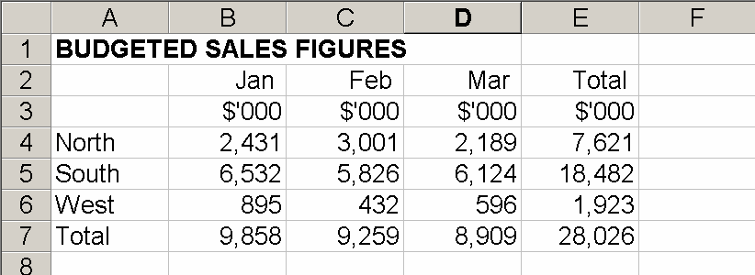
Example

Slide 4
Why Spread Sheets?????
Spreadsheets provide a tool for calculating, analysing and manipulating numerical data.
Spreadsheets make the calculation and manipulation of data easier and quicker. For example, the spreadsheet above has been set up to calculate the totals automatically. If you changed your estimate of sales in February for the North region to $3,296, when you input this figure in cell C4 the totals (in E4 and C7) would change accordingly.

Slide 5
Uses of spreadsheets
Spreadsheets can be used for a wide range of tasks. Some common applications of spreadsheets are:
Management accounts
Revenue analysis and comparison
Cash flow analysis and forecasting
Cost analysis and comparison
Reconciliations
Budgets and forecasts

Slide 6
Cell contents
(a) Text. A text cell usually contains words. Numbers that do not represent numeric values for calculation purposes (eg a Part Number) may be entered in a way that tells Excel to treat the cell contents as text. To do this, enter an apostrophe before the number eg '451.
(b) Values. A value is a number that can be used in a calculation.
(c) Formulae. A formula refers to other cells in the spreadsheet, and performs some sort of computation with them. For example, if cell C1 contains the formula =A1-B1, cell C1 will display the result of the calculation subtracting the contents of cell B1 from the contents of cell A1. In Excel, a formula always begins with an equals sign: = .
There are a wide range of formulae and functions available.

Slide 7
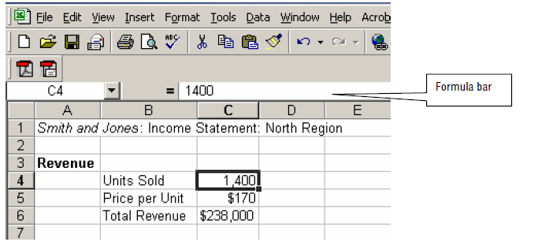
The following illustration shows the formula bar. (If the formula bar is not visible, choose View, Formula bar from Excel’s main menu.)

Slide 8
Examples of spreadsheet formulae
All Excel formulae start with the equals sign =, followed by the elements to be calculated (the operands) and the calculation operators. Each operand can be a value that does not change (a constant value), a cell or range reference, a label, a name, or a worksheet function

Slide 9
Formulae can be used to perform a variety of calculations. Here are some examples.
(a) =C4*5. This formula multiplies the value in C4 by 5. The result will appear in the cell holding the formula.
(b) =C4*B10. This multiplies the value in C4 by the value in B10.
(c) =C4/E5. This divides the value in C4 by the value in E5. (* means multiply and / means divide by.)
(d) =C4*B10-D1. This multiplies the value in C4 by that in B10 and then subtracts the value in D1
from the result. Note that generally Excel will perform multiplication and division before addition or subtraction. If in any doubt, use brackets (parentheses): =(C4*B10)–D1.
(e) =C4*117.5%. This adds 17.5% to the value in C4. It could be used to calculate a price including 17.5% sales tax.
(f) =(C4+C5+C6)/3. Note that the brackets mean Excel would perform the addition first. Without them brackets, Excel would first divide the value in C6 by 3 and then add the result to the total of the values in C4 and C5.
(g) = 2^2 gives you 2 to the power of 2, in other words 22 . Likewise = 2^3 gives you 2 cubed and so on.
(h) = 4^ (1/2) gives you the square root of 4. Likewise 27^(1/3) gives you the cube root of 27 and so on.

Slide 10
Always Keep in Mind
Without brackets, Excel calculates a formula from left to right. You can control how calculation is performed by changing the syntax of the formula. For example, the formula =5+2*3 gives a result of 11 because Excel calculates multiplication before addition.
Excel would multiply 2 by 3 (resulting in 6) and would then add 5.
You may use parentheses to change the order of operations.
For example =(5+2)*3 would result in Excel firstly adding the 5 and 2 together, then multiplying that result by 3 to give 21.

Slide 11
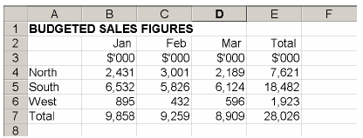
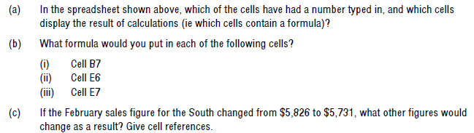
Example

Slide 12
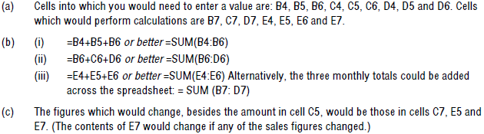
Solution

Slide 13
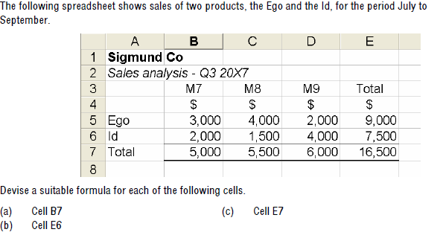
Practice Question

