Slide 1
Capital Budgeting and Financial Planning
Course Instructor: M.Jibran Sheikh

Slide 2
Purpose
A quantitative expression of a plan of action prepared in advance. It sets out the costs and revenues that are expected in future periods.
Planning
Budgets
Co-ordinating Activities
Controlling Costs
Communication of targets
Performance Evaluation
Motivation
Authorisation of expenditure

Slide 3
Preparing Budgets
Define long-term objectives of the business
Produce budget manual
Produce budget for principal budget factor
Form budget committee to communicate budget policy, set and approve budgets.
Identify principal budget factor
Produce and approve other budgets based on budget for limiting factor
Review variances

Slide 4
Different types of budgets
The Master Budget includes the budgeted income statement, the cash budget and budgeted statement of financial position (Balance Sheet).
A continuous budget is prepared for a year (or budget period) ahead, and is updated regularly by adding a further accounting period (month, quarter) when the first accounting period has expired (= Rolling Budgets).

Slide 5
Functional budgets
Functional Budgets
Sales Budget
Production Budget
Labour Budget
Overheads Budget
Raw Material Usage Budget
Raw Material Purchases budget

Slide 6
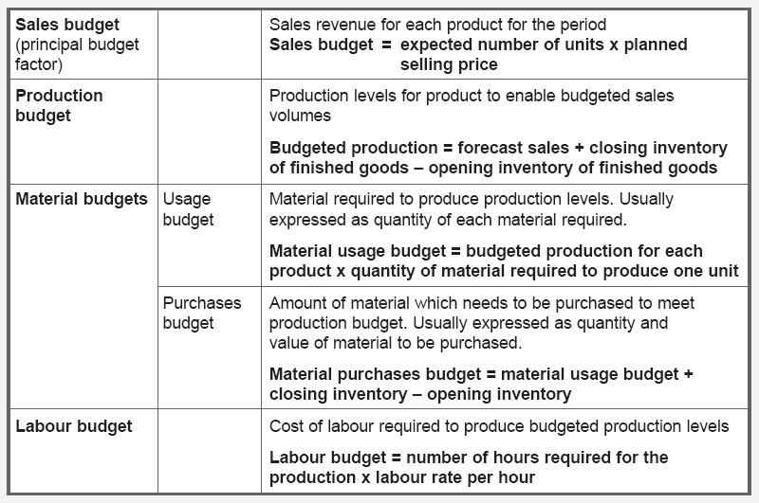
Functional budgets

Slide 7
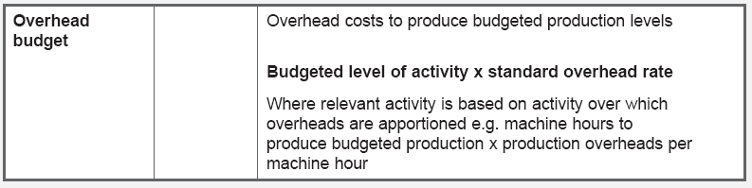
Functional budgets

Slide 8
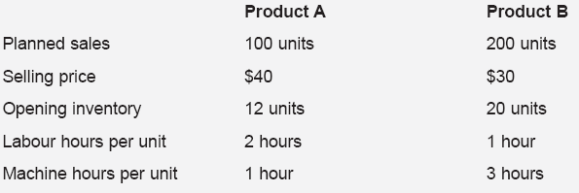
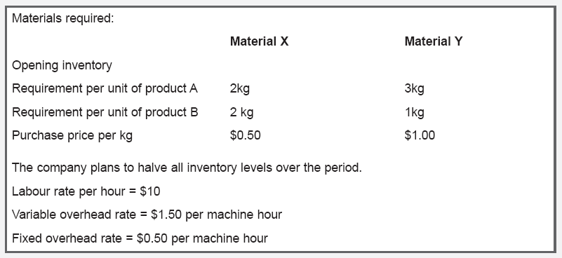
Example

Slide 9
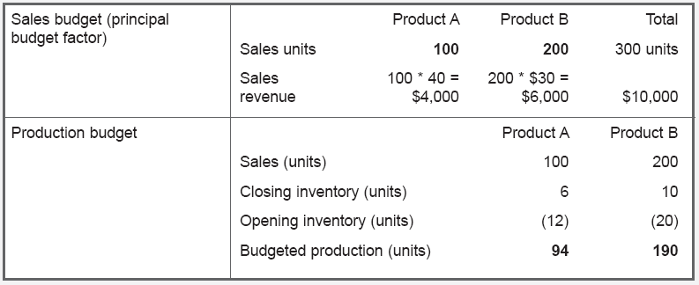
Example - continued

Slide 11
Fixed, flexible & flexed budgets
Fixed Budget
Remains unchanged even though level of activity changes
Does not assist in variance analysis
Flexible budget
Compares Original Budget with actual results
Prepared at the start of the period, for different possible levels of activity
Best, Most Likely, Worst
Flexed budget
Changes as the volume of activity changes
Useful for budgetary control purposes
Cost behaviour of the different items in the original budget
Hi-low method

Slide 12
Flexed Budgets and budget variances
Variances are differences arising between the original budget and actual results.
Volume Variance
Expenditure Variance
Fixed Budget
Original expenditure levels for budgeted activity level
Flexed Budget
Original expenditure levels for actual activity level
Actual results
Actual expenditure levels for actual activity level
Total Variance

