Slide 1
Capital Budgeting and Financial Planning
Course Instructor: M.Jibran Sheikh

Slide 2
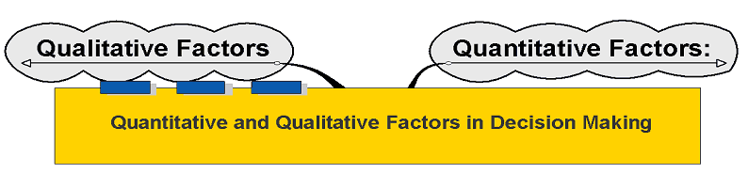
Quantitative and Qualitative Factors in Decision Making

Slide 3
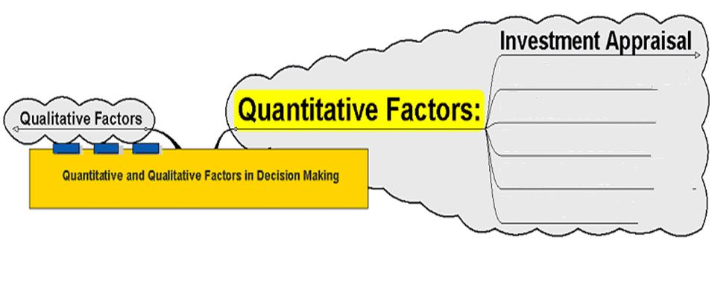
Quantitative Factors

Slide 4
Investment Appraisal
Payback period
NPV
ARR
Etc
Is that all????????????????????
And what about the problems?
How do you deal with other factors?

Slide 5
Quantitative Factors
Provide a numerical basis for decision making – reduces decisions to looking at a monetary value placed on different choices, e.g.
  Forecasted sales figures
  for the next 3 years
  The cost of a series of redundancies
  against the longer term financial benefits
  to the firm of this process

Slide 6
Quantitative Factors
But: such data provides only part
of the story
Other factors need to be taken into account, particularly the effects of decisions on stakeholder groups and their response to such decisions, e.g.
  The takeover of Manchester United by Malcolm Glazer might make financial sense but the reaction of the supporters might make the move unworkable

Slide 7
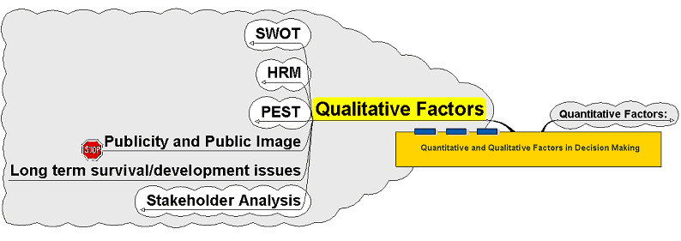
Qualitative Factors

Slide 8
Qualitative Factors
Qualitative factors look to take account of these other issues
that may influence the outcome
of a decision
Can be wide ranging and especially need to consider the impact
on human resources and
their response to decisions

Slide 9
SWOT
A decisions (for example, investment in a new production plant) could be considered not only in financial terms but also to apply other techniques of decision making
to look at wider issues:
A SWOT analysis might be part of this:
  Strengths
  Weaknesses
  Opportunities
  Threats

Slide 10
PESTLE
Might also need to factor in other external issues that might influence the decision making process which can be summarised as:
  Political
  Economic
  Social
  Technological
  Environmental
  Legal
Political could be in its widest sense,
e.g. the internal politics of a firm as well as
the national and international political effect

Slide 11
PESTLE
The decision to site a series of wind turbines in a coastal area might be justified on financial grounds but:
  What is the reaction of the local community?
  Does government policy support such planning developments?
  Are there social impacts – e.g. noise pollution, damage to eco-systems, etc?
Such factors may make the difference between success and failure

Slide 12
Pepsi Cola
Pepsi is a non-alcoholic beverage and is therefore regulated by the FDA. So, they’re supposed to maintain a firm standard of the laws set out by the FDA with consistency. Also, many different markets across the world have different set of regulations that are either relaxed or are either stringent. There is competitive pricing by Pepsi’s competitors and that is one factor that Pepsi has to keep in mind at all times. The political scenario also matters greatly as there can be some civil unrest in certain markets or due to inflation the sales of the product can fall. Most importantly, cross border situations are starkly different therefore Pepsi has to stay in line with all those policies and changes so that they can adapt to all those changes accordingly.

Slide 13
Economic
As the recent economic downturn has plagued the economy, companies had to restructure their sales and marketing campaigns greatly. Also, with diminishing profits they had to undergo downsizing internally and re-think upon how to penetrate the market. Economic conditions have the highest influence on a business, regardless of what trade it is in. Though, in Pepsi’s favor, the economic downturn that started in 2008 resulted in increased sales of its beverages mainly as people were being laid off from jobs, they were spending time with friends and family or at home

Slide 14
Social
Social factors greatly impact Pepsi, as it’s a non-alcoholic beverage it has to remain in line with the strict and stark differences of cultures the world over. Also, Pepsi has to communicate its image as a global brand so that the people can associate it with themselves as something that connects the world together. Usually, the social implications are seen in marketing campaigns for example certain countries have religious festivals, so Pepsi has to keep in line with all those festivals in order to understand the psyche of their market and how they can cash upon the opportunity.

Slide 15
Technological
With the advent of the new age in technology, companies have completely integrated themselves with all the recent changes that have taken place. To mention a recent trend that has greatly picked up and something that almost every business is turning toward is Social Media. The social media explosion has allowed for increasingly interactive engagement with the consumers with real time results so Pepsi has to stay ahead of all the developments that take place with keeping in view how the youth of today utilizes technology for their benefit and how can Pepsi reach them in order to keep on increasing brand recall and brand engagement.

Slide 16
Legal
There can be many legal implications upon the beverage industry. I would cite one very famous incident took place in India, where Pepsi was accused of using contaminated water, given a lab test that was done upon the water flowing into the Pepsi factory that was located nearby an industrial estate. A massive recall was issued for the products from shelves and then the product was tested costing the company many billions of dollars upon the tests as India is a very major market.

Slide 17
Environmental:
These factors can affect Pepsi, but not immensely alter its trade and profit generation as these factors affect agri-businesses much more directly.

Slide 18
Human Resources Management
Impact on a firm’s human resources
is essential to consider,
in particular the effects on:
Motivation
Morale
Recruitment and Retention
May be difficulty to assess and measure
May need to distinguish between short term effects and long term

Slide 19
Stakeholder Analysis
Wider impacts on stakeholder groups may also be necessary, such stakeholders include:
  Employees
  Shareholders
  Managers
  Environment
  Local Community
  Suppliers
  Government
  Consumers

Slide 20
Decision Making
Eventual decision may rest on the balance between the perceived effects of quantitative and qualitative
If the long term effect on the workforce for example was to reduce productivity or increase absence because of
the impact on motivation and morale,
the fact that a decision
makes financial sense may be shelved!
Qualitative by its nature, therefore,
is very subjective

