Slide 1
Capital Budgeting and Financial Planning
Course Instructor: M.Jibran Sheikh
Contact info: jibransheikh@comsats.edu.pk

Slide 2
Adjustment for Risk: Beta (β)
There are three different concepts of beta:
Equity beta (β_{E}) incorporates the effect of operating and financial risk. Equity betas are also referred to as "leveraged" betas or "company" betas.
Assets beta (β_{A}) measures the risk of a firm if it were all equity financed. Asset betas are sometimes referred to as “unlevered betas”. For an all equity firm, asset beta and equity beta are the same. Other wise asset betas are not directly observable.
Debt beta (β_{D}) is a measure of the risk of debt of the entity. Debt beta would be zero if debt is risk free.
Changing financial structure changes equity and debt betas, but not the asset beta.

Slide 3
Company cost of capital versus project cost of capital
Most listed companies will be able to calculate their WACC by calculating their own Beta and target debt capacity. Using this WACC as the project's discount rate is correct provided the risk of the project is the same as the overall risk of the company.
But what if a company is considering a project of different risk to its existing operations? Or how do you determine a WACC for a company that is not listed, where there is no beta of equity available ?
The discount rate should reflect the risk of the project, not the risk of the firm.
In such cases we will estimate the project’s beta (see next slide).

Slide 4
Estimating a Project’s Beta
A project's beta is a measure of its systematic or market risk.
Just as we can use a firm's beta to estimate its required return on equity, we can use a project's beta to adjust for differences between a specific project's risk and the average risk of a firm's projects.
Since a specific project is not represented by a publicly traded security, we typically cannot estimate a project's beta directly.
One process that can be used is based on the equity beta of a publicly traded firm that is engaged in a business similar to, and with risk similar to, the project under consideration.
This is referred to as the pure-play method because we begin with the beta of a company or group of companies that are purely engaged in a business similar to that of the project and are therefore comparable to the project.

Slide 5
Estimating a Project’s Beta
The beta of a firm is a function not only of the business risks of its projects (lines of business) but also of its financial structure.
For a given set of projects, the greater a firm's reliance on debt financing, the greater it’s equity beta.
For this reason, we must adjust the pure-play beta from a comparable company for the company's leverage (unlever it) and then adjust it (re-lever it) based on the financial structure of the company evaluating the project.
We can then use this equity beta to calculate the cost of equity to be used in evaluating the project.

Slide 6
Steps in estimating a Project’s Beta
Find a comparable company: publicly traded so that its equity beta is available or we can calculate it
Un-lever it: remove the effects of leverage from comparable company’s equity beta (i.e. calculate comparable company’s asset beta)
Re-lever it: adjust comparable company’s asset beta for the Project’s Leverage (financial risk). Effectively we will be calculating Project’s Equity Beta

Slide 7
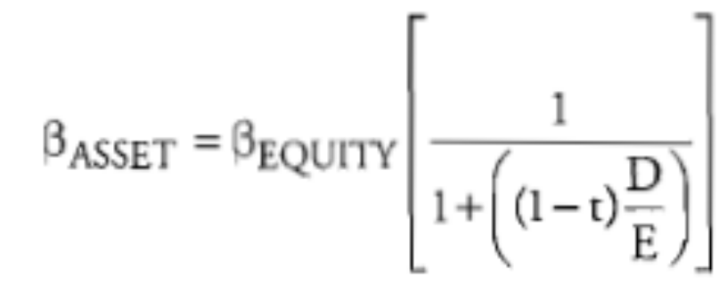
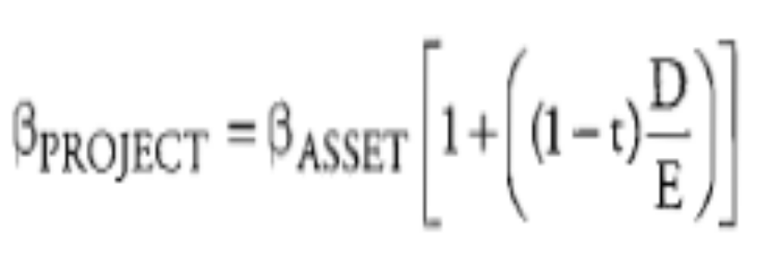
To get the asset beta for a publicly traded firm, we use the following formula:
Where: D/E is the comparable company's debt-to-equity ratio and t is its marginal tax rate.
To get the equity beta for the project, we use the project’s tax rate and debt-to-equity ratio:

Slide 8
Example:
RBA Inc. is considering a project in the food distribution business. RBA Inc. has a D/E ratio of 2.0, a marginal tax rate of 40%, and its debt currently has a yield of 14%.
MBA, a publicly traded firm that operates only in the food distribution business, has a D/E ratio of 1.5, a marginal tax rate of 30%, and an equity beta of 0.9.
The risk-free rate is 5% and the expected return on the market portfolio is 12%.
Calculate MBA's asset beta, use this to determine the project's equity beta, and the appropriate WACC to use in evaluating the project.

Slide 9
Solution:
MBA's asset beta:
β _{Asset} = 0.9 [1/1+(1-0.3)(1.5)] = 0.439
Equity beta for RBA project:
β _{Project} = 0.439[1 + (1 - 0.4)(2)] = 0.966
Project cost of equity = k_{e} = k_{RF} + β (k_{M} - k_{RF})
= 5% + 0.966(12% - 5%) = 11.762%

Slide 10
Calculating WACC using cost of debt and Equity
k_{a} = W_{d} k_{d} (I - T) + W_{e} k_{e}
k_{a} = 1/3 (0.11762) + 2/3 (0.14)(1 - 0.4) = 9.52%
Hint:
To get the weights of debt and equity, use the D/E ratio and give equity a value of 1.
Here, D/E = 2, so if E = 1, D = 2.
The weight for debt, D/(D + E), is 2/(2 + 1) = 2/3, and the weight for equity, E/(D + E), is 1/(2 + 1) = 1/3.

Slide 11
Comments on estimating Project’s Beta
While the method is theoretically correct, there are several challenging issues involved in estimating the beta of the comparable (or any) company's equity:
Beta is estimated using historical returns data. The estimate is sensitive to the length of time used and the frequency (daily, weekly, etc.) of the data.
The estimate is affected by which index is chosen to represent the market return.
Betas are believed to revert toward 1 over time, and the estimate may need to be adjusted for this tendency.
Estimates of beta for small-capitalization firms may need to be adjusted upward to reflect risk inherent in small firms that is not captured by the usual estimation methods.

Slide 12
Marginal cost of capital schedule
The marginal cost of capital (MCC) is the cost of the last new dollar of capital a firm raises.
As a firm raises more and more capital, the costs of different sources of financing will increase.
For example, as a firm raises additional debt, the cost of debt will rise to account for the additional financial risk.
This will occur, for example, if bond covenants in the firm's existing senior debt agreement prohibit the firm from issuing additional debt with the same seniority as the existing debt.
Therefore, the company will have to issue more expensive subordinated bonds at a higher cost of debt, which increases the marginal cost of capital.

Slide 13
Marginal cost of capital schedule (cont….)
Also, issuing new equity is more expensive than using retained earnings due to flotation costs.
Remember: Issuing more debt will also raise the cost of equity as stockholders will require more return to account for increased financial risk
The bottom line is that raising additional capital results in an increase in the WACC.
The marginal cost of capital schedule shows the WACC for different amounts of financing.
Typically, the MCC is shown as a graph. Since different sources of financing become more expensive as the firm raises more capital, the MCC schedule typically has an upward slope.

Slide 14
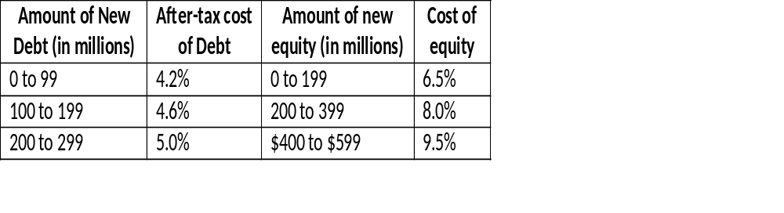
Marginal cost of capital schedule (cont….)
Also relevant is the concept of Break Points. Break Point occur any time the cost of one of the components of the company's WACC changes. A break point is calculated as:
Break point = Amount of capital at which the component's cost of capital changes
Weight of the component in the capital structure
Example: Calculating break points
The Omni Corporation has a target capital structure of 60% equity and 40% debt. The schedule of financing costs for the Omni Corporation is shown in the figure below.

Slide 15
Marginal cost of capital schedule (cont….)
Calculate the break points for Omni Corporation, and graph the marginal cost of capital schedule.
Solution:
Omni will have a break point each time a component cost of capital changes, for a total of four break points.
Break point Debt > 100m = 100 million/0.4 = 250 million
Break point Debt > 200m = 200 million/0.4 = 500 million
Break point Equity > 200m = 200 million/0.6 = 333 million
Break point Debt > 400m = 400 million/0.6 = 667 million

Slide 16
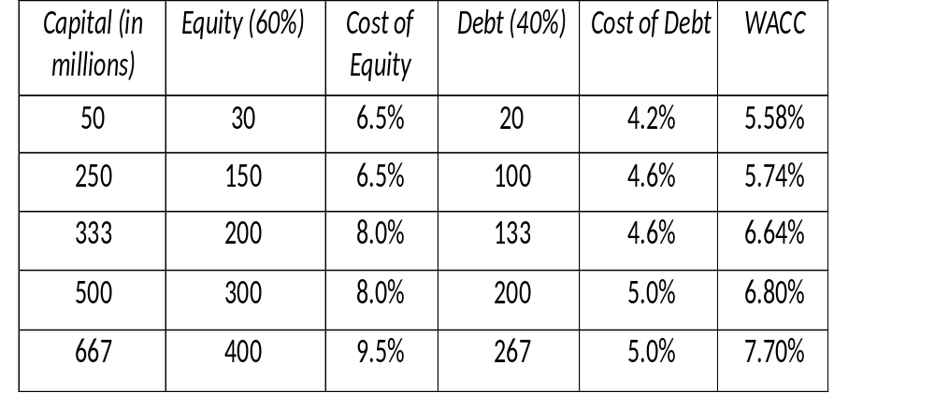
Marginal cost of capital schedule (cont….)
The following figure shows Omni Corporation's WACC for the different break points.

Slide 17
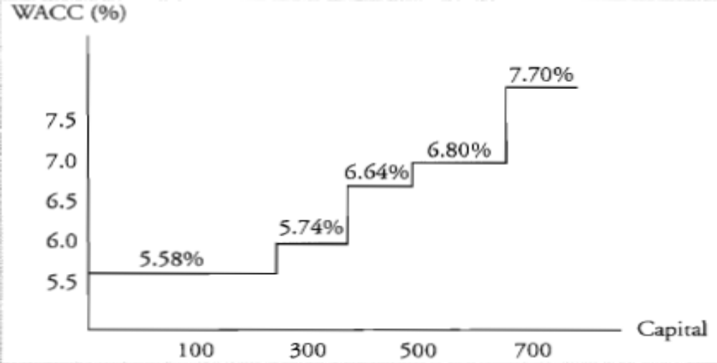
Marginal cost of capital schedule (cont….)
The following figure is a graph of the marginal cost of capital schedule given in the previous figure.
Notice the upward slope of the line due to the increased financing costs as more financing is needed.

Slide 18
Flotation Costs
Flotation costs are the fees that investment bankers charge for providing their services (for brining a new issue of debt or equity securities in market).
Flotation cost for debt are usually low but are high for equity issues (2-7%).
When flotation costs are high they may have a significant impact on a project’s economic feasibility.
Example
For example, RBA Company wants to fund a project with equity and sells 100,000 shares of common stock at Rs. 20 per share. The company has gross proceeds of Rs. 2,000,000 from the sale of the stock and the investment bank charges 6% of the proceeds for its services.
After paying the 6% (Rs. 120,000) flotation cost to the investment bank for finding buyers for the stock, ABC Company nets Rs. 1,880,000.

Slide 19
Incorrect treatment of Flotation Costs
Many financial textbooks incorporate flotation costs directly into the cost of capital by increasing the cost of external equity (or debt).
For example, if a company has a dividend of Rs. 1.50 per share, a current price of Rs. 30 per share, and an expected growth rate of 6%, the cost of equity without flotation costs would be:
k_{e} = [1.50(1+0.06)/30] + 0.06 = 0.1130 or 11.30% (Re-call DDM)
If we incorporate flotation costs of 4.5% directly into the cost of equity computation, the cost of equity would be:
k_{e} = [1.50(1 + 0.06)/30(1-0.045)] +0.06 = 0.1155 or 11.55%

Slide 20
Correct treatment of Flotation Costs
In the incorrect treatment we have just seen, flotation costs effectively increase the WACC by a fixed percentage and will be a factor for the duration of the project because future project cash flows are discounted at this higher WACC to determine project NPV.
The problem with this approach is that flotation costs are not an ongoing expense for the firm. Flotation costs are a cash outflow that occurs at the initiation of a project and affect the project NPV by increasing the initial cash outflow.
Therefore, the correct way to account for flotation costs is to adjust the initial project cost.
An analyst should calculate the dollar amount of the flotation cost attributable to the project and increase the initial cash outflow for the project.

Slide 21
Example: Correctly accounting for flotation costs
Omni Corporation is considering a project that requires a Rs. 400,000 cash outlay and is expected to produce cash flows of Rs. 150,000 per year for the next four years. Omni's tax rate is 35%, and the before-tax cost of debt is 6.5%. The current share price for Omni's stock is Rs. 36 per share, and the expected dividend next year is Rs. 2 per share. Omni's expected growth rate is 5%. Assume Omni finances the project with 50% debt and 50% equity capital, and that flotation costs for equity are 4.5%. The appropriate discount rate for the project is the WACC.
Calculate the NPV of the project using the correct treatment of flotation costs, and discuss how the result of this method differs from the result obtained from the incorrect treatment of flotation costs.

Slide 22
Solution
After-tax cost of debt = 6.5% (1 - 0.35) = 4.23%
Cost of equity = (2/36) + 0.05 = 0.1055 or 10.55%
WACC = (0.1055 x 0.5) + (0.0423 x 0.5) = 0.0739 or 7.39%
Since the project is financed with 50% equity, the amount of equity capital raised is 0.50 x 400,000 = 200,000.
Flotation costs are 4.5%, which equates to rupee cost of 200,000 x 0.045 = Rs. 9,000
NPV = -400,000 -9,000 + (150,000/1.0739) + (150,000/1.0739²) (150,000/1.0739³) (150,000/1.0739⁴) = 94,640

Slide 23
Solution (cont….)
For comparison, if we would have adjusted the cost of equity for flotation costs, the cost of equity would have been:
k_{e} =[2.00/36(1-0.045) + 0.05] = 10.82%
And WACC
WACC = (0.1082 x 0.5) + (0.0423 x 0.5) = 7.525%
Using this method, the NPV of the project would have been:
NPV=-400,000+(150,000/1.07525)+(150,000/1.07525²)+(150,000/1.07525³)+ (150,000/1.07525⁴) = 102,061
The two methods result in significantly different estimates for the project NPV.
Adjusting the initial outflow for the dollar amount of the flotation costs is the correct approach because it provides the most accurate assessment of the project's value once all costs are considered.

