Slide 1
Capital Budgeting and Financial Planning
Course Instructor: M.Jibran Sheikh

Slide 2
Rationale & Aims:
Capital budgeting is the study of investment decisions undertaken by the corporations. It revolves around understanding how corporations allocate funds among alternative investment opportunities.
The ultimate objective of any capital budgeting decision is to maximize the market value of the firm’s common stocks, and thereby, the wealth of its shareholders.
Main aim of this course is to cover basic tools used in capital budgeting decisions.
At the end of the course, the students should be able to understand and apply the following methods of capital budgeting:
NPV, IRR, Payback Period
Cash Flow estimation for Project Appraisal
Risk Analysis of Capital Budgeting Projects
Real Options

Slide 3
Learning outcomes:
Upon successful completion of the course, the students will be able to:
Estimate any project's Cash inflows & outflows
Assess riskiness of these Cash Flows using different risk analysis techniques
Determine appropriate discount rate (cost of capital)
Apply an Investment Appraisal Method/Technique (NPV, IRR, MIRR, PBP etc.)
Accept (or reject) based on acceptance criteria
Understand the basics of Financial Planning
Use Excel for financial planning and Project Appraisal

Slide 4
Core Text:
Selected Chapters from FINANCIAL MANAGEMENT THEORY AND PRACTICE by Brigham and Ehrhardt, 12th Edition (soft copy will be provided to you)
Selected Hand outs, Research papers and other material (will be provided to you)
Websites and Newspapers: (Keep an eye on corporate announcements)
Business section of daily ‘Dawn’ and Dawn Business Review available at (www.dawn.com)
Business Recorder (www.br.com.pk)
Bloomberg , yahoo finacail etc.
Computers and internet access: You will need access to word processing, Excel spreadsheets and the internet.

Slide 5
TOPIC 1:
Capital Investment Appraisal

Slide 6
Definitions:
Capital Budgeting is the process of analyzing different long term Projects (capital expenditures/capital investments) and deciding which ones to undertake based on firm’s acceptance criteria.
Capital Investment involves expenditure on fixed assets for use in a project which is intended to provide a return by way of interest, dividend or capital appreciation
An expenditure that generates a cash flow benefit for more than one year is called a capital expenditure
Note: Project, Capital Investment, Capital Expenditure will be used interchangeably.

Slide 7
Examples:
Purchase of new equipment
Expansion of production facilities
Buying another company
Acquiring new technologies
Launching a research & development program, etc.
Importance of Capital Budgeting:
Defines the firm’s strategic direction
Firm’s survival and growth
Involve large cash outlays with major implications on the future values of the company (liquidity crunch, insolvency, bankruptcy)
Once commit to making a capital expenditure it is difficult to back out (less flexibility)

Slide 8
Implications of Capital Investment
Impact on liquidity (?)
All projects involve cash inflows and outflows.
Consider the impact on liquidity while appraising a project.
If need more liquidity then may have to cut on Capital Investment.
Impact on Earnings and Profits (accounting numbers)
All projects will change the revenues, expenses and values of assets.
Accounting numbers (EPS, P/E) should be part of the analysis if required.
Impact on Cash Flows
Whether project will increase or reduce the cash flow uncertainty.
Check correlation between cash flows from existing and new projects

Slide 9
Types of Projects (based on relationship with other projects)
Independent Project: A project whose acceptance (or rejection) does not prevent the acceptance of other projects under consideration.
Mutually Exclusive Projects: Mutually exclusive projects means that the acceptance of one project eliminates the others from consideration. They cannot be undertaken simultaneously.
Contingent project is one the acceptance or rejection of which is dependent on the decision to accept or reject one or more other projects.
Contingent projects may be complementary or substitutes.

Slide 10
Types of Projects (based on occurrence of cash flows)
Investing Projects: Cash Outflows occur at the start of the project followed by cash inflows. Also called Normal CF Projects. Only one change of sign.
Financing Projects: Cash Inflows occur at the start of the project followed by cash outflows. Also called Normal CF Projects. Only one change of sign.
Mixture: Cash outflows occur at the start of the project followed by cash inflows again followed by Cash Outflows. Also called Non-Normal CF Projects. Multiple change of sign.

Slide 11
Steps in Project Appraisal
Estimate Project's Cash inflows & outflows [will do later]
Assess riskiness of these Cash Flows [will do later]
Determine appropriate discount rate [will do later]
Apply an Investment Appraisal Method/Technique
Accept (or reject) based on acceptance criteria.

Slide 12
Investment Appraisal Methods/Techniques
1) Methods without employing Discounted Cash Flow techniques
ROCE/ROI/Accounting Rate of Return/Average Accounting Return
Payback period (simple)
2) Discounted Cash Flow Methods (Basic)
Discounted Payback period
NPV
Residual Income
IRR
Profitability Index
3) Discounted Cash Flow Methods (Advance)
Adjusted Present Value (APV)
Modified Internal Rate of Return (MIRR)

Slide 13
1) Return on Capital Employed/Return on Investment/Accounting Rate of Return/Average Accounting Return
Different analysts use different versions of return (profit) and Capital Employed.
Further an average of annual profits and capital employed is used.
In this course we will use the following formula:
ROCE = NOPAT/Capital Employed
Where:
NOPAT = Net Operating Profit after Taxes = EBIT x (1 - T) where T is the corporate tax rate or Net profit + After tax Interest Expense
Funds Invested = Net Fixed Assets plus Net Working Capital or Interest Bearing Debt plus Equity
Further, we will use an average of profits and capital employed.

Slide 14
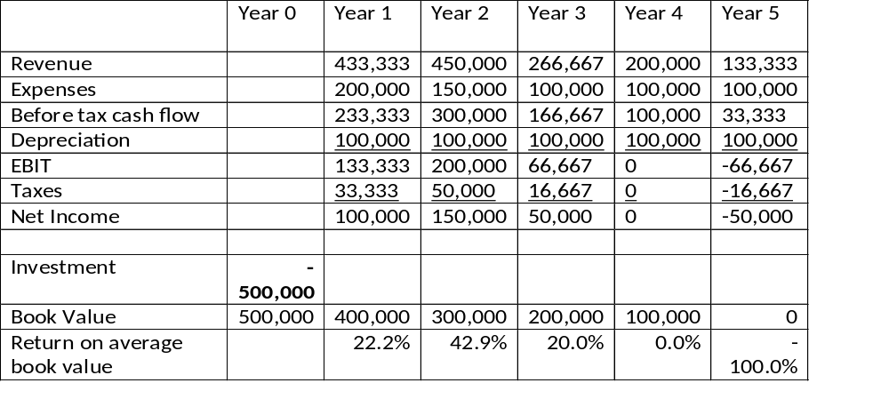
Average accounting return
Average Net Income 50,000
Average Book Value 250,000
AAR 50,000/250,000 = 20.0%

Slide 15
Merits of ROCE/AAR
Simplicity: based on reported figures so easily calculated and understood
Linked with other accounting measures like ROE, ROA, Annual ROCE
Demerits of ROCE/AAR
Ignores project life
Ignores time value of money (no discounting)
Based on accounting figures so depend upon specific accounting policies
Subjective, easy to manipulate
Does not tell you value created
No standard exist for ROCE

Slide 16
2) Payback Period
Definition: The number of years required to recover a project’s cost, or “How long does it take to get the invested amount back?”
Method: Calculated by adding project’s cash inflows to its cost until the cumulative cash flow for the project turns positive.
Decision Rule: When deciding between two or more competing projects, the rule is to accept the project with shortest payback. PBP is used as a first screening method.

Slide 17
Payback Period (normal CF projects and equal annual cash flows)
PBP = Initial Outlay/Annual Cash Inflow
Example: Rs. 2m is invested in a project that will generate Rs. 0.5m net cash inflows for 7 years. What will be the PBP?
PBP = 2,000,000/500,000 = 4 years
Payback Period (normal CF projects but uneven annual cash flows)
Use cumulative cash flows i.e. add cash inflows to initial cash outlay. PBP will be the point at which Cumulative CFs are = 0.

Slide 18
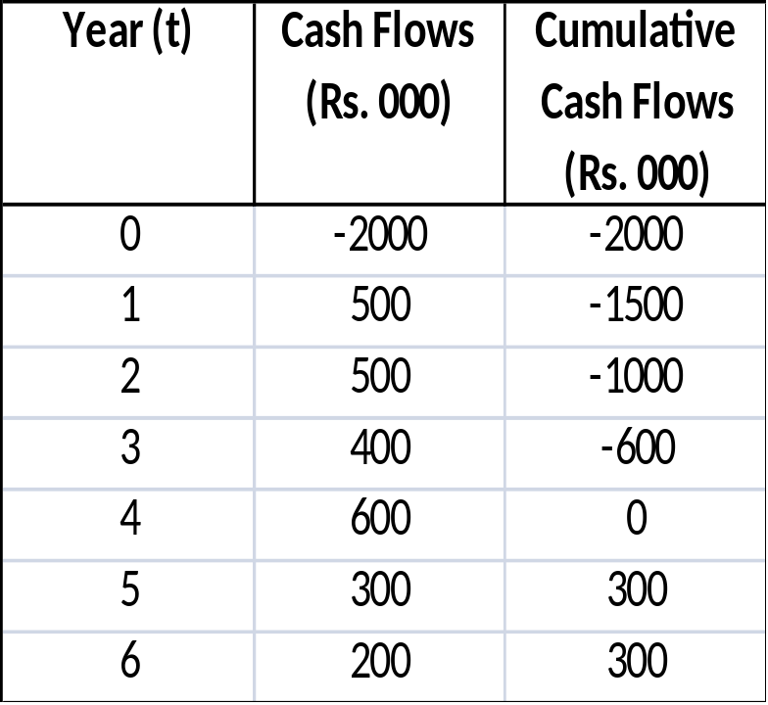
Payback Period (normal CF projects but uneven annual cash flows)
PBP is exactly 4 years.

Slide 19
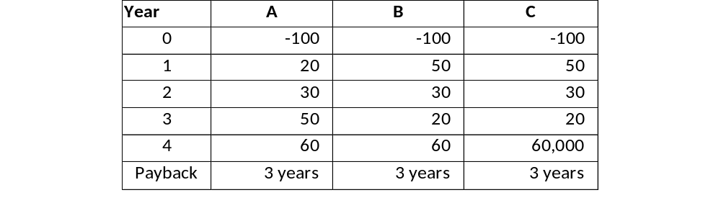
Payback Period
Problems:
Timing of cash flows, no discounting (TVM ?)
Cash flows after payback reached are ignored
No standard exists for payback
Project profitability is ignored

Slide 20
Merits of PBP
Simplicity: Easily calculated and understood
Uses cash flows rather than profits therefore less affected by accounting policies
Uses cash flows rather than profits therefore more conservative
Good measure for projects with rapidly changing technologies
Good measure if funds will be needed in near future for other projects
Good for assessing Time Risk and Liquidity
Demerits of PBP
?

Slide 21
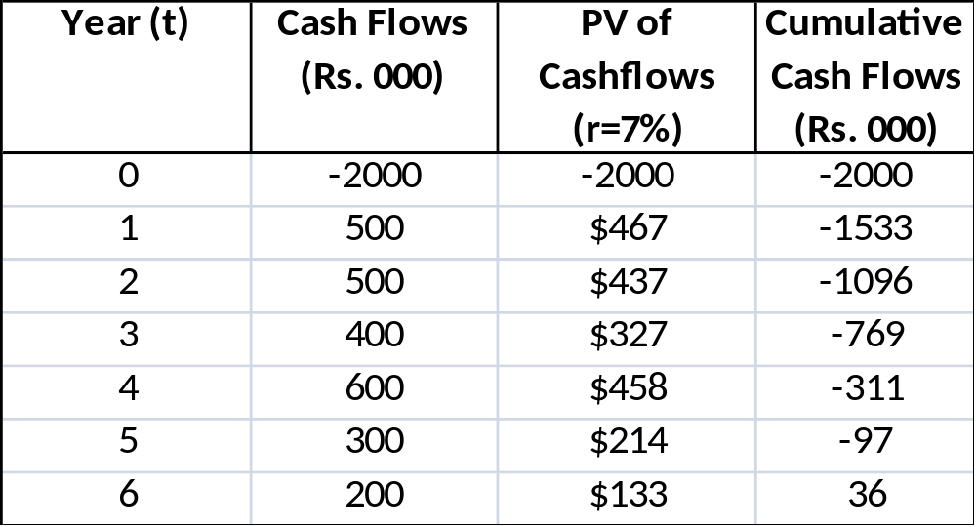
2.1) Discounted Payback Period
How long would it take to recover the investment from present value of cash inflows.
PBP is between 5th and 6th year.
PBP = 5 + (97/133) = 5+0.729 = 5.729 years
Discounted PBP takes account of TVM but still ignores CFs after PBP and profitability of the project.

Slide 22
2.2) Payback Reciprocal
PB Reciprocal = 1/PBP
Expressed as a percentage. In certain cases approximates to IRR.
Using the data in earlier example
PB Reciprocal = 1/4 = 0.25 or 25% (simple PBP)
PB Reciprocal = 1/5.729 = 0.1745 = 17.5% (Discounted PBP)

Slide 23
2.3) Multiple Paybacks
How much time would it take to recover initial investment not once but several time (say 3 or 4 times).
Just keep on cumulating the CFs. First PBP will be when CFF are = 0. Second PBP will be when CFF = Initial Investment, third PBP will be when CFF = double of initial investment and so on…..
Practice it by yourself. Not something very technical. ☺

Slide 24
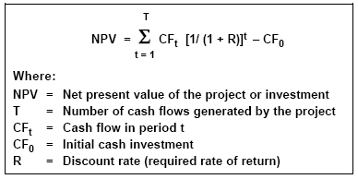
3) Net Present Value
Net Present Value (NPV) is the difference between present value of cash inflows and cash outflows (costs) of a project (investment).
NPV is an estimate of the value added by an asset
In a fully efficient market the NPV of each asset would be zero since all assets would be priced at their correct value.
The NPV rule is that a corporation should invest in every project with a positive NPV, and only in projects with a positive NPV.

Slide 25
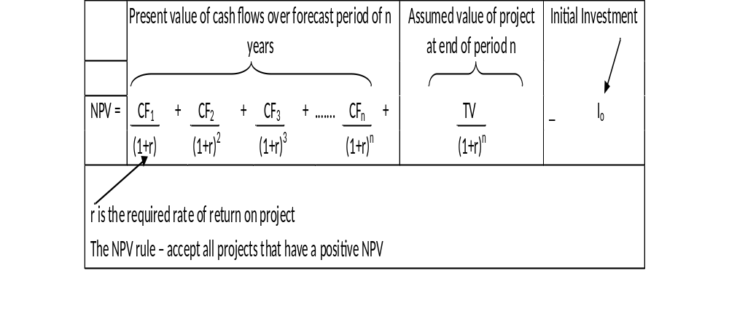
The basic NPV formulation

Slide 26
Simple Example of NPV
You buy a block of units for Rs. 1,500,000 and expect to sell them in two years time for Rs. 1,750,000 (after tax). In the meantime you expect to receive net income after tax of Rs. 70,000 in each of the two years. You reckon you can earn 10% by investing in a property trust.

Slide 27
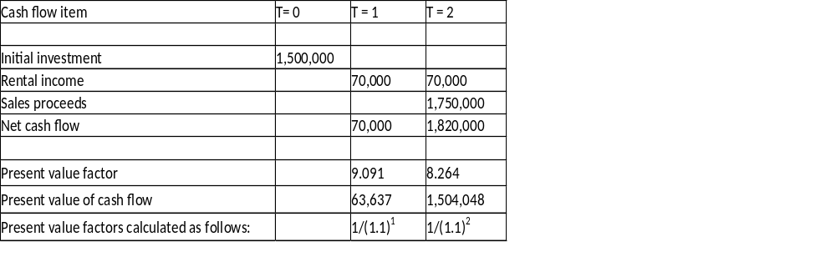
Simple Example of NPV
Net present value = 63,637 + 1 504,048 – 1,500,000 = 67,685.
Positive NPV of $67,685 means you should accept project.

Slide 28
Why Use NPV?
The basic reason for using NPV to decide on investment projects flows from our understanding of the firm's financial objective:
Maximize the value of the firm and owners' (i.e. shareholders') wealth
NPV measures the increase in wealth arising from an investment in real assets. Hence choosing investment projects that maximise NPV also maximizes the value of the firm and shareholders' wealth.
NPV measures the increase in wealth arising from an investment in real assets. Hence choosing investment projects that maximize NPV also maximizes the value of the firm and shareholders' wealth.

Slide 29
Advantages of the NPV rule
Maximising NPV also means maximising value (of the investment or the company);
Incorporates different timing of cash flows and thus assess short term / long term tradeoffs;
Recognizes the opportunity cost of capital (reflected in the discounted rate);
Recognizes risk of the cash flows (discount rate is adjusted according to the risk);
Not distorted by different accounting treatments because it measures cash flows - Directly measures the amount of additional value, or wealth that is expected to be created;

Slide 30
Advantages of the NPV
Incorporates all available information about the financial impact of an investment or decision - all forecast cash flows are included on a comparable basis;
NPV is additive i.e. We can add NPVs and PVs. For example:
we can add the PVs of cash flows of each part of a company and derive what its total market value should be;
we can also break a DCF into component parts and get a better understanding of the various components of total value of a business or proposal

Slide 31
Shortcomings of the NPV
NPV analysis depends upon correct estimation of project Cash Flows. Any mistake in this regard will render the whole analysis useless.
May not be applied to situations where Cash Flow can not be estimated correctly.
May not give correct results when comparing two projects with un-equal lives [will do shortly]
Time consuming

