Slide 1
Lecture No. 5
Introduction
to Risk Management

Slide 2
Objectives
Meaning of Risk Management
Objectives of Risk Management
Steps in the Risk Management Process
Benefits of Risk Management
Personal Risk Management

Slide 3
Meaning of Risk Management
Risk Management is a process that identifies loss exposures faced by an organization and selects the most appropriate techniques for treating such exposures
A loss exposure is any situation or circumstance in which a loss is possible, regardless of whether a loss occurs
  E.g., a plant that may be damaged by an earthquake, or an automobile that may be damaged in a collision
New forms of risk management consider both pure and speculative loss exposures

Slide 4
Objectives of Risk Management
Risk management has objectives before and after a loss occurs
Pre-loss objectives:
  Prepare for potential losses in the most economical way
  Reduce anxiety
  Meet any legal obligations

Slide 5
Objectives of Risk Management
Post-loss objectives:
  Ensure survival of the firm
  Continue operations
  Stabilize earnings
  Maintain growth
  Minimize the effects that a loss will have on other persons and on society

Slide 6
Risk Management Process
Identify potential losses
Measure and analyze the loss exposures
Select the appropriate combination of techniques for treating the loss exposures
Implement and monitor the risk management program
Notes:
Transparency Master 1.2

Slide 7
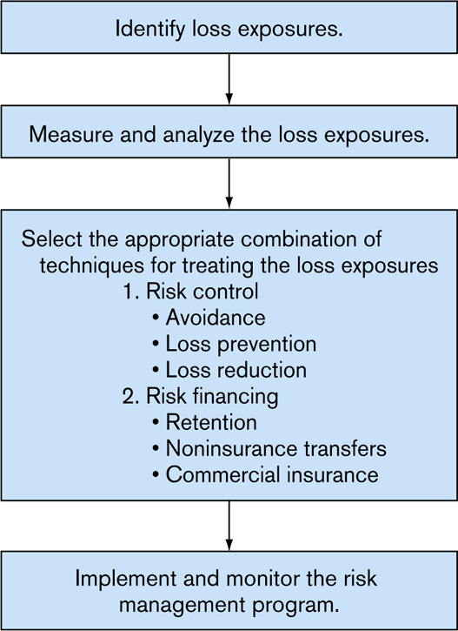
Exhibit 3.1 Steps in the Risk Management Process

Slide 8
Identifying Loss Exposures
Property loss exposures
Liability loss exposures
Business income loss exposures
Human resources loss exposures
Crime loss exposures
Employee benefit loss exposures
Foreign loss exposures
Intangible property loss exposures
Failure to comply with government rules and regulations

Slide 9
Identifying Loss Exposures
Risk Managers have several sources of information to identify loss exposures:
  Questionnaires
  Physical inspection
  Flowcharts
  Financial statements
  Historical loss data
Industry trends and market changes can create new loss exposures.
  e.g., exposure to acts of terrorism

Slide 10
Measure and Analyze Loss Exposures
Estimate the frequency and severity of loss for each type of loss exposure
  Loss frequency refers to the probable number of losses that may occur during some given time period
  Loss severity refers to the probable size of the losses that may occur
Once loss exposures are analyzed, they can be ranked according to their relative importance
Loss severity is more important than loss frequency:
  The maximum possible loss is the worst loss that could happen to the firm during its lifetime
  The probable maximum loss is the worst loss that is likely to happen

Slide 11
Select the Appropriate Combination of Techniques for Treating the Loss Exposures
Risk control refers to techniques that reduce the frequency and severity of losses
Methods of risk control include:
  Avoidance
  Loss prevention
  Loss reduction
Avoidance means a certain loss exposure is never acquired, or an existing loss exposure is abandoned
  The chance of loss is reduced to zero
  It is not always possible, or practical, to avoid all losses

Slide 12
Select the Appropriate Combination of Techniques for Treating the Loss Exposures
  Loss prevention refers to measures that reduce the frequency of a particular loss
    e.g., installing safety features on hazardous products
  Loss reduction refers to measures that reduce the severity of a loss after is occurs
    e.g., installing an automatic sprinkler system

Slide 13
Select the Appropriate Risk Management Technique
Risk financing refers to techniques that provide for the funding of losses
Methods of risk financing include:
  Retention
  Non-insurance Transfers
  Commercial Insurance

Slide 14
Risk Financing Methods: Retention
Retention means that the firm retains part or all of the losses that can result from a given loss
  Retention is effectively used when:
    No other method of treatment is available
    The worst possible loss is not serious
    Losses are highly predictable
  The retention level is the dollar amount of losses that the firm will retain
    A financially strong firm can have a higher retention level than a financially weak firm
    The maximum retention may be calculated as a percentage of the firm’s net working capital

Slide 15
Risk Financing Methods: Retention
  A risk manager has several methods for paying retained losses:
    Current net income: losses are treated as current expenses
    Unfunded reserve: losses are deducted from a bookkeeping account
    Funded reserve: losses are deducted from a liquid fund
    Credit line: funds are borrowed to pay losses as they occur

Slide 16
Risk Financing Methods: Retention
A captive insurer is an insurer owned by a parent firm for the purpose of insuring the parent firm’s loss exposures
  A single-parent captive is owned by only one parent
  An association or group captive is an insurer owned by several parents
  Many captives are located in the Caribbean because the regulatory environment is favorable
  Captives are formed for several reasons, including:
    The parent firm may have difficulty obtaining insurance
    To take advantage of a favorable regulatory environment
    Costs may be lower than purchasing commercial insurance
    A captive insurer has easier access to a reinsurer
    A captive insurer can become a source of profit
  Premiums paid to a captive may be tax-deductible under certain conditions

Slide 17
Risk Financing Methods: Retention
Self-insurance is a special form of planned retention
  Part or all of a given loss exposure is retained by the firm
  Another name for self-insurance is self-funding
  Widely used for workers compensation and group health benefits
A risk retention group is a group captive that can write any type of liability coverage except employer liability, workers compensation, and personal lines
  Federal regulation allows employers, trade groups, governmental units, and other parties to form risk retention groups
  They are exempt from many state insurance laws

Slide 18
Risk Financing Methods: Retention
Advantages
  Save on loss costs
  Save on expenses
  Encourage loss prevention
  Increase cash flow
Disadvantages
  Possible higher losses
  Possible higher expenses
  Possible higher taxes

Slide 19
Risk Financing Methods: Non-insurance Transfers
A non-insurance transfer is a method other than insurance by which a pure risk and its potential financial consequences are transferred to another party
  Examples include:
    Contracts, leases, hold-harmless agreements

Slide 20
Risk Financing Methods: Non-insurance Transfers
Advantages
  Can transfer some losses that are not insurable
  Save money
  Can transfer loss to someone who is in a better position to control losses
Disadvantages
  Contract language may be ambiguous, so transfer may fail
  If the other party fails to pay, firm is still responsible for the loss
  Insurers may not give credit for transfers

Slide 21
Risk Financing Methods: Insurance
Insurance is appropriate for loss exposures that have a low probability of loss but for which the severity of loss is high
  The risk manager selects the coverages needed, and policy provisions:
    A deductible is a provision by which a specified amount is subtracted from the loss payment otherwise payable to the insured
    An excess insurance policy is one in which the insurer does not participate in the loss until the actual loss exceeds the amount a firm has decided to retain
  The risk manager selects the insurer, or insurers, to provide the coverages

Slide 22
Risk Financing Methods: Insurance
  The risk manager negotiates the terms of the insurance contract
    A manuscript policy is a policy specially tailored for the firm
      Language in the policy must be clear to both parties
    The parties must agree on the contract provisions, endorsements, forms, and premiums
  The risk manager must periodically review the insurance program

Slide 23
Risk Financing Methods: Insurance
Advantages
  Firm is indemnified for losses
  Uncertainty is reduced
  Insurers may provide other risk management services
  Premiums are tax-deductible
Disadvantages
  Premiums may be costly
    Opportunity cost should be considered
  Negotiation of contracts takes time and effort
  The risk manager may become lax in exercising loss control

Slide 24
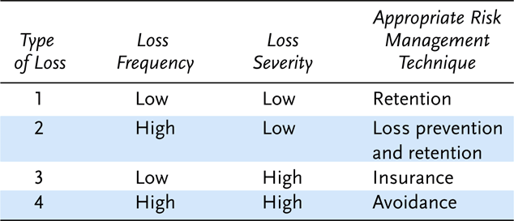
Exhibit 3.2 Risk Management Matrix

Slide 25
Market Conditions and the Selection of Risk Management Techniques
Risk managers may have to modify their choice of techniques depending on market conditions in the insurance markets
The insurance market experiences an underwriting cycle
  In a “hard” market, when profitability is declining, underwriting standards are tightened, premiums increase, and insurance becomes more difficult to obtain
  In a “soft” market, when profitability is improving, standards are loosened, premiums decline, and insurance become easier to obtain

Slide 26
Implement and Monitor the Risk Management Program
Implementation of a risk management program begins with a risk management policy statement that:
  Outlines the firm’s risk management objectives
  Outlines the firm’s policy on loss control
  Educates top-level executives in regard to the risk management process
  Gives the risk manager greater authority
  Provides standards for judging the risk manager’s performance
A risk management manual may be used to:
  Describe the risk management program
  Train new employees

Slide 27
Implement and Monitor the Risk Management Program
A successful risk management program requires active cooperation from other departments in the firm
The risk management program should be periodically reviewed and evaluated to determine whether the objectives are being attained
  The risk manager should compare the costs and benefits of all risk management activities

Slide 28
Benefits of Risk Management
Pre-loss and post-loss objectives are attainable
A risk management program can reduce a firm’s cost of risk
  The cost of risk includes premiums paid, retained losses, outside risk management services, financial guarantees, internal administrative costs, taxes, fees, and other expenses
Reduction in pure loss exposures allows a firm to enact an enterprise risk management program to treat both pure and speculative loss exposures
Society benefits because both direct and indirect losses are reduced

Slide 29
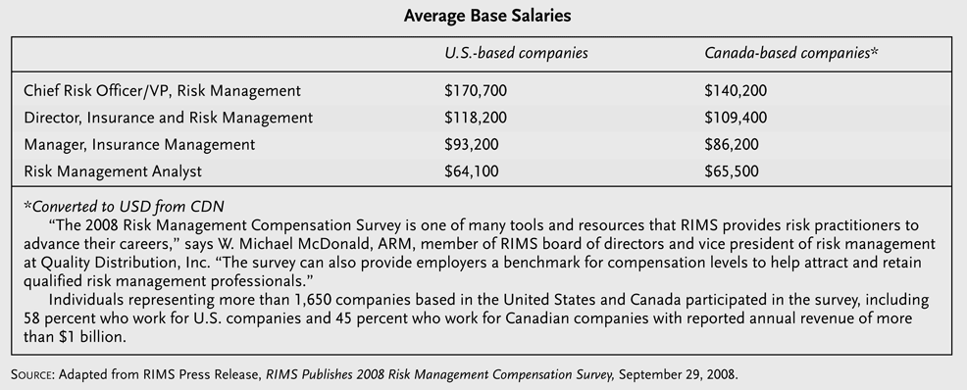
Insight 3.2 Show Me the Money–Risk Manager Salaries Rise

Slide 30
End of Lecture No. 5

