Slide 1
Lecture No. 2
Risk in Our Society (Continued)

Slide 2
Objectives
Different Definitions of Risk
Chance of Loss
Peril and Hazard
Classification of Risk
Major Personal Risks and Commercial Risks
Burden of Risk on Society
Techniques for Managing Risk

Slide 3
Different Definitions of Risk
Risk: Uncertainty concerning the occurrence of a loss
Loss Exposure: Any situation or circumstance in which a loss is possible, regardless of whether a loss occurs.
Objective Risk vs. Subjective Risk
  Objective risk is defined as the relative variation of actual loss from expected loss
    It can be statistically calculated using a measure of dispersion, such as the standard deviation
  Subjective risk is defined as uncertainty based on a person’s mental condition or state of mind
    Two persons in the same situation may have different perceptions of risk
    High subjective risk often results in conservative behavior
Notes:
Transparency Master 1.2

Slide 4
Chance of Loss
Chance of loss: The probability that an event will occur
Objective Probability vs. Subjective Probability
  Objective probability refers to the long-run relative frequency of an event assuming an infinite number of observations and no change in the underlying conditions
    It can be determined by deductive or inductive reasoning
  Subjective probability is the individual’s personal estimate of the chance of loss
    A person’s perception of the chance of loss may differ from the objective probability
Notes:
Transparency Master 1.2

Slide 5
Peril and Hazard
A peril is defined as the cause of the loss
  In an auto accident, the collision is the peril
A hazard is a condition that increases the chance of loss
  Physical hazards are physical conditions that increase the chance of loss (icy roads, defective wiring)
  Moral hazard is dishonesty or character defects in an individual, that increase the chance of loss (faking accidents, inflating claim amounts)
  Attitudinal Hazard (Morale Hazard) is carelessness or indifference to a loss, which increases the frequency or severity of a loss (leaving keys in an unlocked car)
  Legal Hazard refers to characteristics of the legal system or regulatory environment that increase the chance of loss (large damage awards in liability lawsuits)
Notes:
Transparency Master 1.2

Slide 6
Classification of Risk
Pure and Speculative Risk
  A pure risk is one in which there are only the possibilities of loss or no loss (earthquake)
  A speculative risk is one in which both profit or loss are possible (gambling)
Diversifiable Risk and Nondiversifiable Risk
  A diversifiable risk affects only individuals or small groups (car theft). It is also called nonsystematic or particular risk.
  A nondiversifiable risk affects the entire economy or large numbers of persons or groups within the economy (hurricane). It is also called systematic risk or fundamental risk.
  Government assistance may be necessary to insure nondiversifiable risks.
Notes:
Transparency Master 1.2

Slide 7
Classification of Risk
Enterprise risk encompasses all major risks faced by a business firm, which include: pure risk, speculative risk, strategic risk, operational risk, and financial risk
  Financial Risk refers to the uncertainty of loss because of adverse changes in commodity prices, interest rates, foreign exchange rates, and the value of money.
Enterprise Risk Management combines into a single unified treatment program all major risks faced by the firm:
  Pure risk
  Speculative risk
  Strategic risk
  Operational risk
  Financial risk

Slide 8
Major Personal Risks and Commercial Risks
Personal risks involve the possibility of a loss or reduction in income, extra expenses or depletion of financial assets:
  Premature death of family head
  Insufficient income during retirement
    Most workers are not saving enough for a comfortable retirement
  Poor health (catastrophic medical bills and loss of earned income)
  Involuntary unemployment
Notes:
Transparency Master 1.2

Slide 9
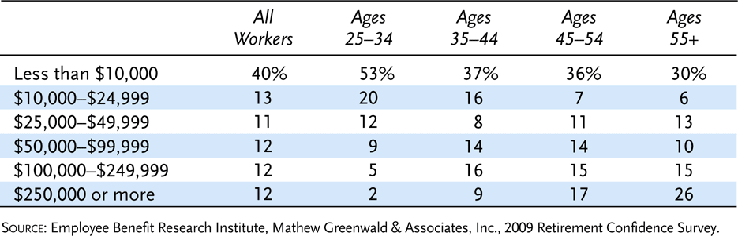
Exhibit 1.1 Reported Total Savings and Investments among Those Responding, by Age
(not including value of primary residence or defined benefit plans)

Slide 10
Major Personal Risks and Commercial Risks
Property risks involve the possibility of losses associated with the destruction or theft of property:
  Physical damage to home and personal property from fire, tornado, vandalism, or other causes
Direct loss vs. indirect loss
  A direct loss is a financial loss that results from the physical damage, destruction, or theft of the property, such as fire damage to a home
  An indirect loss results indirectly from the occurrence of a direct physical damage or theft loss, such as the additional living expenses after a fire to a home. These additional expenses would be a consequential loss.

Slide 11
Major Personal Risks and Commercial Risks
Liability risks involve the possibility of being held liable for bodily injury or property damage to someone else
  There is no maximum upper limit with respect to the amount of the loss
  A lien can be placed on your income and financial assets
  Defense costs can be enormous

Slide 12
Major Personal Risks and Commercial Risks
Commercial Risks
  Firms face a variety of pure risks that can have serious financial consequences if a loss occurs:
    Property risks, such as damage to buildings, furniture and office equipment
    Liability risks, such as suits for defective products, pollution of the environment, and sexual harassment
    Loss of business income, when the firm must shut down for some time after a physical damage loss
    Other risks to firms include crime exposures, human resource exposures, foreign loss exposures, intangible property exposures, and government exposures

Slide 13
Burden of Risk on Society
The presence of risk results in three major burdens on society:
  In the absence of insurance, individuals would have to maintain large emergency funds
  The risk of a liability lawsuit may discourage innovation, depriving society of certain goods and services
  Risk causes worry and fear

Slide 14
Techniques for Managing Risk
There are five major methods for managing risk
  Avoidance
  Loss control
    Loss prevention refers to activities to reduce the frequency of losses
    Loss reduction refers to activities to reduce the severity of losses
  Retention
    An individual or firm retains all or part of a given risk
    Active retention means that an individual is consciously aware of the risk and deliberately plans to retain all or part of it
    Passive retention means risks may be unknowingly retained because of ignorance, indifference, or laziness
    Self Insurance is a special form of planned retention by which part or all of a given loss exposure is retained by the firm
Notes:
Transparency Master 1.2

Slide 15
Techniques for Managing Risk
Noninsurance transfers
  A risk may be transferred to another party by several methods:
  A transfer of risk by contract, such as through a service contract or a hold-harmless clause in a contract
  Hedging is a technique for transferring the risk of unfavorable price fluctuations to a speculator by purchasing and selling futures contracts on an organized exchange
  Incorporation of a business firm transfers to the creditors the risk of having insufficient assets to pay business debts
Insurance
  For most people, insurance is the most practical method for handling a major risk

Slide 16
Financial and Insurance as Powerful Forces in Our Economy and Society
This course seeks to understand the full role of advanced risk management in our economy and society
Finance, insurance, some public finance

Slide 17
The Fundamental Role of Risk Management
All manner of enterprise involves risk
Difficulties in quantifying
Judgment
Financial theory provides an understanding of these risks
Financial institutions provide a framework for applying theory

Slide 18
Moral Hazard
Example: burning down a house to collect on fire insurance
Ubiquity of moral hazard problems
Practical finance has developed institutions to promote risk management while dealing with moral hazard

Slide 19
Major Financial Sectors
Securities
Banks
Insurance
Social Insurance
All of these have a long history of promoting risk management and dealing with moral hazard. They are fundamental elements of our successful modern economy

Slide 20
Radical Financial Innovation
Risks not easily conceptualized
Public resistance to risk management
Each major risk category requires difficult institutional innovations to manage

Slide 21
Democratization of Finance
Trend over the centuries has been to apply financial and insurance principles to a broader and broader segment of population
Advance of information technology

Slide 22
Finance and Psychology
The Behavioral Finance Revolution
NBER-Sage Seminars on Behavioral Finance, with Richard Thaler, starting 1991 http://www.econ.yale.edu/~shiller
A Revolution in the finance profession. But not everyone has been captured by it.

Slide 23
Finance and Management
Most central discipline for managers is finance
Integration into all aspects of business management, including accounting, corporate strategy, industrial organization
Integration into government finance as well
Integration growing through time

Slide 24
Finance and Law
Lawyers are often financial inventors
Often government role in process
Law schools deal with all the minutiae

Slide 25

In Memoriam: Brad Hoorn
Economics 252b Spring 2001
Graduated Yale 2001
Worked Fred Alger Management, 93d Floor, World Trade Center, North Tower, Research Associate, Investment Management
35 of the 38 Alger employees at WTC were lost.

Slide 26
Risk
Risk regarding the possibility of loss can be especially problematic
If a loss is certain to occur
  It may be planned for in advance and treated as a definite, known expense
When there is uncertainty about the occurrence of a loss
  Risk becomes an important problem

Slide 27
The Burden of Risk
Some risks involve only the possibility of loss
Risks surrounding potential losses create significant economic burdens for businesses, government, and individuals
  Billions of dollars are spent each year to finance potential losses
    But when losses are not planned for in advance they may cost even more
Risk of loss may deprive society of services judged to be too risky
  For instance, without malpractice insurance many physicians would refuse to practice medicine

Slide 28
The Burden of Risk
Businesses may try to either avoid risk of loss or to reduce its negative consequences
An entity’s cost of risk is the sum of
  Expenses of strategies to finance potential losses
  The cost of unreimbursed losses
  Outlays to reduce risks
  Opportunity cost of activities forgone due to risk considerations

Slide 29
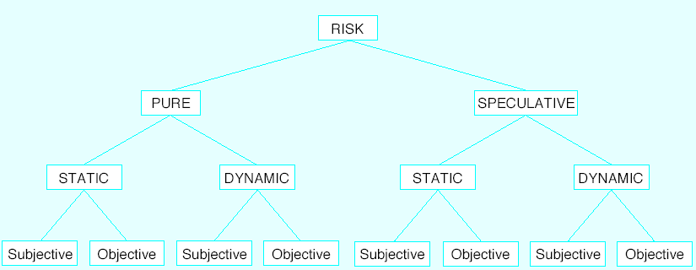
FIGURE 1-1 Types of Risk

Slide 30
Pure vs Speculative Risk
Pure risk exists when there is uncertainty as to whether loss will occur
    No possibility of gain is presented⎯only the potential for loss
Speculative risk exists when there is uncertainty about an event that can produce either a profit or a loss
Both pure and speculative risks may be present in some situations

Slide 31
Subjective vs Objective Risk
Subjective risk refers to the mental state of an individual who experiences doubt or worry as to the outcome of a given event
  It is essentially the psychological uncertainty that arises from an individual’s mental attitude or state of mind
Objective risk differs from subjective risk in the sense that it is more precisely observable and therefore measurable
  It is the probable variation of actual from expected experience

Slide 32
Sources of Risk
Property risks
  Risk that property may be damaged, destroyed or stolen
    For example, lightning, tornadoes, hurricanes, explosions, riots, collisions, falling objects, floods, earthquakes, freezing, etc.
Liability risks
  Legal judgments may result in payments made to compensate injured parties as well as to punish those responsible for the injuries
    Even if the individual is absolved of liability the expenses involved in the defense may be substantial
  All individuals who own or use real property are susceptible to liability losses if others are injured on their premises

Slide 33
Sources of Risk
Life and health and loss of income risks
  The possibility of the untimely death of a star salesperson
  The potential death of a parent with young children
  Employees who become ill or injured in accidents
Financial risk
  Include credit risk, foreign exchange risk, commodity risk, and interest rate risk
  These risks must be identified and assessed in order for the firm to achieve its business goals

Slide 34
Measurement of Risk
Chance of loss
  The long term chance of occurrence, or relative frequency of loss
  Meaningful only when applied to the chance of loss occurring among a large number of possible of events
    Expressed as the ratio of the number of losses that are likely to occur compared to the larger number of possible losses in a given group
Peril
  Specific contingency that may cause a loss
Hazards
  Conditions that exist which either increase the chance of a loss for a particular peril or tend to make the loss more severe once the peril has occurred

Slide 35
Hazards
Physical hazard
  A condition stemming from the material characteristics of an object
    An icy street makes the occurrence of collision more likely to occur
      The icy street is the hazard and the collision is the peril
Moral hazard
  Stems from an individual’s mental attitude
  Associated with intentional actions designed either to cause a loss or to increase its severity
  Also describes the change in attitude that can occur when insurance is available to pay for loss
    Such as the tendency for individuals to consume more health care if the costs are covered by insurance
Morale hazard
  The mental attitude of a careless or accident-prone person

Slide 36
Degree of Risk
Amount of objective risk present in a situation
Relative variation of actual from expected losses
Range of variability around the expected losses
  Objective risk = probable variation of actual from expected losses ÷ expected losses

Slide 37
Degree of Risk
If a loss has already occurred the probable variation of actual from expected losses is zero
  Therefore the degree of risk is zero
If it is impossible for loss to occur the probable variation is also zero
In measuring the degree of risk, results are meaningful only in terms of a group large enough to analyze statistically

Slide 38
Management of risk
Risk management
  Process used to systematically manage risk exposures
Integrated risk management and enterprise risk management
  Intent to manage all forms of risk, regardless of type
Many businesses have special departments charged with overseeing the firm’s risk management activities
  The head of such a department often is called a risk manager
Some firms have formed risk management committees
Some firms have created the position of chief risk officer to coordinate the firm’s risk management activities

Slide 39
Risk Management Process
Identify risks
Evaluate risks
Select risk management techniques
Implement and review decisions

Slide 40
End of Lecture No. 2

