Slide 1
Lecture No. 16
Government Regulation of Insurance

Slide 2
Present Value Analysis
If $1 is invested in an interest rate of i
  The interest earned during the first year is i × 1 = i
    The total in the fund at the end of the year is 1 + i
      Which represents the original $1 plus the $i in interest earnings
If no payments are made from the fund during the second year
  The total amount in the fund after two years will be
    Principal + interest = (1 + i) × i(1 + i) = (1 + i)²
The relationship is such that an original sum of $P invested at an annual interest rate of i for N years will accumulate to a value of $Q as follows
  P(1 + i)^{N} = Q

Slide 3
Present Value Analysis
A slightly different way of thinking about the role of interest in these types of situations is to ask the question
  How much money must be invested now at interest rate i so that it accumulates to a value of $Q after N years?
    By rearranging the terms in the previous general formula, P is
      Q ÷ [(1 + i)^{N}] = P
        This is referred to as the present value of $Q for N years at interest rate i

Slide 4
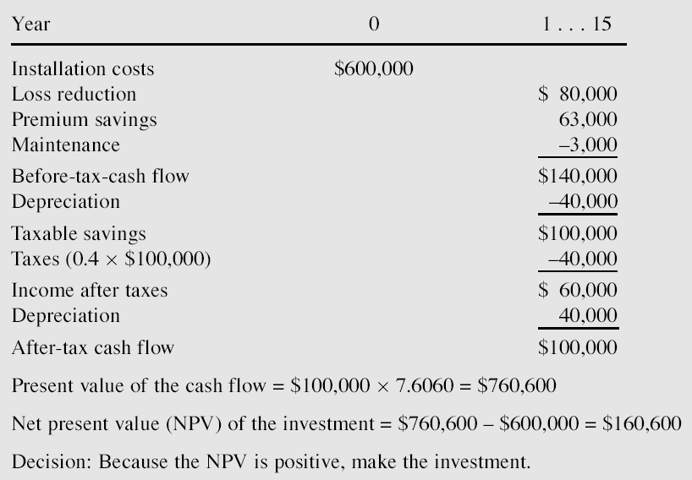
Net Present Value Analysis of Installation of Sprinkler Systems

Slide 5
Select the Optimal Mix of Risk Retention and Risk Transfer
As previously stated, loss control decisions should be made as part of an overall risk management plan
  That also considers the techniques of risk retention and risk transfer
    Often both of these techniques will be used
      The relevant question becomes
        What is the appropriate mix between these two techniques?

Slide 6
General Guidelines
As a rule, risk retention is optimal for losses that have a low expected severity
  With the rule becoming especially appropriate when expected frequency is high
Another general guideline applies to risks that have a low expected frequency but a high potential severity
  In this situation, risk transfer is often the optimal choice
When losses have both high expected severity and high expected frequency
  It is likely that risk transfer, risk retention, and loss control all will need to be used in varying degrees
What constitutes “high” and “low” loss frequency and severity in applying the preceding guidelines must be established on an individual basis

Slide 7
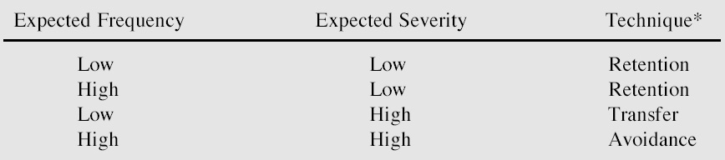
Table 8-2: Guidelines for Using Different Risk Management Techniques

Slide 8
Selecting Retention Amounts
Because in many situations both risk retention and risk transfer will be used in varying degrees
  It is important to determine the appropriate mix of these two risk management techniques
Both capital budgeting methods and statistical procedures may be used in selecting an appropriate retention level
  With insurance purchased for losses in excess of that level
But because the price of insurance does not necessarily vary proportionately with different levels of retention
  The appropriate mix between retention and transfer is not an exact science

Slide 9
The Deductible Decision
Selecting a particular deductible level is one way of mixing risk retention and risk transfer
Deductibles help lower the cost of insurance as well as increase its availability
Deductibles may also make management more loss conscious
  Because a firm must absorb losses within the deductible level
However, as a general rule, risk managers do not accept a deductible unless
  The firm can afford the associated losses
  Sufficient premiums savings will result

Slide 10
The Deductible Decision
Hall Shoe Corporation operates 100 shoe stores in 100 cities
All stores
  Are located in suburban shopping centers
  Have similar construction characteristics
  Have the same fire rating
  Have a value of $150,000
Table 8-3 shows the firm’s losses for the past twelve months
  Are typical of its loss experience during the past several years

Slide 11
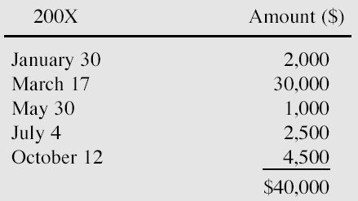
Table 8-3: Hall Shoe Corporation’s Fire Losses

Slide 12
The Deductible Decision
From Table 8-3 Hall Shoe’s risk manager can determine that
  The mean loss was $8,000
  The median loss was $2,500
  The standard deviation is about $11,000
  The loss frequency is five fires per year per 100 stores
The firm is willing to retain no more than $10,000 in fire losses during the year
  In effect, it wants to have an aggregate deductible equal to $10,000
The risk manager must determine the size of the per-occurrence deductible that should be selected in order to absorb no more than $10,000 in losses during the year

Slide 13
The Deductible Decision
The firm has more than 50 loss exposures
The probability of loss is less than 10%
  These two characteristics indicate that the Poisson distribution may be suitable to use in simulating losses
    In this case because the mean is distorted by the $30,000 loss
      The median is the better measure of central tendency

Slide 14
The Deductible Decision
Using the Poisson distribution and an average loss frequency of five per year
  The probability of losses can be computed as shown in Table 8-4
For example, the probability of no losses at all would be
  (5⁰e⁻⁵) ÷ 1 = 0.0067
    Therefore the probability of one or more losses is one minus 0.0067, or 0.9933
If Hall Shoe Corporation chooses a deductible of $1,000 per occurrence there is a
  0.0318 chance that its losses will equal or be greater than $10,000
  0.0681 chance that the losses will equal or be greater than $9,000, etc.

Slide 15
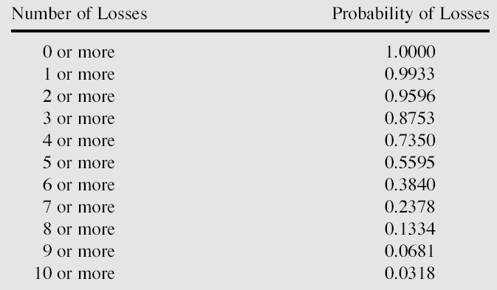
Probability of Losses Using a Poisson Distribution with m = 5

Slide 16
The Self-Insurance Decision
The possibility of self-insurance is another way of mixing risk retention and risk transfer
The same statistical techniques used to select deductibles can be used in choosing a retention level for a self-insurance program
The cash flow advantage of funds set aside in a reserve fund is an additional factor that must be considered in assessing value of self-insurance
  Because losses are not always paid out in the year in which the event producing them occurs
    A company has the use of self-insurance funds for varying periods
      May earn interest on them until such a time as the losses are actually paid

Slide 17
The Self-Insurance Decision
In assessing the financial aspects of a self-insurance program
  The value of operating funds to the firm must also be considered
If the monies in the reserve fund are invested in a liquid form that can be readily converted to cash
  The firm may experience some loss because the funds might have been more profitably used in the business as working capital
    Known as an opportunity cost of funds

Slide 18
The Self-Insurance Decision
Even though it may be clear that a firm can save money in the long run with self-insurance
  Management may prefer stable, predictable insurance premiums each year
Some companies prefer to avoid the details of managing self-insurance programs
  Rather, focusing on their main operations

Slide 19
The Self-Insurance Decision
The following conditions are suggestive of the types of situations where self-insurance is both possible and feasible
  The firm should have a sufficient number of objects so situated that they’re not subject to simultaneous destruction
    The objects should also be reasonably similar in nature and value so that the calculations of probable losses will be accurate within a narrow range
  The firm must have accurate records or have access to satisfactory statistics to enable it to make good estimates of expected losses

Slide 20
The Self-Insurance Decision
The firm must make arrangements for administering the plan and managing the self-insurance fund
  Someone must pay claims, inspect exposures, implement appropriate loss control measures, keep necessary records, and take care of the many administrative details
    It may be possible to contract for these services to be done by an independent third-party administrator
The general financial condition of the firm should be satisfactory
  Firm’s management must be willing and able to deal with large and unusual losses

Slide 21
Implementing Decisions
This step may involve considerable interaction among
  Risk managers
  Insurance agents
  Brokers
  Insurance carriers

Slide 22
Risk Manager versus Insurance Agent
Students sometimes wonder why an employee in a business firm is needed to handle loss exposure
  When similar services are offered by commercial insurance agents or brokers
There are reasons this is the case
  The risk manager and the insurance agent or broker do not perform identical functions
    The job of the risk manager is broader in scope
  Firms have often found that it is difficult to coordinate insurance programs without having someone from inside the firm primarily responsible
    An outside broker cannot have the degree of familiarity with internal business affairs necessary to perform the insurance-buying function
  The firm needs someone with primary concern for the needs of the firm
  The responsibility for the protection of corporate property is often considered too important to place in the hands of an outsider

Slide 23
Organization for Risk Management
Figure 8-1 shows an organizational chart for the risk management function in a large firm
In this firm the risk manager supervises a variety of activities
  Including all kinds of insurance, self-insurance programs, foreign risks, and safety administration
Claims and loss records are also under the risk manager’s control
The risk manager is only two levels beneath the president of the firm
  And may have 5 to 10 professional employees to assist in administering risk management
The duties and responsibilities of the risk manager tend to increase with the size of the firm
  As does a risk manager’s compensation

Slide 24
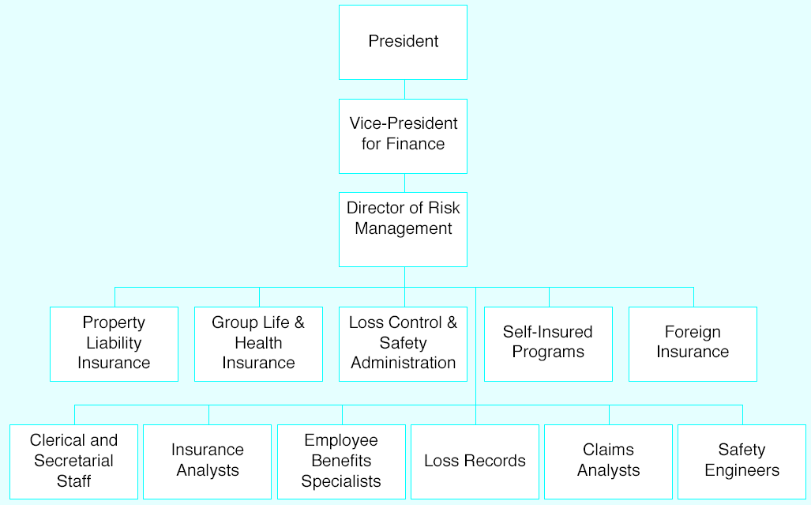
Figure 8-1: Organization for Risk Management

Slide 25
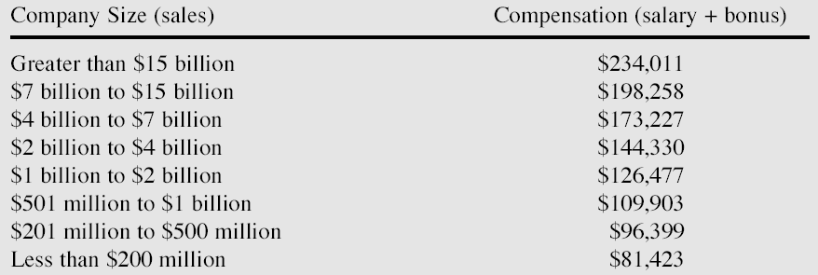
Table 8-6: Average 2002 Compensation of Risk Managers

Slide 26
Commercial Risk Management
One of the first actions a risk manager should take when developing a program
  Develop a risk management policy statement to guide the decision-making efforts of the risk management department
  This statement is normally expressed in general terms
Risk management policy
  A plan, procedure, or rule of action followed for the purpose of securing consistent action over a period of time
  The advantage of having definite policies to guide risk managers
    Once the rule is adopted, executives do not have to restudy recurring problems before making decisions

Slide 27
Managing a Risk Management Program
The loss exposures must be identified and measured with respect to size and frequency
  An analysis must be made to determine how to treat the loss exposure
    Avoid, retain, prevent or transfer
When putting the plan into action, the risk manager must decide who is to do the work
  Will in-house staff be employed or will the work be given to people outside the firm?
When a risk manager is building the insurance side of the risk management program
  Specifications for coverages must be developed
    Several brokers will bid for the account
  Most risk managers take their program to the market at least once every three to five years

Slide 28
Managing a Risk Management Program
The risk manager must manage a department within the firm
  Reports have to be written for management and information provided to the operating units
    So they will know their cost of risk as well as information on losses
Another important task for the risk manager is to negotiate and settle claims with insurers/claimants
  When major losses create claims of millions of dollars, much attention must be given to the process of proving the claims
    Risk managers may retain persons who are experts in handling certain claims
  When the firm is being sued
    The risk manager must work with the legal department to ensure that the claim is handled in the correct manner and that the interests of the firm are protected

Slide 29
Managing a Risk Management Program
With the development of relatively low cost local-area networks and secure web access
  Risk managers need to be able to develop risk management information systems
    The information contained in the system should be organized in such a manner that timely and accurate reports can be made
  By developing such a system
    A risk manager can reduce the department’s dependence on the firm’s data processing department
    Can design a system that is tailored for the needs of a risk management department

Slide 30
Subjective Risk Management
Because objective and subjective risks are often both present in the same situation
  Some consideration must also be given to managing subjective risk
In one sense, the techniques applied to objective risk also should affect subjective risk

Slide 31
Subjective Risk Management
Obtaining more information
  Perhaps the best way of handling subjective risk is by adding knowledge through research, training, or education
  A risk averter may be more willing to accept risk once there is a better understanding of the uncertainties
    With better knowledge, one is likely to perceive less risk in a given situation
  A risk taker may be willing to assume even greater risks as knowledge increases
Group discussion
  Perceived subjective risk declines after group discussion of the problem

Slide 32
Enterprise Risk Management and Alternative Risk Transfer
Rather than focusing solely on pure or hazard risks
  Enterprise risk management seeks to consider all exposures that could negatively affect the firm’s ability to achieve its strategic goals
Russ Banham states that the goal of enterprise risk management is to
  Identify, analyze, quantify, and compare all of a firm’s exposures stemming from operational, financial, and strategic activities
Exposures in this enterprise-wide view of risk include
  Traditional insurable risks such as liability, as well as financial, commodity, legal, environmental, and other less-tangible exposures such as
    Reputation effects and reduction in brand image

Slide 33
Enterprise Risk Management and Alternative Risk Transfer
Traditionally, the risk management tools discussed in this chapter (avoidance, loss control, risk retention, and risk transfer)
  Have been applied primarily to the pure or hazard risks facing a firm
Even when similar risk management techniques have been applied to other categories of risk
  The risk management activities of the firm have remain compartmentalized and relatively uncoordinated

Slide 34
Enterprise Risk Management and Alternative Risk Transfer
Evan Busman observes that risk management for many firms has been performed by different individuals with narrowly defined specialties
  The traditional risk manager handles pure or hazard risk
  The treasurer focuses on credit and monetary risk
  Strategic business units develop controls for operational and commodity risk
  Marketing and public relations staff focus on reputational risk

Slide 35
Enterprise Risk Management and Alternative Risk Transfer
Risk management tools used to manage risks in these separate categories often differ
  Techniques of insurance and self-insurance are commonly limited to the treatment of pure risks
  Futures, options, swaps and other derivatives contracts are typically applied to the management of financial risks
The traditional method of assigning the risk management process to different functional areas
  Can lead to less efficient management of risk for the firm as a whole
    Many types of risks may be relatively uncoordinated with each other
    As a result, combining these risks produces a form of “natural” hedging

Slide 36
Enterprise Risk Management and Alternative Risk Transfer
As the enterprise-wide view of risk management has progressed
  The role of the traditional risk manager and risk management tools have also been evolving
    Traditional risk managers are increasingly being called on to become involved in the management of various non-hazard or financial risks facing their firms
      Table 8-7 reports the percentage of risk managers involved in the management of various financial risks

Slide 37
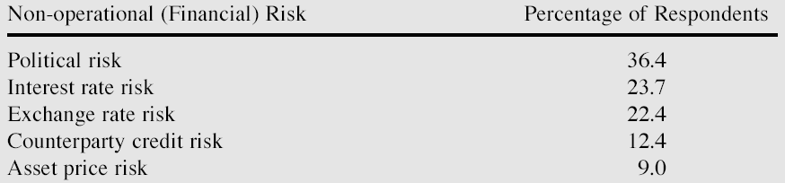
Table 8-7: Financial Risks Managed by the Risk Management Department

Slide 38
Alternative Risk Transfer Tools
A growing array of alternative risk transfer tools have been introduced since the mid 1990s
  Captives
    An insurer owned by a non-insurance firm or organization for the purpose of accepting the risks of the parent firm
  Finite risk or financial insurance
    Risk transfer contracts that are based on the concept of spreading risk over time
      As opposed to across a pool of similar exposures
  Multiline/Multiyear insurance
    Insurance contracts that combine a broad array of risks into a contract with a policy period that extends over multiple years

Slide 39
Alternative Risk Transfer Tools
Multiple-trigger policies
  Reflect the notion that, to the shareholders of the firm, the source of the risk is not as important as the impact of the risk on the earnings of the firm
  These contracts pool risks that in combination could have a very serious impact on the firm’s value
Securitization
  The creation of securities (such as bonds or derivative contracts, options, swaps, futures) that have a payout or price movement that is linked to an insurance risk
    Examples include catastrophe options, earthquake bonds, catastrophe bonds, and catastrophe equity puts

Slide 40
Alternative Risk Transfer Tools
Table 8-8 reports the extent of use by risk managers of these alternative risk transfer tools
Significant increases are anticipated in the use of most of these tools

Slide 41
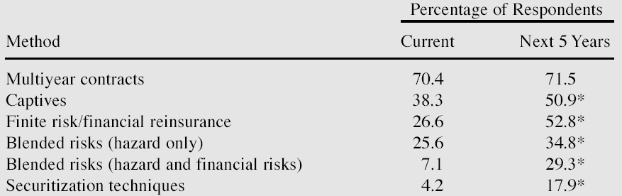
Table 8-8: Use of Alternative Risk Management Methods

Slide 42
End of Lecture 16

