Slide 1
Lecture No. 1
Outline Topics and Risk in Our Society

Slide 2
Objectives
Different Definitions of Risk
Chance of Loss
Peril and Hazard
Classification of Risk
Major Personal Risks and Commercial Risks
Burden of Risk on Society
Techniques for Managing Risk

Slide 3
Text Books
Text Book
Principles of Risk Management and Insurance, 12th Edition
George Rejda
Risk Management and Insurance, 12th edition, Trieschmann, Hoyt and Somer

Slide 4
The Universal Principle of Risk Management: Pooling and Hedging of Risk
Origins of concept of probability
Multiplication rule, law of large numbers is basis of risk management
Examples of risk pooling in operation
Review of basic statistical and associated economic concepts: Expected utility theory, variance, covariance regression analysis

Slide 5
Technology and
Invention in Finance
Financial institutions are inventions as much as engines are
Once discovered, inventions copied around the world
Relation to new information technology
Evolving role of patent law

Slide 6
Insurance: The Archetypal Risk Management Institution
Private insurance institutions were invented after fire of London 1666
Role of discovery of probability theory in this invention
The extension through time of insurance practice into increasingly more realms of human risk
Modern insurance companies and their regulators

Slide 7
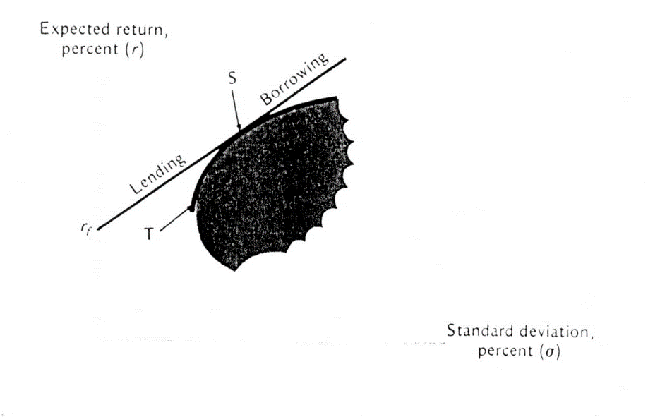
Portfolio Diversification and Supporting Financial Institutions
How risks are spread
Covariance with market portfolio
Beta
Mutual fund theorem
Investment companies and their management

Slide 8
Efficient Markets and Excess Volatility
Efficient Markets Hypothesis vs. Random walk
Apparent inability of professionals to make money
Warren Buffet and David Swensen: What does their experience prove?

Slide 9
Behavioral Finance: The Role of Psychology
Research in psychology
Anomalies in finance
Kahneman & Tversky: Prospect Theory

Slide 10
Human Foibles, Manipulation and Regulation
Louis Brandeis and insiders vs. outsiders
Securities and Exchange Commission, 1934
The battle against fraud
Regulation around the world

Slide 11
Debt Markets, Term Structure of Interest Rates
Notes:
Plot shows US government debt yields against time to maturity. November 2000 was just before the market got an inkling that the Fed would cut rates, as they did in January 2001, so the term structure was exceptionally inverted

Slide 12
Corporate Equity: Earnings & Dividends
Issues in dividend payout
Modigliani-Miller theorem
Historical changes in dividend-price ratios
Financial innovation blurring the role of dividends

Slide 13
Corporate Equity,
Debt & Taxes
Issues firms face in decided how much to borrow
Modigliani Miller irrelevance theorem
Historical changes in leverage
Behavioral finance response to extreme version of Modigliani Miller

Slide 14
Real Estate Finance Today and in the Future
Risk management as practiced today in real estate
Efficiency of markets for houses, commercial real estate
Real Estate Investment Trusts and existing other institutions
New institutions: Home equity insurance, housing partnerships, SAMs, Macro securities

Slide 15
Banking in a Changing World
Multiple expansion of credit
Money multiplier
Major banks of world, size distribution
Importance of banks in less developed countries
Bank regulation, Basel Accord
Impact of information technology on banking

Slide 16
The Evolution and Perfection of Monetary Policy
Board of Governors of Federal Reserve System has been model for world Central Banks
Independent central bank and FOMC procedures adopted around the world
Monetary Policy Rules
Effects of monetary policy on financial markets

Slide 17
Investment Banking and Secondary Markets
The role of underwriters
Directly placed offerings
Regulation of investment banks
Role of investment banks in financial innovation

Slide 18
The Changing Role of Institutional Investing
Objectives and risks facing institutional investors
Limits to arbitrage
Regulation and other forces operating on institutional investors
Impacts on institutional investing of a changing financial world

Slide 19
Brokerage, ECNs
The traditional exchanges: New York Stock Exchange, Amex, regional exchanges
Nasdaq and electronic exchanges
The stock brokerage business
Stock price indexes
Spiders and other exchange-traded instruments

Slide 20
Consumer Finance
Credit cards, home equity loans, etc.
Laws to protect consumers
Rising levels of consumer debt, concerns about rising personal bankruptcy
The transformation wrought by new information technology

Slide 21
Forwards and Futures
Forward contracts and their limitations
Futures contracts since Osaka in 1600s
Fair value
Hedging function
Failure to hedge

Slide 22
Stock Index, Oil and Other Futures Markets
The history of commodity futures
The evolution since 1980 of financial futures
Stock index futures
Interest rate futures
Oil as a fundamental factor in world economy
Innovation in the future

Slide 23
Options Markets
Definition of options
Black-Scholes formula
Chicago Board Options Exchange
The use of options in hedging and speculation
Increasing scope of options contracts in the future

Slide 24
Other Derivative Markets
Swaps, Swaptions
Macro Securities and the American Stock Exchange

Slide 25
Stock Market Booms & Crashes
Stock market crash of 1929
Stock market crash of 1987
Mexican Crisis 1994
Asian financial crisis 1997-1998
Nasdaq crash 2000-2001
Role of financial innovations in these crashes and in their likelihood in the future

Slide 26
End of Lecture No. 1

