Slide 1
Lecture No. 7
Advanced
Topics in Risk Management

Slide 2
Objectives
The Changing Scope of Risk Management
Enterprise Risk Management
Insurance Market Dynamics
Loss Forecasting
Financial Analysis in Risk Management Decision Making
Other Risk Management Tools

Slide 3
The Changing Scope of Risk Management
Today, the risk manager’s job:
  Involves more than simply purchasing insurance
  Is not limited in scope to pure risks
The risk manager may be using:
  Financial risk management
  Enterprise risk management

Slide 4
The Changing Scope of Risk Management
Financial Risk Management refers to the identification, analysis, and treatment of speculative financial risks:
  Commodity price risk is the risk of losing money if the price of a commodity changes
  Interest rate risk is the risk of loss caused by adverse interest rate movements
  Currency exchange rate risk is the risk of loss of value caused by changes in the rate at which one nation's currency may be converted to another nation’s currency
Financial risks can be managed with capital market instruments
Notes:
Transparency Master 1.2

Slide 5
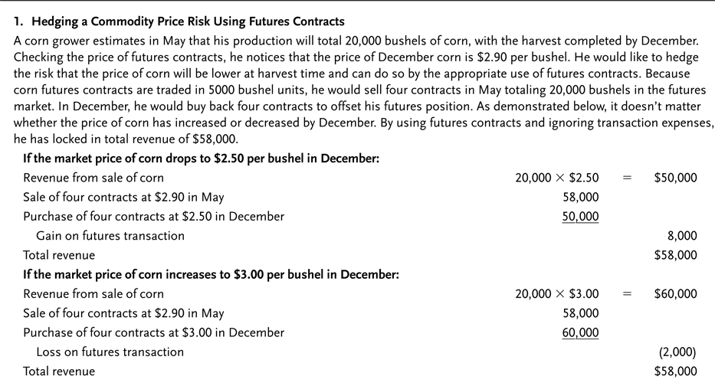
Exhibit 4.1 Managing Financial Risk—Two Examples

Slide 6
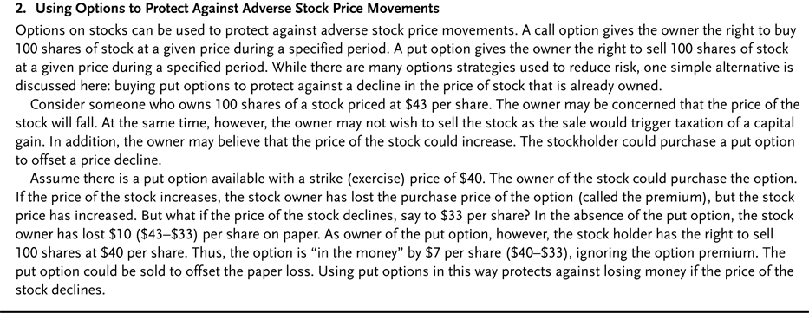
Exhibit 4.1 Managing Financial Risk—Two Examples

Slide 7
The Changing Scope of Risk Management
An integrated risk management program is a risk treatment technique that combines coverage for pure and speculative risks in the same contract
A double-trigger option is a provision that provides for payment only if two specified losses occur
Some organizations have created a Chief Risk Officer (CRO) position
  The chief risk officer is responsible for the treatment of pure and speculative risks faced by the organization

Slide 8
Enterprise Risk Management
Enterprise Risk Management (ERM) is a comprehensive risk management program that addresses the organization’s pure, speculative, strategic, and operational risks
  Strategic risk refers to uncertainty regarding an organization’s goals and objectives
  Operational risks are risks that develop out of business operations, such as product manufacturing
  As long as risks are not positively correlated, the combination of these risks in a single program reduces overall risk
  Nearly half of all US firms have adopted some type of ERM program
  Barriers to the implementation of ERM include organizational, culture and turf battles

Slide 9
The Financial Crisis and Enterprise Risk Management
The US stock market dropped by more than fifty percent between October 2007 and March 2009
  The meltdown raises questions about the use of ERM
  Only 18 percent of executives surveyed said they had a well-formulated and fully-implemented ERM program

Slide 10
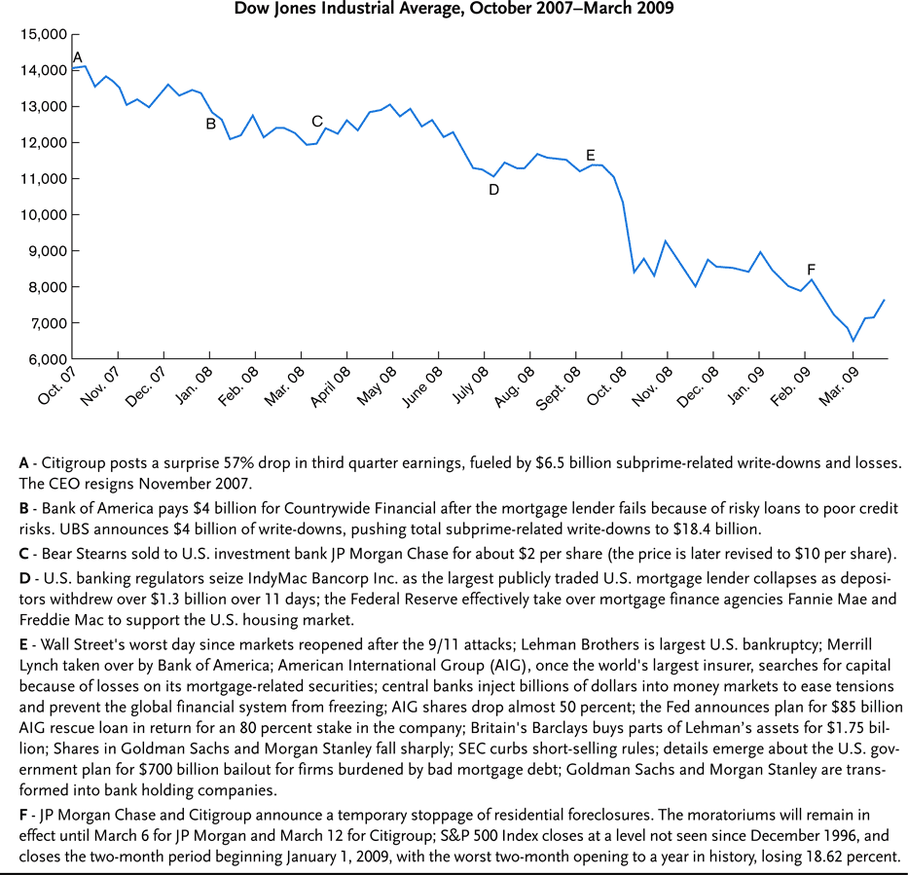
Exhibit 4.2 Timeline of Events Related to the Financial Crisis

Slide 11
The Financial Crisis and Enterprise Risk Management
AIG mentions an active ERM program in its 2007 10-K Report
  Riskiness of the Financial Products Division was not fully appreciated
    The division was issuing credit default swaps
    A credit default swap is an agreement in which the risk of default of a financial instrument is transferred from the owner of the financial instrument to the issuer of the swap
    The default rate on mortgages soared and the company did not have the capital to cover guarantees
The lessons learned by risk managers from the financial crisis will influence ERM in the future

Slide 12
Insurance Market Dynamics
Decisions about whether to retain or transfer risks are influenced by conditions in the insurance marketplace
The Underwriting Cycle refers to the cyclical pattern of underwriting stringency, premium levels, and profitability
  “Hard” market: tight standards, high premiums, unfavorable insurance terms, more retention
  “Soft” market: loose standards, low premiums, favorable insurance terms, less retention
  One indicator of the status of the cycle is the combined ratio:
Notes:
Transparency Master 1.2

Slide 13
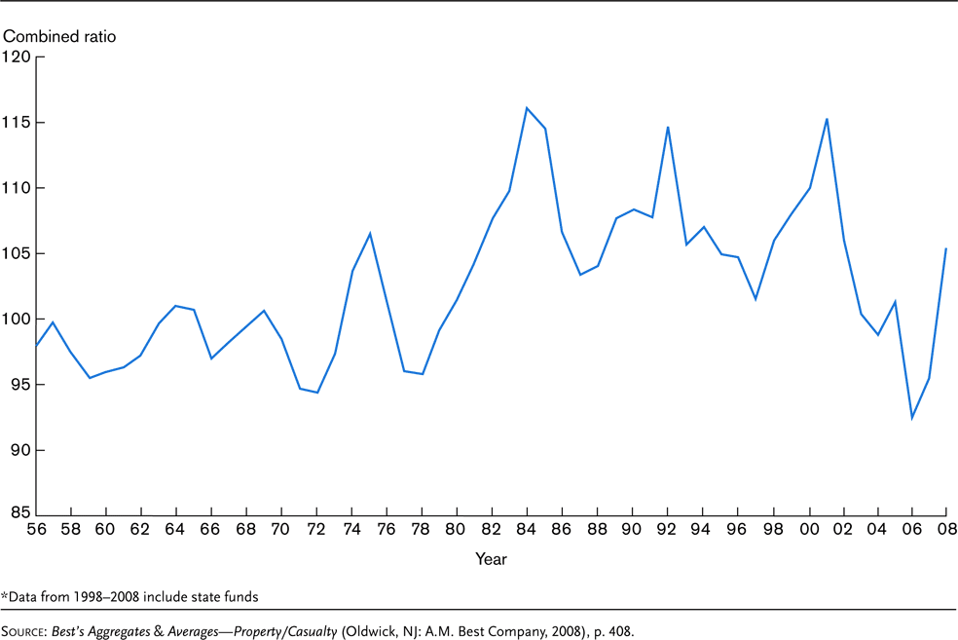
Exhibit 4.3 Combined Ratio for All Lines of Property and Liability Insurance, 1956–2008*

Slide 14
Insurance Market Dynamics
Many factors affect property and liability insurance pricing and underwriting decisions:
  Insurance industry capacity refers to the relative level of surplus
    Surplus is the difference between an insurer’s assets and its liabilities
    Capacity can be affected by a clash loss, which occurs when several lines of insurance simultaneously experience large losses
  Investment returns may be used to offset underwriting losses, allowing insurers to set lower premium rates

Slide 15
Insurance Market Dynamics
The trend toward consolidation in the financial services industry is continuing
  Consolidation refers to the combining of businesses through acquisitions or mergers
    Due to mergers, the market is populated by fewer, but larger independent insurance organizations
    There are also fewer large national insurance brokerages
      An insurance broker is an intermediary who represents insurance purchasers
  Cross-Industry Consolidation: the boundaries between insurance companies and other financial institutions have been struck down
    Financial Services Modernization Act of 1999
    Some financial services companies are diversifying their operations by expanding into new sectors

Slide 16
Capital Market Risk Financing Alternatives
Insurers are making increasing use of capital markets to assist in financing risk
  Securitization of risk means that insurable risk is transferred to the capital markets through creation of a financial instrument:
    A catastrophe bond permits the issue to skip or defer scheduled payments if a catastrophic loss occurs
  An insurance option is an option that derives value from specific insurance losses or from an index of values.
    A weather option provides a payment if a specified weather contingency (e.g., high temperature) occurs
  The impact of risk securitization is an increase in capacity for insurers and reinsurers
    It provides access to the capital of many investors

Slide 17
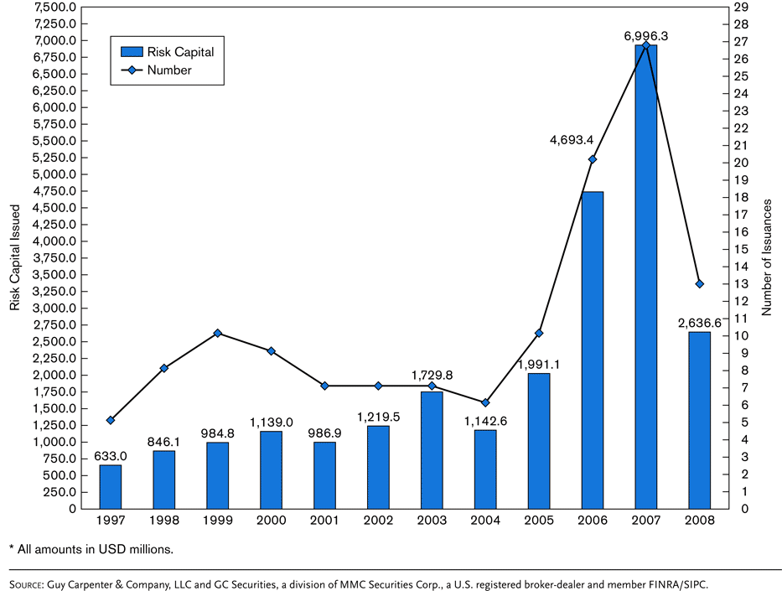
Exhibit 4.4 Catastrophe Bonds: Annual Number of Transactions and Issue Size

Slide 18
Loss Forecasting
The risk manager can predict losses using several different techniques:
  Probability analysis
  Regression analysis
  Forecasting based on loss distribution
Of course, there is no guarantee that losses will follow past loss trends
Notes:
Transparency Master 1.2

Slide 19
Loss Forecasting
Probability analysis: the risk manager can assign probabilities to individual and joint events
  The probability of an event is equal to the number of events likely to occur (X) divided by the number of exposure units (N)
    May be calculated with past loss data
  Two events are considered independent events if the occurrence of one event does not affect the occurrence of the other event
  Two events are considered dependent events if the occurrence of one event affects the occurrence of the other
  Events are mutually exclusive if the occurrence of one event precludes the occurrence of the second event

Slide 20
Loss Forecasting
Regression analysis characterizes the relationship between two or more variables and then uses this characterization to predict values of a variable
  For example, the number of physical damage claims for a fleet of vehicles is a function of the size of the fleet and the number of miles driven each year

Slide 21
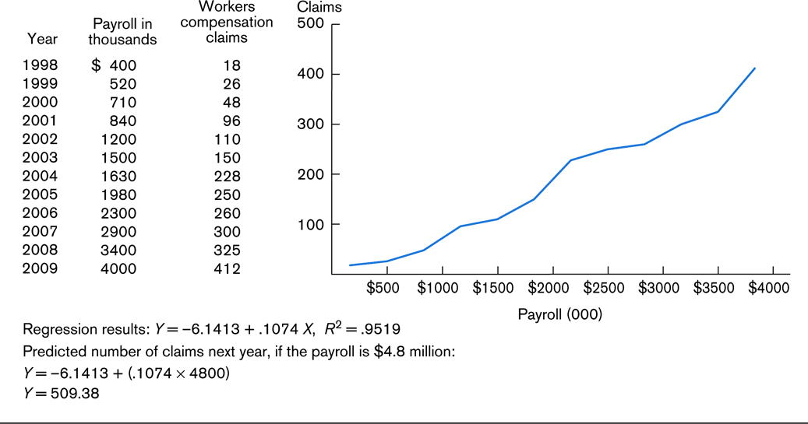
Exhibit 4.5 Relationship Between Payroll and Number of Workers Compensation Claims

Slide 22
Loss Forecasting
A loss distribution is a probability distribution of losses that could occur
  Useful for forecasting if the history of losses tends to follow a specified distribution, and the sample size is large
  The risk manager needs to know the parameters of the loss distribution, such as the mean and standard deviation
  The normal distribution is widely used for loss forecasting

Slide 23
Financial Analysis in Risk Management Decision Making
The time value of money must be considered when decisions involve cash flows over time
  Considers the interest-earning capacity of money
  A present value is converted to a future value through compounding
  A future value is converted to a present value through discounting
Risk managers use the time value of money when:
  Analyzing insurance bids
  Making loss control investment decisions
    The net present value is the sum of the present values of the future cash flows minus the cost of the project
    The internal rate of return on a project is the average annual rate of return provided by investing in the project
Notes:
Transparency Master 1.2

Slide 24
Other Risk Management Tools
A risk management information system (RMIS) is a computerized database that permits the risk manager to store and analyze risk management data
  The database may include listing of properties, insurance policies, loss records, and status of legal claims
  Data can be used to predict and attempt to control future loss levels
Risk Management Intranets and Web Sites
  An intranet is a web site with search capabilities designed for a limited, internal audience
A risk map is a grid detailing the potential frequency and severity of risks faced by the organization
  Each risk must be analyzed before placing it on the map
Notes:
Transparency Master 1.2

Slide 25
Other Risk Management Tools
Value at risk (VAR) analysis involves calculating the worst probable loss likely to occur in a given time period under regular market conditions at some level of confidence
  The VAR is determined using historical data or running a computer simulation
  Often applied to a portfolio of assets
  Can be used to evaluate the solvency of insurers
Catastrophe modeling is a computer-assisted method of estimating losses that could occur as a result of a catastrophic event
  Model inputs include seismic data, historical losses, and values exposed to losses (e.g., building characteristics)
  Models are used by insurers, brokers, and large companies with exposure to catastrophic loss

Slide 26
End of Lecture No. 7

