Slide 1
Lecture No. 23
Life Insurance Contractual Provisions

Slide 2
Objectives
Life Insurance Contractual Provisions
Dividend Options
Nonforfeiture Options
Settlement Options
Additional Life Insurance Benefits

Slide 3
Life Insurance Contractual Provisions
Under the ownership clause, the policyowner possesses all contractual rights in the policy while the insured is living
  Rights include naming beneficiaries and surrendering the policy for its cash value
  The policyholder can designate a new owner by filing an appropriate form
The entire-contract clause states that the life insurance policy and attached application constitute the entire contract between the parties
  Prevents the insurer from making amendments without the policyholder’s knowledge

Slide 4
Life Insurance Contractual Provisions
The incontestable clause states that the insurer cannot contest the policy after it has been in force two years during the insured’s lifetime
  Protects the beneficiary if the insurer tries to deny payment of the claim years after the policy was first issued
  The insurer has two years to detect fraud
  The insurer can contest a claim after the incontestable period if:
    The beneficiary takes out the life insurance policy with the intent of murdering the insured
    The applicant has someone else take a medical examination
    An insurable interest does not exist at the inception of the policy

Slide 5
Life Insurance Contractual Provisions
The suicide clause states that if the insured commits suicide within two years after the policy is issued, the face amount of insurance will not be paid; there is only a refund of the premiums paid
  Reduces adverse selection against the insurer
A life insurance policy contains a grace period during which the policyholder has a period of 31 days to pay an overdue premium
  Prevents the policy from lapsing by giving the policyowner additional time to pay

Slide 6
Life Insurance Contractual Provisions
The reinstatement provision permits the owner to reinstate a lapsed policy
  To reinstate, the following requirements must be met:
    Evidence of insurability is required
    All overdue premiums plus interest are paid
    Any policy loans are repaid or reinstated
    The policy was not surrendered for its cash value
  The policy must be reinstated within a certain period, usually 3-5 years after the date of lapse
  Although it may require a large outlay of cash, it may be cheaper to reinstate a lapsed policy than to purchase a new policy

Slide 7
Life Insurance Contractual Provisions
The beneficiary is the party named in the policy to receive the policy proceeds
  The primary beneficiary is the first entitled to receive the policy proceeds
  A revocable beneficiary means that the policyowner reserves the right to change the beneficiary designation without the beneficiary’s consent
  An irrevocable beneficiary is one that cannot be changed without the beneficiary’s consent
  A specific beneficiary is specifically identified
  A class beneficiary is a member of a group, e.g., children of the insured

Slide 8
Life Insurance Contractual Provisions
Under the misstatement of age or sex clause, if the insured’s age or sex is misstated, the amount payable is the amount that the premiums paid would have purchased at the correct age and sex
A change-of-plan provision allows policyowners to exchange their present policies for different contracts
Life insurance contracts do not contain many exclusions
  Suicide excluded for two years
  Insurers might insert a war clause to exclude payment if the insured dies as a direct result of war
  Some policies contain aviation exclusions
Premiums can be paid annually, semiannually, quarterly, or monthly
  If premiums are not paid annually, a carrying charge is applied

Slide 9
Life Insurance Contractual Provisions
A life insurance policy is freely assignable to another party
  Under an absolute assignment, all ownership rights in the policy are transferred to a new owner
  Under a collateral assignment, the policyowner temporarily assigns a life insurance policy to a creditor as collateral for a loan
    Only certain rights are transferred to the creditor
    Purpose is to protect the insurer from paying the policy proceeds twice

Slide 10
Life Insurance Contractual Provisions
A policy loan provision allows the policyowner to borrow the cash value
  The policyowner must pay interest on the loan to offset the loss of interest to the insurer
  A policy could lapse if the policyowner does not repay a loan and the total indebtedness exceeds the available cash value
Under the automatic premium loan provision, an overdue premium is automatically borrowed from the cash value after the grace period expires
  Prevent the policy from lapsing
  Policyowner may become lazy and exhaust all cash value

Slide 11
Dividend Options
If a policy pays dividends it is a participating policy
  Otherwise it is a nonparticipating policy
Dividends come from three main sources:
  The difference between expected and actual mortality experience
  Excess interest earnings
  The difference between expected and actual operating expenses

Slide 12
Dividend Options
Policyowners have several ways to take dividends:
  Take the cash
  Reduce the next premium coming due
  Let the dividends accumulate at interest and withdraw later
  Apply toward the purchase of paid-up whole life insurance under the paid-up additions option
    Benefits of the paid-up additions option include:
      Paid-up additions are purchased at net rates, not gross rates
      Evidence of insurability is not required
    One disadvantage is that paid-up additions are a form of single premium whole life insurance, which is rarely appropriate for most insureds

Slide 13
Dividend Options
  Apply toward the purchase of term insurance
    The dividend can be used to purchase one-year term insurance equal to the cash value of the basic policy
      The remainder of the dividend is used to buy paid-up additions or is accumulated at interest
    Alternatively, the dividend may be used to purchase yearly renewable term insurance
  Convert the policy to a paid-up contract
    The policy becomes paid up when the reserve value of the paid-up additions or deposits equal the net single premium for a paid-up policy at the insured’s attained age
  Mature a policy as an endowment
    The policy matures as an endowment when the reserve value under the basic policy plus the reserve value of the paid-up additions or deposits equal the face amount of insurance

Slide 14
Nonforfeiture Options
The payment to a withdrawing policyowner is known as a nonforfeiture value or cash surrender value
  A policyowner has a right to the policy’s accumulated cash value; all states have standard nonforfeiture laws
  Policyowners have three nonforfeiture options:
    The policy can be surrendered for its cash value
    Under the reduced-paid up insurance option, the cash surrender value is applied as a net single premium to purchase a reduced paid-up policy
    Under the extended term insurance option, the net cash surrender value is used as a net single premium to extend the full face amount of the policy into the future as term insurance

Slide 15
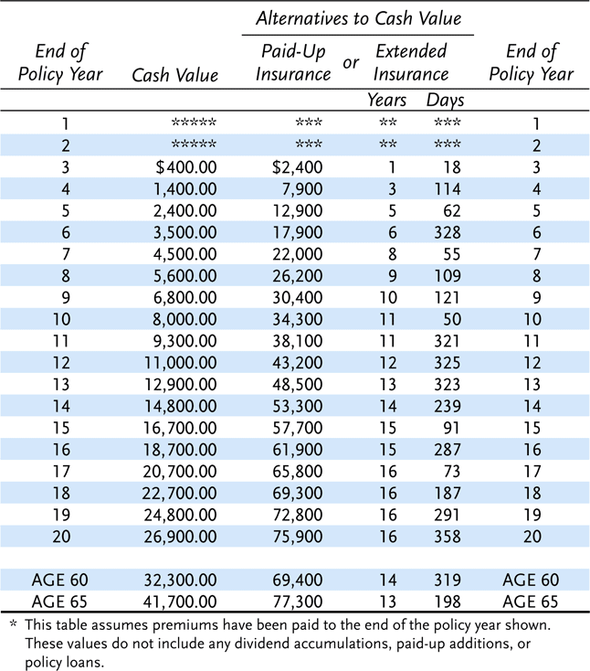
Exhibit 12.1 Table of Guaranteed Values*
$100,000 Ordinary Type Policy, Male Age 37
Notes:
Transparency Master 1.2

Slide 16
Settlement Options
The policyowner can choose among several options for paying the policy proceeds
  Or, the beneficiary may be granted the choice
The most common options include:
  Proceeds are paid in a lump sum
  Under the interest option, the proceeds are retained by the insurer, and interest is periodically paid to the beneficiary
    The beneficiary can be given withdrawal rights
  Under the fixed-period option, the proceeds are paid to a beneficiary over some fixed period of time
  Under the fixed-amount option, a fixed amount is periodically paid to the beneficiary until the principal and interest are exhausted

Slide 17
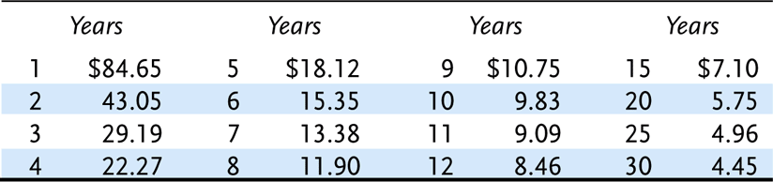
Exhibit 12.2 Income for Elected Period (minimum monthly payment per $1000 of proceeds)
Notes:
Transparency Master 1.2

Slide 18
Settlement Options
  Under the life income option, installment payments are paid only while the beneficiary is alive and cease on the beneficiary’s death
    There is no refund feature or guarantee of payments
  Other life income options include:
    Life income with guaranteed period: if the beneficiary dies before receiving the guaranteed number of years of payments, the remaining payments are paid to a contingent beneficiary
    Life income with guaranteed total amount: if the beneficiary dies before receiving installment payments equal to the total amount of insurance placed under the option, the payments continue until the total amount paid equals the total amount of insurance
    Under the joint-and-survivor settlement option, income payments are paid to two persons during their lifetimes, such as a husband and wife

Slide 19
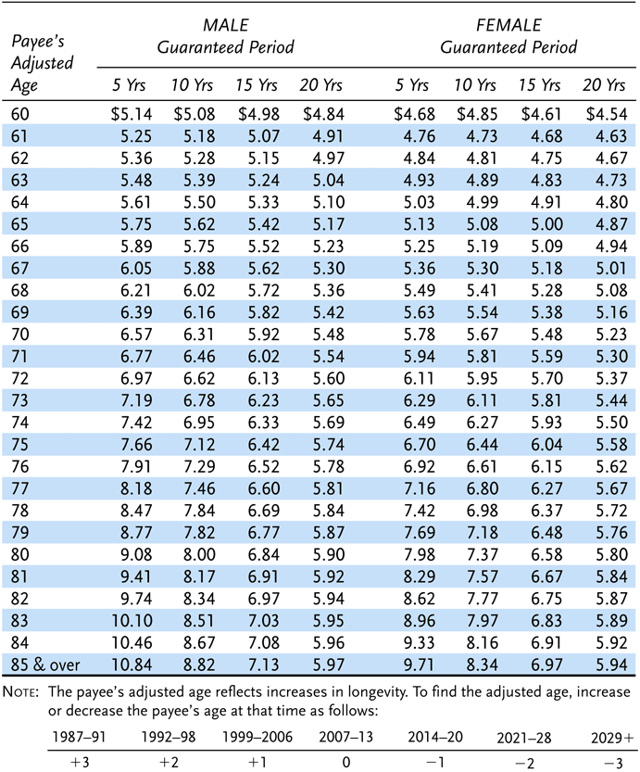
Exhibit 12.3 Life Income with Guaranteed Period (minimum monthly payment per $1000 of proceeds)

Slide 20
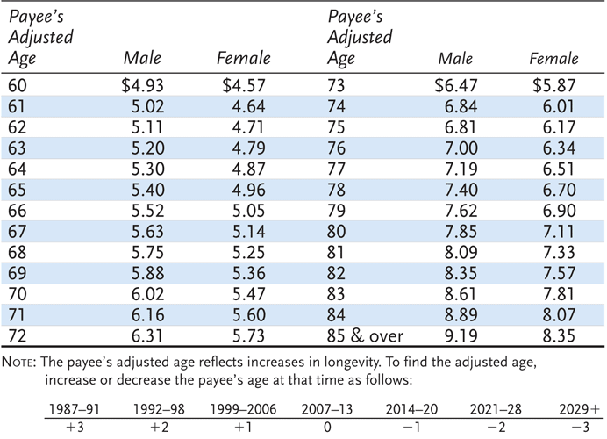
Exhibit 12.4 Life Income with Guaranteed Total Amount (minimum monthly payment per $1000 of proceeds)

Slide 21
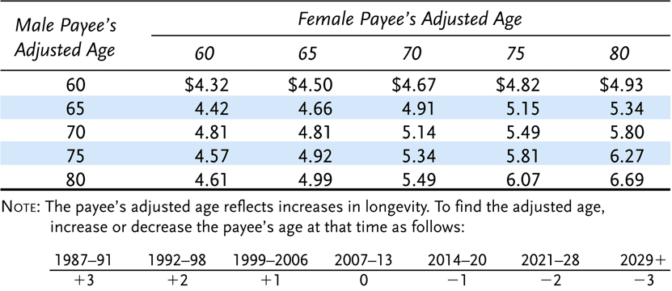
Exhibit 12.5 Joint-and-Survivor Income Option 10-Year Guaranteed Period (minimum monthly payment per $1000 of proceeds)

Slide 22
Settlement Options
Settlement options allow for periodic payments to the family, restoring their financial security
Disadvantages include:
  Interest rates offered by insurers may be lower than rates offered elsewhere
  The settlement agreement may be inflexible and restrictive

Slide 23
Additional Life Insurance Benefits
Other benefits can be added to a life insurance policy for an additional premium
  Under a waiver-of-premium provision, if the insured becomes totally disabled, all premiums coming due during the period of disability are waived
    In many cases, total disability means that the insured cannot do any of the essential duties of his or her job for which he or she is suited based on schooling, training, or experience
  The guaranteed purchase option permits the policyowner to purchase additional amounts of life insurance at specified times in the future without evidence of insurability
    The option guarantees the purchase of specified amounts of life insurance in the future even though the insured may become uninsurable

Slide 24
Additional Life Insurance Benefits
The accidental death benefit rider doubles the face amount of life insurance if death occurs as a result of an accident
  Also known as double indemnity
The cost-of-living rider allows the policyowner to purchase one-year term insurance equal to the percentage change in the consumer price index with no evidence of insurability
The accelerated death benefits rider allows insureds who are terminally ill to collect part or all of their life insurance benefits before they die
  Forms include: a terminal illness rider, catastrophic illness rider, and long-term care rider

Slide 25
Additional Life Insurance Benefits
A viatical settlement is the sale of a life insurance policy by a terminally ill insured to another party, typically an investor group, who hopes to profit by the insured’s early death
A life settlement is a financial transaction by which a policyowner who no longer needs or wants to keep a life insurance policy sells the policy to a third party for more than its cash value
These options create a moral hazard problem, and may not be adequately regulated by the states

Slide 26
Workers’ Compensation Insurance
Covers the loss of income and the medical and rehabilitation expenses that result from work-related accidents and occupational disease
Single largest line of commercial insurance
Growth in workers’ compensation premiums was very high during the 1970s but it slowed during the 1980s
  In the early 1990s this line suffered significant losses
  However, by the mid 1990s high investment returns had returned this line to profitability
    Intense price competition returned
Developed in the latter half of the 1800s in Europe and in the early 1900s in the United States
  Because of hardships placed on workers by common law
A worker receives a guarantee of compensation
  The employer is protected from employees seeking damages for work-related injuries

Slide 27
Major Reform
The National Commission on State Workmen’s Compensation laws was created to determine the extent to which state laws provided adequate, prompt, and equitable compensation to injured workers
  Generally the studies raised doubts about the effectiveness of workers’ compensation as it operated in the United States at the time the studies were made
Since then state legislatures have passed numerous reforms to comply with the commission’s recommendations, including
  Full coverage for medical care and rehabilitation
  Adequate income replacement
  Coverage of all workers
  Cost-of-living adjustments
  Improved data systems

Slide 28
Insurance Methods
Three methods by which an employer can provide employees with the coverage required by law
  Purchase a worker’s compensation and employer’s liability policy from a private commercial insurer
  Purchase insurance through a state fund or a federal agency set up for this purpose
  Self-insure

Slide 29
Private Insurance
The standard workers’ compensation and employer’s liability policy has two major insuring agreements
  Coverage A
    To pay all claims required under the workers’ compensation law in the state where the injury occurred, including
      Occupational disease benefits, penalties assessable to the employer under law, and other obligations
  Coverage B
    To defend all employees’ suits against the employer and pay any judgment resulting from the suits
      Employee suits are surprisingly frequent because methods are constantly being found to bring an action against the employer in spite of the intention of the statutes to discourage such suits
The insured deals directly with the employee and is primarily responsible to the employee for benefits
  Thus, even if the employer should go out of business, the injured employee’s security is not jeopardized

Slide 30
State Funds and Federal Agencies
In 20 states, an employer has the choice of using a private insurer or a state fund as the insurer of workers’ compensation
In five states, the employer does not have this choice
  Must insure in an exclusive state fund or, in three of those states, may self-insure
In addition to state funds, federal agencies provide for workers’ compensation coverage

Slide 31
Self-Insurance
In most states, under specified conditions, an employer is permitted to self-insure the workers’ compensation coverage
Self-insurance is generally not permitted in Canada
Self-insurers are generally large concerns with adequate diversification of risks and financial resources that enable them to qualify under the law

Slide 32
End of Lecture 23

