Slide 1
Lecture No. 22
Life Insurance

Slide 2
Chapter Objectives
Describe the content of insuring clauses and commercial general liability policies and the supplemental benefits of such policies
Explain how limits of liability are determined in commercial liability policies
Differentiate between claims-made coverage and occurrence coverage
Identify the different parts of the commercial general liability policy, the policy’s exclusions, and several endorsements that can be used with it
State the difference between professional liability insurance and regular liability insurance
Indicate how businesses use commercial umbrella policies

Slide 3
Introduction
Liability insurance is an outgrowth of the legal relationships in society that can provide successful lawsuits against individuals for negligence
As it became recognized that negligence could form the basis for a damage suit
  Demand arose for protection against the financial consequences of such suits
The courts initially frowned on liability insurance, believing that contracts of this nature would tend to encourage restless conduct
  Resulting in more injuries to persons and property
However later it was recognized that a true need existed for financial protection
  The existence of properly designed insurance did not cause an unwarranted degree of irresponsible conduct
Today the law takes the attitude that failure to obtain liability insurance against the consequences of negligence in itself constitutes irresponsible financial behavior

Slide 4
Common Liability Contract Provisions
Certain provisions appear in virtually all liability insurance contracts
They include
  The insuring clause
  Supplementary payments
  Definition of the insured
  Exclusions
  Limits of liability
  Specification of claims-made or occurrence coverage
  Notice

Slide 5
The Insuring Clause
A typical insuring clause in a liability policy might read like this
  We will pay those sums that the insured becomes legally obligated to pay as damages because of bodily injury or property damage to which this insurance applies
  We will have the right and duty to defend the insured against any suit seeking those damages

Slide 6
The Insuring Clause
The liability insurance policy almost invariably states that the insurer is bound to pay only the sums that the insured is legally obligated to pay
The policy also states that the insurer has the right and duty to defend the insured against any suit seeking damages for bodily injury or property damage to which the insurance applies
  The fact that the insurer agrees to defend any suit, even if it is groundless, false, or fraudulent
    Releases the insured of the worry and expense of defending against both valid as well as nuisance claims

Slide 7
The Insuring Clause
Generally, the act causing the injury must be accidental for insurance to apply
  Most liability policies now appear without the “caused by accident” clause
  Instead, wording is substituted under which the insurer is liable for any “occurrence” giving rise to legal liability
  Even though these policies declare that injuries caused intentionally by the insured are excluded
    There is the probability that the use of “occurrence” gives more coverage than the “cause to by accident” wording
      The word accident suggests a sudden, unexpected, abnormal event
      The word occurrence, when modified to exclude intentional acts, connotes unexpected and abnormal-but not necessarily sudden-events

Slide 8
Supplementary Payments
Made in addition to any benefits supplied by the basic liability policy
Typically, the insured (referred to as we in the following list) states in that it will pay
  All expenses we incur
  Up to $250 for cost of bail bonds required because of accidents or traffic law violations
    Arising out of the use of any vehicle to which the bodily injury liability coverage applies
  The cost of bonds to release attachments
    But only for bond amounts within the applicable limit of insurance
  All reasonable expenses incurred by the insured at our request to assist us in the investigation or defense of the claim or “suit”
    Including actual loss of earnings up to $250 per day because of time off from work
  All costs taxed against the insured in the “suit”
  Prejudgment interest awarded against the insured on that part of the judgment we pay
  All interest on the full amount of any judgment that accrues after entry of the judgment and before we have paid, offered to pay, or deposited in court the part of the judgment that is within the applicable limit of insurance
Liability insurance has sometimes been termed defense insurance
  Because in a majority of cases liability suits are settled out of court by negotiation between attorneys

Slide 9
Supplementary Payments
The following points concerning the supplementary payments provision are worth noting
  The first supplementary payment, all expenses we incur, would include all the defense costs incurred by the insurer in defending the insured against covered lawsuits
    In analyzing a liability insurance policy, it is critical to verify whether the policy covers defense costs
      Most policies do, but some do not
      In addition, it is important to determine whether the defense costs are included within the policy limits, or are in addition to the limits
  Sometimes courts require that the alleged wrongdoer post the bond to guarantee that, pending the outcome of the negligence action, he or she will not dispose of properties subject to confiscation if the case is lost
    The insurer agrees to pay the premium on these bonds, plus any accrued interest after the date of the judgment
  Under the other terms of the liability policy, the insurer has the right to require the insured to appear in court personally in legal actions arising under the policy, and otherwise cooperate in the defense of such cases
    The insurer agrees to pay the insurer’s reasonable expenses arising from this assistance

Slide 10
Definition of the Insured
All contracts of liability insurance specifically set forth the party who is to be considered an insured
The concept of who is an insured in liability policies is generally very broad
  The wording differs for each type of policy

Slide 11
Exclusions
Certain exclusions appear almost universally, including
  In the case of business policies, all non-business activities giving rise to damage suits are excluded
    In personal contracts, all business pursuits given rise to damage suits are excluded
  An attempt is made in each policy to exclude all sources of liability intended to be covered in other contracts or intended to be covered by a special provision for an extra premium
    Thus, in the commercial general liability policy, most liability from pollution is excluded
  Nearly all liability contracts exclude damage to property belonging or rented to the insured or property in the care, custody, or control of the insured
    Under the general theory that a person cannot be liable to oneself for one’s own negligence
      The insured is expected to obtain physical damage insurance

Slide 12
Exclusions
No general rule seems to be applicable except the general rule that always applies
  Ambiguities in contractual language will be construed against the insurer
Some insurers offer broadened policies, under which the “care, custody, and control” exclusion is liberalized
  Of special interest to contractors, the broad form property damage liability program spells out in considerable detail just what property is covered and under what terms

Slide 13
Limits of Liability
Various types of limits of liability exist
If more than one insured is named in the policy, the question arises
  “Are these limits of liability applicable to each insured, thus doubling or tripling the stated limits?”
    The answer is no
In some policies, such as the comprehensive personal liability policy, only a single limit of liability exists
  Both bodily injury and property damage liability are insured under this limit
  Because no per-person restrictions are in place with respect to bodily injury
    The entire policy limit may be paid to one person

Slide 14
Limits of Liability
Aggregate limits also are used in liability policies
  The policy limit is placed on an annual basis rather than on an occurrence basis
Another aspect of the policy limit is the time period covered
  The policy has inception and termination dates, but there are other time issues
    Does it cover a loss when a person is exposed (exposure doctrine) to a product or a dangerous substance
    Or should coverage apply only when the claimant’s disease or injury is discovered (manifestation doctrine)
    Or is there a triple-trigger approach
      All policies in force during the exposure and manifestation period apply

Slide 15
Limits of Liability
Triple-trigger approach is very attractive to insureds
  However, it causes problems for insurers
To address some of the problems presented by the courts’ liberal interpretation of policy limits, insurance companies have established a new set of limits in the commercial package policy
  Called the commercial general liability form
CPP has separate limits of liability for general liability, product and completed operations liability, personal and advertising liability, medical payments, and damage to premises rented to you
  Additionally, an aggregate limit of liability applies to all claims for general liability, personal and advertising injury, medical payments, and damage to premises rented to you
    Once the total amount claimed from these exposures exceeds the annual aggregate, the insurance company will not pay any more claims under that policy

Slide 16
Claims-Made vs Occurrence Coverage
Due to the tremendously high dollar amount claims and awards associated with asbestos and other “long tail” liability exposures
  The insurance industry is attempting to reduce its uncertainty concerning payment of future claims
A liability line is said to have a long tail when that line will take a long time (e.g., 4 to 10 years) to develop claims from a given event
  Product and professional liability are examples of long tail liability lines

Slide 17
Claims-Made vs Occurrence Coverage
Under the traditional occurrence policy
  Any event in 2004 that led to a claim in 2004 or any future year would be covered by the 2004 policy
  This approach gives the insured the greatest certainty
    But leaves the insurer in a situation where it does not know the cost of its product for 5, 10, or 15 years
Prior to the 1970s, the occurrence approach worked in a reasonable manner
  However, the combination of changing legal standards and rapid economic inflation led to a situation where insurers felt they could no longer accurately price their products under an occurrence policy
    Thus the claims-made policy was developed

Slide 18
Claims-Made vs Occurrence Coverage
Under the claims-made approach
  The insured has protection for 2004 events only if insurance is purchased every year after 2004
If for some reason insurance is not purchased in 2006 and a claim from a 2004 event is filed in 2006
  The insured does not have any protection
See Table 11-1 for examples illustrating the operation of claims-made and occurrence policies

Slide 19
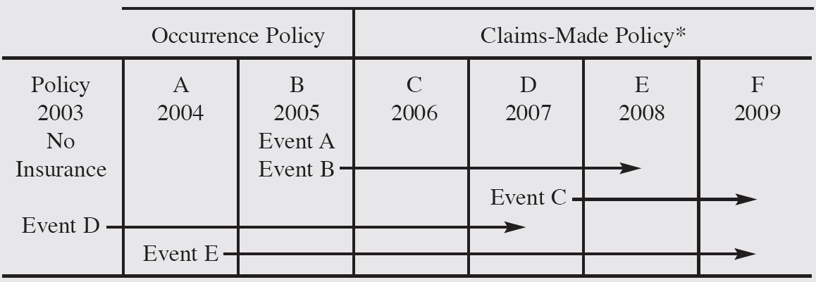
Explanation of Claims-Made and Occurrence Policy

Slide 20
Claims-Made vs Occurrence Coverage
Claims-made policies increase the chance of an insured having a gap in coverage
To ease the burden placed on the insured by the claims-made policy
  The insurance industry has instituted the special provisions for such policies

Slide 21
Claims-Made vs Occurrence Coverage
Basic extended reporting period
  Usually automatically provided and has two parts
    Gives the insured an extra 60 days for claim to be made for an event that occurred before the policy expired
    Provides an extended period of indemnity for five years for known events for which claims were not filed during the policy year
  Provide some added protection for the insured, but even when combined, they’re not as good as the traditional occurrence policy
    To match the coverage of the traditional occurrence coverage, the insured must purchase the supplemental tail

Slide 22
Claims-Made vs Occurrence Coverage
Supplemental tale
  Must be requested in writing within 60 days of the end of the policy term
  Has its own aggregate limit equal to the original policy’s limit
  The insurer cannot charge more than 200% of the original policy’s premium for the endorsement
    The premium is paid only once
    The insured has coverage forever for events that occurred between the claims-made policy’s retroactive date and date of expiration
Notice
  Liability contracts require immediate notice of accident and claim or suit
  It is especially important that this condition be complied with
    Otherwise, available witnesses may be disbursed and evidence dissipated so as to make it difficult or impossible to determine later what actually happened

Slide 23
Commercial General Liability (CGL)
Designed to give the insured considerable flexibility
Covers, on an occurrence or a claims-made basis, a variety of liability losses, including
  Bodily injury and property damage liability losses resulting from
    Conditions of the premises
      If, for instance, the customer slips on a wet spot on the floor, falls down unsafe stairs, etc.
    Business operations
      Could result from performing activities at a customer’s house
    Products
      Damage or bodily injury must result from the business’s product, and the loss must occur away from the business’s premises and after the business has relinquished control of the product
    Completed operations
      Most often associated with contractors or maintenance people
      These losses are said to occur after a person has finished the job and given control of it to the customer
It also provides coverage for liability arising out of various intentional torts
  Such as libel and slander, false arrest, and invasion of privacy

Slide 24
Exclusions in the CGL
The bodily injury and property damage liability coverage section lists 15 separate exclusions
  Automobile
    Virtually all liability related to automobiles, including liability from incidents occurring during the loading and unloading of automobiles is excluded
      One exception is for liability arising out of the parking of nonowned automobiles on the premises
  Product recall
    The act of withdrawing defective products from the marketplace is excluded
    Known as the sistership exclusion
    A manufacturer can purchase recall insurance to cover this exposure
  Liquor liability
    Known as the dramshop exclusion
    In some states the dramshop laws make the seller or distributor of alcoholic beverages liable for losses that can be traced to the use of alcohol sold or distributed by him or her
    Exclusion only applies to insureds who are in the business of manufacturing, distributing, or selling alcoholic beverages
  Pollution
    Liability for pollution losses excluded, with only minor exceptions
    Businesses with significant pollution exposures should look into purchasing specialized pollution policies

Slide 25
Endorsements
Fewer endorsements are needed today than in the past because the commercial general liability form is designed to give coverage for
  Medical payments
  Advertising and personal liability
  Contractual and host liquor liability
  Limited worldwide coverage
  Limited nonowned watercraft coverage
  Coverage for damage to premises rented to the insured
However, for an additional premium, insurance companies are willing to add endorsements that give even broader coverage
  Examples are product recall insurance, pollution insurance, and full worldwide coverage

Slide 26
Endorsements
Exclusion of specific accident(s), products, work, or location(s)
  Gives the insurance company the ability to exclude losses from a specific product or accident, a batch of a product, or a given location or locations of the insured
Vendor’s endorsement
  Many retailers refuse to handle the goods of the manufacturer or a wholesaler unless they are provided with evidence that the distributor has protected them with product liability insurance
  Usually accomplished by naming the retailer in a vendor’s endorsement as an additional insured on the wholesaler’s or manufacturer’s product liability policy

Slide 27
Employment Practices Liability
A recent development in terms of insurance coverage
An issue that risk managers must be especially concerned about
Prior to the 1990s little need existed for this coverage
  However, with changes in employment law and the corporate restructuring that has occurred recently
    This coverage has become more important
Protects businesses against lawsuits alleging sexual harassment, wrongful termination, and discrimination
Table 11-2 reveals how the size of awards has changed

Slide 28
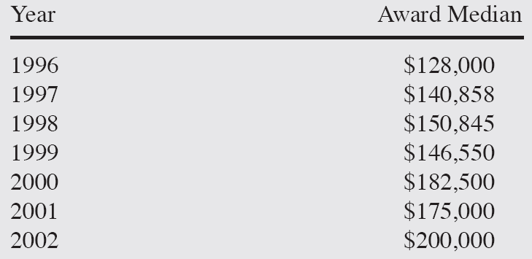
Table 11-2: Employment Practices Liability Awards

Slide 29
Business Auto Coverage
If a company ever uses motor vehicles in the course of business, it needs separate business auto coverage
Obtained through the use of the Business Automobile Policy (BAP)
Coverage is provided for liability resulting from the use of automobiles as well as physical damage that occurs to a firm’s automobiles
  Automobile means a land motor vehicle, trailer, or semitrailer designed for travel on public roads
  Does not include mobile equipment, which is insured under the CGL for liability exposures
  By choosing only those coverages needed, an insured can minimize the firm’s automobile insurance costs

Slide 30
Risk Management Tips—Commercial Auto
The standard BAP gives only basic coverage
To provide broader coverage for employees, risk managers may want to consider three endorsements and/or adjustments
  Employees as insureds
    Employees driving their own cars for business purposes will be covered
  Delete the fellow-employee exclusion
    Employers are giving their employees better protection while driving vehicles on the company’s behalf
  Drive other car coverage
    Provides broader coverage for employees who are assigned corporate cars

Slide 31
Professional Liability Insurance
Sometimes referred to as malpractice policies and errors-and-omissions policy
  Depending on the type of professional person utilizing them
Covers claims arising out of error or mistake of a professional person in the performance of the duties of the profession

Slide 32
Professional Versus Other Liability Contracts
Important differences between professional liability and other liability insurance contracts are as follows
  In professional liability insurance, the insurer often needs the permission of the insured to settle claims out of court by tendering sums in return for releases of liability by the plaintiff
    To allow out of court settlements in the case of professional liability would tend to damage the reputation of, for example, a doctor who appears to admit malpractice by settling claims in this manner
    Therefore, even though it might be less expensive for the insured to pay a claim regardless of its validity
      The professional person has the right to insist that the insured defend him or her in the courts
  The professional liability policy is usually written with only one major insuring clause
    With no distinction made between bodily injury or property damage liability
    And with no limit per occurrence
      Usually a limit of liability per claim is stated

Slide 33
Professional Versus Other Liability Contracts
The professional liability policy does not restrict its coverage to events that are “caused by accident”
  Because usually the act that gives rise to a claim is deliberate
The professional liability policy usually does not exclude damage to property in the care, custody, or control of the insured, as do general liability contracts
Product liability policies insure against claims arising out of a breach of warranty of the vendor regarding the goods
  In the professional liability policy, however, generally an exclusion exists for any agreement guaranteeing the results of any treatment
    A suit by a patient, irritated because the treatment failed when the doctor promised it would succeed, is not covered

Slide 34
Medical Malpractice Insurance
Major professional liability contracts
  Medical malpractice insurance
    Covers physicians, surgeons, and dentists
Typically contain two insuring agreements
  One providing coverage to the individual insured for their professional liability
  One providing coverage for the insured’s association, corporation, or partnership

Slide 35
Medical Malpractice Insurance
The insuring agreement covers the insured’s liability for the act of a nurse, assistant, technician, and so on
  But does not cover the personal liability that might attach to such a person
    They’re expected to provide professional coverage separately for their own liability
Most types of professional liability insurance limit coverage to professional liability
  If a patient slips on a wet doormat while entering the premises, the malpractice policy would not cover any damages
  Thus, the professional needs general liability insurance as well as professional liability coverage

Slide 36
Medical Malpractice Insurance
Physicians’ professional liability insurance policies contain a number of exclusions
  Including liability arising out of criminal acts, discrimination, and pollution
The medical malpractice area has had great volatility
  Occasionally reaching the crisis state
Table 11-3 shows statistics concerning medical malpractice awards
  The data indicate that the magnitude of medical malpractice awards continues to increase dramatically faster than the rate of inflation

Slide 37
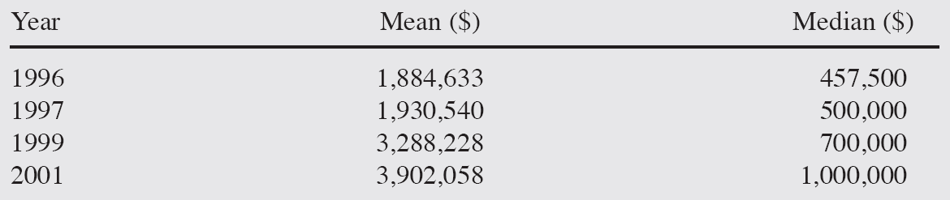
Table 11-3: Medical Malpractice Awards

Slide 38
Insurance Agents’ and Brokers’ Errors-and-Omissions Liability
Insures the agent against all losses that the agent must pay
  Because of negligent acts, errors, or omissions of employees in dealing with clientele
Most insurers give the agency the option of protection against similar claims from the insurance companies represented
To collect, that agent generally need only show that the claim was brought during the policy term
  Regardless of when the professional mistake occurred

Slide 39
Other Professional Liability Insurance
A number of other professionals can obtain insurance protection for their professional liability exposures including
  Lawyers
  Architects and engineers
  Accountants

Slide 40
Commercial Umbrella
Used to give limits of liability of $100 million or more
Commercial umbrella liability policies are not uniform
  A good deal of variation of policy wording among insurers exists
Will require primary insurance in the form of the general liability policy, a business auto policy, workers’ compensation and employers’ liability, and insurance for any owned aircraft
Coverage under the umbrella is quite broad
  Property in the insured’s care, custody, and control may be covered
  Worldwide products coverage is available
  Employers’ liability and liquor liability are insured
  Umbrellas are frequently written with few exclusions
    Endorsements are used to limit coverage

Slide 41
End of Lecture 22

