Slide 1
Lecture No. 19
Analysis of Insurance Contracts

Slide 2
Agenda
Basic parts of an insurance contract
Definition of the “Insured”
Endorsements and Riders
Deductibles
Coinsurance
Other-insurance provisions

Slide 3
Basic Parts of an Insurance Contract
Declarations are statements that provide information about the particular property or activity to be insured
  Usually the first page of the policy
  In property insurance, it contains name of the insured, location of property, period of protection, amount of insurance, premium and deductible information
Insurance contracts typically contain a page or section of definitions
  For example, the insured is referred to as “you”
Notes:
Transparency Master 1.2

Slide 4
Basic Parts of an Insurance Contract
The insuring agreement summarizes the major promises of the insurer
  The two basic forms of an insuring agreement in property insurance are:
    Named perils policy, where only those perils specifically named in the policy are covered
    “All-risks” policy, where all losses are covered except those losses specifically excluded
      May also be called an open-perils policy or special coverage policy
      Insurers have generally deleted the word “all” from policies
    “All-risks” coverage has fewer gaps, and the burden of proof is placed on the insurer to deny a claim

Slide 5
Basic Parts of an Insurance Contract
Insurance contracts contain three major types of exclusions
  Excluded perils, e.g., flood, intentional act
  Excluded losses, e.g., a professional liability loss is excluded in the homeowners policy
  Excluded property, e.g., pets are not covered as personal property in the homeowners policy

Slide 6
Why are Exclusions Necessary?
Some perils are not commercially insurable
  e.g., catastrophic losses due to war
Extraordinary hazards are present
  e.g., using the automobile for a taxi
Coverage is provided by other contracts
  e.g., use of auto excluded on homeowners policy
Moral hazard problems
  e.g., coverage of money limited to $200 in homeowners policy
Attitudinal hazard problems
  e.g., individuals are forced to bear losses that result from their own carelessness
Coverage not needed by typical insureds
  e.g., homeowners policy does not cover aircraft
Notes:
Transparency Master 1.2

Slide 7
Basic Parts of an Insurance Contract
Conditions are provisions in the policy that qualify or place limitations on the insurer’s promise to perform
  If policy conditions are not met, insurer can refuse to pay the claim
Insurance policies contain a variety of miscellaneous provisions
  e.g., cancellation, subrogation, grace period, misstatement of age

Slide 8
Definition of an “Insured”
An insurance contract must identify the persons or parties who are insured under the policy
  The named insured is the person or persons named in the declarations section of the policy
  The first named insured has certain additional rights and responsibilities that do not apply to other named insureds
  A policy may cover other parties even though they are not specifically named
    e.g., the homeowners policy covers resident relatives under age 24 who are full-time students away from home
  Additional insureds may be added using an endorsement

Slide 9
Endorsements and Riders
In property and liability insurance, an endorsement is a written provision that adds to, deletes from, or modifies the provisions in the original contract
  e.g., an earthquake endorsement to a homeowners policy
In life and health insurance, a rider is a provision that amends or changes the original policy
  e.g., a waiver-of-premium rider on a life insurance policy

Slide 10
Deductibles
A deductible is a provision by which a specified amount is subtracted from the total loss payment that otherwise would be payable
The purpose of a deductible is to:
  Eliminate small claims that are expensive to handle and process
  Reduce premiums paid by the insured
    Under the large loss principle, insurance should pay for high severity losses; small losses can be budgeted out of the person’s income
  Reduce moral hazard and attitudinal hazard

Slide 11
Deductibles
With a straight deductible, the insured must pay a certain amount before the insurer makes a loss payment
  e.g., an auto insurance deductible
An aggregate deductible means that all losses that occur during a specified time period are accumulated to satisfy the deductible amount

Slide 12
Deductibles in Health Insurance
A calendar-year deductible is a type of aggregate deductible that is found in basic medical expense and major medical insurance contracts
A corridor deductible is a deductible that can be used to integrate a basic medical expense plan with a supplemental major medical expense plan
An elimination (waiting) period is a stated period of time at the beginning of a loss during which no insurance benefits are paid

Slide 13
Coinsurance
A coinsurance clause in a property insurance contract encourages the insured to insure the property to a stated percentage of its insurable value
  If the coinsurance requirement is not met at the time of the loss, the insured must share in the loss as a coinsurer

Slide 14
Coinsurance
The purpose of coinsurance is to achieve equity in rating
  A property owner wishing to insure for a total loss would pay an inequitable premium if other property owners only insure for partial losses
  If the coinsurance requirement is met, the insured receives a rate discount, and the policyowner who is underinsured is penalized through application of the coinsurance formula

Slide 15
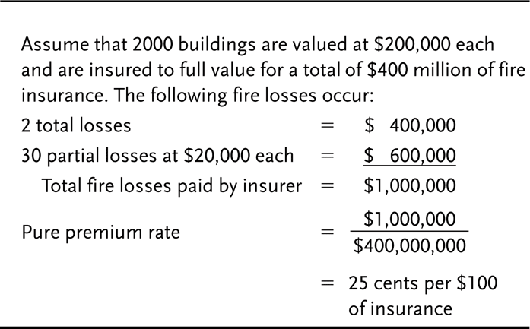
Exhibit 10.1 Insurance to Full Value

Slide 16
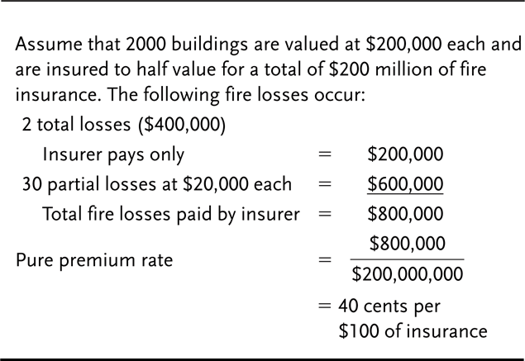
Exhibit 10.2 Insurance to Half Value

Slide 17
Coinsurance in Health Insurance
Health insurance policies frequently contain a percentage participation clause
  The clause requires the insured to pay a certain percentage of covered medical expenses in excess of the deductible
  The purpose is to reduce premiums and prevent overutilization of policy benefits

Slide 18
Other-insurance Provisions
The purpose of other-insurance provisions is to prevent profiting from insurance and violation of the principle of indemnity
  Under a pro rata liability provision, each insurer’s share of the loss is based on the proportion that its insurance bears to the total amount of insurance on the property
  Under contribution by equal shares, each insurer shares equally in the loss until the share paid by each insurer equals the lowest limit of liability under any policy, or until the full amount of the loss is paid

Slide 19

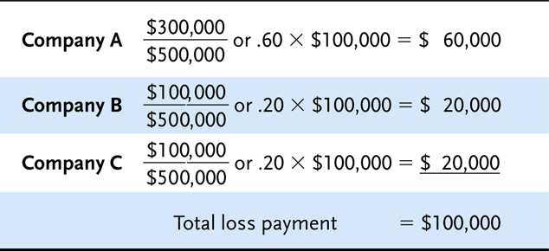
Exhibit 10.3 Pro Rata Liability Example

Slide 20
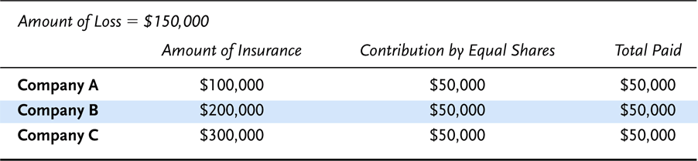
Exhibit 10.4 Contribution by Equal Shares (Example 1)

Slide 21
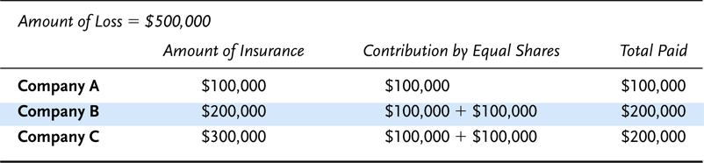
Exhibit 10.5 Contribution by Equal Shares (Example 2)

Slide 22
Other-insurance Provisions
  Under a primary and excess insurance provision, the primary insurer pays first, and the excess insurer pays only after the policy limits under the primary policy are exhausted
  The coordination of benefits provision in group health insurance is designed to prevent overinsurance and the duplication of benefits if one person is covered under more than one group health insurance plan
    e.g., two employed spouses are insured as dependents under each other’s group health insurance plan

Slide 23
Transportation Insurance
One of the oldest and most vital forms of insurance
All types of trade depend heavily on the availability of insurance for successful and expedient handling
Insurance played a vital part in stimulating early commerce
  In Roman times bottomry contracts and respondentia contracts covering the terms under which money was borrowed to finance ocean commerce
    The lender of money took as security for loan either the ship itself (bottomry), or the cargo (respondentia)
    However, if the ship or cargo was lost as a result of ocean perils, the loan was canceled
    If the voyage was successful, the loan was repaid and substantial interest was charged
      Mainly because the interest included an allowance for the possibility of loss of the security
      Essentially an insurance premium

Slide 24
The Perils of Transportation
There is an inability to control adequately or completely the forces of nature
  Or to prevent human failure as it affects the safe movement of goods
With ocean transportation, for instance
  Storms can capsize even the largest ocean vessels
  Hurricane winds often dump tons of sea water onto a vessel and damage cargo
  Engine failure may drive ship aground
With ground transportation
  Vehicles can overturn
  Rough or careless handling can damage goods

Slide 25
The Liability of the Carrier
The question arises
  “Is not the carrier of the goods responsible for their safe movement?”
    To some extent, yes
The common law liability of the carrier differs depending on
  The country in which the transportation conveyances are chartered
  The applicable statutes
  Custom
  The type of shipping, etc.

Slide 26
The Carrier’s Liability in Ocean Transportation
The ship owner is responsible only for failure to exercise due diligence
The responsibility of the carrier is to
  Make the ship seaworthy
  Employ proper crew
  To equip and supply the ship
  Make all holds and other carrying compartments safe and fit for the goods stored there
  Exercise due care in loading, handling, and stowing cargoes

Slide 27
The Carrier’s Liability in Ocean Transportation
The carrier is definitely not liable for certain things, including loss resulting from
  Errors in navigation or management of the vessel
  Strikes or lockouts
  Acts of god
  Acts of war or public enemies
  Seizure of the goods under legal process
  Quarantine
  Inherent vice of the goods
  Failure of the shipper to exercise due care in the handling or packing of the goods
  Fire
  Perils of the seas
  Latent defects in the hull or machinery
  Other losses where the carrier is not at fault

Slide 28
The Carrier’s Liability in Land Transportation
The common law liability of the land carrier is considerably greater than that of the ocean carrier
  But it is still not absolute
In addition to being responsible for failure to exercise due diligence
  The land carrier is responsible for all loss to the goods except for
    Acts of god
    Acts of public enemies or public authority
    Acts or negligence of the shipper
    Inherent vice or quality of the goods

Slide 29
The Carrier’s Liability in Land Transportation
Acts of god
  Have been interpreted to mean perils such as the earthquakes, storms, and floods that could not have been reasonably guarded against
  Fire is not an act of god
Public enemy
  Action by forces at war with a domestic government
  Not gangsters, mobs, or rioters
Acts of negligence of the shipper
  Improper loading or packing and instances where the nature of the goods is concealed
Inherent nature of the goods
  Losses due to decay, heat, rust, drying, or fermentation

Slide 30
Need for Transportation Insurance
Many types of transportation losses fall outside the responsibility of the common carrier
Common carriers have been slow to settle losses for which they’re legally liable
In land transportation, the shipper usually sends goods under what is known as a released bill of lading
  The effect is to limit the dollar liability of the carrier for any loss to the goods
  In return, the shipper obtains a lower freight rate

Slide 31
Ocean Transportation Insurance
Larger ships and more advanced instruments and navigation made long voyages possible
  With these changes came the realization that insurance protection was almost a necessity
The major source of underwriting capacity was England
  Probably because the country was among the first to develop a complex system of admiralty law
Table 10-1 shows that the U.S. market for ocean marine insurance increased almost 120 percent from 1980 to 2002

Slide 32
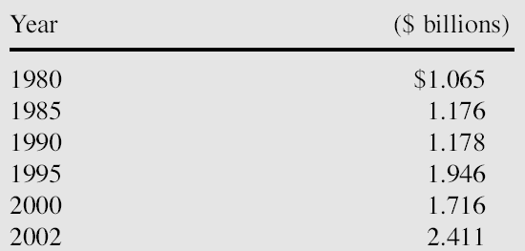
Table 10-1: United States Ocean Marine Insurance Premiums

Slide 33
End of Lecture 19

